Slide 1
The Australian Sub-Treasury offices – the risk-based story from the beginning to the end
Mark Silins
Almaty
May 24, 2023

Slide 2
Topics
Australia as a Federal Government and creation of Sub-Treasuries
The Evolving Control and Risk Framework through four generations of central IT systems
The Mistakes and Lessons Learnt

Slide 3
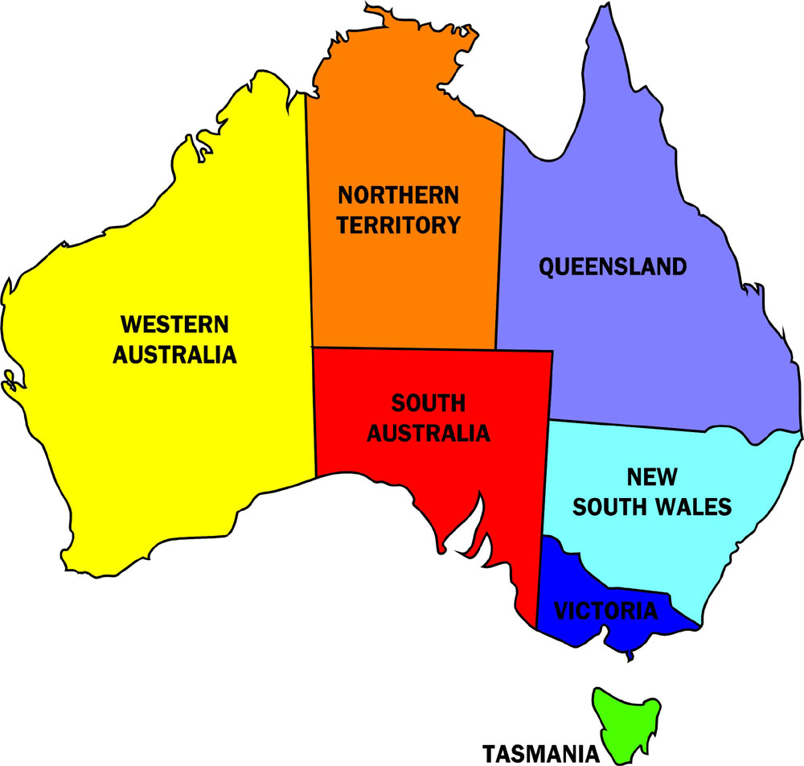
A Brief (European) History of Australia
ACT and Canberra established in 1913 eventually becoming the main focus of government spending and controls
ACT
Colonies retained own governments renamed states – 2nd tier. Constitutionally these are largely autonomous from Federal government
Notes:
Australia has the oldest continual civilization (60,000 years)
It is known that Europeans first sighted Australia in 1608
Captain Cook landed at Botany Bay in 1770 and reported back to England that the country was habitable
In the 1780s, partly in response to a growing social issue (overcrowded prisons), a decision was taken to establish a new colony in the southern hemisphere
The first fleet landed in Australia in 1788 at Botany Bay – modern Day Sydney – all six colonies were subsequently established most as penal colonies
Over time, Australia’s resource rich environment transformed it into a thriving resource – its resources include gold and other minerals and massive forests including the tallest trees in the world
Until 1901 Australia did not exist as a Federation but as six separate colonies

Slide 4
Public Finance in Australia from Federation
1897 Constitution passed
Section 81 and 83 Establishes Concept of TSA
1902
Audit Act 1901 passed (4th act)
This largely focussed on Auditor General who in these early days approved all spending decisions
1904
Treasury Regulations
Established the sub-treasuries in each of the six states and the Northern Territory. Primary focus on strong central cash controls in each sub-treasury. A.C.T. sub-treasury formed later
Section 96 – Responsibility of Ministers
Very strong central controls and risk averse environment
1940s
Modernization process
Major Shift - devolution of authority and responsibility – creation of key financial actors Certifying Officers (45)
Early focus was risk averse
Risk/Control Focus
Risk/Control Focus
Shift of controls to MDAs
Notes:
Australian Constitution passed by British Parliament in 1897
The Audit Act 1901 issued in 1902, 4th piece of legislation of the Federation
Treasury Regulations issued in 1904 establish a sub-treasury in six states and one territory (Australian Capital Territory and Canberra established in 1913)
Continual changes over the years which is to be expected given when the original regulations were passed
Early focus after Federation was on central control over cash in sub-treasuries and periodic reporting back to government
By the 1940s the regulations clearly established PFM as the responsibility of departments under the guidance of Treasury
It took until 1996 for the Audit Act to be replaced!
Great Britain and its former colonies have largely evolved a PFM system where legislative responsibility for spending and controls is devolved to line ministries/departments
There is not one model but many variations, just as there is in Francophone countries and indeed PEMPAL countries
Thus, many anglophone countries retain some central controls but extremes such as Australia have no central controls or central systems or even a central accounting function (Treasury) any longer
In general the philosophy is that the systems and procedures should have adequate controls to assure integrity, and ex-post audit will focus on detecting any breaches.
In addition, MDAs should be held directly accountable for their decisions and controls not the Treasury or MoF.
Why the shift in the 1940s – likely due to poor responsively of government during the war !

Slide 5
What drove the Anglophile approach in Australia (my interpretation)
Tyranny of distance - early on it took many months to undertake the voyage to and from Australia– each colony had a governor appointed who represented the King/Queen but the colonies themselves were very large with challenges and therefore acted with significant autonomy
Independent spirit – Strong central controls would likely be rejected – eg American War of Independence
Decentralised control relatively normal already with colonies and later local and state government operating independently of Federal Government
It appears that Great Britain accepted the need to allow more autonomy for the colonies by supporting the Federation
All of this is somewhat speculative on my part but it is fairly clear that whilst the rule of law had a strong foundation in Australia it is also a culture that promotes autonomy and direct accountability

Slide 6
Public Sector Reform in Australia in the 1970s and 1980s
RMIP
In the 1970s it was called the Financial Management Improvement Program but by the 1980s it was realised this was too narrow and the word financial was replaced with resource to reflect the broader scope of the reforms
Budgetary + Regulatory
Commercial
HR Planning
Incentives
MAB/MIAC
Administrative Law
PPB
Staffing Arrangements
Structural
Reporting Mechanisms
From the 1970s governments were seeking improved performance from the public service
There was a view that the bureaucracy was self serving and underperforming.
A White Paper in the 1970s resulted in a raft of reforms focused on enhanced performance and accountability. This also included a clear leadership role to drive the reforms

Slide 7
Reform Continues in to the 90’s
Outsourcing
Client Focus
Ethics
Accrual Accounting
Enhanced Accountability
Client Focus
Purchaser/Provider
Professionalism
Partnering
Running Costs -Enhancements
Risk Management
Benchmarking

Slide 8
Transition of Budget Control in the CoA from Inputs to Outputs and Outcomes -
Running costs reforms and the move to results based budgeting also removed one of the last areas of true ”central control” as detailed input based budget allocations were gradually eliminated
This also increased the demand for MDA systems, even though a single system could have met most needs
Gradual Transition to Results Based management and reporting, Reduction in input control and pooling of the economic component of the budget
Risk/Control Focus

Slide 9
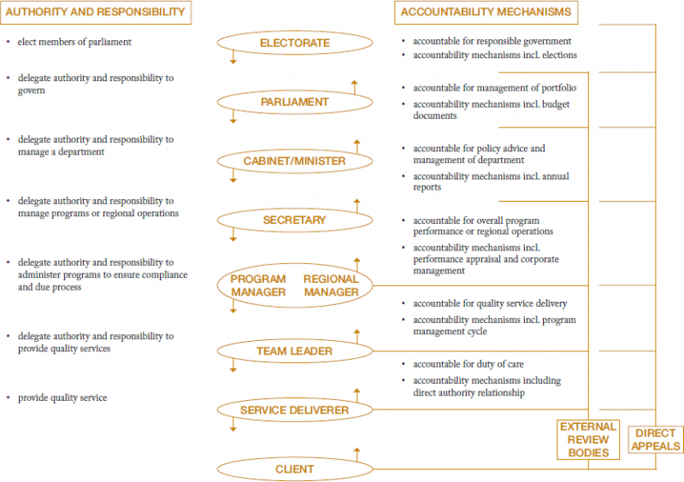
Accountability in Government – MAB/MIAC Model
This is an extract from an early publication of the Management Advisory Board. Accountability and risk management were very much at the fore-front of the reform agenda, although an explicit risk-based framework in government did not come into place until much later.

Slide 10
A major trend in many OECD countries - Australia was an early Implementor
Devolution of Decision Making
Strong Internal Financial Controls
Risk Management
Focus on results
Internal Audit
Principle-based legislative framework
FMIS
…
Establish solid foundation before devolution

Slide 11
Four Generations in Australian Government Budgetary Control and Accounting – Risk Based and Digital Reform in Practice
1970s-1980s
Finance Ledger System
(FLS)
1980s-1990s
Financial Information on Resource Management
(FIRM)
1990s
Accrual Information Management (AIM) System
Reporting System for accrual
2000 to Present Central Budget Management System (CBMS)
No G/L
Cash Management and Banking Decentralized too
Consolidated Accrual Reporting
Centralized Cash Management and Appropriation Control

Slide 12
Generation One - Finance Ledger System (FLS) - 1970s to early 1980s
Risk/Control Focus
Manual Input
TSA
Cash Based
Control, Efficiency and Risk Review
Enhanced commitment controls
Prescribed payments under $1000 subject to lower level of checks by MDAs
MDAs
Finance Payroll System
Manual Forms delivered
Finance Ledger System
(eight regional offices)
Vendor payments Cheques. Repetitive payments sent by tape to commercial banks
Vendor payments Cheques. Repetitive payments sent by tape to commercial banks
Risk/Control Focus
MDAs made all of the decisions.
Regional Offices were not approving payments. ROs verified signatures and performed quality assurance role
Central Bank (RBA)
TSA (Commonwealth Public Account )
Notes:
Mainframe computer in centre and in 8 regional offices – Accounting Operations Branch
Cash Based Accounting system also allowed requisitions and commitments but these were not mandatory
Daily processing
TSA operating in each region
Central unique CoA
Centralized payroll and payments – payroll and some repetitive payments submitted to banks on magnetic tape – other payments by cheque
Manual input of forms – data-processing pools – over 50% of 300+ staff entirely allocated to this activity
Remaining staff focus is on ensuring payroll and end of day and end of month processing achieved
Rudimentary checks regarding forms – eg correct signature
System undertakes checks called “central edits” – these reject simple errors such as erroneous codes, incorrect control totals

Slide 13
Generation Two - Finance Information on Resource Management (FIRM)
Risk/Control Focus
Electronic Input
Appropriation controls in FIRM but detailed accounts mostly in MDA systems
Prescribed payments concept expanded to include payments prepared by a computer (45(A)3(b(ii))
Regional Offices commenced value added role of training including on a fee for service basis –
Developed suit of general training products
Regional Offices no longer checking inputs and all transactions received electronically. This predates e-signature so verification of files still required. Transactions still coming to regional offices
Risk/Control Focus
Notes:
Advent of MDA FMIS and HRMS –
Central unique high level CoA
Shift to modified accrual in MDAs capturing commitments and accounts payable
Centralized payments and payroll continues but all through electronic payment gateway – bank reconciliation all but eliminated most checks also redundant
Inputs to FIRM and payroll shift to electronic media – initially disc, next through electronic secure “dial-up” access
Small agencies used FIRM but entered forms directly into third-party software
Downsizing as no longer a need for data-processing in regional offices
New training and education role commenced growing to 50% of staffing over time - partial cost recovery through user charging ($50 per attendee)
Regional Offices becomes the ”eyes and ears” for DoF

Slide 14
Generation Three – Accrual Information Management System (AIMS)
Risk/Control Focus
MDAs
Accrual Accounting and Budgeting
Devolved Banking
Financial Statements
Annual Reports including performance based results reporting
Regional Offices closed in 1996!
Notes:
All MDAs mandated to acquire a new FMIS – Y2K and accrual the drivers – one system dominants 80% of all selections
MDAs deconcentrating internally across Australia using web-based interfaces
Limited central CoA requirements
AIMS - Centralized system to collect daily and monthly accrual information for consolidated reporting – purpose built
Devolved banking arrangements (initially this also involved maintaining cash balances) – no longer centralized payments
Each MDA produces annual report which includes accrual financial statements
Regional offices closed in 1996!

Slide 15
Why did the Regional Network Close in 1996?
Political decision of convenience – an evaluation in 1995 endorsed by government gave ROS three years to become fully self funding but the incoming government wanted savings in Dept of Finance - $10million. This was equivalent to the annual running costs of the regional offices
Value added roles performed elsewhere in DoF - such as cash management and forecasting, consolidated reporting and debt management performed in other areas of DoF
The philosophical position of incoming government was that government did not need to do anything the private sector could do “yellow pages test”. Training was contestable and this was the main focus of the ROs going forward (even though this was specialist training and retaining a core cadre of experts in-house would have been highly beneficial for government
The strong ongoing perception that Ros were largely operationally focused made the closure decision possible - Management of the ROs did not reform quickly enough nor did they promote the benefits and of the regional network’s education role

Slide 16
Generation Four (and Five) – Central Budget Management System (CBMS)
Risk/Control Focus
The need for centralized appropriation control, cash management and consolidated reporting is ongoing. DoF continues to need this even after ROs closed!
Thus the value added functions continue, only the processing components are devolved
An integrated UCoA was recreated to better support consolidated reporting
Notes:
Second version to be implemented in 2018 (four years late)
New system is multipurpose – centralized accrual reporting for annually consolidated General Government and annual consolidated Public Sector
Focus on new program budgeting reporting requirements
Also supports cash management including releases of cash – CBMS creates a derived cashflow statement for each entity – Entities can change this
Creation of a unique CoA enhanced to overcome issues with consolidation – integrates GFSM (Australia) and AASB reporting
Training material centrally produced and released for use

Slide 17
Issues and Lessons Learnt
There is not a single appropriate solution for all countries. Understand what is required for the end goal and then use technology to achieve this
If you do not manage for change it may leave you behind - major changes should be driven by a careful analysis of costs and benefits
Technological capacity has a major influence on how accounting processes and systems evolved
ICT naturally moves processing and controls over transactions closer to where the transactions are created – central controls will largely devolve and thus the role of Treasury must evolve with this - in Australia the Regional offices should have moved to value added cost recovery much sooner
Devolution without planning can create issues – DoF gave up the UCoA after FIRM was replaced making consolidated reporting challenging (this was resurrected later in CBMS)
Cost of poorly planned devolution - While devolution was justifiable for large entities, smaller agencies, of which there are many, became less efficient – they now had to do all of the activities themselves
500 million overspent on over-engineered systems moving to accrual
Small entities in Australia were required to do the same reporting as large entities – full accrual reports for a four person entity
2019 review recommended moving back to shared services suggesting over 300 million in annual savings (in other words 300 million wasted every year).
Thus decentralization is not the only option – centralization makes sense in some areas too
BUT the big message is operational entities must move to value added roles if they are to continue to be relevant in modern government – cash management and forecasting, financial and strategic reporting, risk management, training and education. If entities see processing and controls as their future it is likely there will not be a future.

