Slide 1
Internal control - the IA perspective
IA-COP plenary session Bucharest
December 2014

Slide 2
What I will cover
What is internal control
The COSO model of internal control
Why is internal control important for internal auditors
The Three lines of Defence model
Flaws in the implementation of internal control cause by different approaches to Budgetary oversight
Possible areas for review by PEMPAL

Slide 3
What is internal control?
COSO definition
Internal control is a process, effected by an entity’s board of directors, management, and other personnel, designed to provide reasonable assurance regarding the achievement of objectives relating to operations, reporting, and compliance.
EU PIFC definition:
Internal Control = Financial and Managerial Control (FMC) + Internal Audit

Slide 4
Internal Control is
Geared to the achievement of objectives — operations, reporting, and compliance
A means to an end, not an end in itself
Effected by people—not merely about policy and procedure manuals, systems, and forms.
Provides reasonable not absolute assurance

Slide 5
… focuses on three objectives
Operations Objectives—The effectiveness and efficiency of the entity’s operations, including operational and financial performance goals, and safeguarding assets against loss.
Reporting Objectives—The internal and external financial and non-financial reporting .
Compliance Objectives—The adherence to laws and regulations to which the entity is subject.

Slide 6
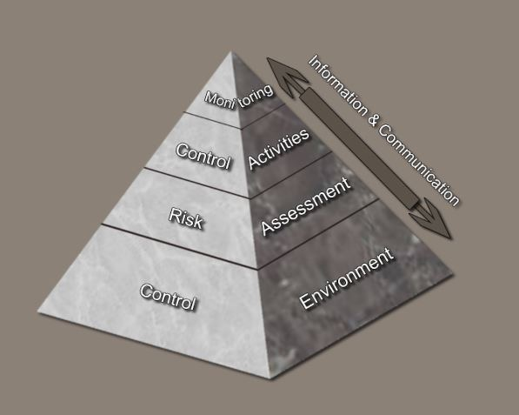
..has five Components

Slide 7
The COSO move to principles
COSO I
The first COSO model introduced the definitions of Internal Control and five components
COSO II
COSO II focus on internal control in the context of risk management
COSO III
COSO III introduces a principles based approach and the need for regular monitoring

Slide 8
Control Environment Principles
The organization demonstrates a commitment to integrity and ethical values.
The board of directors demonstrates independence from management and exercises oversight of the development and performance of internal control.
Management establishes, with board oversight, structures, reporting lines, and appropriate authorities and responsibilities in the pursuit of objectives.
The organization demonstrates a commitment to attract, develop, and retain competent individuals in alignment with objectives.
The organization holds individuals accountable for their internal control responsibilities in the pursuit of objectives.

Slide 9
Risk Assessment Principles
The organization specifies objectives with sufficient clarity to enable the identification and assessment of risks relating to objectives.
The organization identifies risks to the achievement of its objectives across the entity and analyzes risks as a basis for determining how the risks should be managed.
The organization considers the potential for fraud in assessing risks to the achievement of objectives.
The organization identifies and assesses changes that could significantly impact the system of internal control.

Slide 10
Control Activities Principles
The organization selects and develops control activities that contribute to the mitigation of risks to the achievement of objectives to acceptable levels.
The organization selects and develops general control activities over technology to support the achievement of objectives.
The organization deploys control activities through policies that establish what is expected and procedures that put policies into action.

Slide 11
Information and Communication Principles
The organization obtains or generates and uses relevant, quality information to support the functioning of internal control.
The organization internally communicates information, including objectives and responsibilities for internal control, necessary to support the functioning of internal control.
The organization communicates with external parties regarding matters affecting the functioning of internal control.

Slide 12
Monitoring Activities Principles
The organization selects, develops, and performs ongoing and/or separate evaluations to ascertain whether the components of internal control are present and functioning.
The organization evaluates and communicates internal control deficiencies in a timely manner to those parties responsible for taking corrective action, including senior management and the board of directors, as appropriate.

Slide 13
Effective Internal Control
Requires that each of the five components and relevant principles is present and functioning.
“Present” - the components and relevant principles exist in the design and implementation of the system of internal control.
“Functioning” - the components and relevant principles continue to exist in the operations and conduct of the system of internal control to achieve specified objectives.
That the five components operate in an integrated and interdependent manner.

Slide 14
Internal Control Results in:
Reasonable assurance that the organization:
Achieves effective and efficient operations
Understands the extent to which operations are managed effectively and efficiently when external events may have a significant impact on the achievement of objectives
Prepares reports in conformity with applicable rules, regulations, and standards or with the entity’s specified reporting objectives
Complies with applicable laws, rules, regulations, and external standards

Slide 15
Limitations
Internal control cannot prevent bad judgment or decisions, or external events that can cause an organization to fail to achieve its operational goals. Their are inherent limitations from
Faulty human judgment in decision making
Human failures such as simple errors
Ability of management to override internal control
Ability of management, other personnel, and/or third parties to circumvent controls through collusion
External events beyond the organization’s control

Slide 16
The importance of internal control to internal auditors
Internal Audit cannot provide assurance on internal control if auditors do not understand of the main elements of internal control
Internal Auditors need a thorough understanding of the different ways of ensuring effective internal control and the type and nature of controls in operation for example, Preventative and Detective Controls
An understanding of the three lines of defence model can help IA explain the different roles of IA and management in maintaining effective internal control
Internal Audit can help managers understand that internal control is not just financial control but Managerial Control in general

Slide 17
The three lines of defence model
The first line of Defence - direct operation of controls by management
The Second line of Defence - monitoring and oversight of controls by management
The Third line of Defence - review of the effectiveness of controls by audit and evaluation

Slide 18
Some flaws in Internal Control implementation
PIFC is an implementation model promoted by the EU. Its not incorrect but its application in many countries is flawed
The presumption is that only better FMC and new IA functions are needed for effective internal control.
But this ignores the fundamental impact of the budgetary allocation process and control mechanisms on accountability
The problem: When detailed budget allocations are made within ministries the minister is responsible but not accountable for the actual resources spent. Accountability sits with budget holders.

Slide 19
Ministry of Finance
Ministry of Finance
Two different models of budgetary control
Minister
Minister
Budget request
Budget
Holders
Budget
Holders
Budget allocation
Accountabilty

Slide 20
Ministry of Finance
With direct budget responsibility
IA provides assurance to Minister in line with accountability
Budget
Minister
Internal audit
Audit
Assurance
Budget request
Budget
Holders
Budget allocation
Accountabilty

Slide 21
Ministry of Finance
With no direct budget responsibility
IA assurance to Minister does not align with financial accountability
Minister
Internal audit
Audit
Assurance
Budget request
Budget
Holders
Budget allocation
Accountabilty

Slide 22
Possible PEMPAL focus areas
Developing guidance on the three lines of defence model and how this can help IA explain internal control better to t better to management
Sharing of experiences on how IA has improved internal control
Developing a guide on the practical implementation of COSO based internal control based in the Public Sector based on PEMPAL member practices and experience
PEMPAL should not attempt to prepare separate guidance on what internal control is - this is already done through COSO
Other suggestions from you…….

