Slide 1

PEMPAL-Treasury COP
Investing Surplus Cash – Options and Institutional Arrangements
Vienna, November 2023
Mike Williams
mike.williams@mj-w.net

Slide 2
Outline
Investment as part of Cash Management
Institutional Arrangements & Processes
Investment in Practice
Risks and Instruments

Slide 3
Investment is an Intrinsic Part of Modern Cash Management
The investment of surplus cash is not simply an arbitrary add-on
Smoothing of the cash flows implies investment of surpluses
Smoothing brings benefits: reduces the volatility of cash, allows a reduced cash balance with cost benefits, facilitates monetary policy operations
Well-managed investment is inherently cost-effective: reduces net debt interest
Impact of Covid
Reflected in many countries’ cash management objective [“using surplus cash to best advantage”]
But volatility of cash flow and markets – then and now implies temporary liquidity surpluses – makes effective investment more important
Covid brought some challenges – and more focus on cash buffer requirements

Slide 4
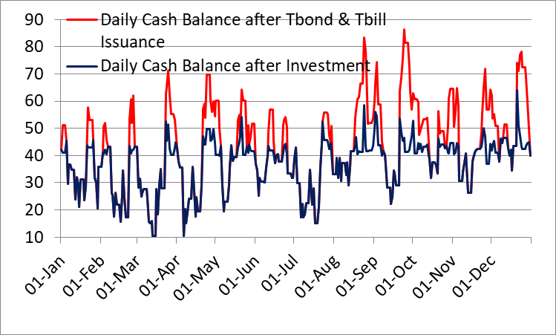
Investment of Short-term Surpluses
The Treasury/DMO or cash manager has responsibility for only short-term investments
Surplus over and above the cash buffer
Shorter-term surpluses with short time horizon – transitory, not expected to be sustained – cash managers rarely invest cash > than 3-6 months
Structural or persistent surpluses should be handled separately
Invested in the money market
Note: the focus is on investment: buying and selling MoF’s holdings of securities risks damaging the bond market; use only as collateral
The “surplus” in this context is identified by the forecast (an allowance for caution may be reflected in either the size or maturity of the investment)
Illustrative example – substantial smoothing even with investments of maturity no longer than one week

Slide 5
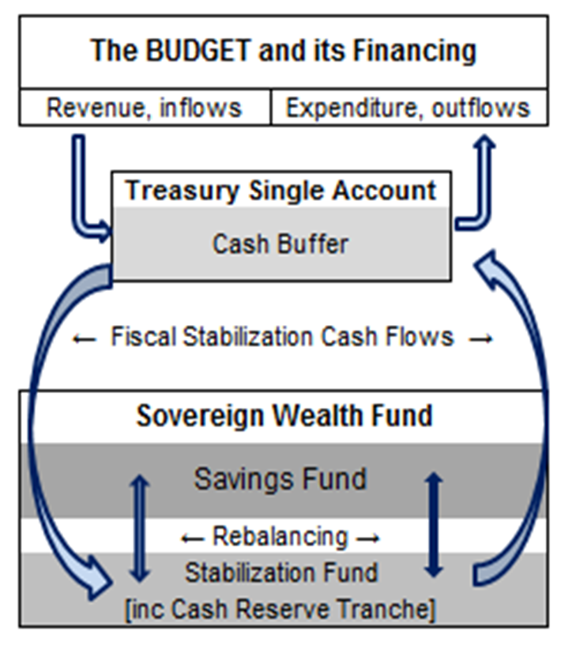
Structural Savings and the Cash Reserve Fund
Structural Surplus
Structurally surplus cash should be identified and managed separately
Long-term savings or stabilisation fund – own governance arrangements & own management: invested according to a strategic asset allocation reflecting risk and balance sheet objectives
Cash Reserve Fund
Sensible if the structural surplus is likely to be run down in the medium term or as a cushion against a concerning future scenario (eg Peru – 3-month fund v possible future banking crisis)
Usual upward sloping yield curve => not cost-effective to hold cash as a longer-term investment. Better use of any surplus is to reduce debt or to invest in other assets.
May be a separate fund or tranche of stabilization or savings fund
Often invested in money market: slightly longer term than cash management investments
Provides additional "liquidity safety net”

Slide 6
Outline
Investment as part of Cash Management
Institutional Arrangements & Processes
Investment in Practice
Risks and Instruments

Slide 7
Risks
Main risks when managing short-term investments
Liquidity: ability to convert an investment into cash before maturity without suffering an unacceptable loss of principal. Requires emphasis on market-based short-term investments
Credit: possibility that the issuer of an instrument or holder of a deposit (or any counterparty) does not meet the repayment of principal and / or interest in full, on time and in accordance with the terms of the transaction. Requires high quality assets and collateral; diversification and "marking to market"
Other risks are important
Market: risk arising from adverse changes in market rates: will be small if the instruments are short term
Legal: that contracts are not legally enforceable: requires clearly documented agreements with partners (eg the global master repurchase agreement (GMRA) for repos)
Operational: resulting from inadequate or failed internal processes, people and systems or external events. Requires defined procedures, segregation of duties, internal control & business continuity plan
Settlement: the counterparty does not fulfil its part of the contract - managed by adopting effective custody arrangements and maintaining accurate and timely records

Slide 8
Credit Risk
Often requires building a new capability: Options:
Relying on external assessment. But difficult to put weight on identified default probabilities –small for high-quality banks but variable from year to year and which will reflect events in different environments.
Building an internal assessment process. Similar to the rating agencies, but with weights reflecting local conditions. But process is time consuming and resource intensive; and, with a cautious approach to investment, unlikely to be cost effective.
Drawing on the assessment methodology used by the central bank or other prudential regulator in the local economy – more promising
A cautious approach
Maximum exposure limit to any one bank
Confine investment to higher-quality banks in the local market – identifying enough of them to provide sufficient competition and adequate aggregate demand for the deposits or other investments likely to be on offer
No single way to set individual risk limits – have to trade off size against need to minimize idle cash. Simplicity and flexibility are important.
Set initial limits somewhat arbitrarily; and adjust if it becomes apparent that low-risk investment opportunities are being missed

Slide 9
Money Market Instruments
The Main Options in most Economies
Repos and reverse repos
Important in most money markets, offering competitive short-term rates (fixed or variable), used by central banks for open market operations
Sale and repurchase of an underlying security - serves as collateral
Term deposits in commercial banks
Similar to repo rates (usually includes penalty if redeemed early}
Must collateralise
Requires a competitive process
Certificates of Deposit (CDs)
Low liquidity risk (if negotiable)
Higher credit risk - cannot collateralise
Money Market Mutual Funds
The Funds invest in short-term instruments
They benefit from diversified market access; but performance may vary and is not without risk
Commercial paper
Issued by highly rated credit-largest banks and non-financial corporations
High performance but potentially more risky

Slide 10
A Digression: Repo
A repo (or “repurchase”; or sometimes “sale and repurchase”) transaction is a purchase or sale of securities with a simultaneous agreement to reverse the transaction at an agreed date and price in the future
The interest rate implied by the difference between the sale and the “repurchase” price is the repo rate
In economic terms it is the same as collateralised lending/borrowing, but
Unlike a collateralised loan it legally involves the transfer of an asset (which gives the lender better access to the collateral in the event of default)
It is more flexible: it maintains liquidity – the loan is effectively securitised and can be on-sold – and it allows for margining

Slide 11
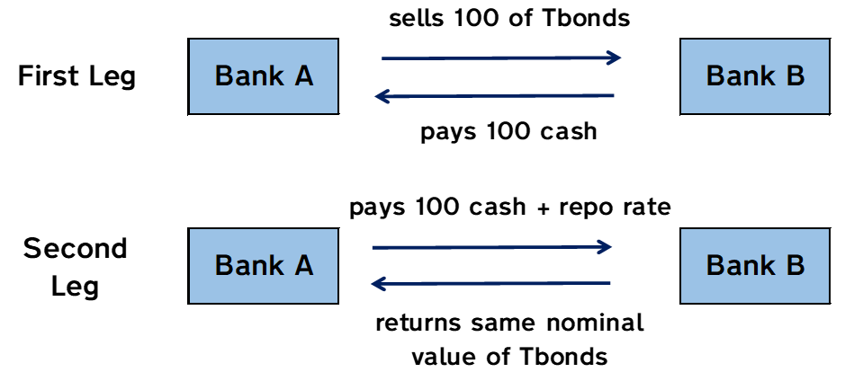
Classic Repo
Repo may be with “general” collateral or a specific bond (eg needed to cover a short – the repo rate will usually be less)
If initial margin (“haircut”) is required, collateral of 100/(1-V) will be paid – where V is the margin
If a coupon is paid during the term of the repo, it will be handed over to the seller (the value of the collateral may need to be restored as the accrued price falls). Markets often avoid collateral near a coupon date for this reason
Interest may be fixed or variable rate

Slide 12
Why Repo is Important
Money Market
Reduces credit concerns; helps to develop interbank market
Flexibility => ideal instrument for monetary policy operations
Supports
debt & cash management
Supports debt and money market development
Ability of lender to use collateral promotes activity & liquidity
Facilitates short-selling – the security sold short can be repoed in as collateral
Promotes arbitrage between debt and money markets
Creates a more continuous yield curve
Provides mechanism for financing positions
Primary dealers can repo out securities to finance purchases of same securities
Supports active risk management by participants
Reduces risk of auction failure
For cash managers
Access to domestic short-term funding
Secure investment of excess cash balances

Slide 13
Outline
Investment as part of Cash Management
Institutional Arrangements & Processes
Investment in Practice
Risks and Instruments

Slide 14
Investment Policy Statement
The investment policy at the operational level must specify
Target cash buffer
Objectives in terms of risk, liquidity and yield
Policy towards market credit, liquidity, legal and operational risks. Includes for example:
Exposure limits to credit risk, as counterparty or issuer diversification or concentration requirements, credit ratings
Manager Selection - if some responsibilities contracted out
Performance measurement and performance
Must have cash to meet commitments - essential
Saving of interest can be estimated by comparing with a situation of inactivity; eg return on deposits at central bank
Smoothing benefits are difficult to measure
Consider other objectives, eg not complicate monetary policy
Collateral Management Framework
What investments are possible and acceptable
Authority to invest surplus cash – and link to high-level cash management objectives

Slide 15
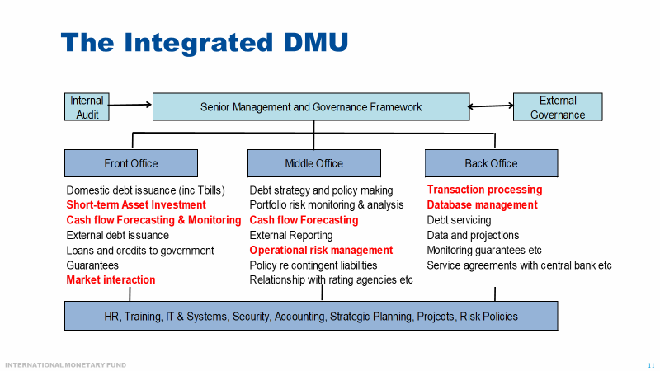
Coordination with Debt Management
The institutional, governance, and decision-making requirements that apply to the investment of cash surpluses are, in principle, no different from those that apply to other cash or debt management transactions
Investment of surplus cash falls naturally into the integrated debt office
The investment of surpluses in some countries lies with the treasury, reflecting its historical role as the (largely passive) cash manager
It has survived the development of a modern debt management office with responsibility for both T-bond and T-bill issuance (Mexico is an example; in Chile, legacy legislation has left the investment of surpluses with the budget directorate)
Separate responsibilities for investment and issuance risk confusing signals to the market (and unnecessary skill duplication)

Slide 16
Separate Functions require Coordination
Coordinated approach to stakeholders
Single interface with the market for transactions
Shared support services
Especially IT, including disaster recovery and BCP
Common operational risk framework
Identification, assessment and reporting
Including role of internal control and internal audit
Systematic exchange of information
Coordination of decision making
Strategic: active cash management supporting debt management strategy and annual borrowing plan
Tactical: the pattern and maturities of investment
Implications for governance framework
Cash Coordination Committee
Useful and widely used coordination mechanism for short-term cash management decisions
Meets weekly, chaired e.g. by Head Treasury
  Including also budget division, macro-fiscal unit, debt managers, central bank, tax authorities
  Delegated authority for decisions within agreed parameters
Main responsibilities:
  Review cash flow outturns, compare to forecasts
  Review cash flow forecasts for the period ahead
Decide on action needed to ensure cash adequacy over the period ahead
Supported by Cash Management Unit (CMU)
  Responsible for forecast preparation, database, error analysis etc
  Also preparation of scenarios and what-ifs
  Policy recommendations (discussed with debt managers)

Slide 17
Interaction with Central Bank*
Coordination requires some form of a Memorandum of Understanding
Cash held at the central bank should be remunerated at market rates without risk ("market-related risk-free interest rate")
Consider deposits (term and remunerated) at the central bank only if there is a monetary imbalance, i.e., when it is a response to a structural problem
The joint program for money market development
Respective operations, whether investments, T-bill issues, or open market operations
The times of day for operations and the timing and forms of announcements
Information exchanges. The central bank must also know the parameters of expected operations in the money market, for example, the target end-of-day balance
* For further discussion of this topic see the PEMPAL 2017 presentation at: http://www.mj-w.net/pdfs/MoF-CB-PEMPAL-Mar17.pdf

Slide 18
Internal Procedures
Procedures, incorporating controls, are an essential part of risk management framework
    To provide a check-list for staff member or manager to ensure that all necessary actions underpinning an activity have been executed and the relevant controls evidenced, i.e.
      Approvals
      Authorisations
      Verifications
      Reconciliations
      Segregation of duties
    To ensure process can be fully and safely discharged even in absence of staff member
    To provide basis for risk manager, auditor or compliance officer to confirm that actions are in accordance with agreed procedures; and embedded controls are effective, efficient and proportionate
In case of investment of surplus cash, need to distinguish between
      Management decisions (eg of Cash Coordination Committee)
      Front, middle and back office functions
      Interaction with others (Central bank, Stock exchange, CSD etc) – and market (inc auction platform etc)
    Time line also of the essence

Slide 19
Outline
Investment as part of Cash Management
Institutional Arrangements & Processes
Investment in Practice
Risks and Instruments

Slide 20
Investment in Practice
Reverse repo is preferred instrument if market sufficiently liquid
It is secure and flexible
The collateral is marked to market daily
Many countries invest in bank deposits
Loans at market rates: term or overnight
Competitive process (or auction if no transparent market prices)
But should be collateralized: reduce credit risk
For repos or bank deposits a list of pre-approved banks is usually established
Sign all documentation beforehand eg GMRAs
Simplify each auction: just short notice is required
Cautious credit risk policy - but the collateral greatly reduces the risk
Often backed by government (or central bank) securities
Possible as differential with respect to, eg, overnight rates (Spain)
Collateral may be managed by central bank (as agent) or Central Securities Depository, CSD (if it offers tri-party repo)

Slide 21
Steps in Establishing the Capability
Identify the target buffer
Research the investment options
Agree on internal responsibilities & platform
Define investment process and timeline
Discuss with central bank, CSD (and regulator?)
ConDoc to explain intentions to the market
Prepare contractual documents
Document internal procedures,
test IT

Slide 22
Experience among PEMPAL Countries
2021 Survey
8 countries reported that they could invest term deposits with the central bank
3 countries indicated that they could do both
Likely to be a range of experiences in relation to maturities available, collateral taken etc (Survey did not explore this further detail)
Just 3 countries have capabilities to borrow and lend through repo
More details on Turkey and Georgia in annex
8 countries reported that they could invest with commercial banks

Slide 23
Developing Repo: the Example of Vietnam
2019: Decided to develop reverse repo capability (previous investment primarily in bank deposits) as part of developing a modern cash management function
High-level policy decisions
Follow market practice (eg in relation to haircuts, collateral)
Invest at market rates
Cautious approach to risk
Auction or tender to establish a competitive rate
Credit risk methodology followed that previously established for term deposits
Initially drew on central bank credit assessments, but now developing own policy framework – addressing both credit risk and concentration risk

Slide 24
Developing Repo: the Example of Vietnam
Legislation and MoUs
December 2020 Market Circular to guide MoF’s repo transactions (handling transactions, respective responsibilities of entities involved, market formula for setting transactions value)
Memorandums of Understanding (MoU) between the State Treasury, the Hanoi Stock Exchange and the Vietnam Securities Depository Center
Operational Risk Framework and Internal Processes
Internal regulation on processes and decision making
Developed into detail procedures and associated controls, supported by a check list with evidenced controls
Master Contract with Banks - follows Circular 107
Launched in 2022
(Initially delayed by Treasury’s role in managing Covid response).
Shown willingness to modify in light of market’s response (eg widening acceptable collateral maturity)

Slide 25
References and Annexes
Main Reference
    Israel Fainboim, Sandeep Saxena, and Mike Williams “How to Develop a Framework for the Investment of Temporary Government Cash Surpluses” (IMF, FAD, How to Note, Dec 2020) at: https://www.imf.org/en/Publications/Fiscal-Affairs-Department-How-To-Notes/Issues/2020/12/21/How-to-Develop-A-Framework-for-the-Investment-of-Temporary-Government-Cash-Surpluses-49954
Annexes
    Money Market Instruments: Risks and their Management (from How to Note)
    International Examples from Turkey, Indonesia, Georgia and UK
Thank You!

Slide 26
Annex: Money Market Instruments: Risks and their Management

Slide 27
International Example: Turkey
Public Finance Law: Envisages that Treasury cash resources could be remunerated at the Central Bank and other state banks
Debt and Risk Management Committee Regulation “Rules & Procedures on Management of the Treasury Cash Resources”
Minister’s Decree. Authorizes Directorate General of Public Finance for the arrangements between Treasury and banks for the remuneration.
Determines which instruments can be used, which banks, procedures on bank accounts, issues to be considered in determination interest rates, rules on the determination of surplus to be invested, circumstances when to terminate term deposits before due date, the distribution of the cash resources to be invested among banks
Not very specific procedures, they are rather formulated as essential principles
Protocol with Central Bank, contracts with state banks
Maturities for remuneration, interest rates to apply and their methodology (market related by formula not competitive)
Source: discussions in PEMPAL workshops

Slide 28
International Example: Indonesia
Front loading of debt issuance => surplus cash. Led to series of reforms in early 2010s
Minister has authority to perform cash management functions (defined broadly), then delegated to DG Treasury, including placement of surplus cash
Ministerial Decree 2010: defines objectives of management of surplus, types of investment, procedures for selection of banks, types of deposit (includes overnight, call depos, time depos & repo), mechanism to purchase bonds and implement reverse repo, and provisions for risk management and accountability.
MoF Regulations 2014: elaborates rules & procedures for placement in banks, requirements for selection, the types of deposit, the maximum amount in one bank, the minimum interest rate (>= 70% of BI rate).
In practice BI may require overnight cash to be kept in TSA to facilitate its management of excess liquidity

Slide 29
International Example: Georgia
Georgia auctions term deposits
Regulated by Government decree, covering type, duration, amount, and collateral
Clear benefits from lower average (and less volatile) TSA balance, and interest earned
First auction: July 2017; auctions now held weekly
Collateralised – CSD manages collateral
Competitive process – banks bid on interest rate offered; multiple bid process
Auctions managed through Bloomberg platform
Accounting, monitoring and payments managed through e-Treasury platform
Source: presentation of Davit Gamkrelidze, Sept 2023

Slide 30
International Example: United Kingdom
Very different approach: no secondary legislation or formal regulations
UK DMO instead publishes an “operational notice” which specifies:
Cash management objective – as set by Treasury Ministers
Counterparty selection – regulated institutions who must complete legal documentation (primarily GRMA), accept operational notice, etc
Range of instruments (very wide, including swaps) & maturities (to 1yr)
Dealing arrangements for unsecured deposits and repo (mostly bilateral or through recognised brokers or platforms)
Settlement arrangements – mostly same day
Dealing procedures – telephone or via platforms, respective obligations
[Procedures and controls prepared within the DMO]

