Slide 1

Expenditure Controls during Budget Execution
Ministry of Finance of the Republic of Moldova
Government budget of the Republic of Moldova is structured in accordance with the budget classification which consists of:
a) organizational classification;
b) functional classification;
с) program classification;
d) economic classification;
e) source classification

Slide 2

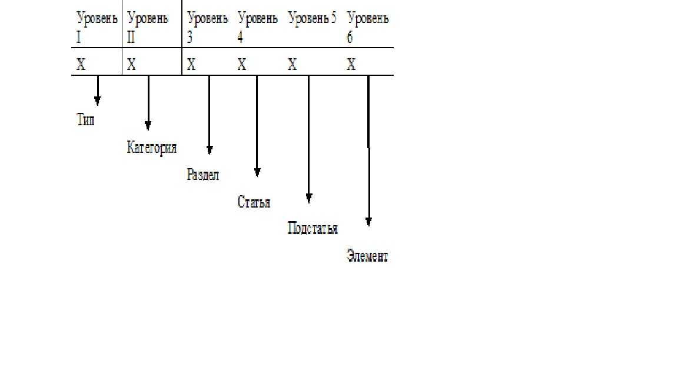
The economic classification is integrated with the Chart of Accounts to capture the economic substance of transactions, as a uniform coding system and is structured along 6 levels: type, category, section, item, subitem, element
Министерство Финансов РМ
The budget is adopted by Parliament at the level of 2 digits (type, category)
With the automation of public finance management (2016); there is no monthly allocation breakdown; the budget is planned on an annual basis

Slide 3

Министерство Финансов РМ
Within the fiscal year, appropriations adopted by the annual budget law may be reallocated in the following cases:
a) with government permission – between central public entities (except independent ones) and between programs of one public entity – up to 10% of the value of adopted budget appropriations;
b) with permission of the Ministry of Finance – between economic categories of one central entity provided that it does not incur HR expenditures or change capital expenditures and inter-governmental transfers;
с) for central public entities and, if needed, for subordinate entities – in case of reallocation types other than those specified in para a) and b), which do not entail changes in budget appropriation limits.

Slide 4

Министерство Финансов РМ
Budget entities/organization are responsible for acceptance, payment and reporting on operations in compliance with public procurement laws and other bylaws.
(2) Budget organizations may assume obligations only within the limits of their budget appropriations taking into account arrears carried over from the previous year.
(3) Long-term capital construction obligations (up to 3 years) may be assumed within expenditure limits with annual adjustments in compliance with budget appropriations earmarked in the respective fiscal year.

Slide 5

Министерство Финансов РМ
▪ in 2018, Moldova adopted a technical Concept for e-procurement (MТender).
▪ Ministry of Finance as the owner of the MTender central database must ensure go-live, operation and rollout of the said System in compliance with national legislation and international treaties.
▪ Currently, the system supports small-value procurement contracts (1000 -10000 €) and open tender procedures
▪ МТеnder is used to import awarded and signed contracts (e-format) into the treasury system.

