Slide 1
TREASURY SINGLE ACCOUNT STRUCTURE AND MANAGEMENT IN THE REPUBLIC OF MOLDOVA
MINISTRY OF FINANCE OF THE REPUBLIC OF MOLDOVA
The State Treasury
Vienna, Austria
November 2023

Slide 2

THE TREASURY SYSTEM PRIOR TO TSA ESTABLISHMENT, 1993-2007
The National Bank
Commercial Banks
1993-2007
1. State budget (revenues)
1993-2007
State budget (expenditures)
Budgets of administrative and territorial units
Budget of the State Social Security
Mandatory Health Insurance Funds
CB
Prior to 1997
1997- 2007
NB
CB
CB
АISS
CB
Central Treasury
(client)
СB
CB
Government agencies
Commercial banks
Economic agents
Regional treasuries (38)

Slide 3
BACKGROUND AND REGULATORY FRAMEWORK FOR ESTABLISHING TSA
  Memoranda on economic and financial policies with the IMF.
  Decree of the Government of the Republic of Moldova on socio-economic development of the Republic of Moldova and execution of Action Plan on implementing the Government Action Program for 2005-2009 “Modernization of the Country – Wellbeing of the People” in the first half of 2007.
  Action plan to transfer resources of the state budget, State Social Security budget and Mandatory Health Insurance Funds to the TSA – signed by the Ministry of Finance, National Bank, National Social Insurance Fund and National Health Insurance Company.

Slide 4



TSA ESTABLISHMENT AND GRADUAL EXPANSION
Since April 1, 2007 the State Treasury is a direct participant of the AISS
(Automatic Interbank Settlements System)
Stage I – March 1, 2007
State budget (revenues)
State Social Insurance budget (revenues)
Mandatory Health Insurance Funds (revenues)
Mandatory Health Insurance Funds
CB
Stage II – January 1, 2008
State budget
Budgets of administrative units
State Social Security budget
Mandatory Health Insurance Funds
(revenues + expenditures)
State Budget
Treasury services
TSA
NB
АISS
Stage III - 2015
Servicing externally financed projects
Self-governed government agencies
Local budgets
CB
Stage IV - 2016
Consolidation of special resources and social funds with the state budget basic component
Opening separate accounts for temporarily held resources of government agencies
State Social Insurance budget

Slide 5
LAW # 181 of July 25, 2014 on public finance and fiscal responsibility
Section 3
Budget Execution
Article 62. Treasury Single Account
(1) Receipts to budgets and payments from component budgets to component budgets of the national public budget in national currency shall be made by transfer through the Treasury single account, and in foreign currency - through accounts opened with the National Bank of Moldova and with financial institutions, in accordance with the foreign exchange legislation.
(2) Budget administrators may on a contractual basis borrow/provide loans from the component budgets of the national public budget, managed through the treasury single account, to cover temporary cash gaps, with repayment due in the same budget year.
(3) Budget administrators may on a contractual basis borrow from financial institutions to cover temporary cash gaps, with repayment due in the same budget year.
(4) The temporary surplus balance managed through the treasury single account may be placed on deposit accounts with the National Bank of Moldova and in government securities;
(5) Budgetary agencies/institutions are prohibited to:
а) open bank accounts to carry out receipt and payment transactions through financial institutions, except for payment business cards, opened with the permission of the Ministry of Finance, to cover expenses related to sending high-ranking executives of central public authorities on business trips abroad. The procedure of opening and management of payment business cards shall be established by the Ministry of Finance;
b) take/provide loans.
(7) The Ministry of Finance, the National Social Insurance Fund and the National Health Insurance Company may conclude contracts with payment service providers operating on the territory of the Republic of Moldova, in order to carry out certain operations related to cash execution of budgets.
(8) The procedure for selection of commercial banks as providers of payment services for operations related to cash execution of budgets shall be carried out once in three years in accordance with the legislation on public procurement.
(9) Financial means received from the component budgets of the national public budget by self-governed public authorities/institutions, state-owned enterprises and joint-stock companies whose founder/shareholder is the central and local public authorities, based on their list approved by the annual budget law, shall be managed through the treasury single account.
(10) The Ministry of Finance may temporarily use the balances on the accounts of the entities specified in part (9), opened in the treasury single account, to cover temporary cash gaps in the state budget, with their repayment within 180 days from the date of the loan and without this being reflected in the payments of the entities concerned.
(11) It is prohibited to borrow funds provided for earmarked purposes under financing agreements, from proceeds intended for externally financed projects.
Notes:
Article 62. Treasury Single Account
The receipts and payments from the national public budget, in national currency, shall be performed by transfer through the Treasury Single Account (hereinafter TSA) and those in foreign currency – through accounts opened at the National Bank of Moldova and financial institutions in accordance with the foreign exchange legislation.
It is forbidden for budgetary authorities/institutions to contract loans; this could only be done by the budget administrators.
The budget administrators can employ/provide loans on the basis of contracts, with the maturity in the same budget year, from budgets/to budgets component of the national public budget, managed in the TSA, meant to cover the temporary cash gaps.
The balance of temporarily free resources in the TSA can be placed on deposit accounts of the National Bank of Moldova and other bank authorized by National Bank to accept such deposits.
There shall be prohibited for the budgetary authorities/institutions to open bank accounts for performing operations of receipts and payments through financial institutions.
By derogation from the paragraph (5), there shall be allowed, with the authorization of the Ministry of Finance, the opening of bank accounts and performance of receipts and payments operations through financial institutions for projects financed from external sources, which implements projects on the basis of agreements concluded prior to coming into force of this law, if required by the respective agreements as well as in other cases provided for by the effective legislation.
(7) The Ministry of Finance, the National Social Insurance House and the National Health Insurance Company could engage the commercial banks acting in the territory of the Republic of Moldova for carrying out certain operations referred to cash execution of budgets.
(8) The procedure of selecting commercial banks for carrying out operations referred to cash execution of budgets shall apply once every three years in compliance with the provisions set forth by the law on public procurements

Slide 6
TSA – THE STRUCTURE OF SUBACCOUNTS
State budget
25 (one main account, others zero balance accounts)
AISS correspondence account (National Bank) incudes 260 subaccounts
Local budgets (subnational level)
37
TSA
Externally financed projects
48
State budget
State Social Insurance Budget/Mandatory Health Insurance Funds
50
FX accounts (National Bank) 150 accounts
Externally financed projects
Off-budget accounts
100
TSA is a unified bank account with separate subaccounts - segregation (not recording)

Slide 7
TSA coverage
TSA covers 100% of the national public budget:
State budget
Local budgets
State Social Insurance budget (SSIB)
Mandatory Health Insurance Funds (MHIF)
Self-governed government agencies - as per the Law on Public Finance and Fiscal Responsibility, fiscal resources that the self-governed government agencies receive from the national public budget are administered through the TSA

Slide 8


THE CENTRALIZED TRANSACTIONS PROCESSING SYSTEM
IFMIS
АISS – Automatic Interbank Settlements System
Budget institutions
National Bank
Commercial banks
Taxes and other
collections
Economic agents
Regional treasuries
State Treasury
(TSA manager / administrator)
Payments
Off-budget institutions
Commercial banks
Authorizations for executing payment instructions
individuals
Local governments
Based on bank statements, all cash inflows and outflows are directly recorded in the IFMIS
(budget execution information)

Slide 9
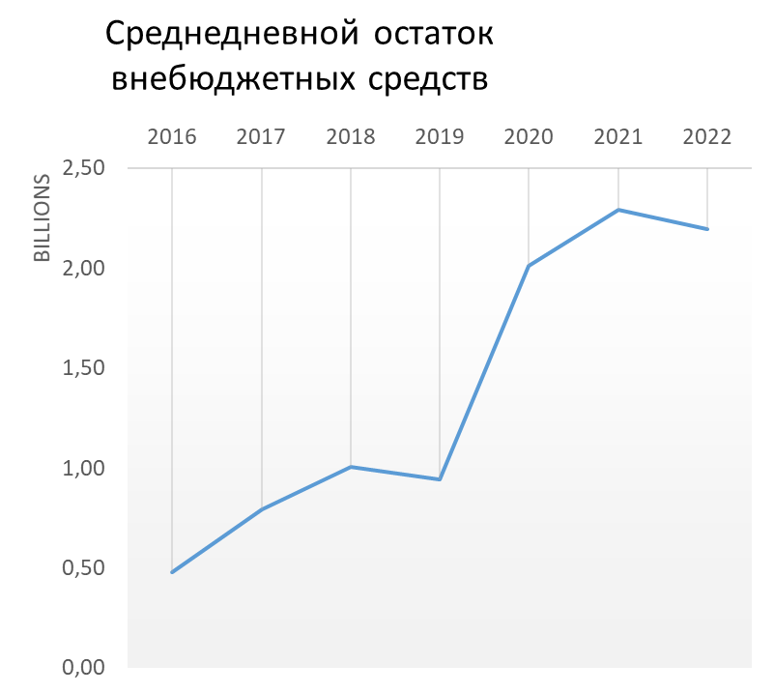
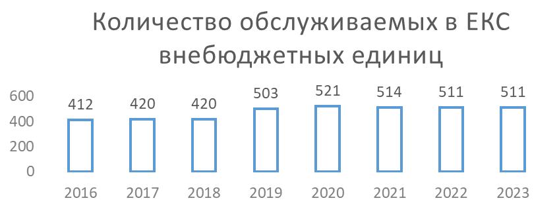
BRINGING RESOURCES OF OFF-BUDGET INSTITUTIONS TO TSA
Average daily balance of
off-budget resources
SOEs
State institutions in health care sector
Using administrative influence
Favorable terms of servicing
Secondary and higher education institutions
Other off-budget institutions (State Road Administration, IT and Cybersecurity Service, Agency for Regional Development)
Number of off-budget
units services by TSA
Cash temporarily available to budget organizations

Slide 10
USING SURPLUS BALANCES OF OFF-BUDGET INSTITUTIONS IN THE TSA
Goal:
Ensure availability of resources needed to finance cash gap and uninterrupted state budget execution
Used in forecasting for both rough tuning and fine tuning (smoothing unexpected changes in revenues and expenditures forecasts)
Possibility to place surplus balances on deposits with the National Bank
FULL
borrowings
Conditions:
subventions
Monitoring balances to maintain adequate liquidity and ensure off-budget institutions payments
Repayment before the end of the budget year
LOW !
State budget
Off-budget resources
Local budgets
Social/Health Insurance budget

Slide 11
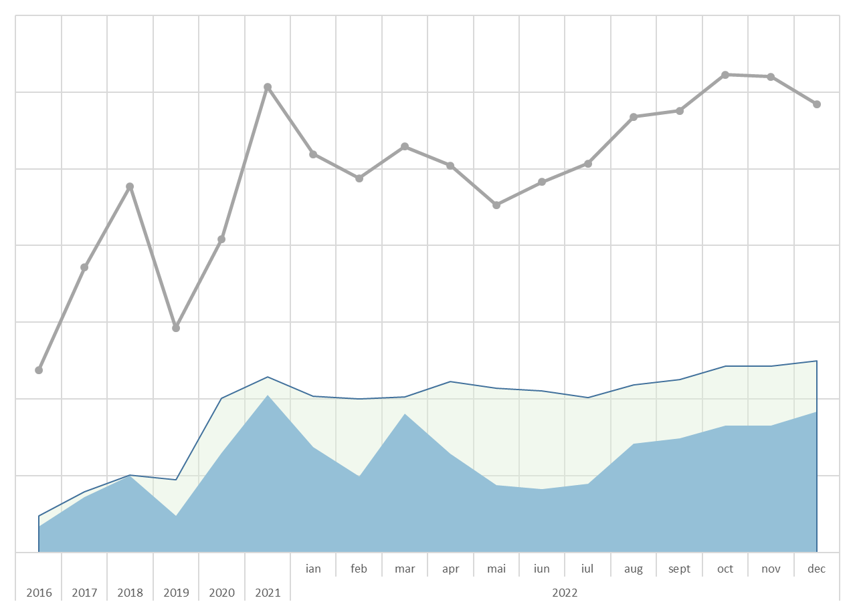
Средний остаток по ЕКС 2016-2022
MANAGING BALANCES OF OFF-BUDGET INSTITUTIONS
Average TSA balance, 2016-2022
Total TSA balance
Unavailable surplus balances
Borrowings to finance the budget
Off-budget balance

Slide 12
LONG TERM PROSPECTS AND TSA DEVELOPMENT PLANS
Eliminate regional separation of off-budget institutions’ and local budgets’ accounts
Design and implement robust tools to forecast and monitor cash flows in TSA
Use active cash management tools

Slide 13
Thank you!

