Slide 1



  IA COP
  2015-2017
  Strategy & action plan to be align to
  PEMPAL
  Strategy

Slide 2
PEMPAL independent 2012 evaluation recommended:
  More top down input – engage political level
  Explore sustainability options – eg member country contributions
  Improve membership quality – membership definition, strategies
  More knowledge products – engage between meetings
  Increased and more dependable, longer term sources of financing
  A stronger shared vision – acknowledge value of fostering individual professional competency
Notes:
More input from political level -Deputy Ministers and Ministers often open the meetings and sometimes get involved. However, the target beneficiaries to the network are those at the middle management and technical levels as these people are the ones who implement PFM reform.
However, the evaluation did recommend that investigations should be made to strengthen input from the political level and to develop a more ministry to ministry network.
Therefore we propose to consult Ministers and Deputy Ministers to determine the feasibility of such a network. The bank is also undertaking research and consultations on PFM in the ECA region and plan to consult and promote PEMPAL at its annual meetings. Views and input from the political level will be gained and fed into the PEMPAL COP action plans from these initiatives.
Sustainability. From those consulted during the evaluation, there appeared to be legal impediments for countries to provide membership subscriptions to the network. However, countries have shown some willingness to host meetings and provide financial and in-kind support including financing attendance of members to meetings.
Membership Quality - The evaluator did find that there was a risk with the network growth, that quality would be sacrificed for quantity (ie more members that only attend once and don’t stay to form a network as measured in the Network Analysis Map). Thus, it was recommended to examine membership and come up with strategies to ensure targeted and quality membership. Some COPs have already done this. For example IACOP, has Platinum, Gold and Green membership which involves incentives and benefits at each level (eg Executive Committee members volunteer a lot of their time to develop, drive and implement agendas, so they are platinum and therefore automatically get nominated to the Minister as preferred representatives to attend the specified meeting).
More knowledge products – we have started already with the development of the virtual library and the current study of PFM related assessments across the region.
Dependable financing. The evaluator found that lack of certainty in funding was a serious impediment to planning and network effectiveness. Developing and costing a five year strategy is part of the approach to this issue.
The evaluator also recommended that the Secretariat set up be changed. Currently there are only 4 part time staff assigned within an existing PFM training institute which core aim is to provide training to the Balkans region. Given the growth of the network, this set up needs reviewing. The evaluator also highlighted that other networks such as the OECD SBO network, the CABRI network of African budget officials, the various INTOSAI networks have permanent Secretariats that drive network formation, and content under the guidance of member country based governance structures.
Stronger shared vision. The network currently has a results framework and various performance information that is regularly collected and reported. However, there is no ownership of this framework which was established with the initial evaluation back in 2008. Thus, we plan to have meeting in 2013 and review and revise this framework including acknowledging the value of fostering professional competency as advised by the evaluator.

Slide 3
PEMPAL STRATEGY 2012-17
Goal: PEMPAL member Governments from Europe and Central Asia more efficiently and effectively use public monies resulting from applying new PFM practices
Outcome: A sustainable, professional public financial management platform through which individual members are networked to strengthen their capacities and to enable them to share learnings and benchmarking between countries

Slide 4

PEMPAL objectives
Objective 4: Awareness of high government and political levels is raised regarding the benefits and value of engaging through PEMPAL
IMPACT
Objective 2: Quality resources and network services, supporting relevant PFM practices, are provided to members
Objective 3: A financially-viable network of public financial management professionals, committed to improving PFM practices, is built and maintained
QUALITY
Objective 1: PFM priorities of member governments are addressed by the PFM network platform
DEPTH AND RELEVANCE

Slide 5
Objective 1: PFM priorities of member governments are addressed by the PFM network platform (2012-2014 implementation)
Action 1: Develop two year, rolling COP strategic plans aligned with PEMPAL Strategy 2012-17 Results Framework
IA CoP 2012-2014 action plan was developed
http://www.pempal.org/about/action-plans/iacop
The IA CoP was drafted but not finished
http://www.pempal.org/data/upload/files/2013/03/2012-2014-ia-cop-activity-plan_dec2012_eng.pdf

Slide 6
IA CoP draft strategy for 2012- 2014
GOAL : To contribute to improved PFM systems by supporting members to establish a modern and effective Internal Audit service in their Governments that meets international and EU standards and facilitates good governance in the public sector by:
Maintaining and developing a volunteer network of internal audit professionals through peer learning, knowledge management, and providing
a range of relevant activities (internal processes)
Serving member Governments and accomplishing sponsor needs (customer)
Achieving best value for money with the help of the PEMPAL Secretariat (financial)
Encouraging volunteers, strengthening Executive Committee leadership, promoting sustainability of IACOP, and ensuring effective coordination
with other COPs and the Steering Committee (Learning and Growth).

Slide 7
IA CoP draft strategy for 2012- 2014
Purpose: To facilitate PEMPAL members learning from each other by:
Helping each other solve problems
Developing networking in the profession
Supporting transition to modern internal audit management
Increasing exposure of internal auditors to best practices
Achieving international standards in internal audit
Finding a voice and gaining influence

Slide 8
Revised IA CoP Strategy for 2015-2017 aligned to PEMPAL is needed
Action 1. Develop 2015-2017 IA COP action plans aligned with COP specific strategic plans and the PEMPAL Strategy 2012-17 results framework
TO do:
To collect priorities of each country and choose the thematic areas to be addressed using a transparent and fair prioritization process. These priorities sufficiently address the priorities of the member governments.
How to confirm the areas identified are aligned with respective Government priority areas?

Slide 9
Action 2: Implement IA COP 2012-2014 Action Plans that address priorities
Full COP annual plenary meetings. More than 70 participants per event. Two participants per country paid from IA CoP budget + Ex com member
Working groups twice per year face-to-face meetings. More then 40 participants per event. Many participants are members of more then one WG (selection and budget challenges)
Study visits. Maximum 15 participants from few countries
Executive Committee meetings in different formats (face-to-face, audio, video, web)
Virtual communication through web based forum (wiki page, facebook, skype)
COP surveys (web based, using survey monkey)

Slide 10
Action 2 : Implement IA COP 2012-2014 Action Plans that address priorities
Risk Assessment (April 2012-March 2014)
Quality Assurance (June 2012 – December 2014)
RIFIX (ongoing)
Finalizing Knowledge Products for use by member countries:
Training and certification (March 2009- October 2012)
Body of knowledge (2009-2011)
Internal audit manual template (2010-2011)
Continuous professional development (2012)
Benchmarking of Internal Audit systems (Not addressed)

Slide 11
Action 2. Implement COP Action plans, in accordance with budget management guidelines, that address IA CoP priorities.
Proposals:
Ministers/Heads of Organizations assign appropriate participants in line with Rule of Operation membership eligibility guidelines
To fulfill eligibility: Members of the COP are public finance officials in the PEMPAL member countries, who have been nominated by public administration institutions that provide services to the governments in these countries’ existing functional areas of IA CoP, as interpreted by the Executive Committee. http://www.pempal.org/rules/
To approve definition of functional area of IA CoP
To propose additional selection criteria for events to face budget constraints
To propose new cost effective format of events

Slide 12
Action 2: Alternative format of events?
Small thematic group meetings (face-to-face and virtual)?
Reverse study visit (few PEMPALists and more host country’s participants)
Common pilot projects on practical issues
Learning sessions in the countries promoting knowledge products (paper versions and e format)

Slide 13
Action 3. Identify synergies and working projects between COPs
Priority areas have sufficient commonalities to generate interest in cross-COP exchanges
To do:
To review TCoP and BCoP plans and to see events for delegating IA representatives
To include in our CoP plan common interest topics identified in Moscow Cross CoP plenary

Slide 14
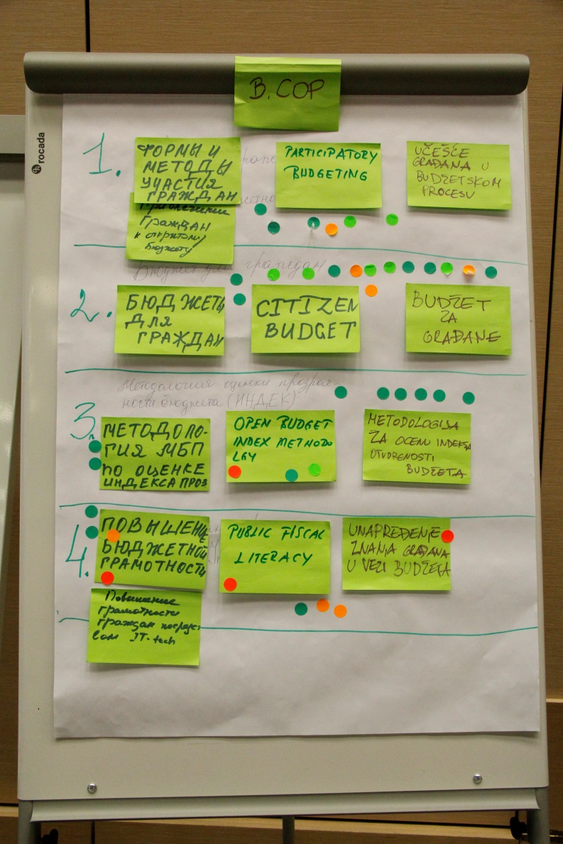
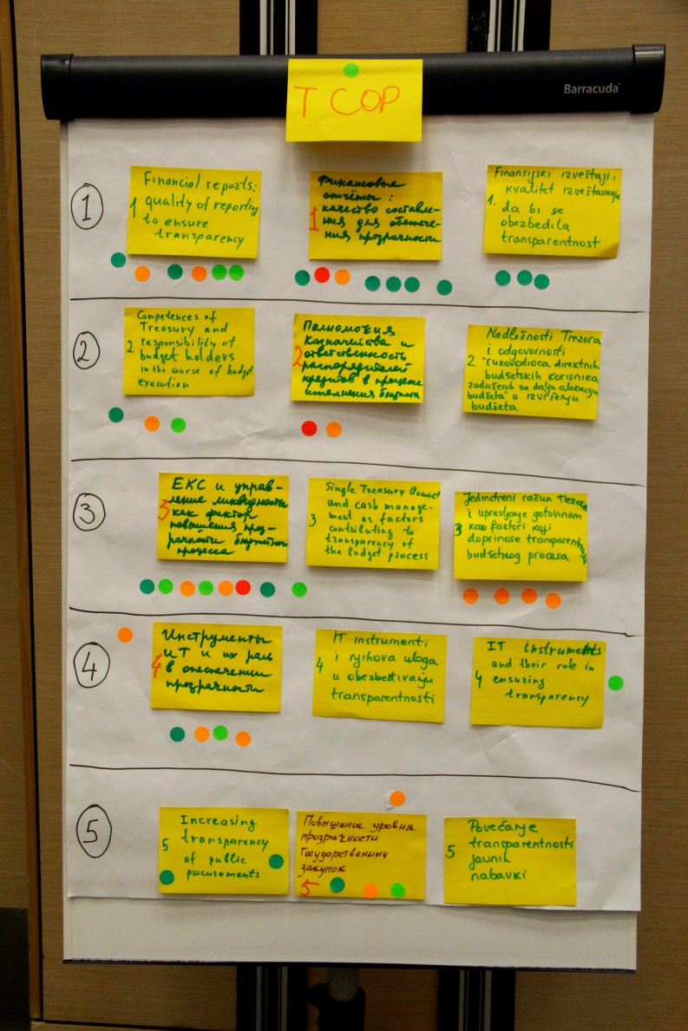
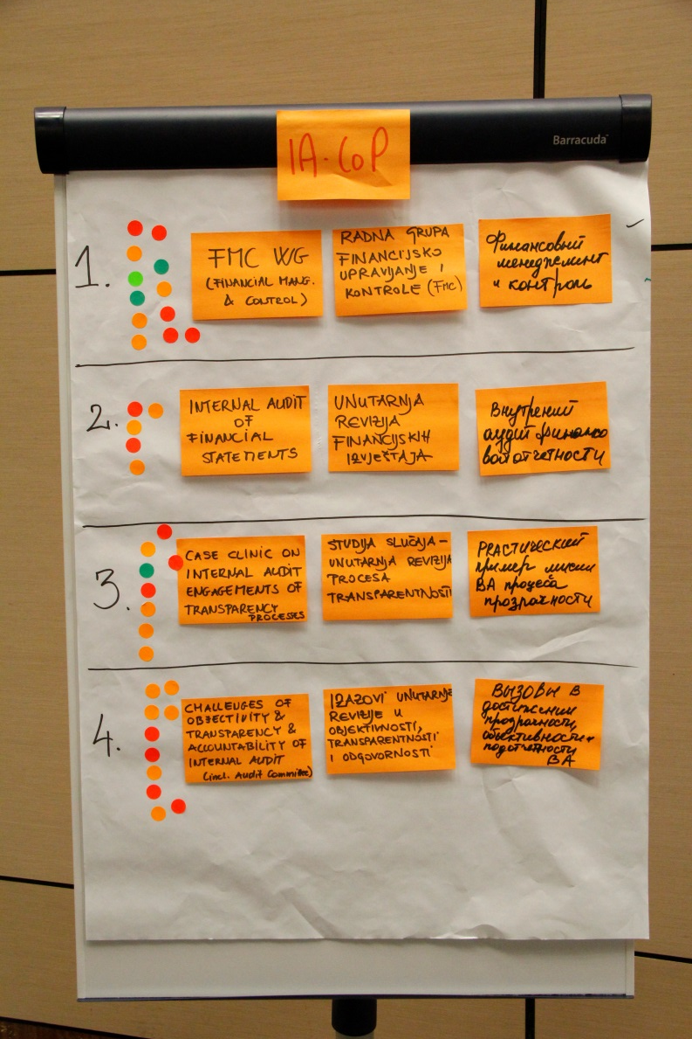
AGENDA ACTIVIST IN MOSCOW

Slide 15


AGENDA ACTIVISTS OF IACOP
(Moscow)
Financial and Control – FMC WG
Challenges of objectivity & transparency & accountability of internal audit (incl. Audit committee)
Case clinic on internal audit engagement of transparency processes
Internal audit of financial statements

Slide 16
Objective 2: Quality resources and network services, supporting relevant PFM practices, are provided to members
Action 4: Ensure the Secretariat addresses members’ needs in an efficient and effective way.
Action 5: Develop and share knowledge resources and products. Committed membership ensure the network provides valuable knowledge resources (e.g. knowledge products, library, PFM research: survey, reports etc)
Action 6a: Facilitate access to PFM experts. PFM experts are identified from within and outside Ministries of Finance where required in accordance with the priority PFM themes identified by COPs. Eg FMIS professionals, non-MOF ministries and additional representatives above two members per country rule if active participation to support event agendas is required.

Slide 17
Action 6b: Provide the Executive Committees with sufficient and effective support (COP technical Resource Teams).
Action 7: Differentiated services will be provided as part of the strategy to cater for countries at different levels of reform progress. This will ensure that members from more advanced countries will not lose interest and that the additional needs of countries just starting out on specific reform paths are met!!!
Action 8: Roles and responsibilities of key network actors as specified in the Rules of Operation are understood and followed. Clearer assignment of roles and responsibilities between the Steering Committee, Executive Committees, Secretariat, Resource Teams, and PFM Adviser will be implemented.

Slide 18
Action 9: Facilitate access to PFM training institutes
a) showcasing institutes at COP plenaries (e.g. Slovenia, Armenia, Kazakhstan, Russian Federation, Poland, Lithuania, UK) and
b) support study tours for those countries interested in establishing such institutes. A high priority need has been identified to access training and capacity building opportunities for government finance officials in existing regional PFM training institutes. Funds will be made available to visit established PFM institutes (e.g. CIPFA in the UK; Center of Excellence in Finance in Slovenia; Financial Research Institute of the State University of the Ministry of Finance of the Russian Federation; Centre for Training, Retraining and Professional Development of Financial System in Kazakhstan) Several PEMPAL countries are also investigating options to establish such an institute to enable local language international certified modules of accounting and internal audit courses to be provided, in addition to national modules targeted at the policy and legislative frameworks established within the member country.

Slide 19
10: Facilitate members working together in a geographically dispersed environment by adopting suitable technology solutions.
Adobe Connect and wiki are key technology platforms that are used regularly to facilitate communication and to work on reforms.
The work undertaken within wiki will be periodically summarized on the website to ensure stakeholders are aware of the significant work being undertaken within these platforms. However, these platforms sometimes face difficulties.
Options, solutions??

Slide 20
Objective 3: A financially-viable network of public financial management professionals, committed to improving PFM practices, is built and maintained
Action 11: COPs to monitor and sustain quality membership including analysis of existing membership and provision of advice to COP Executive Committees. This will ensure the appropriate target members are participating in the network to maximize the benefits of peer learning and to ensure value for money is achieved from donor investments.
Action 12: Seek co-financing and in-kind contributions from members where possible. This will contribute to the financial sustainability of the network over time. The Secretariat will also monitor the type and amount of co-financing and in-kind contributions and report to the Steering Committee on a quarterly and annual basis.
Action 13: Implement targeted marketing of PEMPAL to promote program to potential donors and professional associations. A communication and marketing plan will be developed to ensure that information and benefits facilitated by PEMPAL are shared.

Slide 21
Objective 4: Awareness of high government and political levels is raised regarding the benefits and value of engaging through PEMPAL
Action 14: Investigate the feasibility of transforming PEMPAL into a more formal network of national PFM institutions. Increased engagement with Ministers is planned to more closely align member action plans to country PFM priorities. Most Ministers of Finance across the ECA region currently attend the annual meetings in Washington. The interest in forming such a network will be explored there and a presentation given on the PEMPAL’s results and to see the areas of future focus.
Action 15: Implement a revised approach to marketing at the senior management level including to the Minister and Deputy Minister levels. Sending thank you letters after every specific COP event is not effective. A six monthly electronic and hard copy newsletter is proposed that summarizes attendance from all three COPs .
PEMPAL - part of an integrated package of services and products available to member countries to advance their reform priorities. This initiative would run in parallel to PEMPAL and offer an annual forum where Ministers and Deputy Ministers from the ECA region meet to discuss policy, institutional and administrative reform issues associated with PFM.

Slide 22
Mid-term review of implementation progress of Pempal Strategy 2012-17
Review the implementation progress at mid-point (strategy objectives)
Assess the validity of the original design of operation
Evaluate the results (output, outcome, impact)
Explore possible need of restructuring or other changes -> revised strategy and costs table
An survey will be done in February 2015
Please be active and provide your inputs for

Slide 23
Please be active and provide your inputs for:
1.Reviewing the results of Strategy implementation in IA CoP
2.And for Strategy update and IA CoP action plan for next 2 years
Thank you

