Slide 1

Public Participation in Fiscal Policy
at the National Level:
Selected Country Examples
PEMPAL BCOP Budget Literacy and Transparency Working Group
Tashkent, March 18, 2019
Murray Petrie
GIFT’s Lead Technical Advisor
petrie@fiscaltransparency.net
@fiscaltrans

Slide 2
Overview of Presentation
Public engagement mechanisms across the budget and fiscal policy cycles
A range of public engagements conducted by the New Zealand Treasury
Pre-Budget Consultations in selected countries
Other public engagements by MOFs: UK, South Africa, Mexico, Philippines
Concluding Observations and Issues for Discussion
References and resources

Slide 3

1. Why engage directly with the public?
  Global Financial Crisis: publishing information insufficient for accountability.
  To gain information and insights from citizens, business, experts.
  To improve the design and implementation of tax and spending policies.
  To improve the efficiency and effectiveness of line ministries.
  To increase legitimacy, trust in government, willingness to pay taxes.
  Participation is key for Sustainable Development Goals: 1-poverty, 5-gender equality, 10-reduce inequality, 16-peace, justice & inclusive institutions.
  Government data at reach: big data, open data & information technologies.

Slide 4
1.GIFT Making a Difference
Contributions | Impact
High-Level Principles on Fiscal Transparency, Accountability and Participation | More aligned norms that include public participation (IMF Code, OBS, PEFA, OECD tool kit)
Principles on public participation + Guide | Public Participation mechanisms in the Philippines, Mexico, Slovenia & Guatemala
Technical collaboration & peer learning | Improvements in OBS scores + Open Data Barometer in GIFT stewards: SA, MX, BR, PH, Indonesia, Croatia, DR, GT
Methodology for portals dedicated to users | Uruguay, Indonesia, South Africa, Dominican Republic, El Salvador, Brazil, Mexico
Open Fiscal Data Package | MX, Paraguay, South Africa publishing budget data MX linking open contracts+extractives Pilots in S.Africa, Croatia, Uruguay, Argentina, Dominican Rep, Brazil, Guatemala, Kosovo

Slide 5

Core considerations
Publish information accessibly
Clarity on the rules of engagement in order to ensure clear expectations
Reach out to those usually quiet (INCLUSION)
Add value & relevance to the process: inform well, on time, give feedback, try to institutionalize, ensure good terms of engagement
Ensure public participation complements what government institutions do

Slide 6
1. Fiscal Policy Engagement Mechanisms
Audit and oversight
SAI engagement on audit planning, and conduct of audits
Executive Budget Preparation
Conultation on national planning
Legislative
approval
Consultation on Budget Policy Statement, and annual budget proposal
Budget Implementation
Citizen feedback on public services
Citizen monitoring of procurement
Social audits of revenues and expenditures
Legislative consultation on departmental reviews
Conultations on annual budget
Submissions on money Bills
Public engagement on public service needs, and on investment project appraisals
Tax policy and expenditure policy reviews and consultations
Citizen engagement with management of individual service delivery units e.g. schools
Citizen complaint mechanisms
Independent Fiscal Institutions

Slide 7
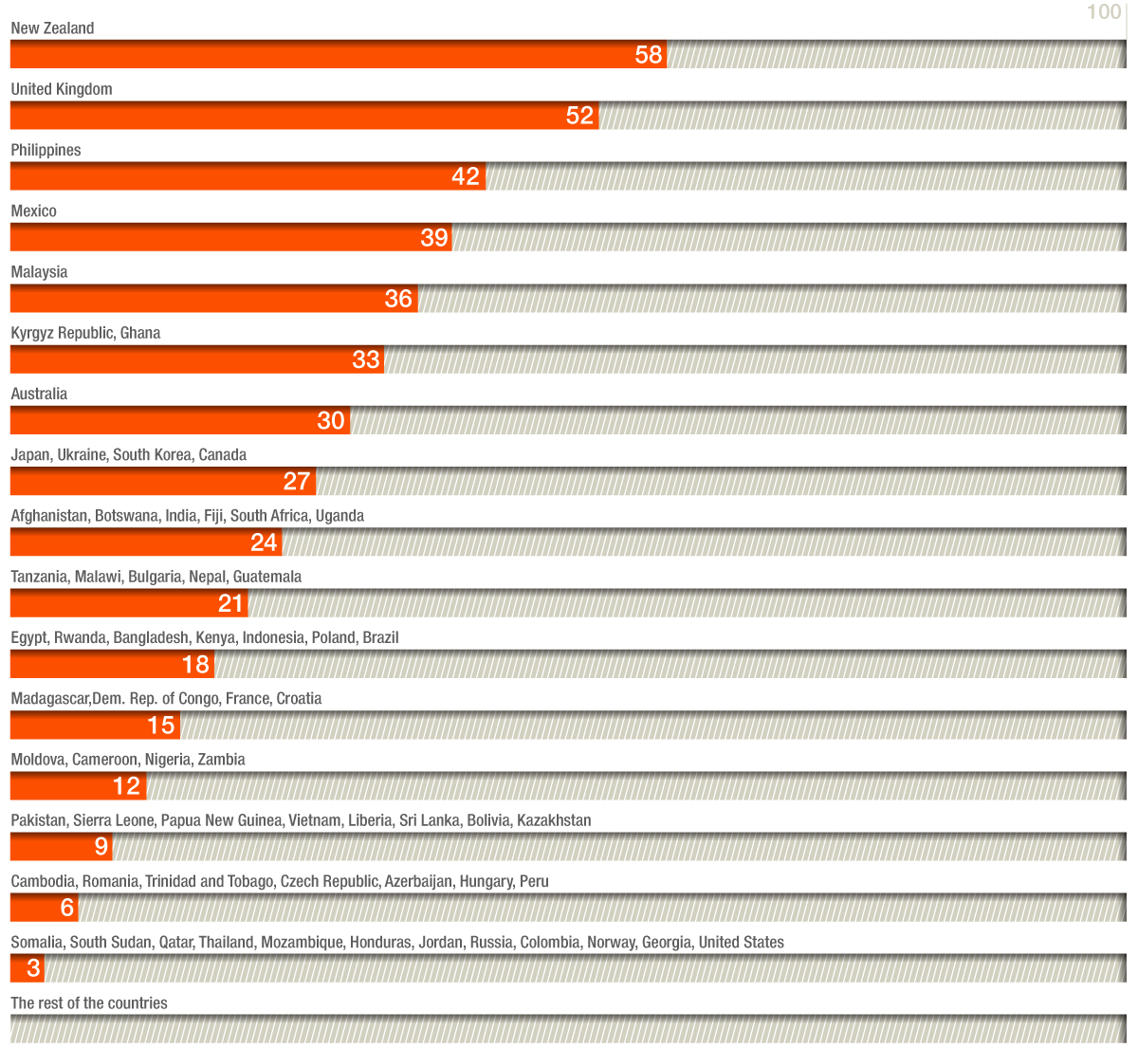
1. Open Budget Survey 2017:
Country participation scores for executive branch

Slide 8
2. NZ Treasury:
Public engagement mechanisms
Mechanism name | Stage of policy cycle | Mechanism type
A. Social Investment Panel | Budget preparation | Regular in-year consultation
B. Capital Investment Panel | Budget preparation | Regular in-year consultation
C. New infrastructure agency | Policy design | One-off consultation
D. Open budget | Budget preparation | One-off consultation
E. Earthquake Commission review | Policy implementation and design | Multi-year consultation
F. Tax reform | Policy design | Time-limited Working Group
G. Independent Fiscal Instit. | Policy design | One-off consultation
H. Other | Various | Various

Slide 9

2.A Social Investment Panel
Convened by Treasury to assess selected line ministry budget proposals.
Meets in two stages: to determine which proposals should be further developed for next budget; 4 months later, to prioritize proposals for inclusion in budget.
The Panel includes NGOs, academics, a representative from Maori/iwi (tribal), other external organisations, and senior officials from Treasury and selected agencies.
Selection for Panel: informal process, perspectives needed, not organizations.
Rules to manage conflicts of interest.
A report to Treasury senior management and relevant ministers with their assessments of proposed policy initiatives publicly available on Treasury website as part of a "Budget pro-active release".
Helped Minister of Finance deal with spending ministers.
Has not met since Feb 2018, change of government.

Slide 10
2.B Capital Investment Panel
The Capital Investment Panel:
From 2013 met four times during the year to review and evaluate new capital initiatives from "whole of government" perspective to assess their relative value.
Mandatory for new spending bids, discretionary if within baseline.
Sub-panel for small bids.
Convened senior public CFOs (Treasury, ministry & SOE),1 private sector rep.
Participants signed confidentiality agreements; conflict of interest rules.
Recommendations consolidated into a report to Government ministers and Cabinet, separate from Treasury advice. Report both system-level view and individual projects.
Picked themes e.g. ICT, earthquake re-build
Did not make decisions, but provided "valuable third-party perspective on proposed Government investments", influential advice informing Treasury's budget process, and "Played a key role in improving the quality and consistency of investment analysis and advice across the State sector." Practical, operational advice.
Has not met since Feb. 2018, change of government.

Slide 11
2.C Consultation on new Infrastructure Body
Initiative of new Minister for Infrastructure: major infrastructure deficit, require better information on needs, better coordination.
Treasury consultation document published 8 October 2018.
Submissions required by 26 October, web and social media dissemination
- responses via online survey (40), or online submission template, or other written
- meetings in October in the three main cities, plus Sydney, and at Treasury
  - small group discussions by industry group at one event
  - meetings hosted at indivisual business premises
  - invitees identified from mailing lists, asked to pass invitation on
  - Expert Review Panel supported Treasury throughout

Slide 12

2.C Consultation on new Infrastructure Body
130 submissions, assessed individually by one analyst, themes extracted, summary compiled and reported to Ministers, some Treasury advice based on what was in submissions
Design of questionnaire important (used Likert scales for some questions)
Submissions and brief summary published 20 Feb - constraints of Official Information Act and Privacy Act (p.2 of consultation document) to earlier publication
Cabinet paper published, refers to views of submitters
If had more time would have gone back to more individual submitters to explore interesting ideas

Slide 13
2.D Consultation on Open Budgets
Commitment in NZ’s 2016-2018 Open Government Partnership Action Plan:
- 'make budget more accessible and open'
Due to tight timeline, need for specialist research skills,Treasury commissioned survey research company to seek stakeholder views.
Budget for surveys (within baseline): NZ$60,000, tender let for $42,000
Report contained recommendations; discussed by Treasury senior management group and reported to Minister.
Changes to 2018 Budget documents: new “EFU basics” and 'Budget at a Glance', more data in open data formats, more historical data

Slide 14

2.D Consultation on Open Budgets:
Methodology
Treasury compiled list of stakeholders after informal discussions.
List finalised in discussion with contractor. Both 'usual voices' and 'new voices.'
35 qualitative in-depth interviews:
Media (5), industry reps (4), analysts (3), financial orgs (3), academics (3), international orgs (2), indigenous groups (4), social and community service
groups (6), professional network groups (4)
Contractor prepared interview questions, finalised in discussion with Treasury.
Interviews lasted up to one hour, and took place over two months (April, May 2017). Half of interviews were conducted face-to-ace, half over the phone.

Slide 15
2.E Earthquake Commission Review
EQC a government entity that provides homeowners with disaster insurance
Following major 2011 earthquake in Canterbury, government announced review in 2012 of EQC's insurance claims management and insurance coverage issues
Consultation process led by the Treasury:
- initial informal 'soft consultation', listening, to identify and understand issues
- used general Community Advisory Group set up for all post-earthquake issues
- Consultation document not published until 2015; contained 22 specific proposals
- 62 submissions received
- officials talked in detail to insurance companies (both one on one and with Insurance Council), could develop initial ideas in confidence
Submissions withheld under the Official Information Act (issue still under
active consideration), not released until 2017 becasue of delay in review
Initial legislation in 2018, other elements of review on-going

Slide 16

2.E Earthquake Commission Review
Major policy reviews can be subject to long delays.
Insurance industry complained about delays, welcomed opportunities for input.
Needed careful stakeholder management: multiple points of engagement with different interests; for private sector, used both industry bodies and direct one on one consultations; high degree of openness, gave formal feedback to all participants at group meeting to avoid mixed messages
Possible competition policy constraint on individuals' comments at group discussions amongst competing companies
Did not get required consent from individuals to publish their submissions, had to go back later for consent
Disclaimer: 'None of the information in this
[consuiltation] document should be construed
as financial advice. Readers should contact
a qualified advisor if they have a question
about their own insurance arrangements.'

Slide 17
2.F Tax Policy Reform
Since the mid-1990s introduction of a Generic Tax Policy Process including public consultation; publication of annual tax policy work program; scheduling of two tax bills per year outside annual budget to avoid budget secrecy and time constraints; frequent consultations on small policy and changes to tax administration; occasional major external reviews of tax policy.
Tax Working Group (TWG): set up November 2017 https://taxworkinggroup.govt.nz/. Chaired by former deputy P.M., the other ten members span tax law pracitioners, academics, business, community, Maori community, and sustainable development. Supported by a secretariat of officials from Treasury and Inland Revenue Department acting independently.
Two-month public consultation 1 March - 30 April 2018. Other public
engagements following release of interim report on 20 September 2018.
Final report published 21 February 2019.

Slide 18
2.F Tax Policy Reform:
engaging indigenous peoples
Maori are NZ's indigenous people, about 15% of population, rights established in Treaty of Waitangi 1840 and recognized in law in recent decades. Consultation and partnership with Maori now an essential part of public policy in NZ.
Tax reform engagement started with informal 'soft testing' with 8-10 Maori leaders (identified on advice of Treasury's Principal Advisor Maori, established networks).
Formal meetings around NZ on tribal marae.
Recognizing cultural context very important to success: terminology ('partners', not 'stakeholders'); personal connection, consult on home ground; catering; feedback.
Importance of positive engagement: not ' we are required to consult you'.
Government guidelines on engaging with Maori

Slide 19
2.G Setting up an Independent Fiscal Institution
Government election promise; Treasury gap analysis
Consultation document produced (2 FTEs over 2 months plus contractor to edit): Used Treasury, OECD and IMF networks and publications
Two workshops in Wellington, visit to Australia IFI
25 submissions, published 6 March
Would have liked more time to consult (consult outside Wellington, and more cross-agency consultation).

Slide 20

2.H NZ Treasury: Other engagement mechanisms
Long Term Fiscal Statement every 4 years - legal requirement to consult
Investment Statement every 4 years - legal requirement to consult
Outreach to and annual competitions for university students. and for school students

Slide 21
2. NZ Treasury engagement: concluding observations
Wide variety of engagement mechanisms: one-off/institutionalised; single stage/mulitple rounds; informal/legally required; expert-based and general public.
Spans macro-fiscal, tax, expenditure, investment; mainly outside annual budget.
Role of Treasury v role of government.
Limited centralised guidelines for staff, reliance on experienced staff and culture of cross-Treasury discussion and sharing of experience.
Often done on short time frames, but sometimes long drawn out, political factors.
Well-established non-government actors and patterns of interaction.
Specific efforts and mechanisms to engage Maori (indigenous people).
Delays (sometimes long) in publishing submissions and summary of submissions.
Most work done by Treasury staff, within baselines, occasional contracting out.
Clear processes to manage privacy issues; potential conflicts of interest etc.

Slide 22
3.A Pre-Budget Consultations
South Africa: Tips for the Minister: general public invited to submit proposals for next budget on Treasury web site or hand them in. Over 500 tips per year. Treasury Communications staff vet them for Minister, submit shortlist of 10 to Treasury executive team. Minister considers those that are closest to government priorities and refers to them in Budget Speech.
Canada: since 1990s, pre-budget consultations with the public organized by Dept. of Finance to gather input on government's areas of focus for upcoming budget.
Use of social media (Google Hangouts, Facebook), dedicated website .
  Purpose, scope and process outlined in press release on launch of consultations.

Slide 23
3.B Pre-Budget Consultations
Ireland: A National Economic Dialogue is held in June after the government has determined (from its spring budget semester) the level of “fiscal space” available in the coming year, and before line ministries have submitted budget proposals.
The forum brings together civil society and parliamentary stakeholders to discuss priorities for the October budget. The Forum is moderated by an independent chairperson and all of its sessions are held in public.
Kyrgyzstan: Open invitation by MinFin to participate at the Budget Hearings on proposed Budget,as required by regulation. Hearings in the capital Bishkek and 2 regional cities, with representatives of all relevant ministries and MinFin. Discussion are open to all; the public's questions and proposals are addressed and recorded.

Slide 24
4.A UK Tax Policy Engagement
2011 Government Tax Consultation Framework:
requires early and continuing engagement on all (other than minor) tax changes
where possible, the Government will engage interested parties, minimise the occasions on which it consults confidentially, set out its strategy, the policy objectives, any relevant broader policy context, the scope of the consultation, its current assessment of the impact of the proposed change and which department and official is leading the consultation.
To enable legislation to be properly scrutinised, draft clauses for the Finance Bill will be published for scrutiny at least three months before the Bill is introduced to Parliament and the period for comment will be at least eight weeks.

Slide 25
4.B South Africa:
Annual budget workshop with CSOs
Programme agreed between Treasury, sector experts and CSOs.
Increasingly detailed agendas, questions pre-agreed, for targeted engagements.
Treasury funds (within baseline) venue hire (if not hosted at government buildings), catering, staff and CSO travel and accommodation costs, printing of documentation.
Used to take Treasury 6 months to organise, decreased to an average of 3 months.
New CSO structures have evolved making meaningful engagement possible again. For example, IMALI YETHU, a coalition of civil society was formed to partner directly with Treasury to develop the budget online portal, www.vulekamali.gov.za.
Results: better understanding of role of Treasury, and of trade-offs required in budgeting; new and deeper Treasury/CSO collaborations.
Could use more ICT tools; more social audits; evidence-based CSO submissions.

Slide 26

4.C Mexico: School Infrastructure Program
Poor state of rural school buildings (2013 infrastructure census)
Problems of inefficient and ineffective spending (corruption, interest group capture)
Min. Public Education/MOF initiative: fund each school directly (debit cards).
School body meeting (principal, teachers, parents and students) decides and signs off on agreed investment priorities and monitors construction at each school.
Ministry of Education in charge, MOF involved in design of operating rules
New Eucation Reform Program created in MOE's 2014 Budget. Initially US$400 million approx., 11,000 schools; 3 months to develop, 3 MOE staff to manage
New School Infrastructure Platform on Fiscal Transparency Portal (9 photos /school/year taken before/during/after construction, citizens can upload information).
Independent annual evaluations by academic
organisations (first one by World Bank).

Slide 27
4.D Philippines Budget Partnership Agreements
During the formulation of the annual budget:
National Budget Memo requires each Agency to include CSO recommendations and feedback/inputs from the Agency led consultations, and submit to the Department of Budget and Management
A Budget Preparation Form is used for CSO’s inputs on ongoing and new spending projects and activities
National and local consultations + review of agency performance with participation of CSOs
During budget implementation:
The Department of Education partners with the Affiliated Network for Social Accountability in East Asia and the Pacific (ANSA-EAP) Foundation in the CheckMySchool Program where citizens participate in monitoring budget implementation for school improvement projects

Slide 28
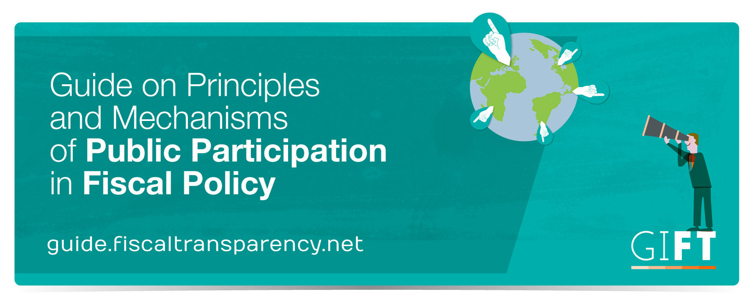

Slide 29
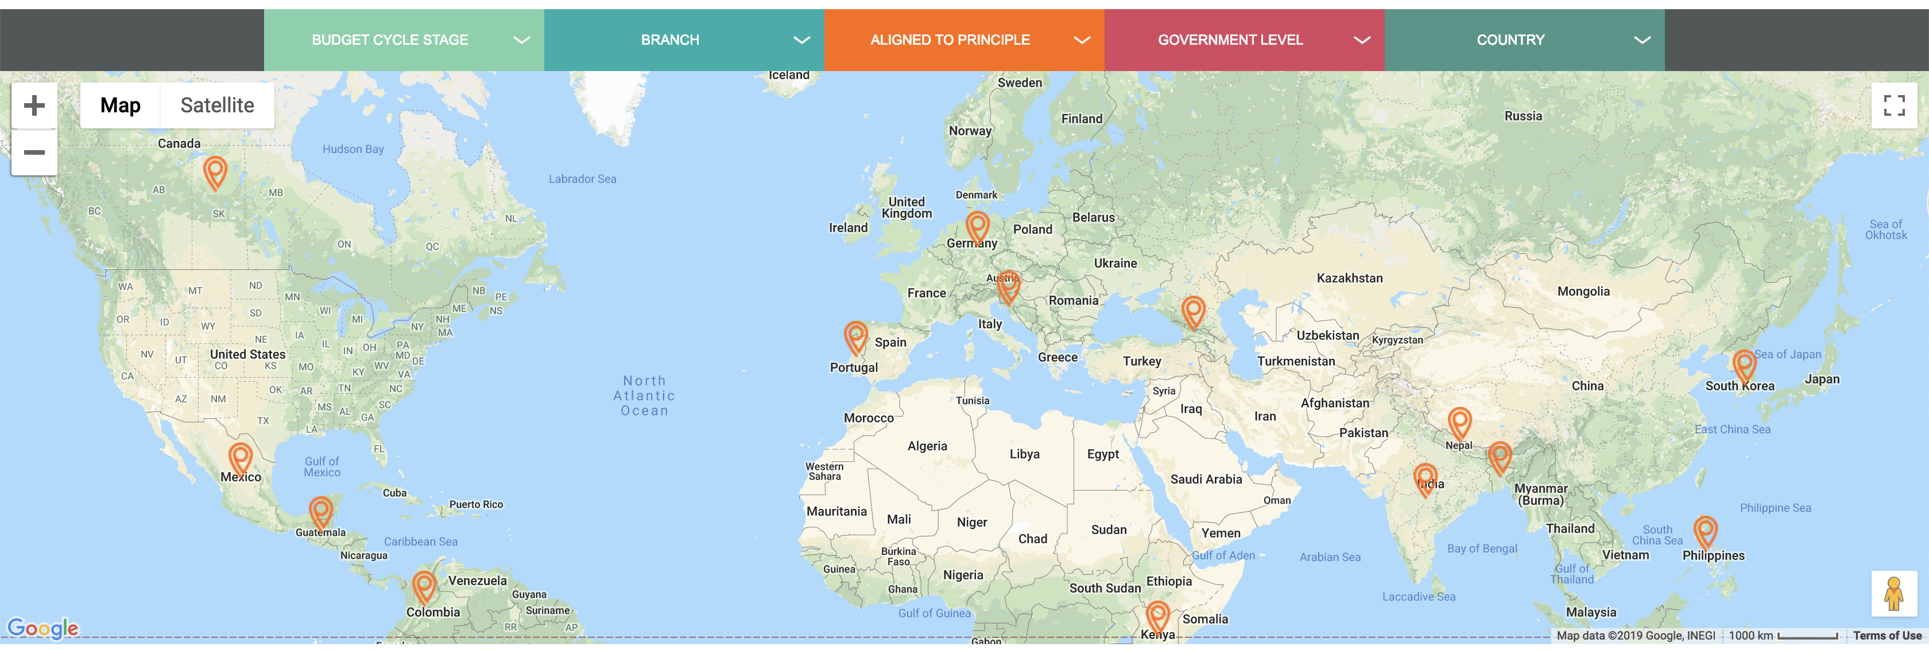
GIFT Particiation Guide:
Contains 19 fiscal policy cases
Lessons Learned identified by practitioners in charge as well as tips and the main conditions and factors associated with the success or failure of the engagement
Principles of Public Participation: Which principles, and how the engagement aligns to the principles
Country context: information to facilitate a general understanding of the surrounding factors and conditions in which the engagement in question took place
Examples considered: Argentina, Bangladesh, Brazil (3), Canada, Colombia, Croatia, Germany, Georgia, Guatemala, India, Kenya, Korea, Mexico, Nepal, Philippines (2), Portugal

Slide 30
5. Direct public engagement by MOFs:
main levers and tools
Any general or fiscal policy-specific regulatory or legal requirements to consult
Annual budget cycle:
  Two-stage budget process, consultation on macro-fiscal policy
  Budget Call Circular
Leverage with respect to new spending initiatives
Major tax or expenditure reviews
Choice of expert-based, CSO-led, or general public, or mixes
Opportunities to use new ICT tools (to facilitate consultation and citizen monitoring)
Perfromance-oriented budgeting: KPIs on citizen satisfaction and engagement
Work with reform-minded Finance Ministers
Collaboration with reform-minded line ministries

Slide 31

5. Direct public engagement by MOFs:
Contextual factors
Constitutional arrangements
General nature of government /civil society relations
Approach of current government
Role and level of capacity of MOF
Civil society context

Slide 32
5. Direct public engagement by MOFs:
some issues for discussion
What country examples of specific engagement mechanisms are most relevant to your country, and why?
What do you see as the appropriate role of the MOF in your country, compared to the role of the government; the legislature; the role of line ministries?
What level of capacity does your MOF have for public engagement?
What is the civil society context in your country? e.g. number and role of CSOs; presence of umbrella national CSOs; levels of capacity; nature of government/civil society relations.
What are the main challenges you see to increased or new public engagement?
What do you think are the key requirements for a specific new public engagement mechanism to be introduced in your country?
What role could GIFT play to support your efforts?

Slide 33
6. General References
GIFT Guide on Public Participation: www.guide.fiscaltransparency.net
2017 Open Budget Survey, individual country reports (Q. 125 on public engagement by MOF) https://www.internationalbudget.org/open-budget-survey/results-by-country/country-info/
OECD Toolkit on Budget Transparency (Part J): https://read.oecd-ilibrary.org/governance/oecd-budget-transparency-toolkit_9789264282070-en#page84

Slide 34
6. NZ Treasury web sites
New Infrastructure Body: https://treasury.govt.nz/publications/consultation/new-independent-infrastructure-body
Open Budget: https://treasury.govt.nz/publications/information-release/open-government-partnership-information-release
Earthquake Commission review: https://treasury.govt.nz/news-and-events/reviews-consultation/review-earthquake-commission-act
Tax reform: https://taxworkinggroup.govt.nz/
Engaging with Maori: https://tearawhiti.govt.nz/assets/Maori-Crown-Relations-oopu/6b46d994f8/Engagement-Guidelines-1-Oct-18.pdf

Slide 35
6. NZ Treasury web sites
Independent Fiscal Institution: https://treasury.govt.nz/news-and-events/reviews-consultation/establishing-independent-fiscal-institution
Long Term Fiscal Statement 2016 (including public engagement process): https://treasury.govt.nz/publications/strategies-and-plans/long-term-fiscal-position/he-tirohanga-mokopuna
Investment Statement 2018: https://treasury.govt.nz/publications/investment-statement/2018-investment-statement
Universities and schools: https://treasury.govt.nz/about-treasury/our-work/education-community/

Slide 36
6. Other web sites
South Africa: budget online portal, www.vulekamali.gov.za
Mexico rural school infrastructure: http://documents.worldbank.org/curated/en/147431545086837057/pdf/Disclosable-Version-of-the-ISR-Mexico-School-Based-Management-Project-P147185-Sequence-No-09.pdf
UK Tax consultation: https://www.gov.uk/government/publications/tax-consultation-framework
UK Government Code of Practice on Consultation: https://webarchive.nationalarchives.gov.uk/20140206144828/http://www.berr.gov.uk/files/file47158.pdf

Slide 37



Stay tuned!
@fiscaltrans
@fiscaltransparency
@fiscaltransparency
www.fiscaltransparency.net

