Slide 1

OPTIMIZING THE CHART OF ACCOUNTS DESIGN
Tips for PFM Practitioners
Mark Silins,
Elena Nikulina
December 2020

Slide 2
Content
What is PEMPAL TCOP and why this paper was produced
The important role of an integrated UCoA for modern PFM system inter-operability
How this approach supports the metadata requirements for government reporting through data warehousing
How the CoA can support cross cutting reporting requirements such as COVID
The key role of ICT officials in “connecting the dots” for the functional departments

Slide 3
What is PEMPAL TCOP and
Why this paper was produced?
Treasury COP (TCOP) operates under the Public Expenditure Management Peer Assisted Learning network (PEMPAL) supporting exchange of professional experience and knowledge transfer among PFM practitioners across the ECA countries.
Practical focus of the peer learning activities is what makes PEMPAL unique and highly valued by the members (focus on how to implement various PFM improvements in specific environments).
The paper was produced on the request of the TCOP Public Sector Accounting and Reporting Working group as a practical guide for developing or updating a government’s Chart of Accounts

Slide 4
Country Representatives’ Views on
the State of Integration of Budget Classifications and Chart of Accounts and Plans for Improvement
Country | Integration of BC and CoA (as viewed by country representatives) | Plans for revision
Albania | Full | Yes, following IPSAS implementation
Azerbaijan | Partial | New software is needed
Belarus | From Missing to Partial | UCoA will be piloted in 2020-2021
Croatia | Partial | UCoA was adopted in 2014
Georgia | Partial | Following IPSAS new requirements
Kazakhstan | Partial | Yes, revisions are being prepared
Kyrgyzstan | Partial | Yes, subject to automation
Moldova | Full | On a needs basis
Montenegro | Full | Yes, following transition to accrual
Russia | Full | Simplification of the economic segment
Tajikistan | Partial | Discussion to use expanded CoA structure and eliminate economic classification
Turkey | Full | There was a recent upgrade (IPSAS)
Source: Compiled during the group discussion session at the meeting in Moscow, October 2019

Slide 5
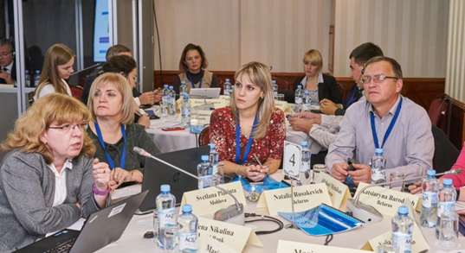
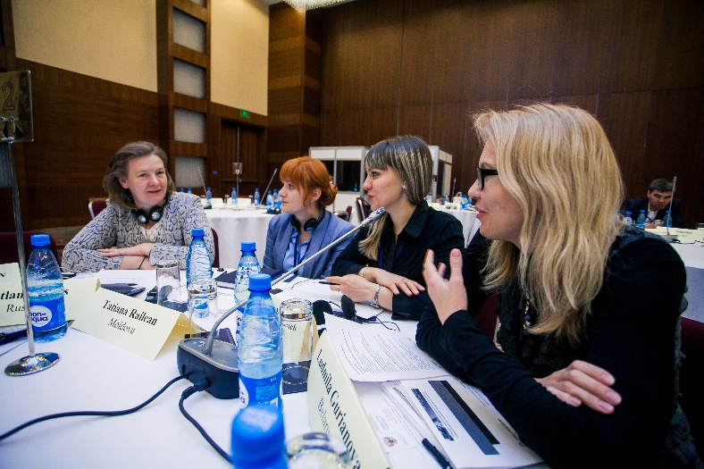

Moscow, October 2019
Baku, April 2018
Moscow, October 2019

Slide 6
Why did different classifiers evolve in government?
Classifiers existed even in manual processing environments, however they tended to be simple, often two dimensional, reflecting paper-based recording systems
As different requirements evolved, particularly with partial automation in systems, different classifications were often developed to meet different objectives
  As an example many countries developed a budget classification to report cash-based budget out-turns and a modified accrual classification for annual financial reporting
This tended to result in multiple layers of reporting and some challenges when seeking to reconcile data from the different systems/reports
Modernization of government systems into a more unified framework has revealed the weaknesses in this approach – ultimately the transactions used in these different systems are the same - It is often timing and the classifications that are different

Slide 7
Defining a Unified Chart of Accounts
The broad classification system which provides linkages across the PFM framework and systems to ensure data is classified in a unified manner, allowing consolidation of information across all of general government
Ideally the UCoAs will also be the CoAs in the General Ledger of the FMIS. However, where the FMIS does not serve all MDAs/controlled entities, the UCoAs enables consolidation of data and transactions from those entities too. It also provides the data linkage to other PFM systems

Slide 8
Treasury and FMIS is the engine room of many country Public Financial Management frameworks!
(A Handbook on Financial Management Information Systems for Government” authored by Ali Hashim

Slide 9
Coverage and Consolidation are fundamental to the design of the UCoA

Slide 10
Coverage and Consolidation (1)
Using accounting concepts for the template of the economic structure
Economic
Accrual based CoAs
Source of Funds
Organization
Project
Location
Program
Function
Cash based budget classification
Cash based budget Classification
Accrual based CoAs
An integrated economic segment, which supports budget, macro-fiscal, financial and statistical reporting is key. If well designed it should also support control and reporting requirements for MDAs

Slide 11
The Moldovan Integrated Approach

Slide 12
Coverage and Consolidation (2)
The UCoA should cover all government funds, allowing cash consolidation and also reducing the movement of cash within government. It should also support user defined reporting and control, for example, for each project funded by Development Partners
General Fund
Oil/Future Fund
Trust/Deposit Fund
Development Fund
Extra-Budgetary Fund
Sinking Fund
Contingency Fund

Slide 13
The ledger should be structured to reflect bank account operations but also to eliminate redundant accounts. This will allow consolidation of actual cash, automated bank reconciliation and cash book management for MDAs. Modern banking interfaces also reduce the dependency on external bank account controls and allow real time reporting (in some cases)
TSA Head Account
General Fund Sub Account
Development Fund Sub Account
Multilateral DPs
Deposit Fund Sub Account
Bilateral DPs
Sinking Fund Sub Account
Contingency Fund Sub Account
World Bank
President’s Contingency Fund
Disaster Relief Fund
Debt Sinking Fund
Asset Replacement Fund
Money Held in Trust
Contractors’ Deposit Fund
Importers’ Deposit Fund
IMF
China
Russia

Slide 14
The general ledger should be arranged as a set of hierarchical relationships where transactions between reporting entities are reported at the entity level but eliminated at the consolidated/higher level. Significant external transactions are undertaken sub-optimally in many countries because of the poor understanding that these can be created as internal transactions
XX Tier 2 Ledgers
Consolidated Government General Ledger
XXX Tier 3 Ledgers
Own Revenues
Contingency Funds
Deposit Funds
EBF
XXXX Tier 4 Ledgers
Transaction between SUs report on a gross basis in the SU accounts, however, at higher levels the integrated ledger automatically eliminates them
XXXXXX
Spending Units Ledgers
Tier 1 Ledger

Slide 15
Where MDAs operate their own accounting systems, the UCoA should be mandatory although MDAs should be free to expand on the core structure as long as they do not impinge its integrity
PFM Portal
(APIs)
MoF Budget Preparation
System
Spending Unit Accounting System
Unified CoA
Unified CoA
Project Management System
Spending Unit Accounting System
Unified CoA
E-Procurement
Unified CoA
Spending Unit Accounting System
Unified CoA
Unified CoA
FMIS
Budget Control and Execution Reporting
Spending Unit Accounting System
Banking System

Slide 16
Integration and Consolidation are the trends - user defined reporting demands will increase in the future as users become more aware of capacity and sophisticated!
Budget Preparation
E-Procurement
Debt Management
FMIS
MDA Accounting Systems
Banking System
Cash Management
Revenue Management
Systems
Project Management
Systems
Data Warehouse
(Reporting)
APIs/interfaces with Other Systems
Asset and Inventory Management
Systems
Unified Chart of Accounts (underpins data integrity across PFM systems)

Slide 17
It may not always be possible to develop the perfect UCoA but if you can convince decision-makers to capture transactions at a detail level then reporting capabilities will be maximized.
Primary School Number 1
Ministry of Education
Pre-Primary and Primary Education Division
Primary Education Department
Primary Education Program
Primary Education Sub-Function
Balts Primeria (Municipality)

Slide 18
Responding to an Emergency – How some countries track COVID using the existing CoA structure
Moldova - utilizes the SOF segment
Croatia – created specific COVID related activities in the program segment
Kosovo – opened a separate bank account for COVID which operates as a sub-account of the TSA. They also created a specific COVID related project activity to be able to produce reports separately from other expenditures
Albania – added new economic items for specific expenditure categories for social benefit transfers. At least one new special project has also been set up for this including for grants received from DPs which are also recorded in a COVID related revenue classification for grants. Payments are also deposited into a separate account allowing transactions to be separately monitored. In addition COVID related transactions are identified in a free “description field”
Ukraine - utilizes a feature outside of the UCoAs which allows the payment purposes to be registered during the payment order process
Each arrangement above was implemented rapidly to ensure some level of separate reporting on COVID was possible from the country FMIS. This reflects well on each countries ability to use the UCoAs flexibly and responsively
The challenge is to ensure these changes do not reduce the effectiveness of other reporting

Slide 19
COVID Tracking - Building Cross Cutting Reporting Capabilities into the UCoA for the Long-term

Slide 20
Concluding Remarks - The role of ICT in promoting the UCoA
A major issue with some modern CoAs is that the conceptual design and final structures do not include all stakeholder reporting requirements
Modern ICT officials are generally providing services across functional areas of government – this provides them with a useful broader view of processes and requirements
In contrast, many departmental officials largely consider reporting and the automation of processes only from their own perspectives
  budget officials need to appreciate that while the budget has primary importance it is not the only reporting requirement
  annual financial reporting is also not the only focus for a UCoA albeit an important one
When designing or upgrading the UCoA ICT officials must be involved – they maybe the key to ensuring broader design considerations prevail
It is important that they guide officials and seek to build bridges across “functional silos” to ensure a broader UCoA design
Hopefully this paper can be helpful in supporting this role
in influencing future UCoA design

