Slide 1
Participatory Budget in Sakhalin Oblast
Anna Kharchenko
Minister of Finance, Sakhalin Oblast/Region

Slide 2
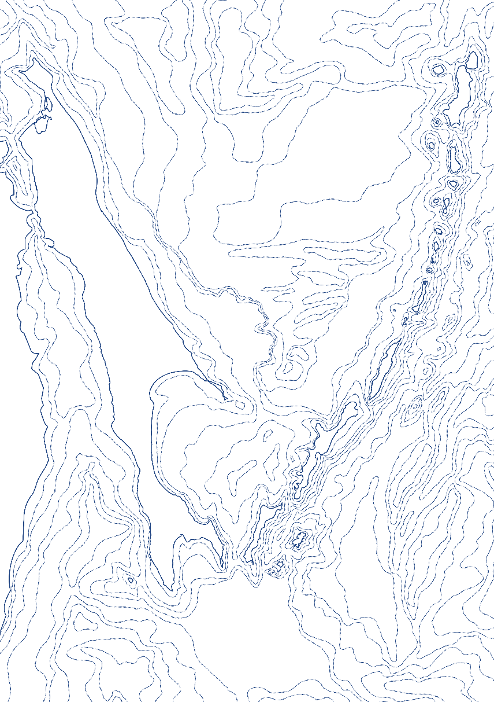
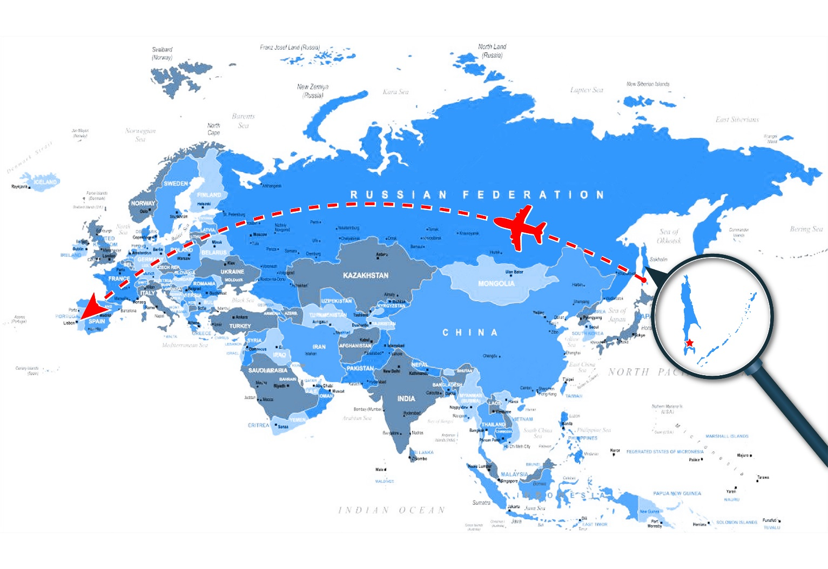
about Sakhalin Oblast
Area
87.4K km²
Population
490.2K
More than 100 ethnical groups
The only island oblast (region) in Russia
More than 100 islands
The biggest of them is SAKHALIN
More than 200 human settlements
Administrative center is Yuzhno-Sakhalinsk
10 549 km
6 655 km
446 km
from Yuzhno-Sakhalinsk to Lisbon
from Yuzhno-Sakhalinsk to Moscow
from Yuzhno-Sakhalinsk to Sapporo, Japan

Slide 3
Three PB practices in Sakhalin Oblast
Goal – development of a dialogue between citizens and local governments and solution of local problems
SUPPORT OF LOCAL
INITIATIVES
YOUTH BUDGET
DEVELOPMENT OF
TERRITORIES
Development of a dialogue through solutions of local problems related to the public infrastructure development at the local level
Fostering budget literacy and citizenship in schoolchildren
Involving citizens in decision making on building of major infrastructure facilities
125 Million Roubles
375 Million Roubles
≤1 % от доходной части бюджета
≈ 1 Billion Roubles
about 100
52,000
>10,000
from 125
14,492
3.9%
human settlements
beneficiaries
high school students
schools
voters
of people older than 18
%

Slide 4
LISP
Local Initiatives Support Program

Slide 5
SUPPORT OF LOCAL INITIATIVES
Program Launch– 2017
DESIGN SPECIFIC FEATURES:
FOCUS:
Criteria- based competitive selection of municipalities’ proposals (public support for the projects, financial contributions from public and businesses, etc.)
75–80% projects win in the competition
Co-financing by public and businesses (with money and gratuitous labor)
Small and medium municipalities, primarily rural
Small projects (below 3 Million Roubles)
Solution of basic social problems at the local level and improvement of public space

Slide 6
SUPPORT OF LOCAL INITIATIVES
ANNUAL PROCEDURES
Discussion and proposal of initiatives at the community meetings
Preparation of documentation at the level of a municipality
Competitive selection
Implementation

Slide 7
SUPPORT OF LOCAL INITIATIVES
PROJECT FINANCING
Oblast (Regional) Budget
OBLAST
Local Budget
URBAN DISTRICT
Raion (Local) Center
Village 1
Village 2
Village 3

Slide 8
SUPPORT OF LOCAL INITIATIVES
GYM renovation
In Zabaikalets village
1 241 956
Million Roubles

Slide 9
PORT
Public Organized for (Re)development of Territories

Slide 10
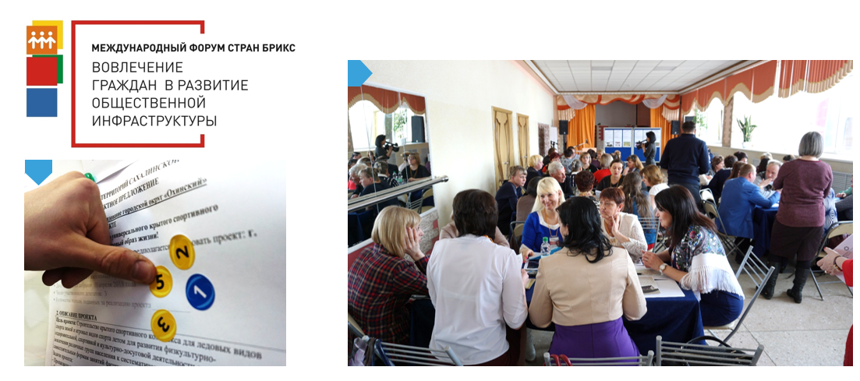
PORT PROJECT
(engagement of citizens in development of public infrastructure)

Slide 11
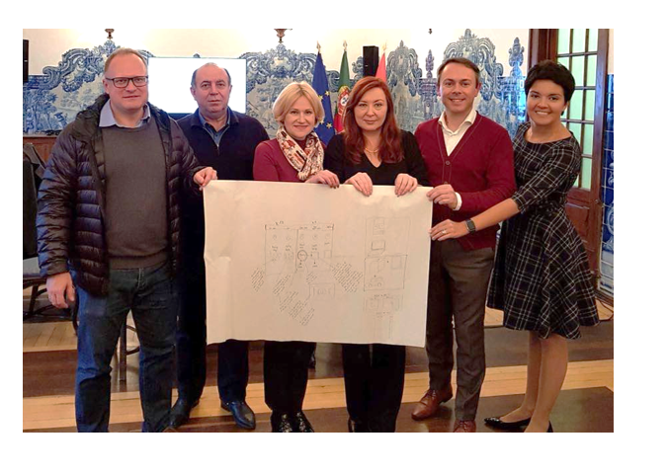
Development of PORT Model in Sakhalin Oblast based on Cascais Experience
Establishment of a joint team with the World Bank
Study visit to Cascais to learn about the design and implementation details at every phase
Joint development of a design for a practice taking into account Russian Federation and Sakhalin-specific features

Slide 12
Development of Territories
PROGRAM LAUNCH– 2018
DESIGN SPECIFIC FEATURES:
FOCUS:
Two phases of public consultations:
Preliminary public meetings in municipalities
Meetings of delegates at the urban district level
Region-wide public online voting
Authentication through an official web-platform of public services (GosUslugi – Public Services Website)
Urban and suburban districts
Major infrastructure projects (up to 100 Million Roubles per project)
combination of LISP and Cascais PB Models

Slide 13
Project Criteria
1
Cost per project
Co-financing from a municipal budget
Up to100 Million Roubles
of budget allocations
(regional and municipal)
At least 1 %
Billion Roubles
Project implementation timeline
Thematic Areas
Up to 2 years
Construction/rehabilitation
From the date when the project is approved and decision made on its financing
Purchase of facilities
Upgrade

Slide 14
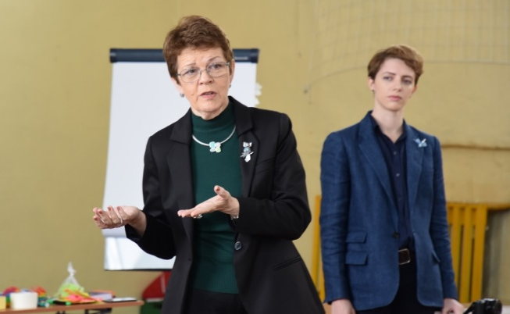
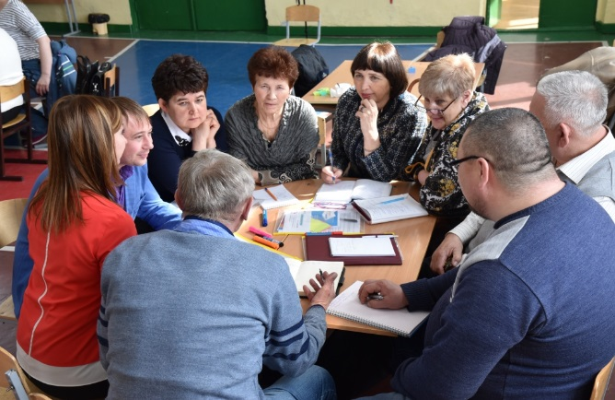
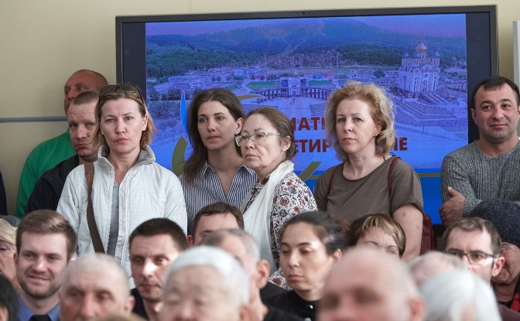
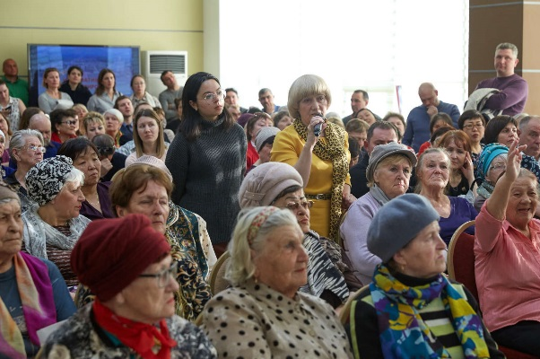
IMPLEMENTATION PHASES
Training of volunteers
Training simulates selection of project proposals
Preliminary Meetings
Community residents meet to choose 1 project proposal and
3 delegates, to present the project at the final meeting

Slide 15
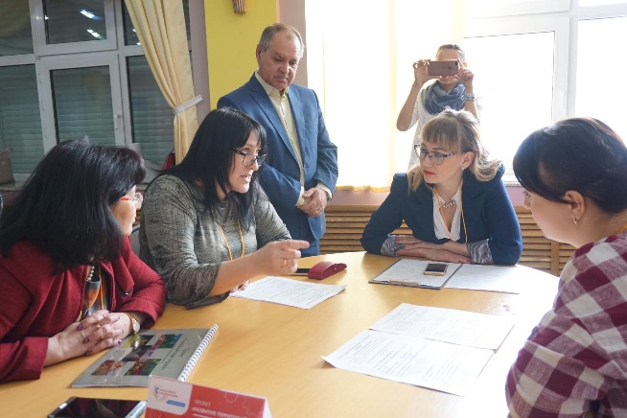
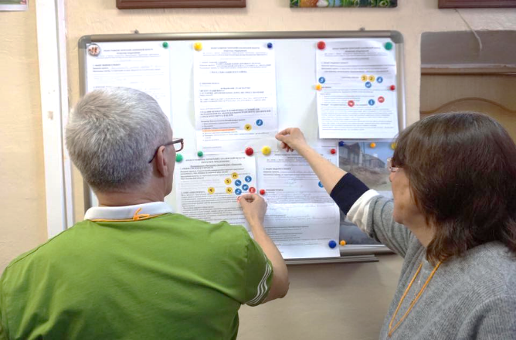
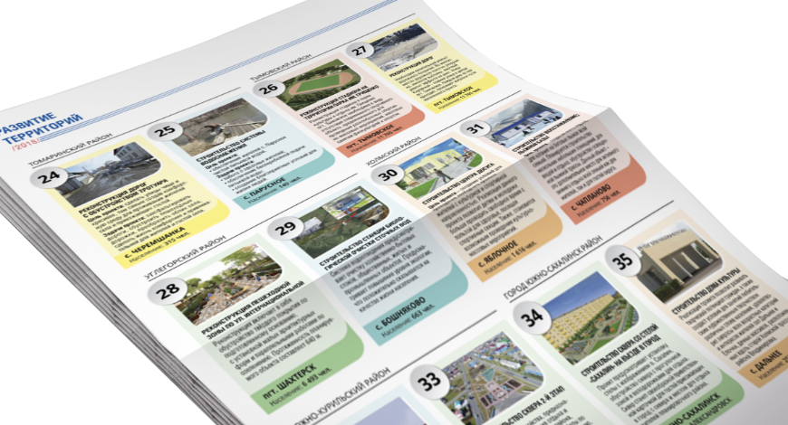
IMPLEMENTATION PHASES
Final meetings of delegates
Meetings of delegates at the urban district level choose 2 projects for participation in the oblast (region-wide) voting
Technical Review phase selects viable projects and develops a complete list of participating projects
TECHNICAL REVIEW

Slide 16
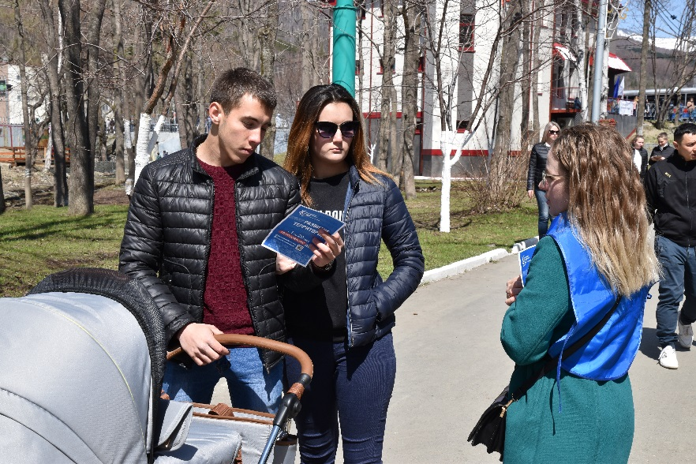
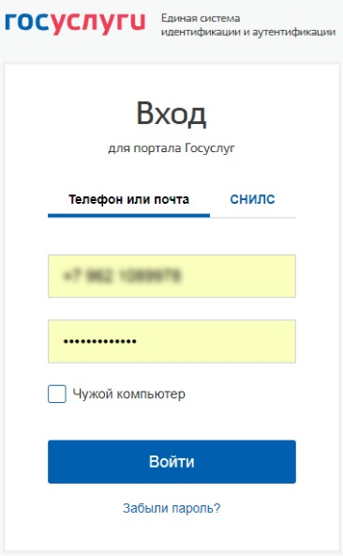
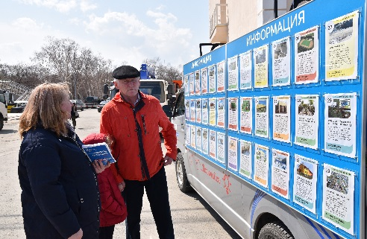
ОБЩЕОБЛАСТНОЕ votesАНИЕ
REGION-WIDE VOTING
Online voting
pib.sakhminfin.ru/vote
Selection of 2 projects
2 projects from the same urban district CANNOT be selected

Slide 17
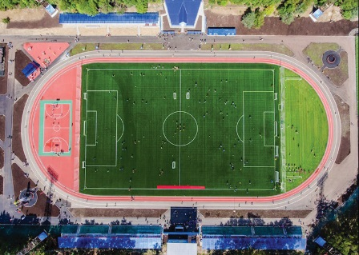
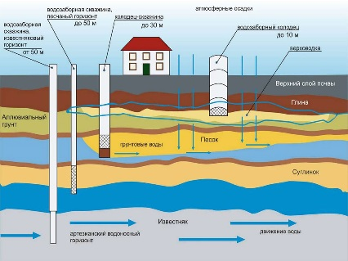
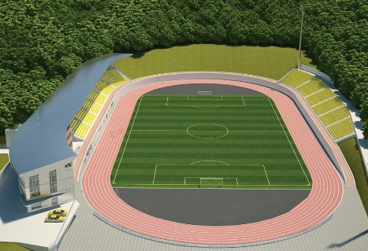
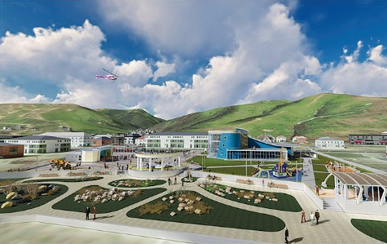
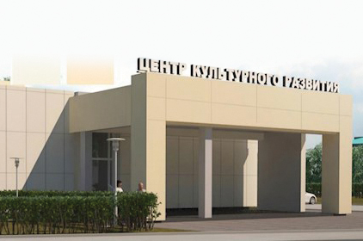
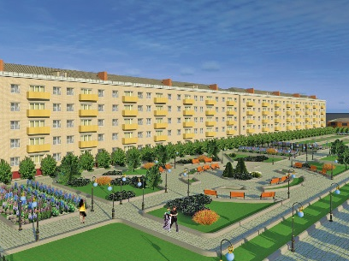
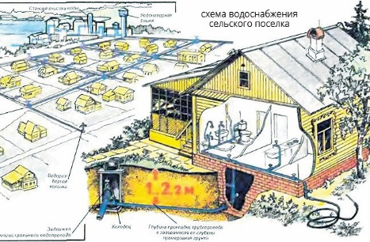
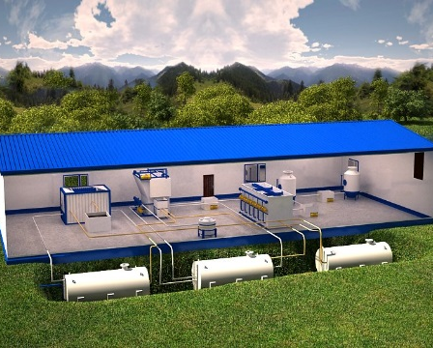
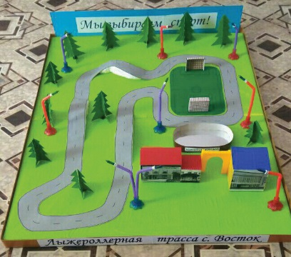
VOTING WINNERS
CHILDREN’S CAMP
Stadium
Water supply system
stadium
1943
1763
1624
1610
votes
votes
votes
votes
Recreational park
Center of cultural development
Mini Park with a monument
Water supply system
1557
1420
1270
1243
votes
votes
votes
votes
Gravity social center inclusive for disabled children
Sewage water treatment plant
Stadium with a roller ski track
1159
973
971
votes
votes
votes

Slide 18
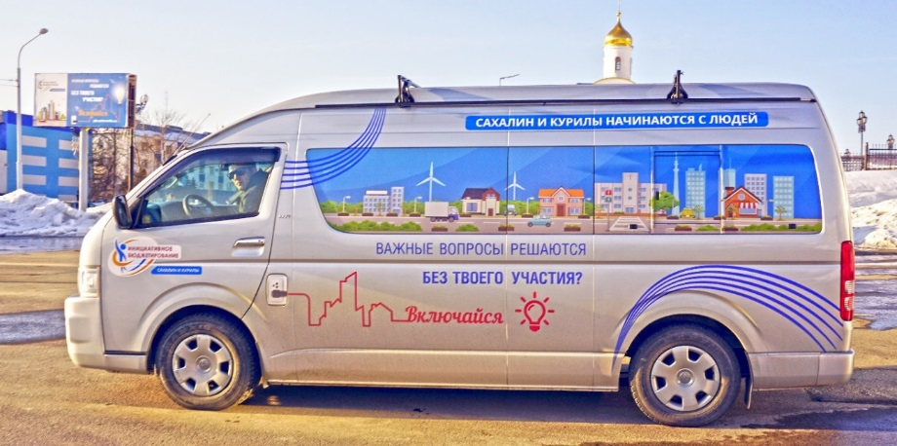
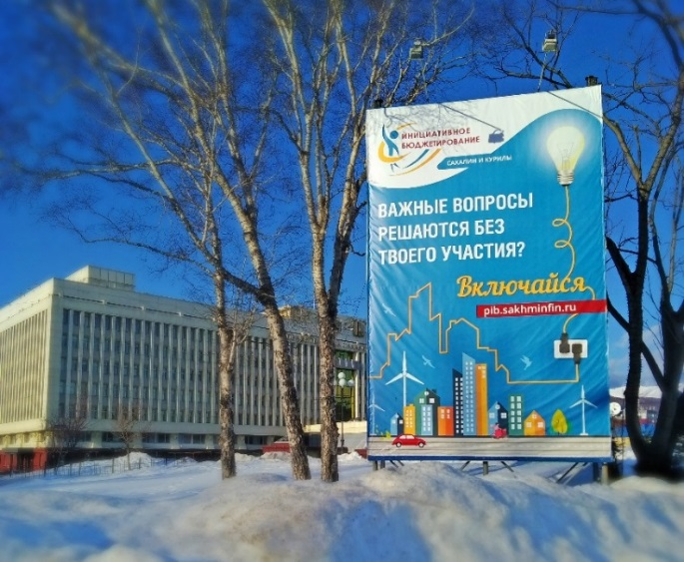
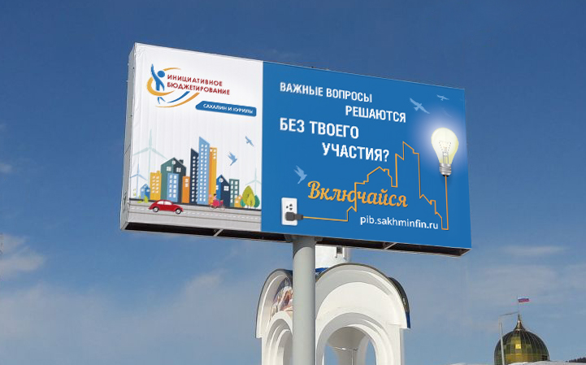
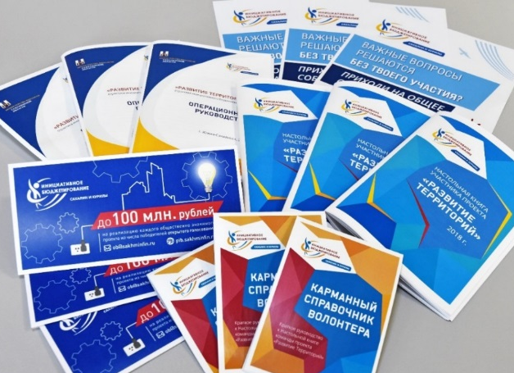
PUBLIC INFORMATION CAMPAIGN
Public information activities are supported at all phases of the program
OUTDOOR ADVERTISING BANNERS,
PRINT-OUTS, TV VIDEOS AND TALK SHOWS

Slide 19
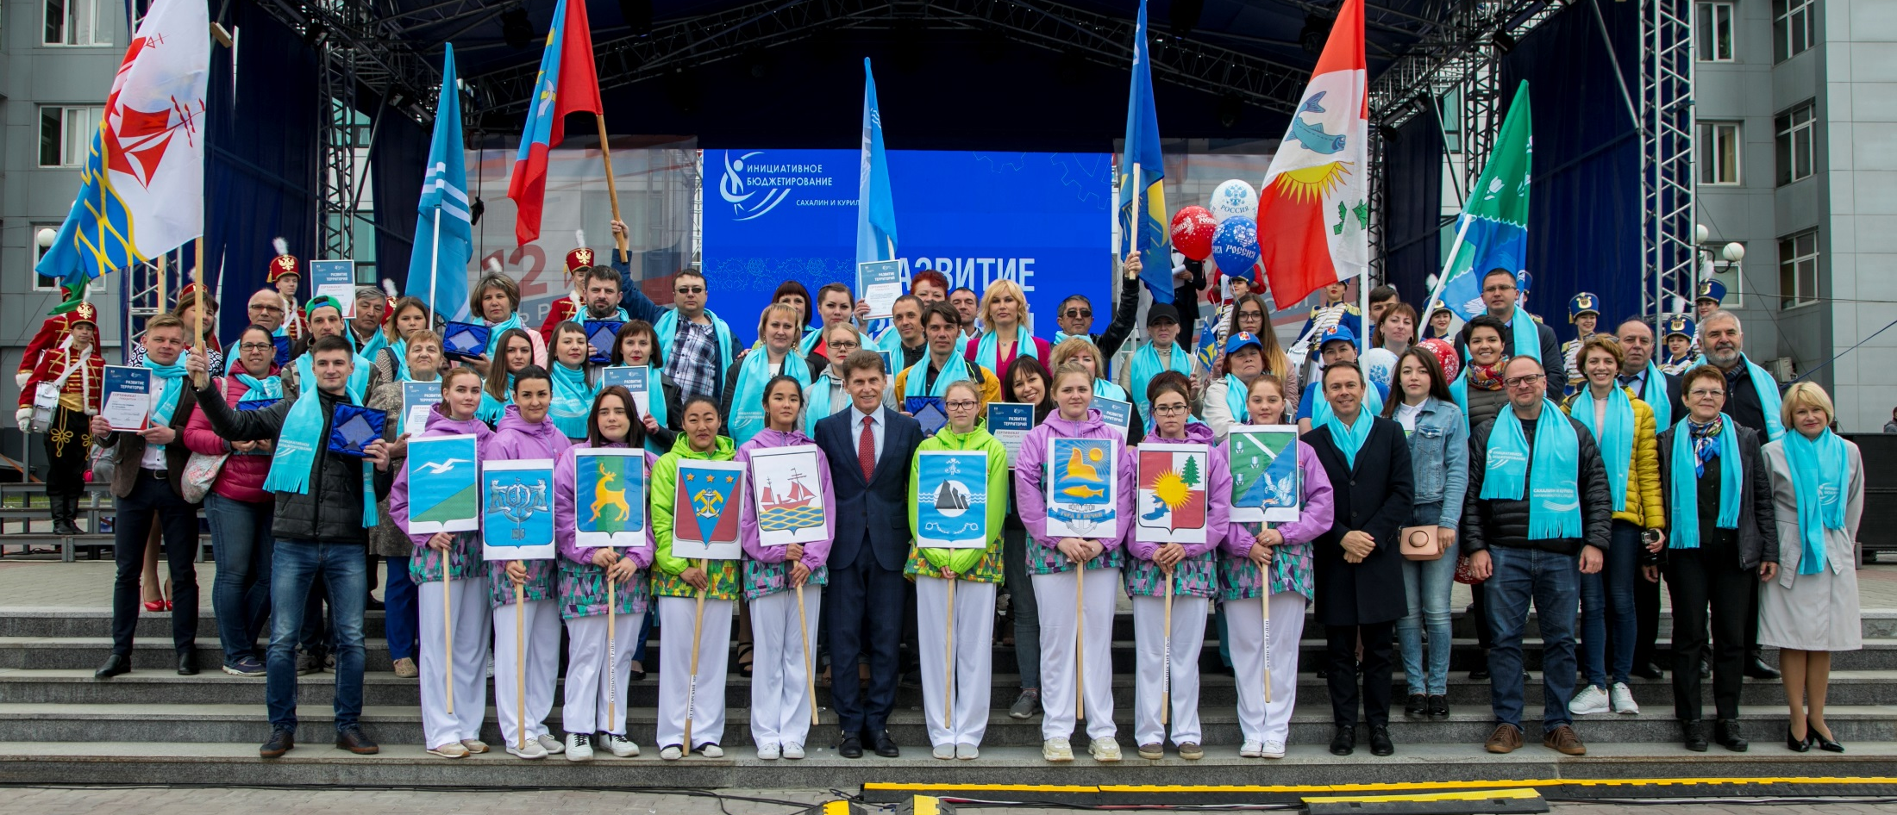
June 12
Announcement of Winners

Slide 20
YOUTH BUDGET

Slide 21
YOUTH BUDGET
Youth engagement
More than 10,000
3
high schoolers - Project participants
Million Roubles
Program Launch – 2017

Slide 22
YOUTH BUDGET
Program Launch – 2017
FOCUS:
DESIGN SPECIFIC FEATURES:
Budget literacy for students of 9 -11 grades of general secondary schools of Sakhalin Oblast/Region
Development of skills and motivation of high school students to engage in PB
Civic engagement of schoolers
Procedures are similar to those on PORT
Submission, discussion and selection of projects

Slide 23
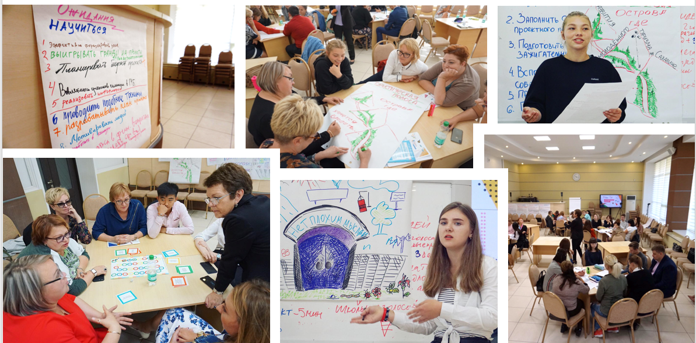
Training for Schoolchildren and Teachers

Slide 24
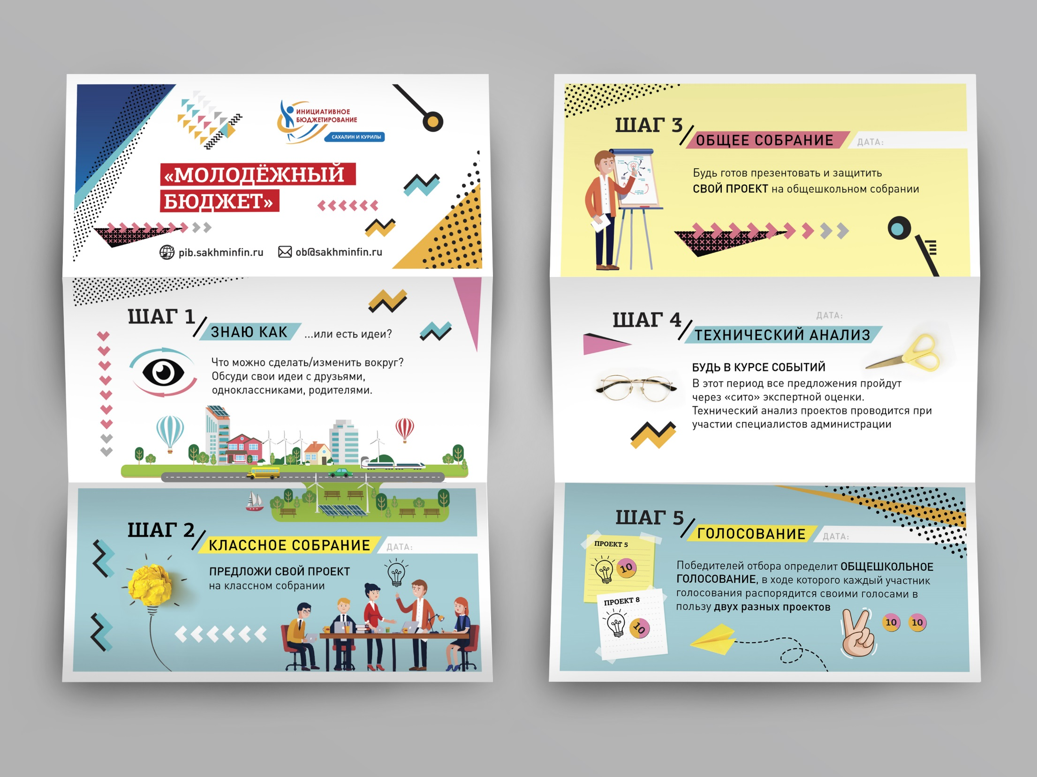

Slide 25
Challenges and Plans for the Future
CHALLENGES:
Честность и открытость процедуры votesания
Вовлечение в проекты наибольшее количество участников (увеличение охвата населения)
Электронная процедура votesания через государственный портал с верификацией участников
Медиа компания по проекту ПОРТ
Реализация выбранных населением проектов качественно и в сроки установленные правилами проектов Порт, МБ и ППМИ
Fair and transparent voting procedure
Engagement of larger number of people in project processes (enhance public coverage)
E-voting procedure through a government portal with verification of participants
Media campaign on PORT project
Implementation of projects selected by the public with high quality and within a timeline established by PORT project, Youth Budget and LISP regulations
PLANS FOR THE FUTURE:
На постоянной основе проведение тренингов и обучение участников проекта
Социологический опрос населения
В рамках проекта МБ воспитание активной жизненной позиции у подрастающего поколения.
Популяризация практик ИБ Сахалинской области (ПОРТ, МБ) на территории РФ и в мире.
Разработка новых проектов ИБ для лиц с ограниченными возможностями здоровья.
Regular training and learning of project participants
Public surveys
Development of civic advocacy among young people through participating in Youth Budget program.
Dissemination of Sakhalin PB practices (PORT and Youth Budget) in Russia and world-wide.
Development of PB practices for people with disabilities.

Slide 26
Thank you for your attention!

