Slide 1
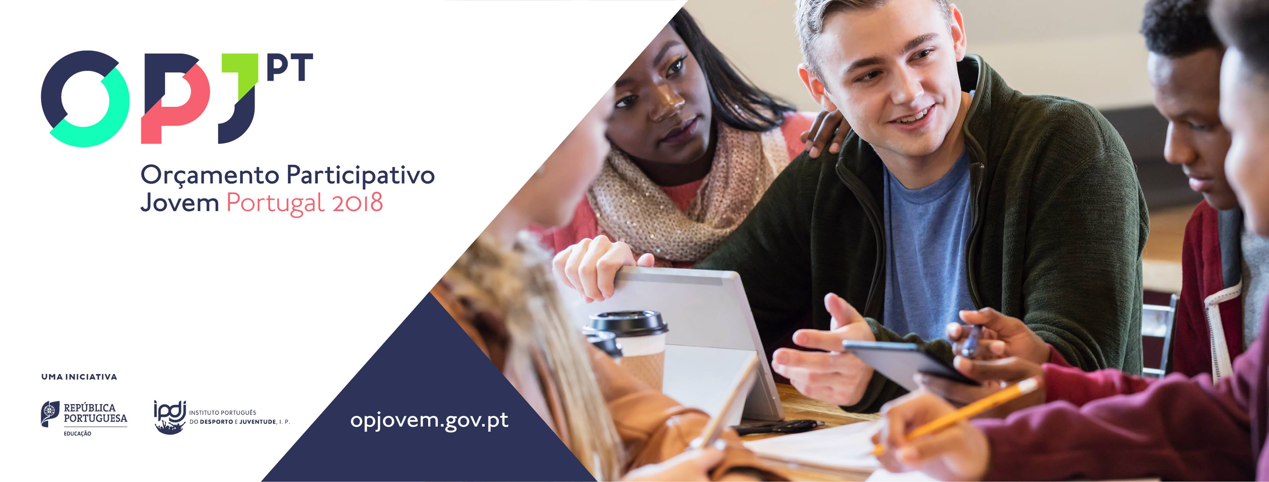
Participatory Youth Budget - Portugal

Slide 2
Central purpose: empowering youth
A process of democratic participation: young citizens can propose and vote projects that the public authorities have the responsibility to implement.
A tool to stop the progressive and growing gap between young people and public participation.
Inspired by several innovative experiences such as local participatory budgets, the Participatory Budget Portugal, as well as the Schools Participatory Budget.
This is the first national participatory budget at the national level, specifically targeted to young people, globally speaking.

Slide 3
Started in 2017, aiming to:
Improve the quality of democracy and its tools, valuing participatory democracy within the Portuguese Constitution framework;
Foster active and informed participation of young people in decision-making processes, favouring the existence of a strong and active civil society towards cohesive economic and social development;
Promote young people’s participation in the definition of the public policies that meet their needs and are responsive to their opinions;
Reinforce education for citizenship and the sense of belonging to the community, enabling responsible citizenship by making public administration closer to young people.

Slide 4
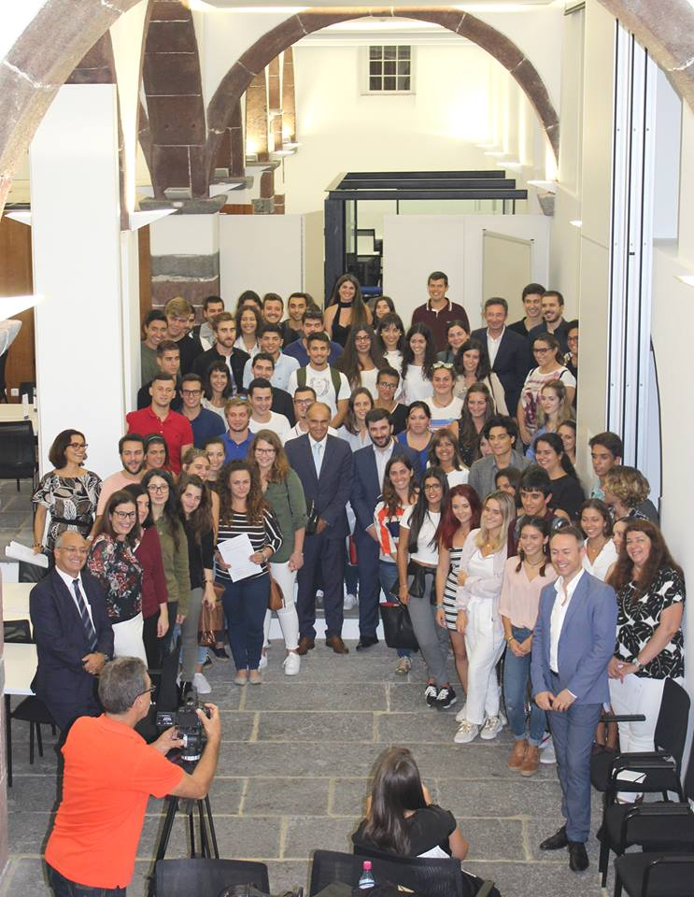
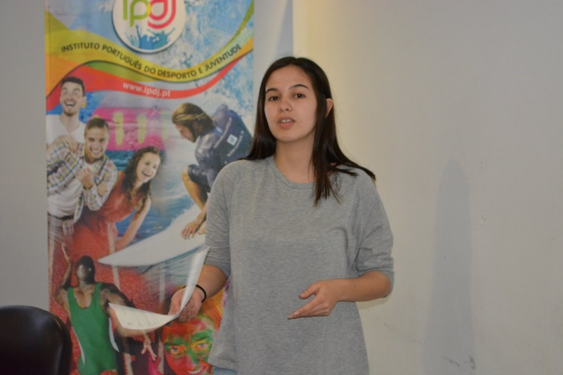
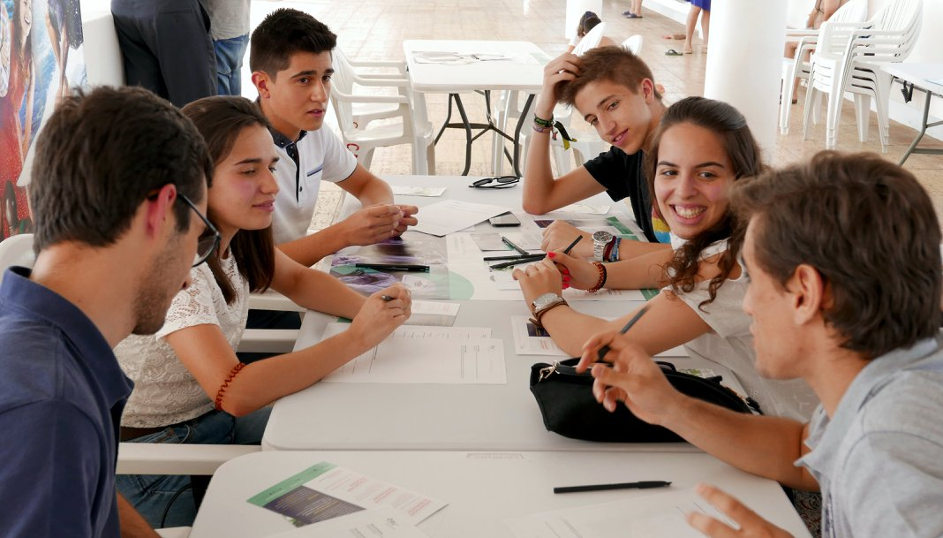
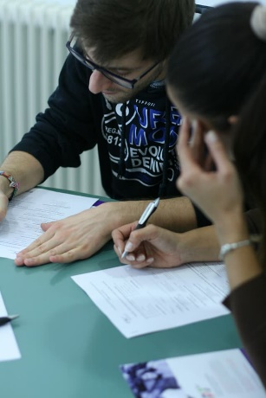
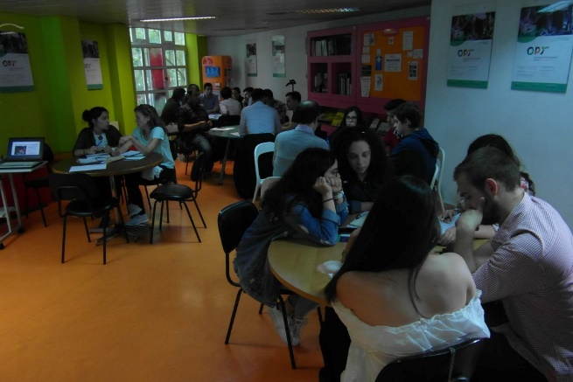
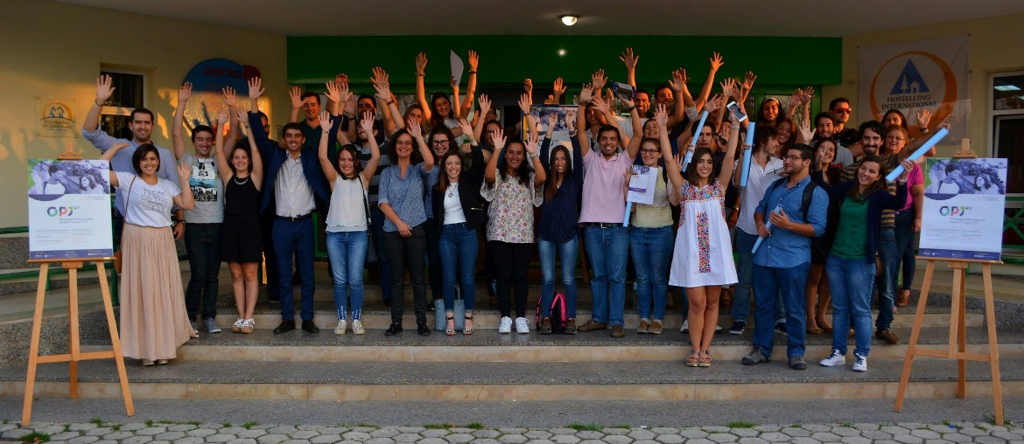
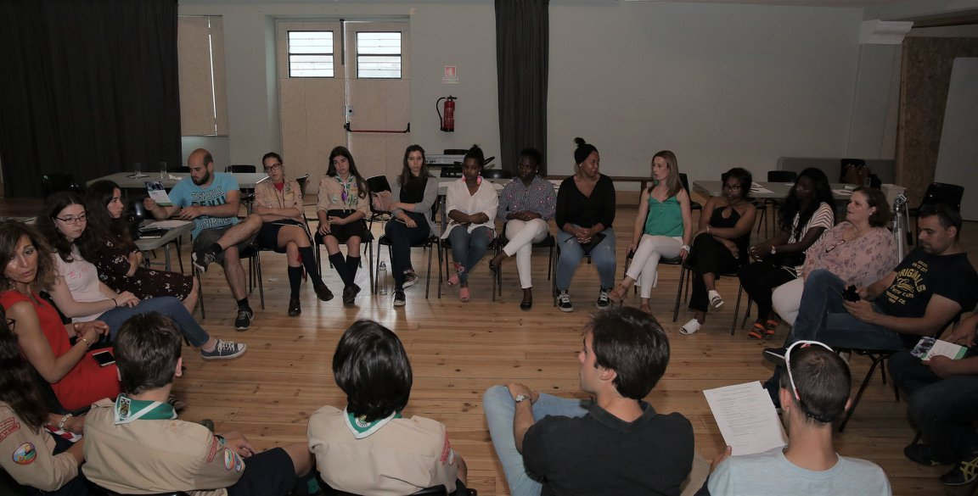
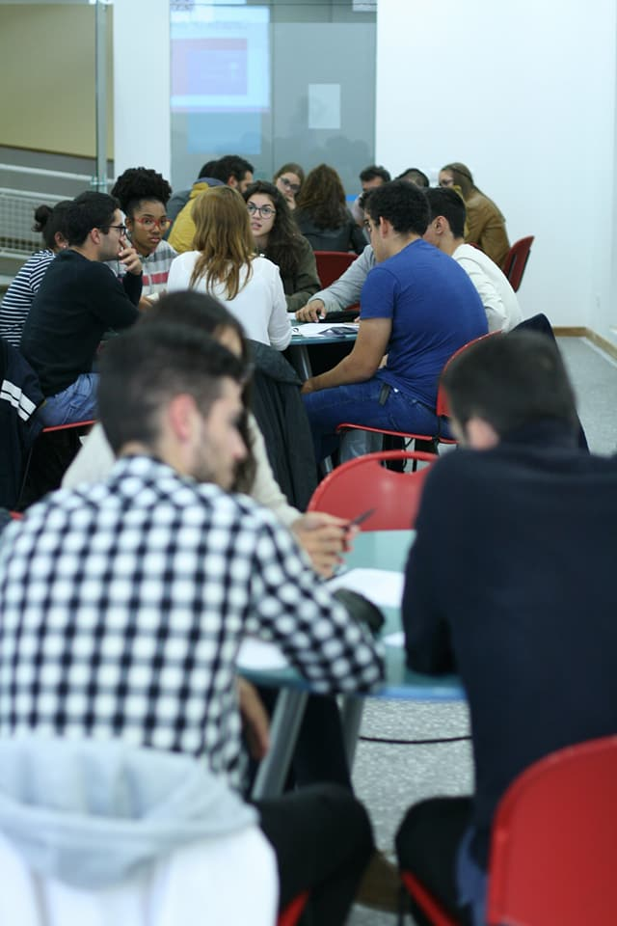
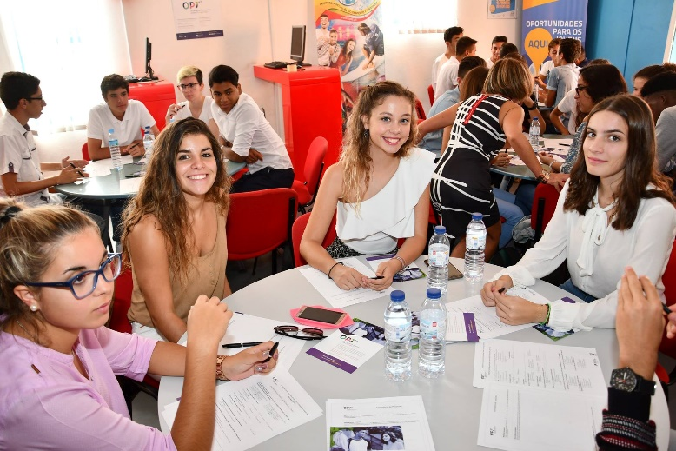
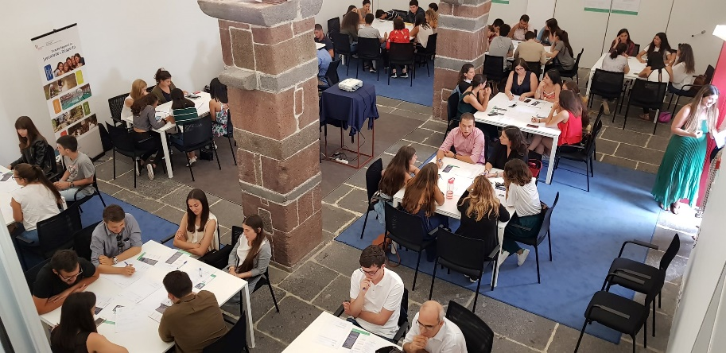
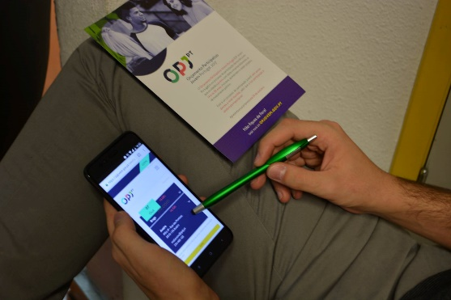

Slide 5
Methodology
A process applied in the whole national territory;
In 2018, the overall budget is € 500.000;
The proposals must respect the following criteria:
  To fit the thematic areas of cultural innovation, environmental sustainability, inclusive sport and intergenerational dialogue;
  To have a budget until the maximum ceiling of € 100.000;
  Do not require the building of new infrastructures;
  Do not ask for subsidies or involve a pre-established service supply;
  To be concrete and technically feasible;
  To benefit more than one municipality;
  Do not go against the Government´s policy, or projects and programs already in course in the different policy fields.

Slide 6
Phase I – Proposal submission
  In the website opjovem.gov.pt
  In the Participatory Meetings
  Self-organised Meetings
Phase II – Technical analysis
  By the public administration services, in the four thematic areas
Phase III - Public consultation
  The provisional list of projects to be voted was published online
Phase IV – Voting
  In the website opjovem.gov.pt or through a free of charge SMS
Phase V – Presentation of the outcomes
  In 2017, at the Lisbon Youth Center, it was an informal moment, in the scenario of na online show presented by a well-known entertainer

Slide 7
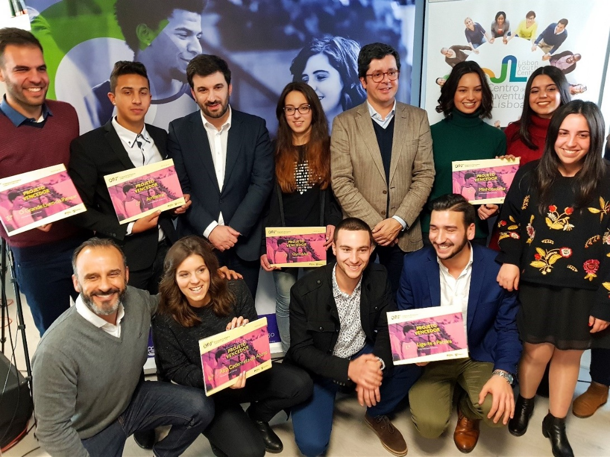
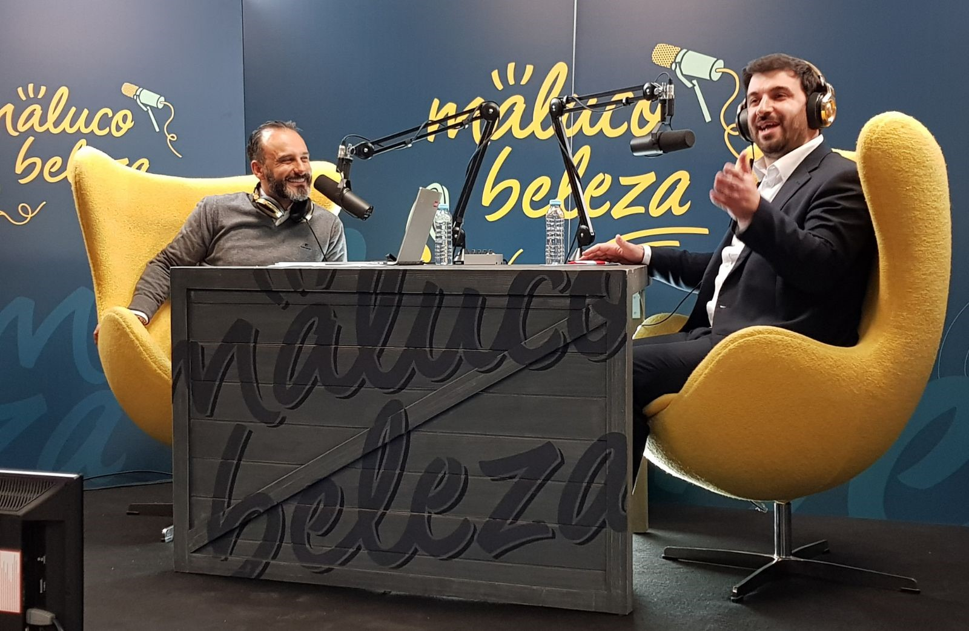
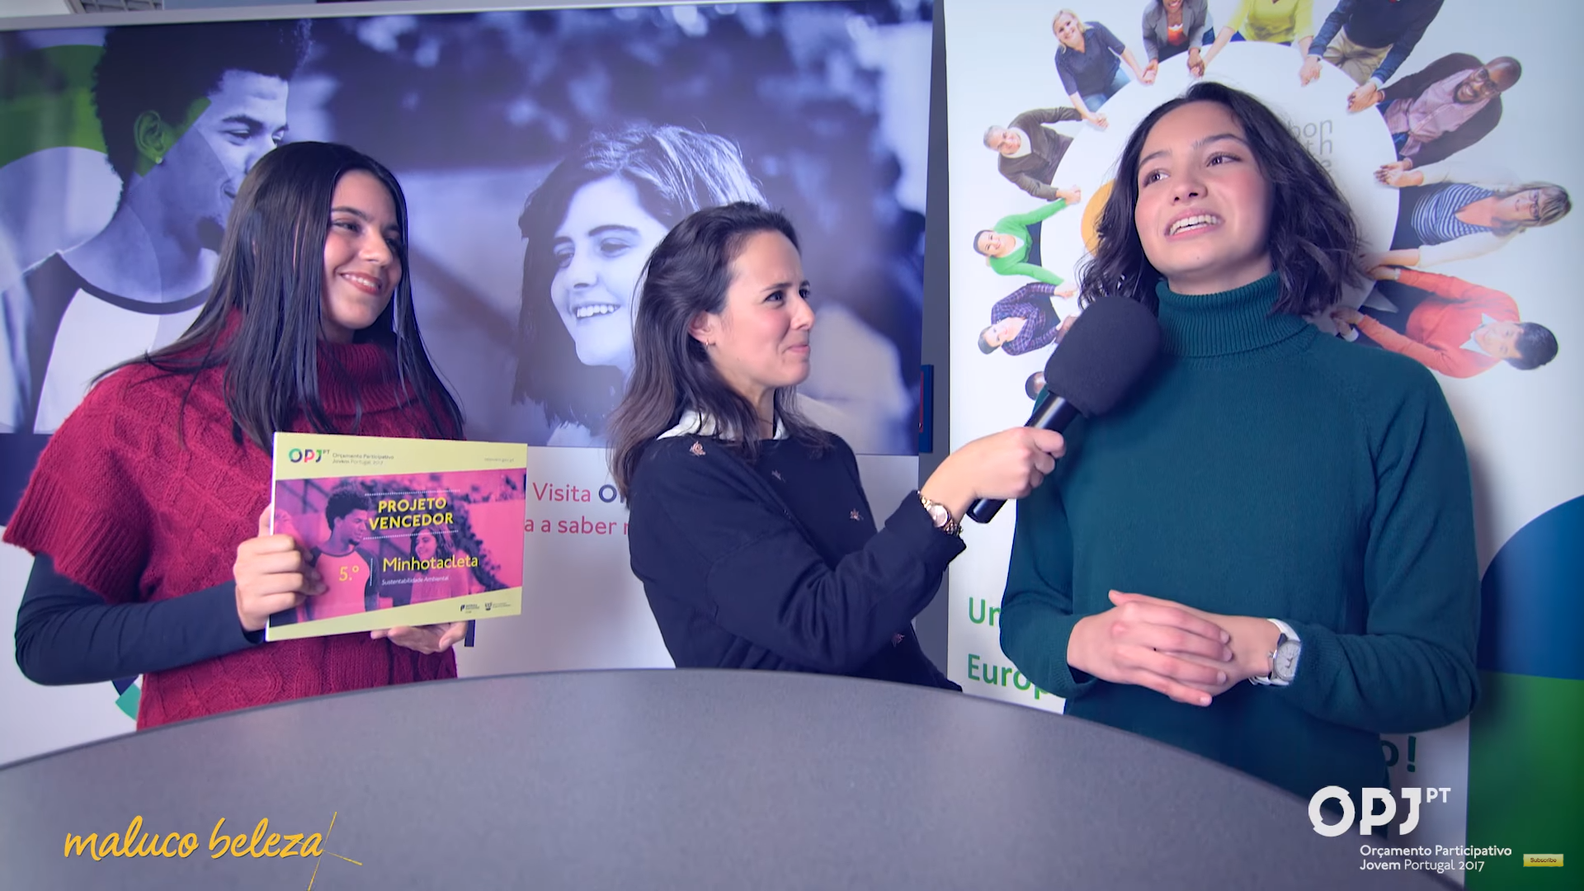

Slide 8
Some data
Overall budget
    2017: € 300.000; 2018: € 500.000
Maximum ceiling for proposal
  2017: € 75.000; 2018: € 100.000
Participatory Meetings
  + 20, in 2017; + 50, in 2018
Projects
    169, in 2017; 392, in 2018
    1st edition: 7 winner projects (3 on environmental sustainability, 2 on inclusive sport and 2 on science education)
Voting
  10.000 participants (2017)
  The winner projects summed 4.000 votes
  2018: ongoing

Slide 9
From listening to sharing
In the 21st century, youth policies must be responsible not only for assuring better lives for young people in the present moment but also to anticipate the future and contribute for building a better world, which can only happen when we learn, as a society, to capitalize the transformative energy of youth.

Slide 10
Thank you!
Cascais, 16th October 2018
Paulo Tomaz
Adviser to the Secretary of State for Youth and Sport
Ministry of Education
paulo.tomaz@medu.gov.pt

