Slide 1
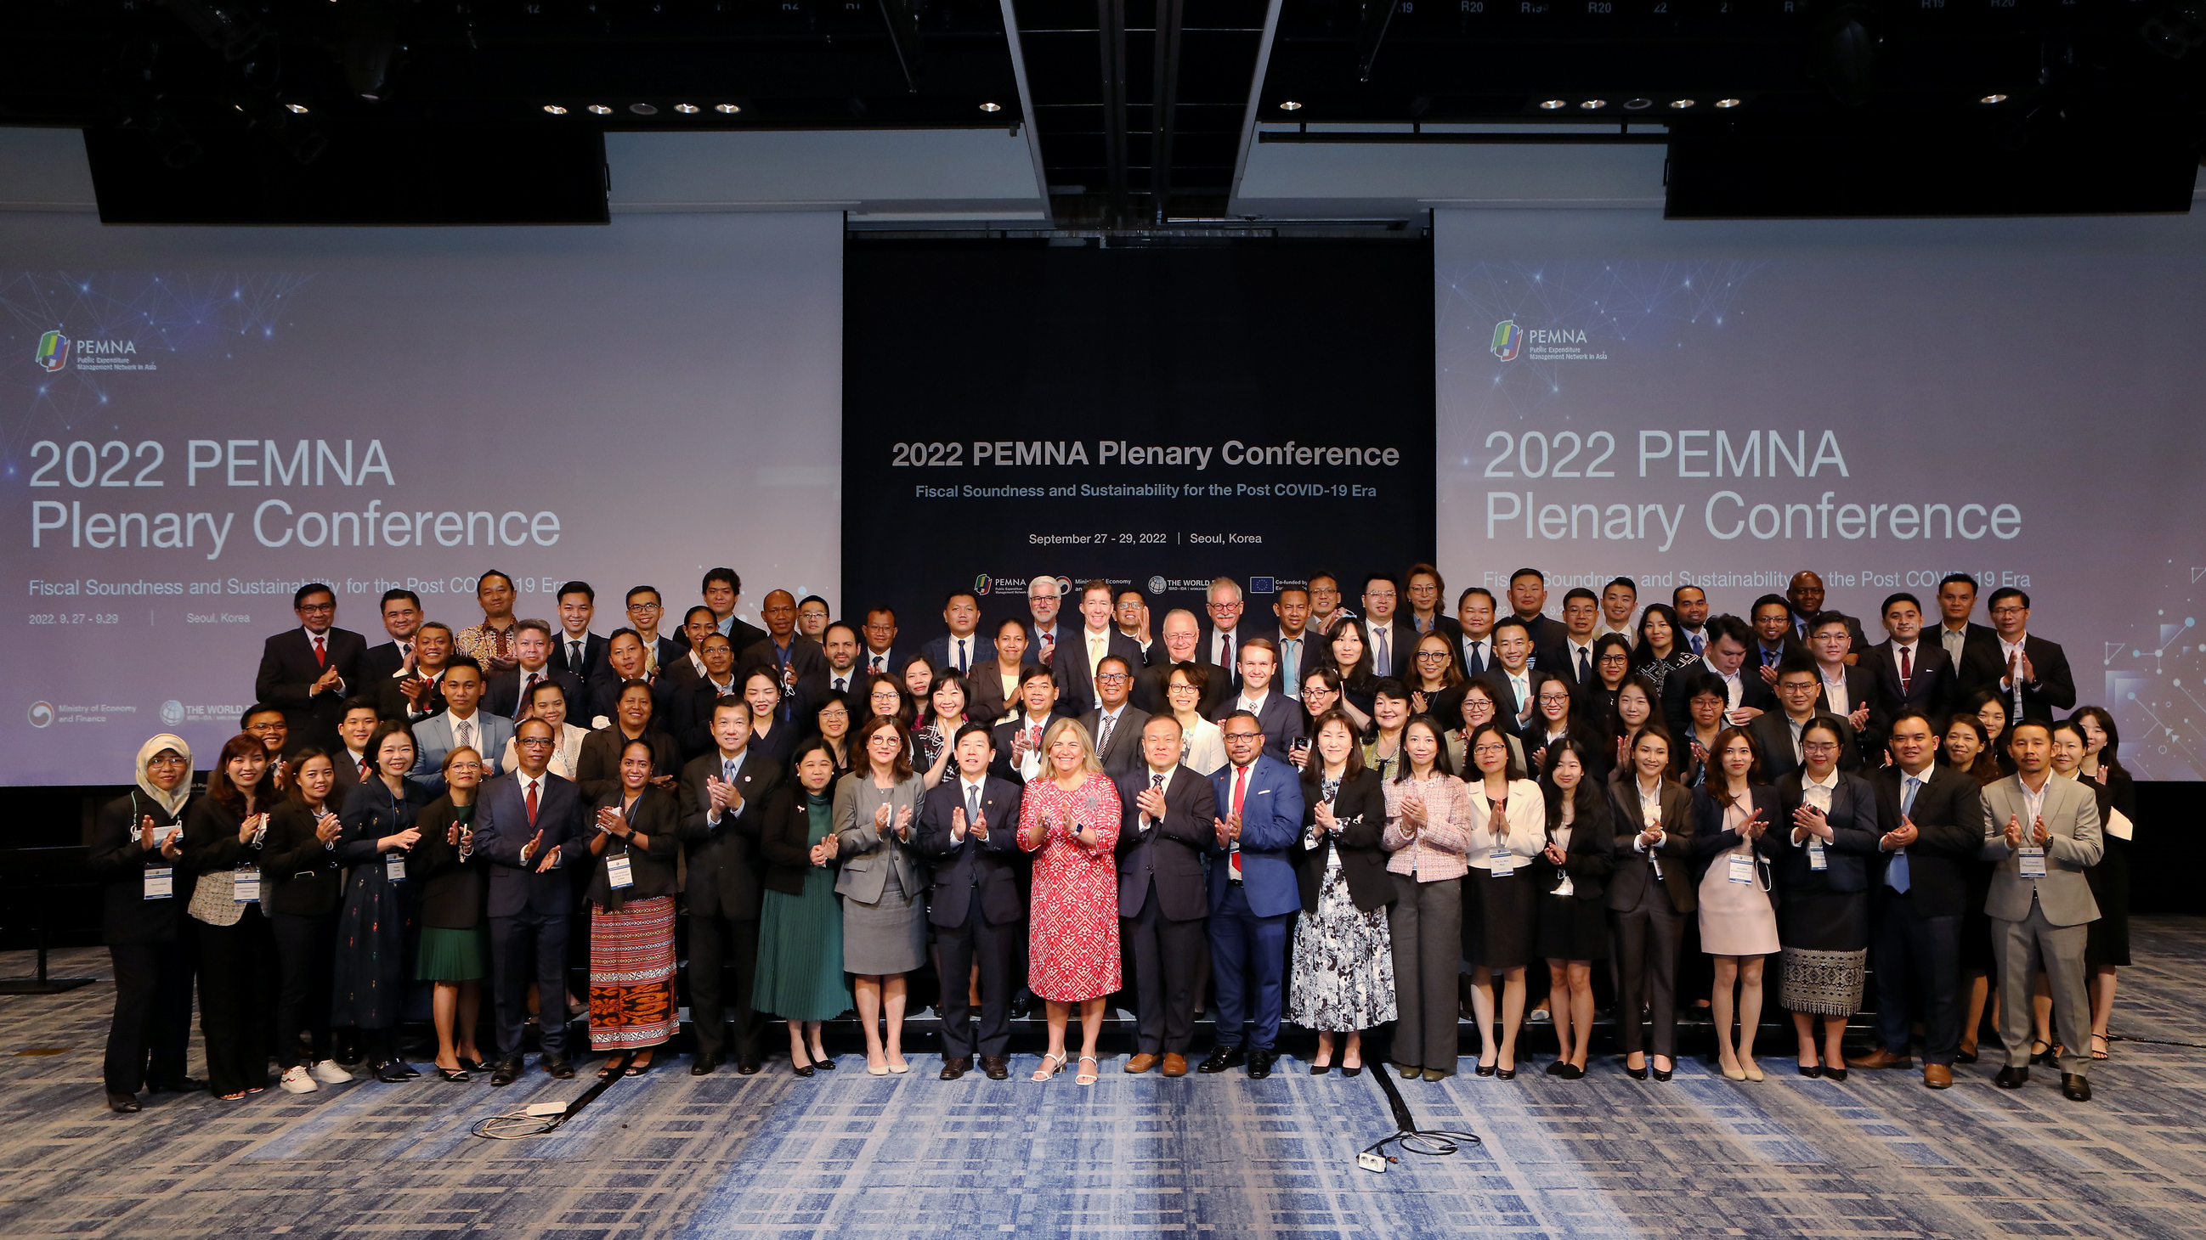
PEMNA
Public Expenditure Management Network in Asia

Slide 2
Table of Contents
The Public Expenditure Management Network in Asia
1
ABOUT PEMNA
2
PEMNA ACTIVITIES
3
PEMNA TREASURY-COP
4
PEMNA-PEMPAL EXCHANGES

Slide 3
Public Expenditure Management Network in Asia
About PEMNA
Peer-Learning Network of PFM officials in the Asia Region
Established in 2012, the network aims to strengthen the efficiency, effectiveness, and transparency of PFM systems in the region by helping individual officials to better understand the attributes of a sound PFM system.

Slide 4
Public Expenditure Management Network in Asia
14 Member Countries
Brunei
Cambodia
China
Indonesia
Korea
Lao PDR
Malaysia
Mongolia
Myanmar
Philippines
Singapore
Thailand
Timor-Leste
Vietnam

Slide 5
Public Expenditure Management Network in Asia
PEMNA Structure
Steering Committee
CoP Chair
CoP Chair
B-CoP
T-CoP
Facilitator
Leadership
Team
Facilitator
Leadership
Team
PEMNA Secretariat
Task Team Leader

Slide 6
The Public Expenditure Management Network in Asia
PEMNA Development Partners
PEMNA MDTF Donors

Slide 7
Korean Government Affiliated Research Institute
Korea Institute of Public Finance
Knowledge & Ideas for a Prosperous Future
Founded in July 1992 as the only national research institute in the areas of tax and public finance, KIPF has raised nation’s status to a higher level through numerous research and studies. KIPF has also worked closely with international organizations (OECD, IMF, World Bank, IDB, ADB, AMRO, and IPSASB).
362 employees
Tax Policy
Fiscal Policy
Government
Accounting
State-Owned
Enterprises
Performance
Evaluation

Slide 8
Public Expenditure Management Network in Asia
PEMNA Secretariat
Provide administrative and logistical support
Conduct monitoring and evaluation of PEMNA activities
Prepare an annual work plan
Facilitate communication between PEMNA members
Conduct research on PFM issues
The center of the network operation
Head of the Secretariat and
6 Program Officers
* Visit the PEMNA Website for more information.

Slide 9
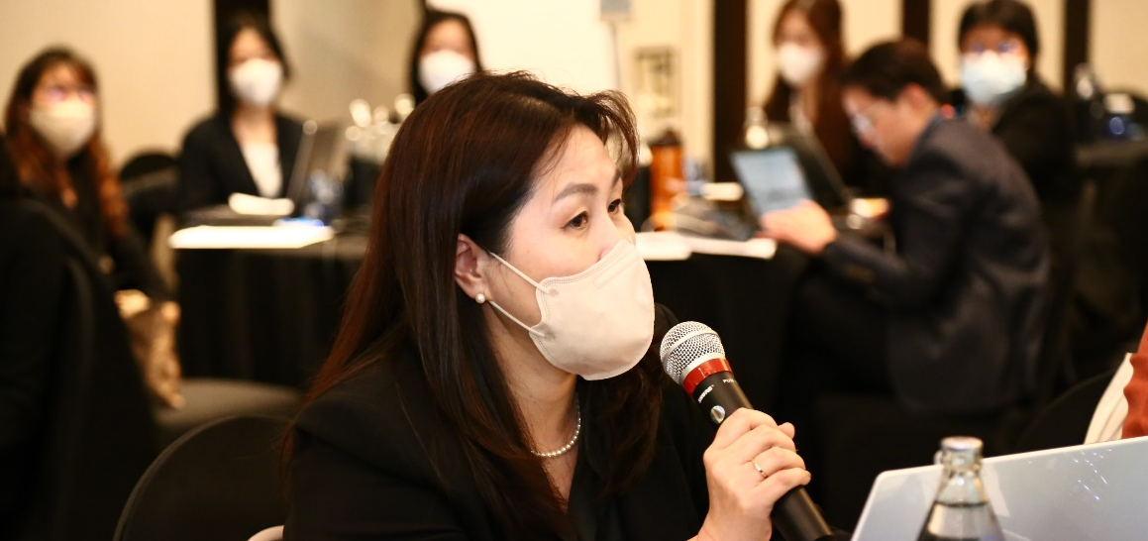
Public Expenditure Management Network in Asia
PEMNA Secretariat
Head of the Secretariat
Overall Operation
Financial Management
Senior Program Officer
Senior Program Officer
Jae Young Lee
Lloyd S. Choi
Kyoungsun Heo
Senior Program Officer
Senior Program Officer
Senior Program Officer
Treasury CoP
Budget CoP
Program Officer
Program Officer
Rufio, Yi-joo Kim
Youngmi Lee
Communication
Study Visit
Senior Program Officer
Senior Program Officer
Senior Program Officer
Program Officer
Program Officer
Jamie, Dohyun Park
Seunghyun Han

Slide 10
Public Expenditure Management Network in Asia
PEMNA Activities
Peer Learning Activities
Research & Advisory Services Program
Communication, Reporting and M&E

Slide 11
Public Expenditure Management Network in Asia
PEMNA T-CoP Activities
in 10 different
member countries
35
11
PLENARY CONFERENCE
35
19
COP MEETINGS
5
STUDY VISITS

Slide 12
Public Expenditure Management Network in Asia
PEMNA T-CoP Activities
Date | Name | Location | Topic
2019.3.6-7 | T-CoP Meeting | Seoul, Korea | Digital Transformation in Government Treasuries in East Asia - Trends and Opportunities
2019.5.22-24 | 2019 Plenary Conference | Quang Ninh, Vietnam | Budget restructuring and public debt management for national financial prudence and sustainability
2019.10.1-3 | T-CoP Meeting | Moscow, Russia | Russian Treasury - PEMNA Knowledge Exchange in Public Finance Management
2020.6.3 | T-CoP Meeting | Webinar | Impact of COVID-19 on the Core Functions of Treasury and the Governments’ Responses
2020.12.17-18 | 2020 Plenary Conference | Webinar | Enhancing the effectiveness and sustainability of public finance to COVID-19
2021.4.28 | T-CoP Meeting | Webinar | Cash management with a focus on the impact of COVID-19 on cash flows and liabilities
2021.9.8-9 | 2021 Plenary Conference | Webinar | Sustainable and resilient capital expenditures for a post-COVID recovery
2021.11.30 | T-CoP Meeting | Webinar | Fixed Asset Management, Valuation and Registries
2022.2.16 | T-CoP Meeting | Webinar | Korea’s Public Asset Management
2022.9.27-29 | 2022 Plenary Conference | Seoul, Korea | Fiscal Soundness and Sustainability for the Post COVID-19 Era
2023.1.18-19 | T-CoP Meeting | Bangkok, Thailand | Making the Treasury More Efficient and Accountable to Enhance Service Delivery

Slide 13
Public Expenditure Management Network in Asia
PEMNA T-CoP Activities
TOPICS | COUNTRIES
Public Asset Management | Korea, Malaysia, Philippines
Cash Management | Indonesia, Korea, Philippines
Modernization of Treasury | Mongolia, Philippines
Transition from Cash to Accrual Accounting | Indonesia, Korea, Malaysia
Integrated Financial Management Information System (IFMIS) | Indonesia, Korea, Vietnam

Slide 14
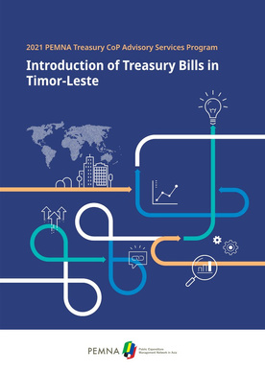
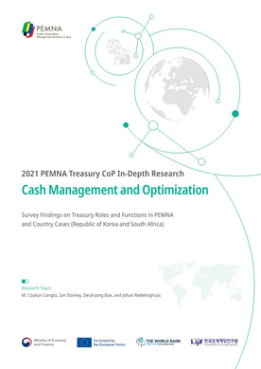
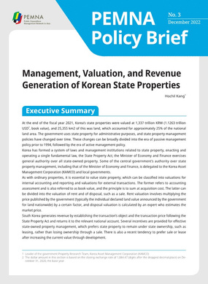
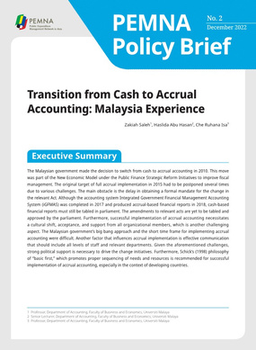
Public Expenditure Management Network in Asia
PEMNA T-CoP Activities Phase 2
Advisory Services Program
Research Activities
In-Depth Research
Policy Brief
Introduction of Treasury Bills
in Timor-Leste
Cash Management and Optimization
Transition from Cash to Accrual Accounting (2021); Management, Valuation, and Revenue Generation of Korean State Properties (2022)

Slide 15
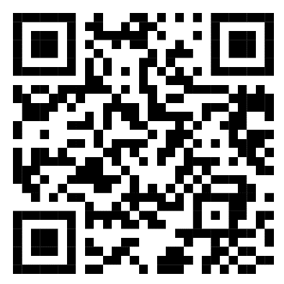
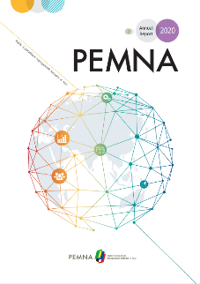
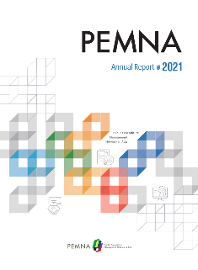
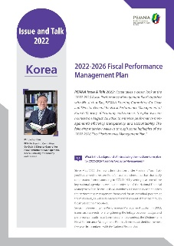
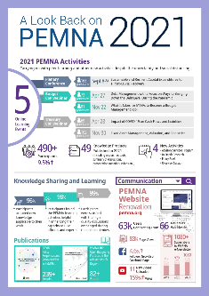
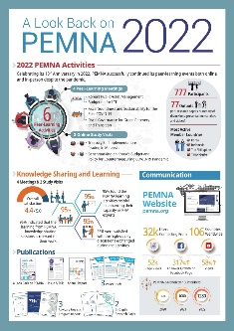
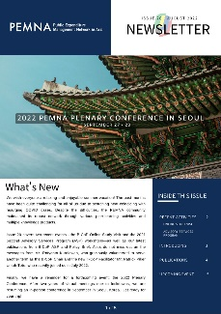
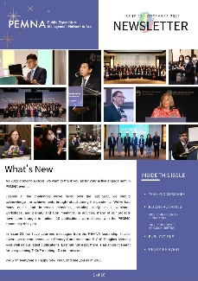
Public Expenditure Management Network in Asia
PEMNA Communications
PEMNA Website (www.pemna.org)
Annual Report
Issue & Talk
A Look Back on PEMNA
e-Newsletter

Slide 16
Public Expenditure Management Network in Asia
PEMNA T-CoP-PEMPAL Exchanges
2020.6.24
2019.12.3
PEMPAL Treasury CoP VC
The Federal Treasury of Switzerland: Overview of the Organization and Approach to Cash Management and Liquidity Planning
2020.11.19
2023.5.23
PEMPAL Treasury CoP VC
Turkish Approach to Setting and Managing Liquidity Buffers
PEMPAL Treasury CoP VC
Albanian Integrated Financial Management Information System
PEMPAL T-CoP Annual Plenary Meeting
Evolution of the role and functions of the Treasury
2019
2020
2023
2019.10.1
2020.2.27
2020.9.15
2023.1.18.
PEMNA T-CoP
Moscow Meeting
Russian Treasury - PEMNA Knowledge Exchange in Public Finance Management
PEMPAL Treasury CoP VC
Albanian Experience in Clearing Government Expenditures Arrears and Improving Commitment Controls
PEMPAL Treasury CoP VC
Kazakhstan Treasury's Structure, Role and Functions
PEMNA T-CoP Bangkok Meeting
Making the Treasury More Efficient and Accountable to Enhance Service Delivery

Slide 17
Public Expenditure Management Network in Asia
2023 PEMNA T-CoP Work Plan
2023 PEMNA T-CoP Meeting
July 19-21, 2023 | Manila, the Philippines
Adapting to Change: Managing Fiscal and Disaster Risks in a Digital World
2023 PEMNA Plenary Conference
November 7-9, 2023 | Lao PDR
Topic: TBD

Slide 18
The Public Expenditure Management Network in Asia
PEMNA 10TH Anniversary Video

Slide 19
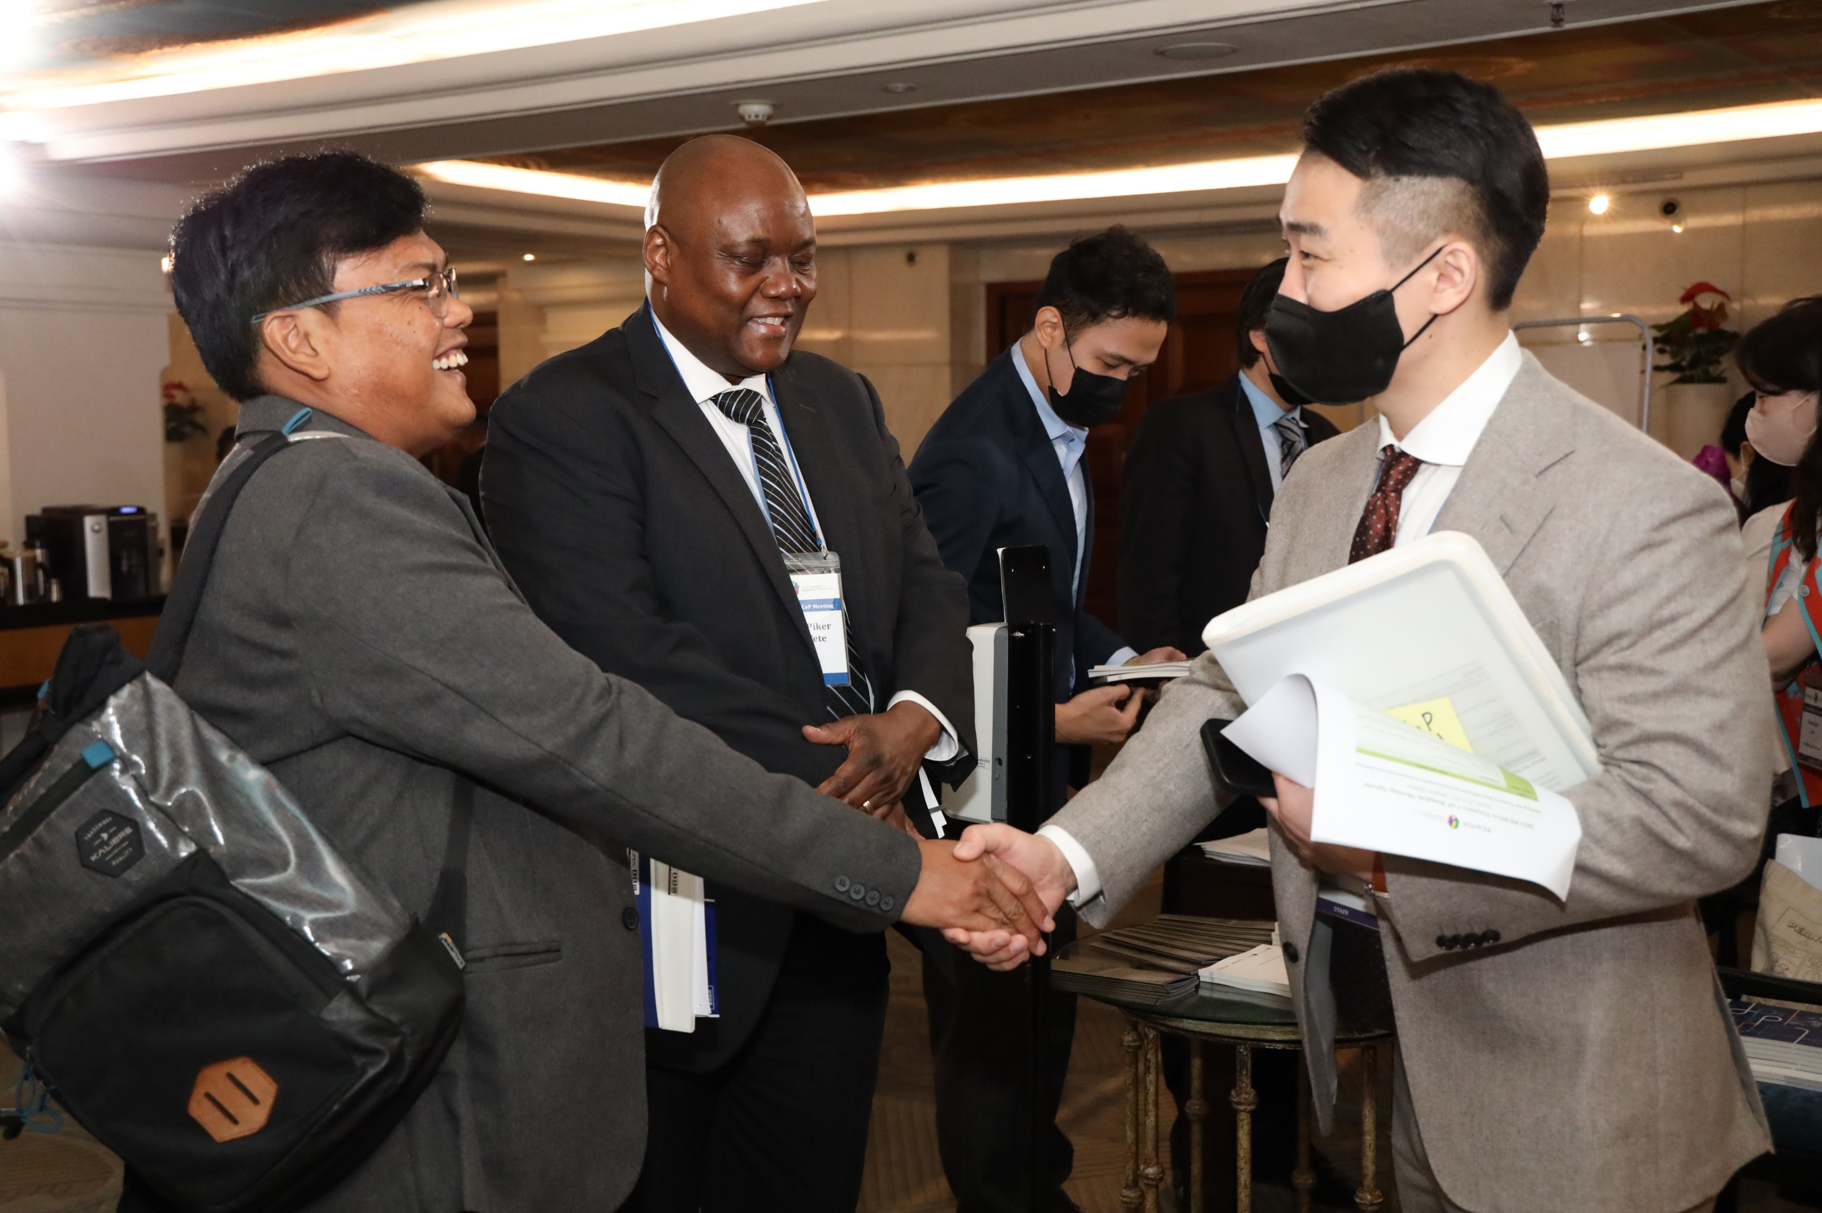
Thank You
Website
Number
E-mail
www.pemna.org
+82-44-414-2389
pemnasec@kipf.re.kr

