Slide 1
Targeting the Cash Balance: the Cash Buffer
PEMPAL Treasury Community of Practice
Cash Management Thematic Group Meeting
Ankara
March 2016
Mike Williams
mike.williams@mj-w.net

Slide 2
Outline
The Cash Buffer
  What it is and why we need it
Determining the buffer
  The importance of forecasting
  The transaction buffer and the precautionary (safety) buffer
International examples
The buffer and other surpluses

Slide 3
Why do we need a Cash Buffer?
What is the Cash Buffer?
  “The minimum level of cash balances to be sure of meeting day to day cash requirements, at all times, under all circumstances, taking into account the availability of other liquid resources”
Why do we need it?
  To meet day to day volatility
  To cope with forecasting errors
  To tide over times of financial stress or crisis

Slide 4
New Risks
Need for cash buffers long understood: but the Financial Crisis drew attention to
  Risk that domestic markets (not only FX markets) can dry up
    Liquidity risk; activity in the interbank (especially) and repo markets fell
  Several countries increased their cash buffer (esp in Europe)
  Recognised importance of a “financing continuity plan”
    Cash buffers are part but only part of this
Note: cash buffer is separate from structural surpluses
  Cash managers control cash or investments needed in the short-term [less than 3 months?]
  Any excess should be managed separately – see later
  May still be cost-effective to borrow to manage cash volatility (and wider benefits to money market)

Slide 5
Cash Flows and Cash Balances
Effective cash management requires managing both flows and balances
Cash flow management asks…
  During each period, how much cash do we have coming in and going out?
  How can we smooth the flows, at the same time meeting our cash balance target?
Cash balance management asks…
  What actions do we take to ensure that we have the right amount of cash at hand?
  How do we put temporary surpluses to good use?
Governments need access to liquidity – implies some cash balances
  We need to identify the minimum

Slide 6
Identifying the Cash Buffer

Slide 7
What Determines the Cash Buffer?
1. The volatility of daily cash flows
2. The ability to forecast those cash flows and respond to the forecasts
  Standard deviation of errors in the forecast will [should] be much less than standard deviation of outturn
  How far can we smooth flows even if we forecast them perfectly
3. The scope to manage unanticipated fluctuations and the timescale over which they can be managed
  How soon can additional Tbills be issued?
4. Safety nets
  Cash buffer; or other cash reserve funds
  Emergency credit facilities
  End of day borrowing from commercial banks
  Short-term borrowing from central bank, where it is available
Note: a large cash buffer is expensive (cost of carry); but if there are limited safety nets available, cost of carry is less important than maintaining the minimum buffer

Slide 8
The Usefulness of Historical Volatility
If historical daily volatility is known, able to calculate relationship between size of buffer and chance that cash will always be sufficient.
  Example: buffer to give e.g. 99% confidence level that balance will not fall below zero over a month.* But:
    Underlying distributions, of flows or forecast errors are not normal
    Expect negative serial correlation (errors offset within the month – tax receipts or transfer payments may be delayed by a day, but still happen)
    Is there a way of dealing with the residual 1%? Do we worry about black swans?
Possible to develop probabilistic models relating the optimal cash balance to the interest rate differentials (on overdraft or funding rate compared to the rate on cash balances). Measures cost of caution. But again assumes:
  Normally distributed errors
  Overdraft borrowing is available and acceptable
* Multiply daily standard deviation (StDev) by [square route of number of days in month]*[value of normal distribution at a 2% confidence level (1% for each tail)] = StDev*(22^0.5)*2.33 = StDev*11

Slide 9
The Value of Forecasting
With a good forecast possible to plan a smoothing strategy
  Borrowing (Tbills) and investment
If forecasts are “perfect” and Tbill market sufficiently liquid no need for any cash buffer
The better the forecasts, the less the buffer

Slide 10
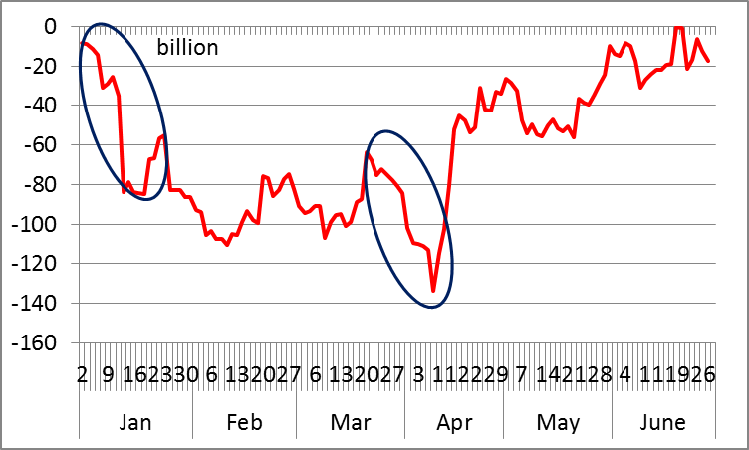
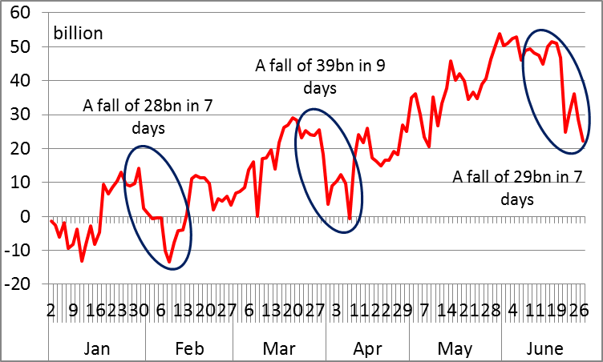
Example: Importance of Forecasts
Actual cumulative cash flow: fall of 80 billion in a short period
Cash flow forecasts: accumulated error in a short period suggests that 30 billion would be sufficient
Note: if it is not possible to respond to forecasts, then underlying volatility remains relevant – if Tbills issued weekly, likely still to be volatility within the week (unless repo is available)

Slide 11
Impact of Forecast Errors
Standard deviation of the errors in the forecast << standard deviation of the outturn
  but they will not be zero
  It is the cumulative error that is important
Identify: the maximum unanticipated fall in the cash balance over any period where intervention is no longer practical
  In this context, the timescale over which unanticipated fluctuations can be managed is important.
  In countries that issue Tbills regularly that is probably between 1-2 weeks
Concept of transactions buffer

Slide 12
Transaction Buffer: Illustration
Deterioration 5.8 bn over 6 days
Buffer = Cumulative forecast error over reaction period, plus precautionary balance
Deterioration 4.9 bn over 4 days

Slide 13
Other Example...

Slide 14
Focus on Cumulative Errors
October: cumulative negative error at start of month – 29,000 over 7 days.
June: at end of month, cumulative error 37,000 over 5 days. But linked with rescheduled bond sale. To the extent that decision was made earlier, no problem.
September v. volatile. Positive error mid month, linked with bond auctions and a tax receipt, reversed itself, then deterioration 30,000 at end month
Suggests minimum balance c.30-40,000 [plus reserve] – needs more analysis

Slide 15
Safety Buffer
Options
  Maximum amount of financing needed if the capital market was disrupted for [1-2] months and no bond issuance could take place in that month
  Some countries allow explicitly for a failed government securities auction
Transactions and safety tranches have some parallels in motives traditionally identified for holding cash, i.e. the transactions and precautionary motives

Slide 16
Cash Buffers in Practice
Several northern European countries operate with cash balances in the central bank << 0.1% annual central government expenditure
  But they have liquid money markets, sophisticated active cash management. Some plan to be long of cash and on-lend only when position is secure
  Drying up of liquidity in financial crisis led some to be more cautious
Some other approaches – the importance of signalling prudence:
  Target balance calculated as a safety reserve in event of adverse market conditions – market closure or higher costs
    depends on expected time to return to normality
  Maintaining balances at least as great as the debt redemptions due in the following month, implicitly allowing for a failed auction
  To guarantee budget execution or debt service for [X] months
  In Italy used to be (until 2011) a legal requirement for balances to exceed €10 billion – the peak of cumulative net outflows reached in any period
But the buffer has an opportunity cost – there is a trade-off with caution

Slide 17
World Bank Survey* - 1
Benefits of a buffer generally recognised (11 responses)
  But motives vary
  Different emphasis as between transactions/volatility and financial stress
  Some countries (Hungary, Uruguay) quoted need to support debt management operations – e.g. buy-backs – or to reduce refinancing risk
  Different views about telling the market
The target
  Often expressed as months of financing – whether regular flows or specific lumpy flows (redemptions, auctions)
Some countries have no formal buffer
  May be because either too much cash or easy access to cash (Chile, Poland, Colombia) or not enough cash (Kenya, Nigeria)
All countries have some safety nets (borrowing from central bank and/or overnight from commercial banks)
* WB Capital Markets Group: Peer Group Dialogue – May 2014

Slide 18
World Bank Survey - 2
Uruguay – a different approach
  Deficit + amortization for 12 months (=4% of GDP)
  Based on probability that market is “closed”
    “closed” = EMBI+ 20%>trend; or Uruguay paying 200bps>EMBI+
    Focus on external borrowing only – not clear why
Some questions arising from the survey
  Where do the rules of thumb come from – are they arbitrary?
    Why 3 months or 12 months of debt servicing – why not 6 months?
    In responding countries the financial crisis did not lead to an increase (unlike Europe)
  Are balances for refinancing operations part of the buffer? Suggest manage separately
  Does there need to be a separate FX buffer?

Slide 19
Investing the Buffer
Normal presumption is that the buffer is held in the Central Bank
  Part of the Treasury Single Account – as seems to be the case from the survey
  Avoids any credit or liquidity risk
  If cash managed actively to keep TSA close to the buffer, no adverse implications for monetary policy
  Should be remunerated at risk-free market rate (close to the policy rate) – reflects opportunity cost and to give the right incentives
There are other options
  Deposits with commercial banks; but beware of
    credit risk unless collateralized (or as reverse repo)
    liquidity risk unless very short term (breaking term deposits incurs a penalty)
  Money market funds – but claimed liquidity may be a chimera
  Credit lines – may evaporate at times of financial stress
Such options may be more appropriate for a cash reserve fund over and above the buffer (next slide)

Slide 20
Handling the Structural Surplus
Sums above the cash buffers, not part of management of daily fluctuation, should be managed separately (or used to repay debt)
  Structural cash reserve, stabilization fund, sovereign wealth fund
Cash managers have responsibility only for short-term investments that are part of the cash flow smoothing process
  Mostly deposits or repos with a maturity < 3-months
Management of structural surplus subject to different criteria, with different managers and a different governance framework
  Own objectives, asset allocation (linked to balance sheet objectives), performance reporting etc
May still invest part of surplus in relatively short-term assets
  Especially if money market is thin or volatile
  Comprises a reserve source of liquidity if cash management problems
  Examples: UK 3G 3-month cash fund; Peru’s market liquidity fund

Slide 21
Some (General) Conclusions
Cash buffers just one part of the ”financing continuity plan”
Need to consider:
  Underlying volatility
  Ability to forecast and take advantage of the forecast
  Ability to react
  Safety nets
Distinguish between a transactions buffer; and a safety or precautionary buffer
Avoid formulaic approaches: identify the drivers and consider the opportunity cost
Are there signalling advantages from telling the market?
Thank You!

