Slide 1
Treasury PFM Reforms
Nino Tchelishvili
State Treasury, Mof
February, 2012

Slide 2






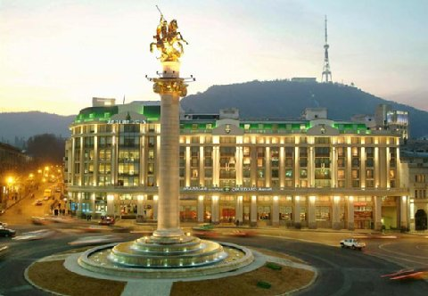
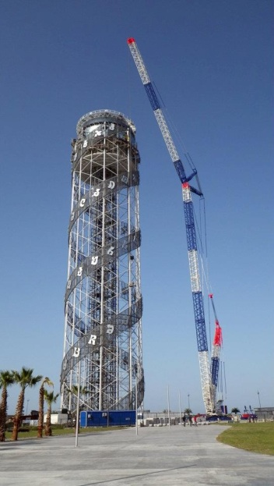



Georgia – The Outlook

Slide 3



Georgia - Sovereign Credit Rating
BB- Stable
BB- Stable
Ba3 Stable
Upgraded from B+ Positive in November 2011
Upgraded from B+ Positive in December 2011
Affirmed in December 2011

Slide 4
The Real Economy
Contributions to the real GDP growth based on Q3 2011
Source: Geostat

Slide 5
Fiscal Performance
  The Government’s program of fiscal consolidation has advanced ahead of schedule with the deficit for 2011 declining to 3.7% of GDP (compared with an IMF target of 4.3% under IMF’s SBA 7/8 Review)
  Improved compliance on the back of simplified procedures and policies has lifted tax receipts significantly
  Government spending is more heavily weighted towards capital expenditure than among peers, with future positive multiplier effects
  The Government is exceptionally prudent and conservative in managing recurrent and social costs, with growth-enhancing capital expenditures being the only contributor to the deficit formation. Fiscal consolidation thus does not pose any political or social challenges
  The Public debt stock peaked in 2010 at a comfortable 42% of GDP and is expected to decline over 2010-2013 (even under the most conservative scenarios the downward trend in this ratio shall be materialized). The Public debt ratio decreased by 5 percentage points to 37.0% of nominal GDP in 2011.
  The Public debt stock is prevailingly on concessional terms - the weighted average interest rate on the public external debt stock being a mere 2%. Interest payments/revenues ratio is very low relative to peers. Refinancing risk is inexistent.
  The modest government debt stock and the low and largely fixed interest rates help to reduce external vulnerabilities
  Driven by strong fundamentals, Georgia’s 2013 and 2021 Eurobonds have had stellar secondary market performance, despite challenging global context
CAPITAL VS. CURRENT EXPENDITURES (high ratio of capex)
COMPOSITION OF 2012 STATE BUDGET OUTLAYS

Slide 6
Fiscal Performance
One of the steepest fiscal consolidation paths in the broader region
STRONG FISCAL PERFORMANCE IN 2011 DRIVEN BY SUSTAINABLY HIGH REVENUES AND PRUDENT GOVERNMENT SPENDING
Source: MOF

Slide 7
Georgia – PFM Reforms
Broad Directions of PFM Reforms:
Budgeting, Accounting and Resource Management;
Taxation Policies and Tax Administration;
Internal Audit;
o.w. State Treasury is responsible for the PFM reforms in the fields of:
Accounting and reporting;
Resource Management;

Slide 8
Treasury PFM Reforms
Goals and Objectives
  Improve effectiveness, efficiency and transparency of Public Finance Management process
  through
        Simplifying and streamlining the Treasury Business Processes; and
        Achieving full compliance with the International Public Sector Accounting Standards;
  Improve Treasury Cash management practices and mechanisms and support improvements in local financial markets

Slide 9
Treasury PFM Projects implemented in 2011
Electronic Treasury System is fully functional in online regime; i.e. all payments through the Treasury Service are undertaken based on electronic documents;
January, 2011
Some components of Payroll module were implemented in the TIS
January, 2011
Treasury Service joined SWIFT (Society for Worldwide Interbank Financial Telecommunication)
In 2011 Long term Treasury Bonds were issues first time
May, 2011
January, 2011
April, 2011
CPV (Common Procurement Vocabulary) Codes are used in combination with budget classification while accounting and Reporting Budget Expenditures; Public Procurement process is integrated with the Budget Payments process in the Treasury information System;

Slide 10
Treasury PFM Projects planned in 2012
  Implement the Public Financial Management information System (PFMS);
  Establish Double Entry Based Treasury General Ledger
  Move LEPL (Legal Entities of Public Law) own revenues to the Treasury;
  Tax Refund procedures based on the Electronic documents are implemented;
  Treasury Bills and Bonds are managed in the Integrated Public Debt Management Information System;
  Implementation of activities envisaged in the IPSAS implementation Strategy;
  Design and implement policies and procedures to cover old budget arrears (from the Years 1998-2003).

Slide 11
Treasury PFM Projects planned in 2012
1. IMPLEMENT THE PUBLIC FINANCIAL MANAGEMENT INFORMATION SYSTEM (PFMS)
The system will ensure:
Exchange of PFM information via web;
Integration of budget Cash transactions and BOs accrual accounting Data in the Single Information System
PFMS
BUDGET PLANNING AND MANAGEMENT
PUBLIC PROCUREMENT
BUDGET EXECUTION
DEBT AND AIDS MANAGEMENT
HUMAN RESOURCE MANAGEMENT
ACCOUNTING AND REPORTING

Slide 12
Treasury PFM Projects planned in 2012
2 . ESTABLISH DOUBLE ENTRY BASED TREASURY GENERAL LEDGER makes it possible:
To generate Government Balance Sheets on Assets and Liabilities in real time mode
To generate the general ledgers for each Budget Organization and to consolidate them
TREASURY GENERAL LEDGER COVERS ALL TRANSACTIONS UNDERTAKEN BY THE BUDGET ORGANIZATIONS:
Procurement/commitment;
Accounts Payable/Accounts Receivable;
Assets and Inventories;
Other non-monetary operations;
Other Economic flows;

Slide 13
Treasury PFM Projects planned in 2012
3. MOVE LEPL (LEGAL ENTITIES OF PUBLIC LAW) OWN REVENUES TO THE TREASURY
Information on LEPL Revenues and Expenditures will be easily accessible in time;
Improve fiscal discipline in LEPL sector
4. TAX REFUND PROCEDURES ARE IMPLEMENTED BASED ON THE ELECTRONIC DOCUMENTS
Establish Electronic service of document exchange with the Revenue Service
Objectives:

Slide 14
Treasury PFM Projects planned in 2012
5. TREASURY BILLS AND BONDS ARE FURTHER DIVERSIFIED IN TERMS AND MATURITIES AND ARE MANAGED IN THE INTEGRATED PUBLIC DEBT MANAGEMENT INFORMATION SYSTEM;
Objective;
Maintain Treasury Liquidity on adequate level;
At the same time: development of the State Securities market and different instrument positively affects Local Financial Market

Slide 15
Treasury PFM Projects planned in 2012
6. IMPLEMENTATION OF ACTIVITIES ENVISAGED IN THE IPSAS IMPLEMENTATION STRATEGY
Accounting Reforms Strategy is designed and approved in 2009 and involves period of 2010-2020 for the full compliance with IPSAS;
In 2012 the strategy implies to implement the modified cash IPSAS in the Central Government Budget Organizations;
Trainings of the Accountants and CFOs of the Central Government Budget Organizations;
Publish Georgian official translation of IPSAS;

Slide 16
Treasury PFM Projects planned in 2012
7. DESIGN AND IMPLEMENT POLICIES AND PROCEDURES TO COVER OLD BUDGET ARREARS FROM THE YEARS 1998-2003
Reasons for accumulation of arrears: Severe Cash shortages in 1998-2003;
Objective: to design the clear picture – What is the exact number of arrears? How significant the stock of arrears is? Who are the creditors? What can be done to clear the stock of arrears?
Total stock of arrears is around GEL 300 millions for the central government – less than 5 percent of the annual budget 2012;
Reassess accumulated arrears on the balance sheets of the Budget Organizations;
Design the strategy of Arrears repayments with the clear reference to the following aspects:
Aging of Arrears;
Primary documentations verifying arrears;
Write of unreal arrears;
Schedule of arrears repayment (5 years suggested)

Slide 17
Treasury PFM Reforms
Thank you for your attention!
www.mof.ge
www.treasury.gov.ge
Nino Tcheishvili
February, 2012

