Slide 1


Cash Management Instruments
PEMPAL Treasury Community of Practice
Webinar, 19 October 2016
Mike Williams
mike.williams@mj-w.net

Slide 2
Outline
Cash management objectives
  A brief reminder
Rough tuning and fine tuning
Instruments
Investment of short-term cash surpluses

Slide 3
To Recall the Benefits of Efficient Cash Management
Overriding objective to ensure obligations are met as they fall due
But efficient cash management
  Economises on cash within government, minimising idle balances and associated costs
  Facilitates monetary policy (and buttresses the separation of cash management from monetary policy)
  Supports debt management
  Reduces risk
  Contributes to development of short-term money markets – and financial markets more generally
Implies cash flow smoothing

Slide 4
Managing Risk
Liquidity risk
  Ensuring liquid funds available, avoid overdraft
Funding risk
  Securing ability to raise funds at market yields when required
Improving the ability to cope with uncertainty
  Risk attached to estimates of the borrowing requirement - insufficient information
  Volatility or lumpiness of underlying cash flows
As well as:
  Market risk – associated with management of cash balances
  Credit risk – of counterparties
  Operational risk – of transactions, payments and accounts

Slide 5
The Policy Challenges are linked…
Cash Flow Forecasting
2. Targeting Balances
3. Monetary Policy
4. Cash Flow Management in Money Market
5. Market Development
1. Budget Execution
Debt redemptions, less capital receipts
Expenditure etc outflows
Cash Balance (TSA)
6. Debt Management Policy (and Gov Balance Sheet)
Tax etc inflows
Debt issuance
Loans & Credits

Slide 6
Management of Daily Cash Flows
Who takes responsibility for managing day to day fluctuations in cash balances
  Central bank takes account of fluctuations in its own monetary policy operations – as in Canada, and some EMCs
  Treasury should pass cash flow forecasts to central bank
  The MoF/Treasury/DMO actively manages its own cash – targeting a low balance [or narrow range] at central bank by short-term borrowing or investment of temporary surpluses – as in Europe and increasingly the rest of the world
Varies greatly: distinguish between:
  “Rough tuning” – issuing Treasury bills (or other short-term instruments) to a pattern designed to offset the impact on banking sector of net cash flows in and out of government, ie to smooth somewhat the changes in the TSA
  “Fine tuning” – more active policies, wide on a wider range of instruments, to smooth the treasury’s balance more fully

Slide 7
Rough Tuning: Example
Rough Tuning with weekly issue of Treasury Bills only
Converts this profile to this profile
[Fine tuning makes it flat]

Slide 8
Fine Tuning
Treasury takes full responsibility to manage its cash flows
  Associated with monetary policy independence of central bank (and helps to ensure it)
Considerable advantages
  Clarity in financial markets
  Eases monetary policy operations – central bank can assume change in the TSA balance is zero; or Treasury/DMO informs central bank of its daily target
But technically demanding
  Needs wider range of instruments
  Relatively few countries manage to fine tune well
  France, smaller northern eurozone countries, UK, Sweden
Efficient payment infrastructure is important
  Ideally, same day settlement in money market

Slide 9
Cash Managers Focus on the TSA
Smoothing objective is independent of TSA’s constituents
  Central government budgetary balances
  Extra-budgetary funds
  Donor-financed project accounts
  Sub-national governments
  State-owned enterprises
Underlying principle: whoever has the permission to spend or claim on resources, the Treasury has use of the funds until they are needed
FX balances not usually part of the TSA
  Unless there is full fungibility or mirrored accounts
Ideally debt managers need real time information on the TSA
  In practice often take decisions on basis of forecast, which is updated during the day in the light of information about actual flows

Slide 10
Cash Management Instruments
Borrowing
Treasury bill usually main instrument in moving towards more active cash management
  TBill has different roles as instrument of
    debt management
    cash management
    monetary policy
  Emphasis on shorter-term (e.g. 1 month) bills for cash management
Some EU countries issue commercial paper (CP)
Repo usually used for fine tuning – but requires liquid market

Slide 11
United Kingdom Tbill Stock (January 2002-March 2005)

Slide 12
Cash Management Instruments
Lending
(Reverse) repo preferred instrument if market sufficiently liquid
  Secured and flexible
Many countries use bank deposits
  Lend at market rates – term or overnight
  Competitive process (by tender if no transparent prices)
  But must be collateralised – reduce credit risk
Consider (remunerated) deposits with central bank if important to underpin monetary policy stance
Note: buying and selling MoF’s holdings of securities risks damaging the bond market; use only as collateral

Slide 13
Other Approaches
Management by borrowing and lending with SoEs
  Takes cash flows off the money market – does nothing to help development of market
  Cutting across commercial performance of SoEs
  [Colombia 10 years ago – not now]
Cash management objectives are in domestic currency
  May be scope to move between FX and DX – for same day value
  Depends on central bank’s exchange rate policy
  Unusual in practice except as a safety net
Rare to transact with non-residents (in external securities)
  More relevant to longer-term structural funds (see below)

Slide 14
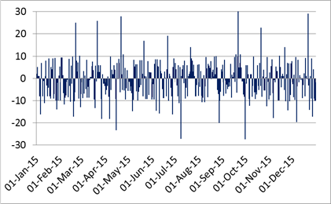
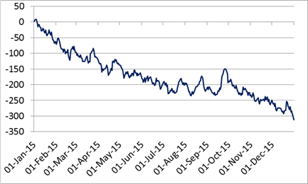
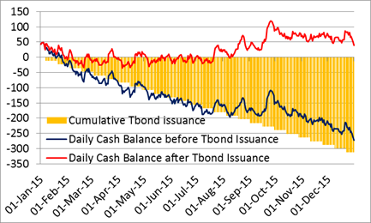
Smoothing Cash Flows: Tbonds
Daily cash flow before bond issuance
Cumulative daily cash flow
The impact of smooth gross Tbond issuance (net issuance = deficit)
How does the Treasury maintain the cash buffer close to its target (40 in the example)?

Slide 15
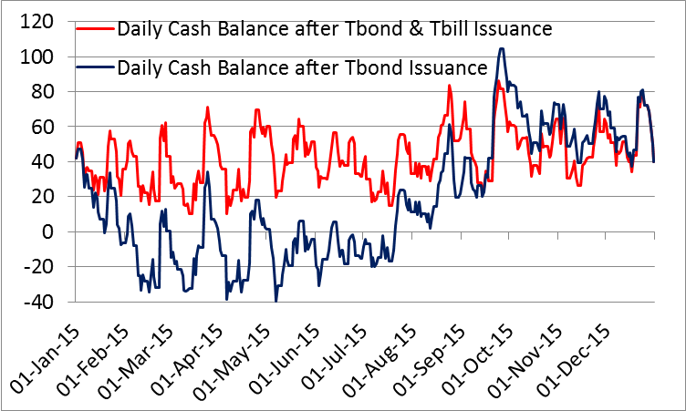
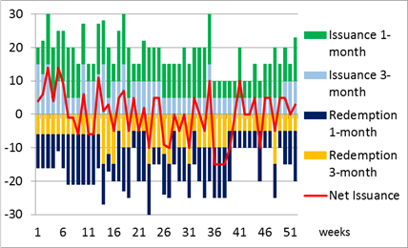
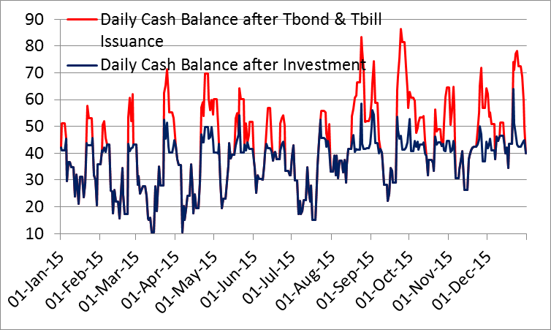
Smoothing Cash Flows: Tbills and Short-term Investment
Smoothing with 1-month & 3-month Tbills
Additional Smoothing with short-term investment

Slide 16
Investment of Short-term Surpluses
The Treasury or cash manager has responsibility for only short-term investments
  Invested in the money market
  Generally, with maturities not exceeding three months
  Any structural surpluses are handled separately
The structural funds will be invested according to a strategic asset allocation
  Reflects objectives, risk, balance sheet (balance sheets) of the country and government, etc
But there may be a more liquid tranche of the stabilization fund or savings fund invested in money markets – e.g. Peru

Slide 17
Investment is an intrinsic part of modern Cash Management
The investment of surplus cash is not simply an arbitrary add-on
  Smoothing of the cash flows from an investment of surpluses
  The well-managed investment is inherently cost-effective: reduces net debt interest
Different models
  Expect earlier in the day to borrow or lend on that day (or week)
  Operating from a surplus (France, Italy)
  Operating from a deficit (Holland, Germany)
  Approximately neutral (UK)
  Being short of cash saves money – there is a "cost of carry" – but it is only feasible if there is a liquid market

Slide 18
Investment Policy
Cash managers’ objectives
  Ensuring cash availability, smoothing cash flows
  Buffers must be readily available
    in TSA or other call deposits
    or term deposits that can be broken (in central bank or commercial banks)
  Investing surplus cash mostly in domestic currency
    Maturity geared to cash flow profile (loans/deposits redeemed on days of cash outflow) – including build up of assets to meet end year expenditure surges
Cautious approach to risk:
  Typically allow only investments in highly liquid securities, high quality deposits (collateralized) with suitable financial institutions and in repos

Slide 19
Risks
Main risks to face when managing short-term investments:
  Liquidity: ability to convert an investment into cash before maturity without suffering an unacceptable loss of principal. Requires emphasis on marketable short-term investments
  Credit: possibility that the issuer of an instrument (or any counterparty) does not meet the repayment of principal and / or interest in full and on time. Requires high quality assets and collateral; diversification and "marking to market".
Other risks are important
  Market: risk arising from adverse changes in market rates: will be small if the instruments are short term
  Legal: that contracts are not legally enforceable: requires clearly documented agreements with partners (e.g. the overall master repurchase agreement (GMRA) for repos)
  Operational: resulting from inadequate or failed internal processes, people and systems or external events. Requires defined procedures, segregation of duties, internal control and business continuity plan

Slide 20
Money Market Instruments
Repos and reverse repos
  Important in most money markets, offering competitive short-term rates (fixed or variable), used by central banks for OMOs
  Sale and repurchase of an underlying security - serves as collateral
Term deposits in commercial banks
  Similar to repo rates but usually includes penalty if redeems in advance
  Must collateralise
  Requires a competitive process
Certificates of Deposit (CDs)
  Low liquidity risk (if negotiable)
  Higher credit risk - cannot collateralise
Market mutual funds money (money market mutual funds)
  The Funds invest in short-term instruments
  They benefit from diversified market access; but performance may vary and is not without risk
Commercial paper
  Issued by highly rated credit-largest banks and non-financial corporations
  High performance but potentially more risky

Slide 21
Investment in Practice - 1
The maturity of investments depend on the profile of both market and cash flow but usually not greater than 30 days and rarely up to 90 days
Reverse repo is the preferred instrument if the market is sufficiently liquid
  It is secure and flexible
  Often backed by government securities (or central bank)
  The collateral is "marked to market" daily
Many countries invest in bank deposits
  Loans at market rates: a term or overnight
  Competitive process (for auction, if there is no transparent market prices): possible as differential with respect to, eg, overnight rates.
  But be collateralized: reduce credit risk

Slide 22
Investment in Practice - 2
For repos or bank deposits it is recommended that a list of pre-approved banks is established
  Sign all documents of the case; e.g. GMRAs
  Simplify each auction: just short notice is required
  Cautious credit risk policy – but the collateral greatly reduces the risk
Cash held at the central bank should be remunerated at market-related risk-free interest rate
  Consider deposits (term and remunerated) at the central bank only if there is a monetary imbalance, i.e. when it is a response to a structural problem
Thank You!

