Slide 1
Evolution of the Treasury System in the Republic of Azerbaijan
Ministry of Finance of the Republic of Azerbaijan
State Treasury Agency
November 2015
Baku

Slide 2
Contents
Evolution of the Treasury System
Treasury Functions
TIMS Implementation
E-workflow
Development Plans Going Forward
Objectives

Slide 3
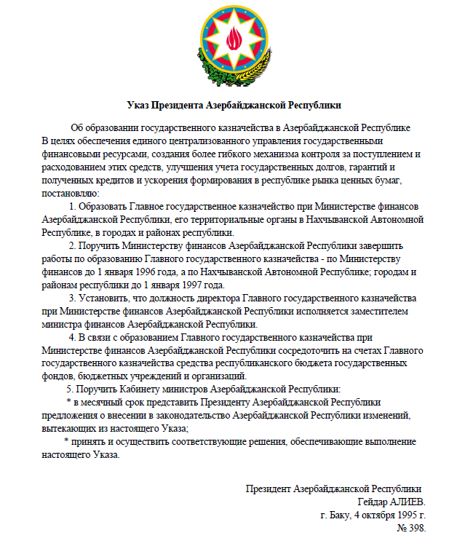
Ministry of Finance of the Republic of Azerbaijan
State Treasury Agency
Decree of the President of the Republic of Azerbaijan “On Establishing the State Treasury in the Republic of Azerbaijan”
of October 4, 1995

Slide 4
Treasury Single Account (TSA)
Treasury System Objectives
Treasury
School
Hospital
Kindergarten
Equipment supplier
Food supplier
Book supplier

Slide 5
Public (Budget) Mandates
Treasury System Objectives
Budget Institutions
Staff
Boss
Division Chief

Slide 6
Treasury System Objectives
TREASURY ACCOUNTING FOR GOODS (WORKS AND SERVICES)

Slide 7
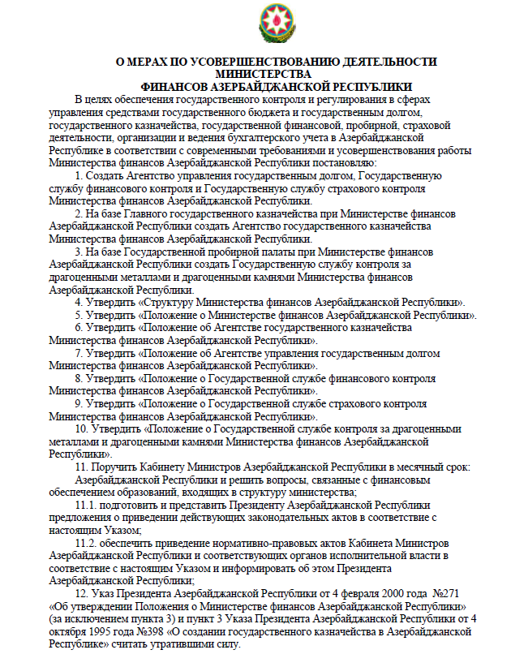
Ministry of Finance of the Republic of Azerbaijan
State Treasury Agency
Decree of the President of the Republic of Azerbaijan “On Establishing the State Treasury Agency in the Republic of Azerbaijan”
of February 9, 2009
Илхам Алиев,
Президент Азербайджанской Республики,
Г.Баку, 9 февраль 2009 года

Slide 8
Treasury Functions
Engage in annual government and consolidated budget preparation processes, as well as in budget planning for the following year and the next three years, prepare reporting on cash budget execution
Provide methodological guidance for accounting and reporting of treasury transactions in the context of government budget execution
Provide funding for the adopted government spending consistent with government budget revenues and deficit
Utilize envisaged sources (liquid funds) of budget deficit financing
Put in place an accountability framework to promote public finance transparency in budget-financed organizations and institutions
Draft consolidated reports on the execution of the government budget
Finance activities and enforce control over cash execution of extrabudgetary funds in line with adopted cost estimates
Register goods, works and services procured by budget organizations in the treasury ledgers.
Other functions

Slide 9
TIMS Implementation: New Stage in the Evolution of the Treasury System
Project Preparation (April 2009)
Conceptual Design (October 2009)
Implementation (August 2010)
Piloting (November-December 2010)
Productive Launch (January 2011)

Slide 10
Top-Tier Conceptual Model
Budget Appropriation
Ministry of Finance – Budget
Fiscal reports
Taxpayers
Budget for budget institutions
Chief spending units
Treasury Information Management System (TIMS)
Treasury HQ
Suppliers
Revenue and cash expenditure projections, Applications for cash limits
SWIFT payments
Treasury Single Account held with the central bank
Commercial banks
Payments/wages
Cash limits, reports
SWIFT interactive payments and balances
Budget institutions subject to regional control
Revenue and cash expenditure projections, Applications for cash limits
Regional treasury offices
TSA receipts
Cash limits, reports
wages
Applications for mandates, reconciliation and invoice clearance
Budget institutions
Cleared mandates, invoices, payments, accounting reports

Slide 11
Information System Components
1. Budget management
2. Budget mandate management
3. Payment management
4. Revenue management
5. Debt management
6. Cash management
7. Budget and financial reporting

Slide 12
Project Objectives
Objective | Implementation Status
 | Start of work | Work in progress | Implemented
Provide for both cash and accrual accounting and reporting.
Carry out accounting as per IPSAS-consistent national standards.
Obtain reports required by the legislation of the Republic of Azerbaijan and consistent with GFS and IPSAS.
Move from a treasury single account framework comprising transit accounts to one that captures all revenue and expenditure transactions in a treasury single account.
Provide flexible opportunities for operational liquidity management.
Allow for external audit of public expenditures and revenues.
12
Notes:
12
Content Layouts

Slide 13
Project Objectives
Objective | Implementation Status
 | Start of Work | Work in Progress | Implemented
Audit tracking of treasury transactions in a documentary and user format
Manage all treasury transactions performed in Azerbaijan from financing to obtaining real-time reports
Put in place a wide platform to design a PFM database for reference and information purposes
Allow for more components to be integrated into software, such as budgeting, accounting for capital goods, programmatic budgeting, payroll and HR management
Design a database which could be easily integrated with external system for financial and economic planning, analysis, and management.
13
Notes:
13
Content Layouts

Slide 14
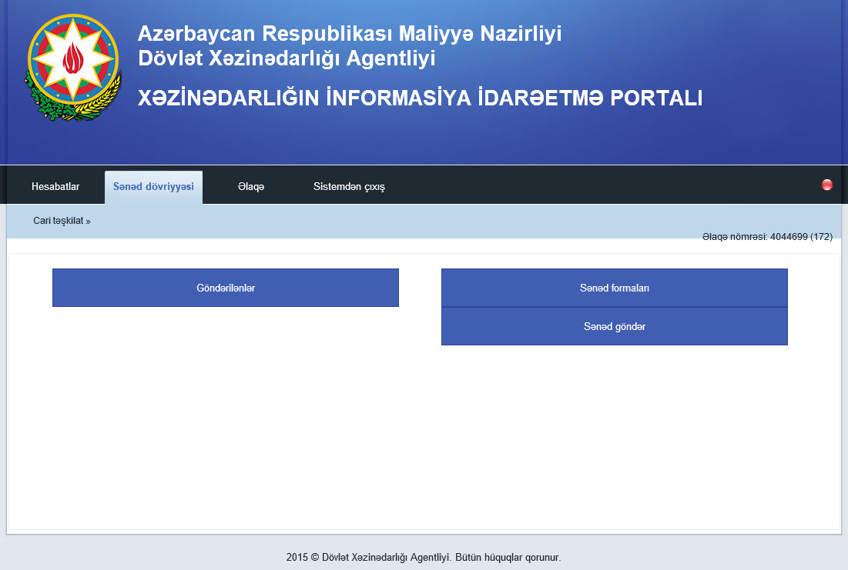
E-workflow

Slide 15
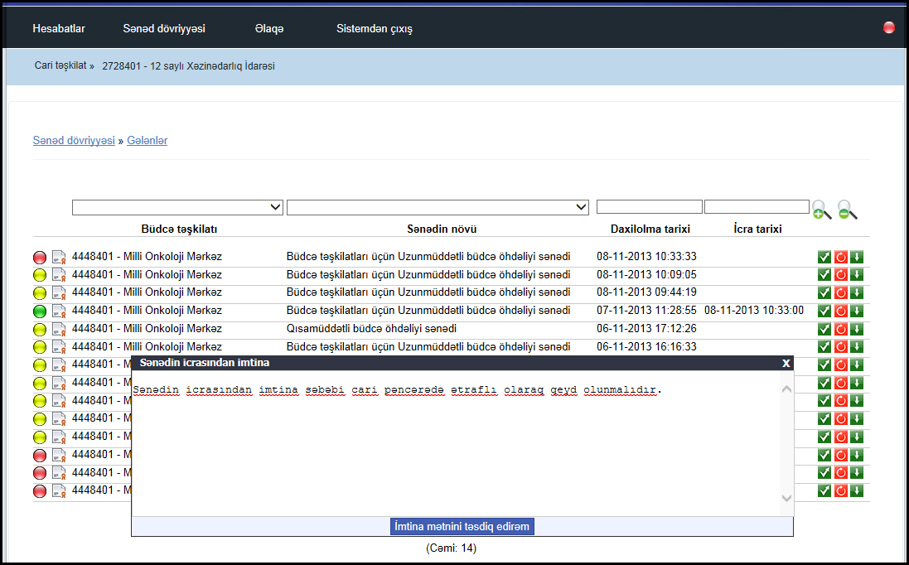
E-workflow

Slide 16
System Integration
Financial and Accounting Reporting Arrangements in Budget Institutions and Treasury Information Management System (TIMS)
Financial and Accounting Reporting Arrangements in Budget Institutions (FARABI)
Treasury Information Management System (TIMS)

Slide 17
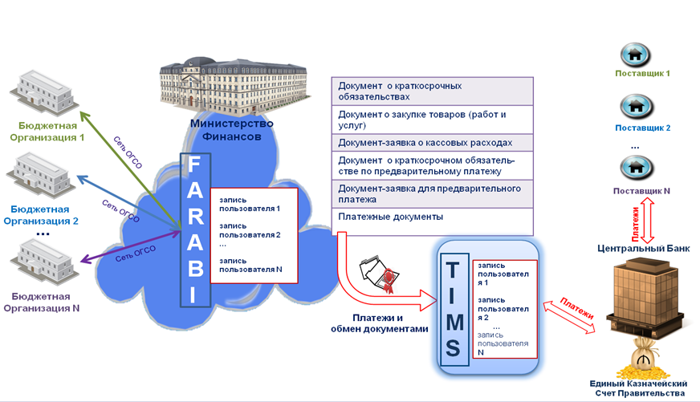
System Integration
Financial and Accounting Reporting Arrangements in Budget Institutions and Treasury Information Management System (TIMS)

Slide 18
Development Plans Going Forward
Connecting budget institutions to TIMS
FMIS Design and transition to TIMS
TIMS Accounting
TIMS payroll assessment
HR Management
On-line connection to SWIFT foreign currency terminal

Slide 19
Objectives
Treasury HQ reorganization due to automation of treasury control functions
Revision of the organizational network of Treasury regional offices
Redistribution of functions between the Treasury and budget institutions
Widening the scope of Treasury services
Learning from other countries’ experience
Staff training
Budget institutions staff
Ministry of Finance staff
Hardware
Software

