Slide 1

PEMPAL-Treasury COP
The 2021 Survey on the TSA & Cash Management: Main Findings
PEFM COP and PEMPAL-Treasury COP
Virtual Worksop: September 28, 2022
Mike Williams
mike.williams@mj-w.net

Slide 2
Outline
The Context
Treasury Single Account
Cash Forecasting
& Cash Management
Conclusions & Next Steps

Slide 3
Background to the Survey
Objective:
• to benchmark the Treasury Single Account (TSA) and cash management practices within the PEMPAL community
• to help to identify good peer practices and to promote treasury reforms in the member countries
Survey
• Followed (and expanded) a similar survey in 2016
• Completed early 2021 by 16 countries

Slide 4
The Three Pillars of Cash Management
The Treasury Single Account
Unified structure of government bank accounts to give a consolidated view of government cash resources
Cash Flow Forecasting
Active Cash Management
Use of Tbills and other short-term borrowing and lending instruments in the money market to smooth cash flows (reduce timing mismatches)
Estimating future government cash inflows & outflows
Key concepts: full coverage; fungibility of cash and under control of Treasury/MoF
Support action necessary to ensure sufficient funds are always available to facilitate the budget
[and use any net cash surplus, to best advantage]
While maintaining cash buffer target

Slide 5
Cash Plans and Cash Forecasts
Cash Plans
Cash Flow Forecasts
Linked to budget execution
    Forecasts based on budget profiles
    Profiles often linked to appropriations
    Revenue “forecasts” may also be constrained to budget target
Two objectives:
    Controlling spending profile to ensure cash availability
    Identifying short-term cash requirements and surpluses
Risk confusing targets/ controls with forecasts
Forecasts independent of control totals
    what “will” happen” not what “should” happen
Two objectives
    Ensuring that cash is available when required, with no risk of cash rationing
    Minimising use of cash over the period ahead
Often managed separately from budget execution processes
Both are needed!

Slide 6
Outline
The Context
Treasury Single Account
Cash Forecasting
& Cash Management
Conclusions & Next Steps

Slide 7
A Solid Core of Sound Practice
All countries have a TSA in the central bank
Tax and non-tax revenues flow directly and quickly to the TSA in all countries
Payments are mostly made directly from the TSA, not via the commercial banks
13/16 also include the balances of SNGs (although not clear whether they are fully integrated with C.Gov balances in all cases)
All countries have a TSA structure which allows simultaneous separation and control of funds while fully consolidating cash holdings for at least central general government
Based either on bank accounts or (increasingly since 2016) the ledger of the FMIS
Also the case for SNG tax and non-tax revenues where SNGs are part of the TSA.
More than half also have some other funds whose receipts flow to the TSA as do donor grants and loans. But coverage is far from complete.
10/16 are members of RTGS – a striking development

Slide 8
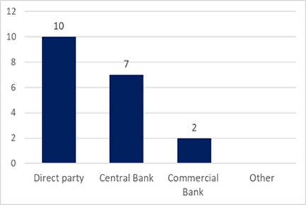
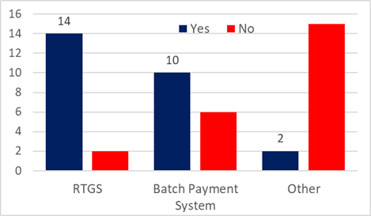
Most receipts flow directly into the TSA (Yes/No by country response)
Most countries have direct access to banking system for payments
E-payments dominate

Slide 9
But Room for Improvement
Coverage incomplete
“Commercial” relationship with central bank
More than half have some funds, budgetary & extra-budgetary, whose receipts flow to the TSA as do donor grants & loans
Almost all have documented their relationship with their central bank − in most of those cases some fees are paid
But coverage is far from complete
Management of trust/deposit money also mixed − fewer than half confirming funds are held in the TSA
Only 10 /16 receive interest on at least some cash balances at the central bank
More countries earn interest below the central bank’s policy rate than above
(Similar proportion receive interest on their balances with commercial banks)

Slide 10
Outline
The Context
Treasury Single Account
Cash Forecasting
& Cash Management
Conclusions & Next Steps

Slide 11
A Mixed Picture
Most countries, 12 / 16, reported a high-level cash management objective
Three countries (only) have a formal target for the cash buffer
Mostly defined as efficiently supporting budget execution, rather than also the efficient use of cash
Others are likely to target a buffer in practice.
But some objectives are ill-defined or imprecise
Most had some safety nets available (eg breaking deposits with commercial banks – none had credit lines in place)
All countries have some forecasting capability
Some variations in practice (next slide)
Difficult to measure “performance”

Slide 12
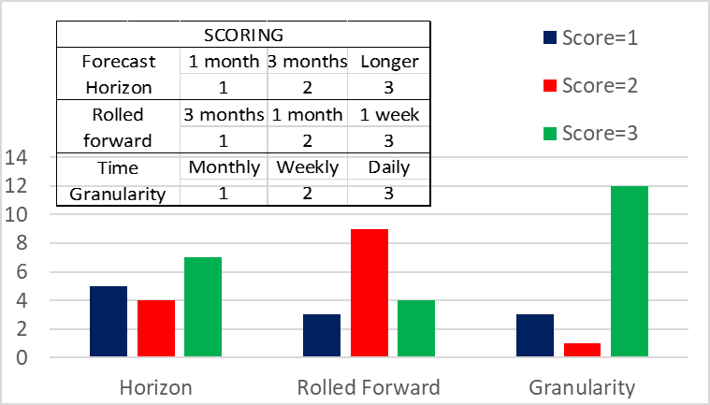
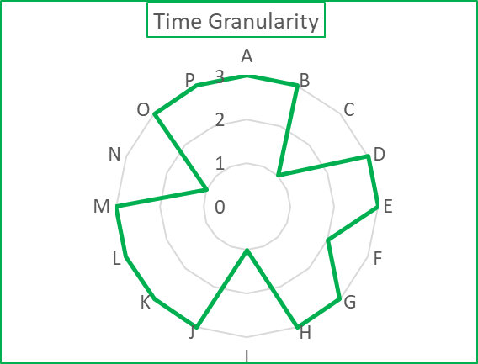
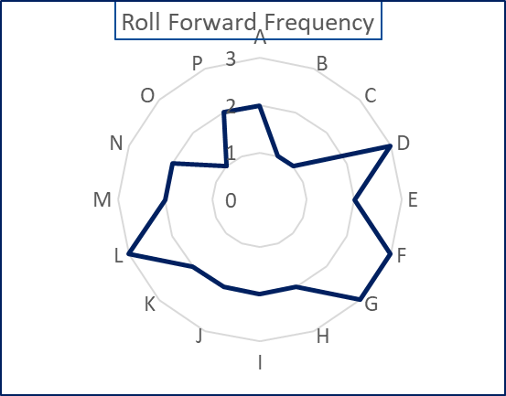
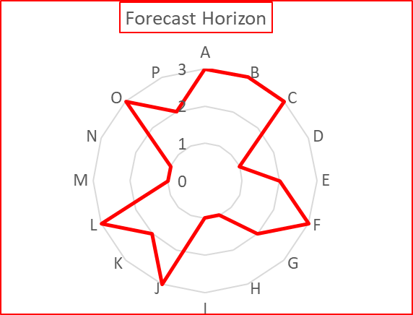
Forecasting Practice
Only I country scores 3 on all 3 dimensions; many score 2

Slide 13
Institutional Models
2 countries
11 countries – characteristic of the region – a strong Treasury with the debt management function growing separately
2 countries
1 country
Only 7/16 have a formal high-level cash coordination or liquidity management committee

Slide 14
Limited Active Cash Management
In all countries responding, the debt department or equivalent is responsible for short-term (as well as long-term) debt issuance and other borrowing
Cash surpluses: half respondents able to place deposits with central bank and half with commercial banks (with some able to do both)
But lead responsibility varies for short-term investment of temporary surplus cash,
Most countries have Tbills available as a short-term borrowing instrument
But answers suggest they are seen more as a regularly-issued debt management instrument
Just 3 countries have capabilities to borrow and lend through repo.
The capability to manage cash actively, drawing on a wide range of instruments, clearly has further to develop
Raising concerns about coordinated / consistent interaction with the money markets
Rather than a more flexible cash management instrument

Slide 15
Outline
The Context
Treasury Single Account
Cash Forecasting
& Cash Management
Conclusions & Next Steps

Slide 16
Some Conclusions
There is some diversity of practice - to be expected in view of different legal frameworks, institutional and financial structures, and administrative cultures and histories
At the same time, there is a solid core of countries that have developed capabilities and mechanisms in line with sound international practice.
Responses to the survey indicate that for many countries activities of the TCOP Cash Management Working Group have contributed to these achievements
Several countries reported recent reforms: including widening or other improvements in their TSA; upgrades in their payments systems to support electronic or faster processing; and cash flow forecasting and cash management reforms. Covid has promoted further or planned changes

Slide 17
Looking Forward
The results nevertheless suggest that all countries have at least some need to further develop their practices, instruments or institutions
There are potential areas for further comparative work and technical assistance – next slides
Clear scope for further exchange of experiences among the participating countries; the working group continues to be highly relevant for the members

Slide 18
TSA Structures and Coverage
Structures
Different TSA and payment models: pros and cons
Coverage
Extending to balances of EBFs, Trusts, donors, etc
Internal structure (networks, pyramids)
Advantages of credit limits; control through the IFMIS or banks
Improving accounting and control
Linking CB sub-structures through the UCoA
Protecting the claim on resources where legally required
Managing the process; incorporating within forecasts
Balances of Sub-national Governments
Inclusion or exclusion? Pros and cons.
International practices; what it means in practice
Using ICT to improve consolidation

Slide 19
Cash Management
Cash Management Objective
Implications for treasuries: developing new functions and capabilities
Interaction with debt management: respective roles and coordination structures
The Cash Buffer
What “should” the cash management objective be? International examples
What it is, why we need it, and the benefits of formalising a target
Determining the buffer
International examples
Investment of Surplus Cash
Risks and Instruments
Institutional Arrangements & Processes
Investment in Practice

Slide 20
Thank You!
Questions and Comments
Full Survey results at: https://www.pempal.org/knowledge-product/government-treasury-single-account-and-cash-management-pempal-countries

