Slide 1

PEMPAL TCoP Thematic Group Meeting
Organizational Models for Managing ICT in Public Sector
Use of Information Technologies in Treasury Operations
Tbilisi, Georgia October 5-7, 2015
Cem Dener
Governance Global Practice

Slide 2

Managing ICT
Contents
Global Trends and Challenges
Effective Management of ICT
Organizational Models for ICT

Slide 3
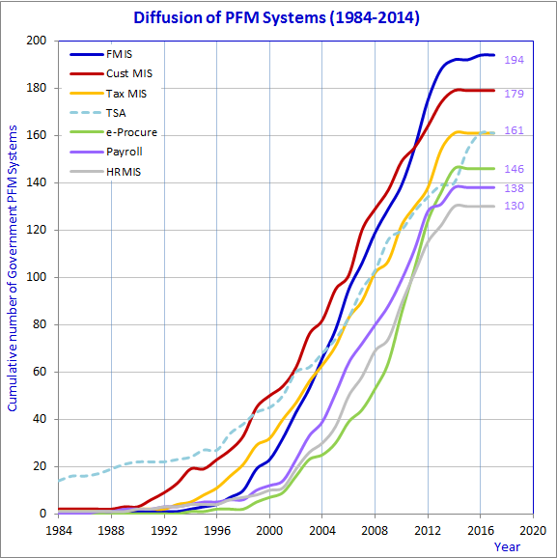
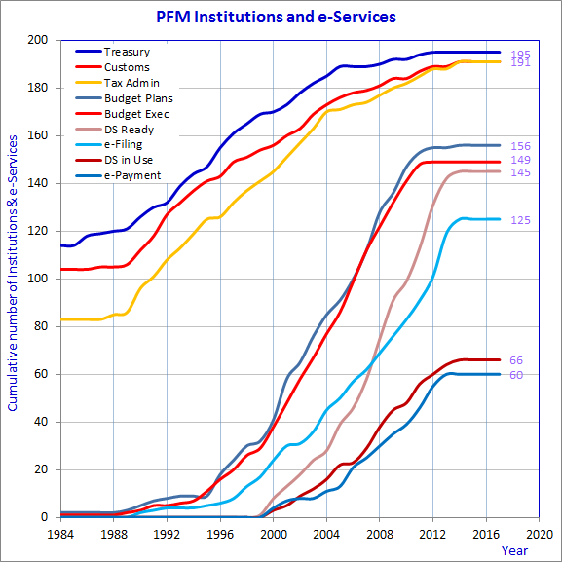
Global Trends
Diffusion of PFM Systems and e-Services (1984-2014)
Trends in ECA countries: Integration of PFM systems & expansion of e-Services
⧫ World Wide Web
⧫ World Wide Web
Source: WBG > Global Data Sets (198 economies) on Government Systems and e-Services (December 2014)

Slide 4
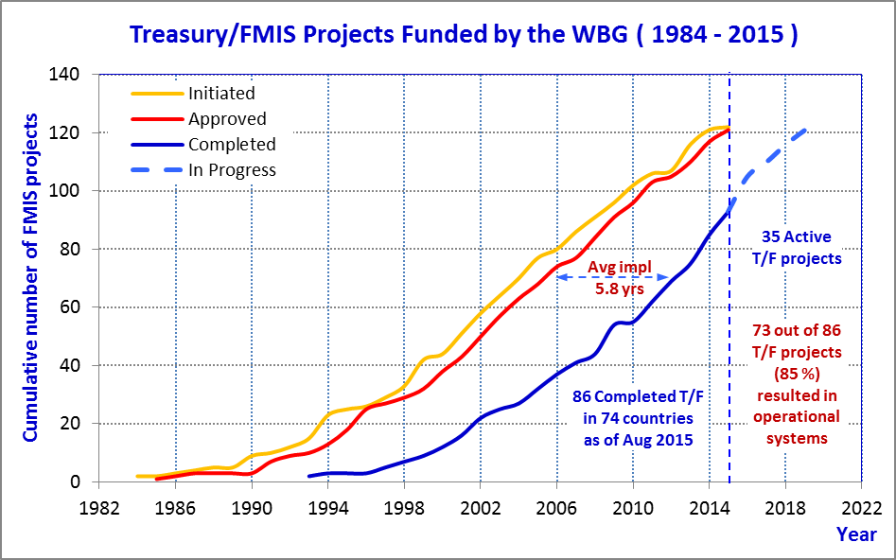
WB Funded FMIS Projects
Observations
Despite large ICT investments, progress in improving public resource mobilization & management, openness, and public services has been slow.
Transition from fragmented and outdated information systems to integrated solutions offers great opportunities to address these challenges.
There are also risks to be addressed while replacing outdated ICT platforms or integrating existing systems (e.g., privacy and security concerns, financial and technical sustainability, ICT governance and capacity).
Impact of WWW on FMIS and PFM Systems
⧫ WWW
Cell phones 
HTML, Browsers 
Open Source 
Yahoo 
Google 
Blogs 
Wikipedia 
Wireless 
Skype 
Facebook 
You Tube 
Twitter 
iPhone 
iPad 
Source: WBG > FMIS Database (August 2015)

Slide 5
Challenges
www.worldbank.org/publicfinance/fmis
Global Challenges
Source: OECD PGC Recommendation on Digital Government Strategies (15 July 2014)
Many governments still do not see technology as a collaborative means to shape public governance outcomes.
A “business as usual” approach to technology that reinforces existing internal government processes only leads to failed projects and public criticism.
The challenge is not to introduce digital technologies into public administrations; it is to integrate their use into public sector modernization efforts.
OECD recommendations for effective use of digital technologies for more open, participatory and innovative governments:
Using technology to improve government accountability, social inclusiveness and partnerships.
Creating a data-driven culture in the public sector.
Ensuring coherent use of digital technologies across policy areas and levels of government.
Strengthen the ties between digital government and broader public governance agendas.
Reflecting a risk management approach to address digital security and privacy issues.
Developing clear business cases to sustain the funding and success of digital technologies projects.
Reinforcing institutional capacities to manage and monitor project implementation and operations.
Assessing existing assets to guide procurement of digital technologies.
Reviewing legal and regulatory frameworks to allow digital opportunities to be seized.

Slide 6
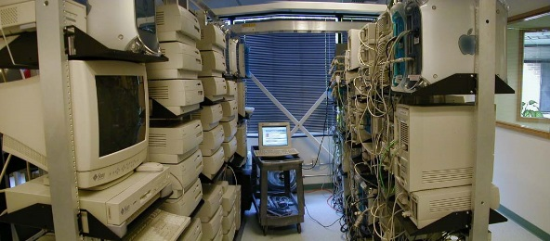
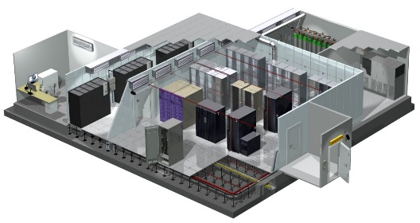

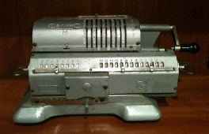

Managing ICT
Effective Management of ICT
ICT is essential for collecting, storing, and processing data, and for delivering information, knowledge, and services.
ICT is complex. Special skills are required to develop and maintain ICT platforms. Adequate resources are needed for ICT investments, maintenance, training & support.
Transition from traditional ICT service management to modern practices provides opportunities to strengthen institutional capacity and improve enabling environment.
A dedicated ICT unit and experienced/qualified technical specialists
are vital components of any information system
Traditional
Technology focus
“Fire-fighting”
Reactive
Users
Isolated, silos
“One off”, adhoc
Informal processes
IT internal perspective
Operational specific
Contemporary
Process focus
Preventative
Proactive
Customers
Integrated, countrywide
Repeatable, accountable
Formal good practices
Business perspective
Service orientation
Source: IT Service Management (http://www.itsm.info/ITSM.htm)

Slide 7
Managing ICT
Effective Management of ICT
Existing ICT Governance frameworks provide useful guidance to improve the organizational structures, institutional capacity, and services.
Several well-known ICT Governance and Service Management frameworks are being used in public sector as well.
ISO 9000
Quality Management Systems Standards
Since 1987
ISO/IEC 27000
ISO/IEC 20000
Legend
Information Security Mgmt. Systems (ISMS) Std.
Since 2009
2014 Free
Since 2005
Revised 2011
IT Service Management (ITSM) Standard
IT service management standard/framework
ITIL
FitSM
Quality management standard
Information Technology Infrastructure Library (ITIL)
Since 1996
ITIL 2011 Ed.
Since 2013
Free
Family of Stds for Lightweight IT Service Mgmt. (ITSM)
Information security management standard
COBIT
Control Objectives for Information and Related Technology (COBIT)
Since 1996
COBIT v5 2012
Software engineering maturity model
ISO/IEC 15504
CMMI
Adoption of concepts
Software Process Improvement and Capability Determination Std. (SPICE)
Since 1997
Since 2002
CMMI v1.3 2010
Capability Maturity Model Integration (CMMI)
Source: IT Governance Frameworks (https://en.wikipedia.org/wiki/IT_service_management)

Slide 8







Managing ICT
Organizational Models for Managing ICT
Several organizational models have emerged for ICT Governance within the scope of World Bank funded FMIS/PFM reform projects to support the needs of MoF/Gov entities:
Internal ICT units within the MoF organizations
State Owned Enterprise under the MoF structure
Outsourcing (private firms)
Hybrid models
Important Aspects
Roles and Responsibilities
Policy/Strategy
Coordination
Implementation
Support
Audit/Assurance
Data Protection
Organizational Structure
Centralized
Decentralized (central & local units)
Budget
Autonomous, with its own budget
Semi-autonomous, requiring budget
Dependent on MoF/Gov
Number & composition of staff
Managers
Business and system analysts
Programmers/software developers
Web designers and developers
Database and system administrators
Network specialists
Information security experts
Technical support/Help desk/Call center
A typical 3-tier web-based system > Who will manage [ ICT ] components?
B C C
1
[ 3 ]
Central Servers
2
[ 2 ]
FMIS Application Software
M S C
Database Server(s)
Application Servers
Users
Citizens
Businesses
Internet
FMIS DB
Web Server
Firewall
[ 1 ]
Wide Area Network
Spending Units
MoF / Treasury
District Offices
[ 4 ]
Field
Hardware
On-demand lines for towns
Collection Point
(city center)
3
Virtual Private Network
Local Server
Encryption
District Offices
Tunnelling
[ 5 ]
Network Equipment
PCs / Thin Clients
District Offices
Spending Units
MSC : Main System Center
BCC : Business Continuity Center
Spending Units

Slide 9
Managing ICT
Organizational Models for Managing ICT
Internal ICT units within the MoF organizations
A strong ICT unit is established by providing incentives to attract qualified technical specialists for permanent staff positions, and form a dedicated team within the MoF.
Such ICT units are composed of necessary central level and field staff, project teams, software developers, database and system administrators, network specialists, information security experts, technical support teams, help desk, and other necessary staff.
Operations of the ICT unit are monitored by the relevant section of internal audit units.
Project and contract management capabilities, business process mapping and reengineering (BPM/BPR), data warehouse, digital signature operations and other more advanced functions can also be supported through such units.
High level political commitment and allocation of necessary resources are key factors to ensure the sustainability of such models.
Sometimes, there may be several strong ICT units within the same Ministry or within the Gov, and coordination of efforts may be a challenge.
Despite all challenges, a number of countries managed to use this model effectively over the years, and managed to maintain their systems and e-Gov platforms cost effectively.
This model is visible in the Russian Federation, Ukraine, Kazakhstan, Indonesia, Chile, Vietnam, Turkey, Dominican Republic, and other countries.

Slide 10
Managing ICT
Organizational Models for Managing ICT
2. State Owned Enterprise under the MoF structure
When it is difficult to establish strong ICT units within the MoF/Gov organizations, another option is the establishment of an SoE (or similar organization) under the MoF/Gov structure (head is reporting to the Minister and other governing bodies).
Such SoEs can attract competent and experienced ICT specialists with salaries comparable to private sector, and support all critical ICT functions for the government (and do not participate in any other commercial activity, alone or as a part of a consortium).
SoE develops necessary ICT solutions (in most cases by outsourcing some of the development work, and managing these contractors), maintains data centers, portals, and other ICT platforms, and provides technical support.
This model may require more resources than internal units, but when it is not possible to change the legislation/regulations to create a strong ICT unit within the organization, it may work.
The MoF/Gov still needs to establish a core ICT unit to manage the information systems, users and data centers, and ensure the reliability and security of databases and applications.
Also, the allocation of necessary resources to the SoE for supporting core ICT operations is crucial (since they are not involved in commercial activities).
This model is visible in India, Brazil, Georgia, Kyrgyz, Moldova, and other countries.

Slide 11
Managing ICT
Organizational Models for Managing ICT
3. Outsourcing
Another option is to outsource most of the ICT software development, maintenance and support functions to private sector (firms or individuals), and establish a core MoF/Gov ICT team to manage these contractors/solution providers.
The MoF/Gov ICT unit should be capable of managing the information systems, users and data centers, and ensures the reliability and security of databases and applications.
This model may require additional resources compared to other options, and stronger ICT units to manage all contractors and existing platforms.
When local firms/consultants take over the core ICT functions of the MoF/Gov (fragile states, or initial attempts for transition to automation), there is a risk of vendor lock-in or information security, among others.
Hence, heavy reliance on outsourcing is not recommended. MoF/Gov organizations usually develop a transition plan to take over core ICT system management functions within a few years.
This approach is visible in Fiji, Gambia, Comoros, Afghanistan, Nigeria, etc.

Slide 12
Managing ICT
Organizational Models for Managing ICT
4. Hybrid models
There may be a combination of above models (ICT Units + SoEs or ICT Units + Local Firms/Consultants) depending on country specific needs and solutions.
In Brazil and India, for example, many departments have strong ICT units in addition to a very strong SoE supporting the whole government.
In Korea and Philippines, there is a preference to outsource as much as possible, but there are strong ICT units and coordinated efforts to manage these contractors.
Important aspects in each of these models:
The distribution of specific roles and responsibilities among various units/staff should be clearly identified to ensure that there is a robust ICT governance framework
Organizational structure should be clearly identified (centralized/decentralized)
What is the budgetary setup for the ICT unit (autonomous/semi-autonomous/dependent)
Number and skill levels of ICT staff.

Slide 13
PEMPAL TCoP Discussion Points
What is your organizational model?
FMIS technology architecture
  Web-based (centralized) / Distributed (decentralized)
  Network topology / Security
  Data Centers (main + disaster recovery)
  Interconnectivity & Interoperability
Organizational model for managing ICT
  Internal unit / SoE / Outsourcing / Hybrid
  ICT governance framework (standards?)
  Roles and responsibilities
  Structure / Geographical locations
  Number and skill levels of ICT specialists
  ICT annual operating and investment budget

Slide 14
http://www.worldbank.org/publicfinance/fmis
Thank You
https://eteam.worldbank.org/fmis

