Slide 1
State Budget Payment System of Georgia
Zurab Tsitlauri
2012

Slide 2
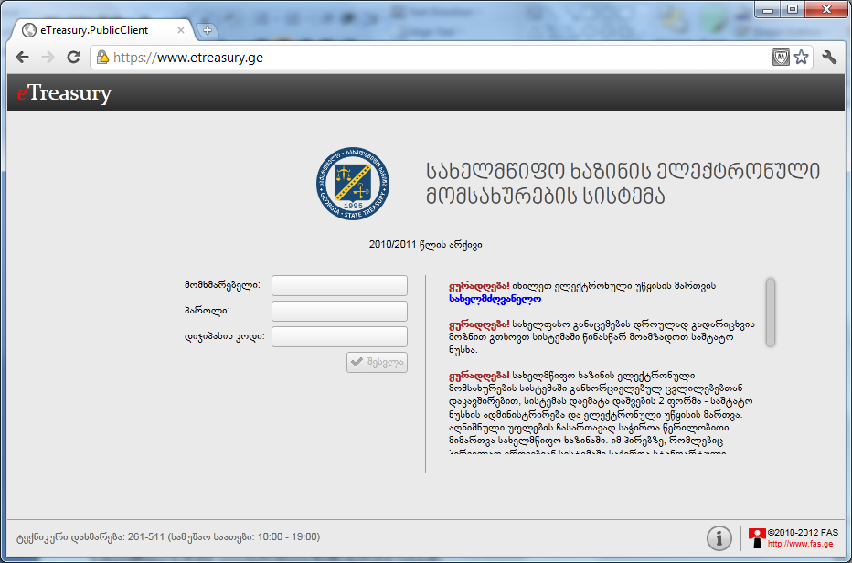
E-TREASURY ELECTRONIC PAYMENT SYSTEM
CONTEMPORARY, SIMPLE AND CONVENIENT FORM OF MAKING PAYMENTS FROM THE BUDGET, WHICH PROVIDES FOR ELECTRONIC PERFORMANCE OF ALL PAYMENTS RELATED PROCESSES
BUDGET ORGANIZATIONS CAN
SUBMIT TO THE TREASURY ALL PAPERS ELECTRONICALLY
RECEIVE INFORMATION ON PERFORMED TRANSACTION AND RESOURCES AT THEIR DISPOSAL IN THE REAL TIME REGIME

Slide 3
State Treasury History of Development
2001 – 2003
Core – Treasury system
2006
Consolidated National Currency Account
2007
RTGS
2009
Unified multi-currency account
Before 2010 - the State Treasury comprised Central and 11 regional services.
JANUARY-FEBRUARY
REQUIREMENTS AND DESIGN
MARCH-JUNE
SOFTWARE
JULY-SEPTEMBER
500 USERS
SEPTEMBER-DECEMBER
440 ORGANIZATIONS
2500 USERS
2010

Slide 4
OUTCOMES
SAVING OF HUMAN AND MATERIAL RESOURCES
Regional services of the Treasury were abolished and all transactions are consolidated in the central staff.
SIMPLIFIED AND ACCELERATED OPERATIONS, NEW SERVICES
Payment of wages to each employee by means of individual transfer principle (so-called “package transfer”);
Payment of travel money to each public servant and submission of the business trip report;
Principle of the “green corridor”, which implies automatic processing of payment documents (orders) received by system from budgetary organizations (without intervention of the treasury operator) and transfer to the bank for payment in real time regime

Slide 5
OUTCOMES
REDUCTION OF OPERATIONAL RISKS
Structural analysis of bank accounts has been conducted and maximum validations were entered into the informational system of the Treasury; it drastically reduced operational risks.
MAXIMUM TRANSPARENCY OF REVENUES AND PAYMENTS OF PUBLIC SERVANTS
System contains full information on salaries paid to each employee and taxes paid by them
Volume of information to be submitted on business trip expenses; it ensured maximum transparency of business trip expenses

Slide 6
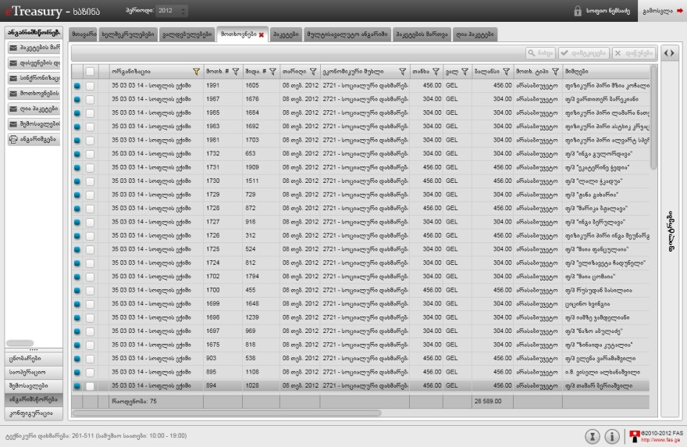
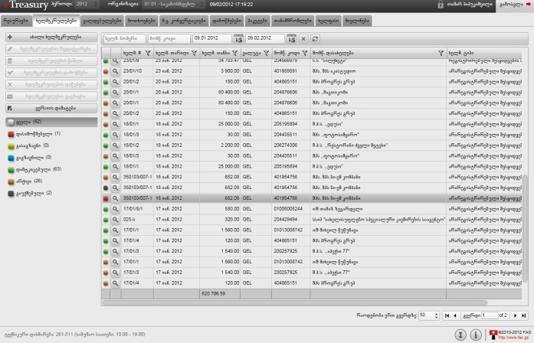
SOFTWARE
E-TREASURY

Slide 7
Users
Three types of access to working on electronic documents
Entering data/preparation of electronic documents;
Verification of electronically developed documents
Sending electronic documents to the State Treasury
E-TREASURY - process of engagement of users:
Organization fills out a special application on connecting to the system and submits it to the Ministry of Finance;
Ministry of Finance registers users based on the application and issues the additional authentication device (Digipass) in accordance with the access category

Slide 8
Service Process
ORGANIZATIONS
can place in the e-system documents established by the rules of payments from
STAFF OF THE TREASURY SERVICE
examines content of documents entered in the E-Treasury (textual fields)
Digital part of documents is automatically examined in the SYSTEM (digital fields)
After examination (verification):
Comprehensive document will processed in the informational system of the Treasury, as a result of which relevant treasury transaction will be carried out;
Incorrect documents will be rejected and returned to the client-organization with indication of the rejection reasons (code);
Clients will be informed about status of payment documents with the system itself;

Slide 9
Service Flow
Planning and Management of budget appropriations
Competition and Public Procurement Agency
Civil Registry Agency
Public Registry Agency
Status of documents
Status of the document
SERVICE DEPARTMENT OF THE TREASURY
DEPARTMENT FOR ACCOUNT SETTLEMENT OF THE TREASURY
RTGS
SWIFT
ORGANIZATION
National Bank
Rejected document
HR
Payroll
Green Corridor
Business Trips

Slide 10
Functional Diagram
NATIONAL BANK
DEBT MANAGEMENT
BUDGET MANAGEMENT
STATE TREASURY
BUDGETARY ORGANIZATION
CIVIL REGISTRY AGENCY
REVENUE SERVICE
AUDIT
PROCUREMENT AGENCY
MAIN BOOK -
REPORTING
FUNCTIONAL PROCESS
FUNCTIONAL PROCESS
PRIMARY DOCUMENT
Budget/Appropriations
contract
System of e-tenders
Reporting
Verification of contracts/liabilities
Procurement/liabilities
Basis for liabilities, other document
taxes
Verification of invoice /tax claims
Payments payables/receivables
$
General Ledger
Invoice
$
RTGS
Accounting of revenues/moving to returns
Other non-material operations except assets and investments
Non-monetary economic event
$
Assets and investments management module
debt
external
internal
HR - management
Settlement of accounts with staff

Slide 11
Integration of External Services
E-TREASURY
BUDGET/APPROPRIATIONS PLANNING AND MANAGEMENT SYSTEM
Ministry of Finance
(exchange of information regarding plans)
UNIFIED PUBLIC PROCUREMENT ELECTRONIC SYSTEM
Competition and Public Procurement Agency
(contracts from that system automatically transfer to the treasury e-service system)
CONSOLIDATED PROCUREMENT VOCABULARY (CPV)
is used together /in combination with budget classification of budget payments’ accounting; by this, the procurement process was linked to the budget payment process;
SERVICES OF CIVIL AND PUBLIC REGISTRY AGENCIES
Ministry of Justice
(information of natural persons and legal entities)

Slide 12
Security and Technical Support
Security and technical support of the system is provided by the LEPL “Financial-Analytical Service” of the Ministry of Finance. For this purpose it does the following:
Signs contracts with budgetary organizations on provision of relevant services.
Transfers to the organization the devices of electronic codification authentication, so-called DG-pass and system password; without that, it will be impossible to enter the system.
Provides connection via available for everyone internet network, in a protected regime of SSL (Secure Sockets Layer) protocol. SSL (Secure Socket Layer) is a protocol protecting data sent between the web-browser and web-service.

Slide 13
State Budget Payment System of Georgia
Thank you for Attention!
www.mof.ge
www.treasury.gov.ge
Zurab Tsitlauri
February, 2012

