Slide 1

MINISTRY OF FINANCE OF GEORGIA
Public Finance Management Reform
Program Budgeting
Tbilisi, Georgia
November 1, 2018
Ekaterine Guntsadze
Head of Budget Department
E-mail: e.guntsadze@mof.ge

Slide 2
Public Finance Management (PFM) Reform
2007
  MTEF - Basic Data and Directions document (BDD Document) strengthened
2008
  GFSM 2001 Classification is Operational
  New Budget Code approved
  Program Budget Piloted
2009
  Program Budget Piloted
  E-Budget Designed and piloted
2010
  E-Budget is integrated with E-Treasury
  Program Budget Piloted and BDD Coverage extended
2011
  Program Budget on State Budget Level Introduced
  Reporting on LEPL revenue integrated in ePFMS
  PIFC reform started
2012
2013
  Program Budget on Municipal Level Introduced
  Organic Low on “Economic Freedom” introduced
  Fiscal Governance Practice of Georgia and EU standards reviewed and action plan developed
2014
  All budget organizations (Including Local Government) are fully integrated in the System of Treasury Accounts and ePFMS
  Mid-term Action Plan Methodology developed and piloted
  2016 State Budget Citizen’s Guide improved and Published
  FMC reform introduced
2015

Slide 3
Public Finance Management (PFM) Reform
  State Budget package expands coverage of performance related data and information
  Mid-term costed Action Plans are introduced in all line Ministries
  Public Investment Management (PIM) Reform - PIM Guideline and Methodology was adopted
2016
  Public Discussions on Fiscal Governance and Fiscal Discipline
  Public Investment Management system Piloted
  PEFA Self-Assessment prepared;
  FTE and Fiscal Rules report prepared by IMF
  2016 State Budget Annual Report extends coverage of Performance related data
2017
  PIMA Assessment;
  MTBF – coverage of information for BDD preparation process is increased;
2018
PFM coordination Council is operational which involves Parliament, MOF, State Audit Office, Public Procurement Agency, Civil Society and Donor organizations. The council is in charge of approving PFM reform mid-term strategy and annual action plans and performance reports;
Georgia has been supported by the International Donor organizations on this road, not only financially but with the technical expertise. This plays the vital role in the capacity building process and ensuring that the reforms go into the right direction.

Slide 4
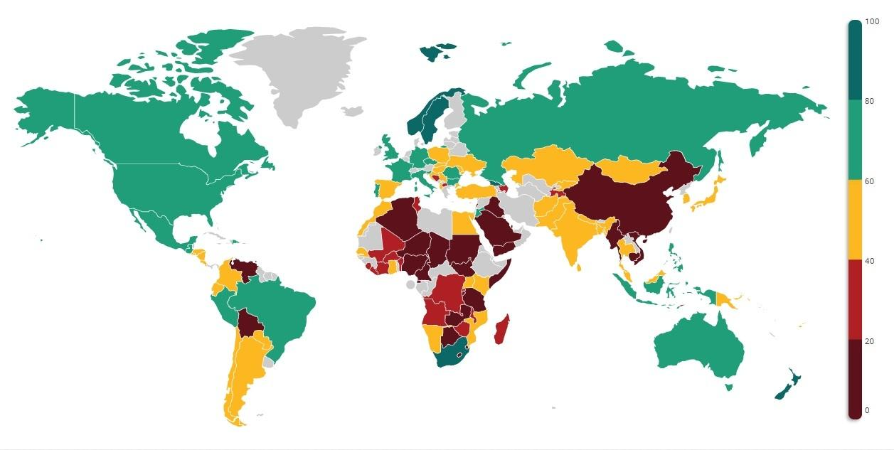
Open Budget Index - Georgia 2006-2017
Source: OECD CESEE SBO, May 25, 2018 “Budgets as Bridges” Insight from the Open Budget Survey 2017, By Elena Mondo, Senior Technical Advisor, IBP

Slide 5
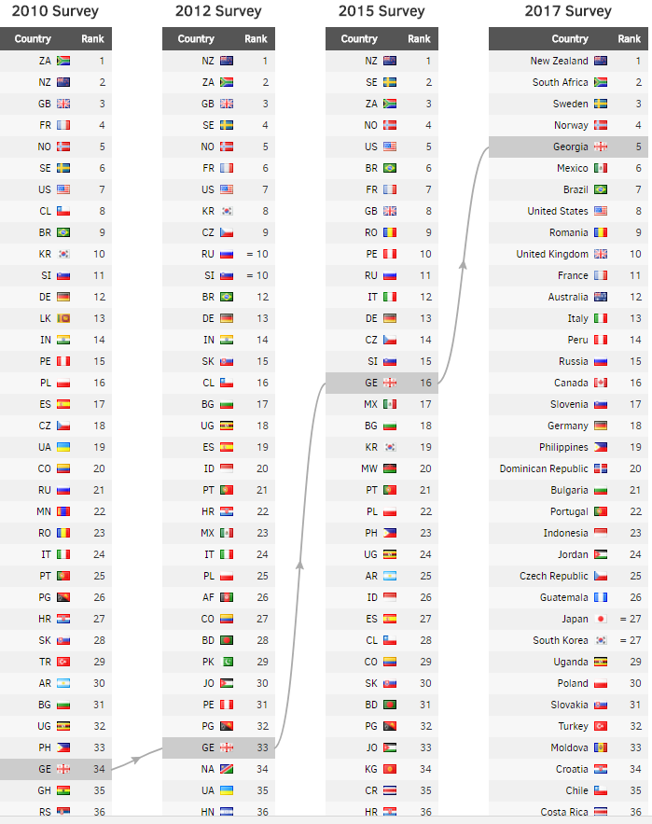
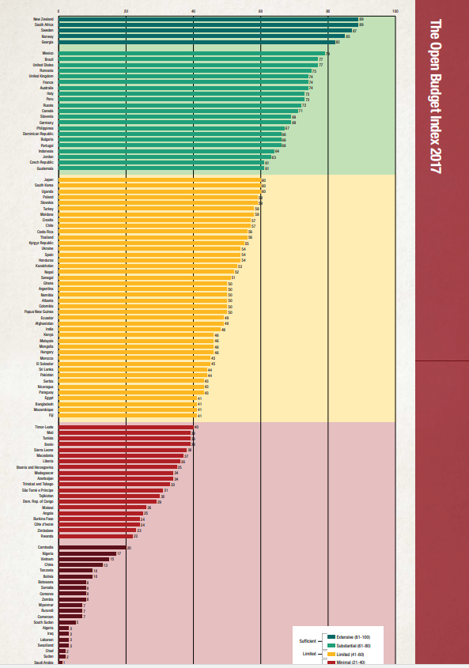
Georgia - Open Budget Survey 2006-2017

Slide 6
PEFA - FTE – PIMA
PEFA Assessment report validated by the World Bank published in 2018, which covers 2014-2016 completed year. According to the assessment:
Georgia has a strong performance on the 7 PEFA pillars compared to average results of 24 countries that have used the 2016 PEFA Framework;
Georgia’s 29 out of 31 indicators (94%) scored higher than average scores for 24 countries;
27 out of 28 (96%) indicators improved or were maintained in 2017 compared to 2012 PEFA scores
With support of IMF technical Assistance:
- Fiscal Transparency Evaluation (FTE) report prepared in 2017 - Georgia meets the standard of good or advanced practice on 18 of the 36 principles, and the basic standard on a further 10 principles;
“Enhancing the Fiscal Rules Framework” report prepared and published in 2017;
Public Investment Management Assessment (PIMA) report prepared in 2017.

Slide 7
Implementation of Program Budgeting in Georgia
2007
2010 Budget proposals were prepared in parallel with the organizational structure according to the program budget structure by three Ministries;
2011
Program Budget Methodology was finalized and adopted by the Minister of MOF (Government Resolution N385, July 8, 2011);
2015
2016
Program Budget Methodology updated (MOF Decree N265, August 14, 2015);
Methodology for Public Investment Management (PIM) became the part of program budget methodology adopted by the Minister of Finance;
2018
Program Budget Methodology updated (MOF Decree N283, July 30, 2018)
2010
Implementation Plan of Program Budgeting adopted by the Government of Georgia in 2010 N284 according to which 2011 Budget proposals were prepared in parallel with the organizational structure according to the program budget structure by additional two Ministries
2012
2012 State Budget proposals were submitted to MOF in program budget format; Draft of the 2012 State Budget submitted to the parliament in program budget format
The role of Internationall partners (GIZ, EU etc.)was significant in this process
Notes:
2009 - საქართველოს იუსტიციის სამინისტრომ;
საქართველოს განათლებისა და მეცნიერების სამინისტრომ;
საქართველოს შრომის, ჯანმრთელობისა და სოციალური დაცვის სამინისტრომ;
2010 - +საქართველოს სოფლის მეურნეობის სამინისტროს;
საქართველოს გარემოს დაცვისა და ბუნებრივი რესურსების სამინისტროს;

Slide 8
Updated Program Budget Methodology – Program Budget Structure
The program budget incorporates a broader indicators system:
Basic Indicator (Baseline);
Targeted Indicator;
Possible Risks;
Possible Deviations.
It is important to put data source for measuring relevant indicators.
Name of Program (Program code)
Implementing Agency
Program Description and Goal
Expected outcome
Performace Indicator:
N | Basic Indicator (Baseline) | Targeted Indicator | Possible Deviation (%/Discription) | Possible Risks
1
2
3
4
5. (Gender Indicator if applicable)
Since 2017 All line ministries approve their Medium-Term Action Plans which is in compliance with Annual Budget Law and the Basic Data and Direction document (BDD)

Slide 9
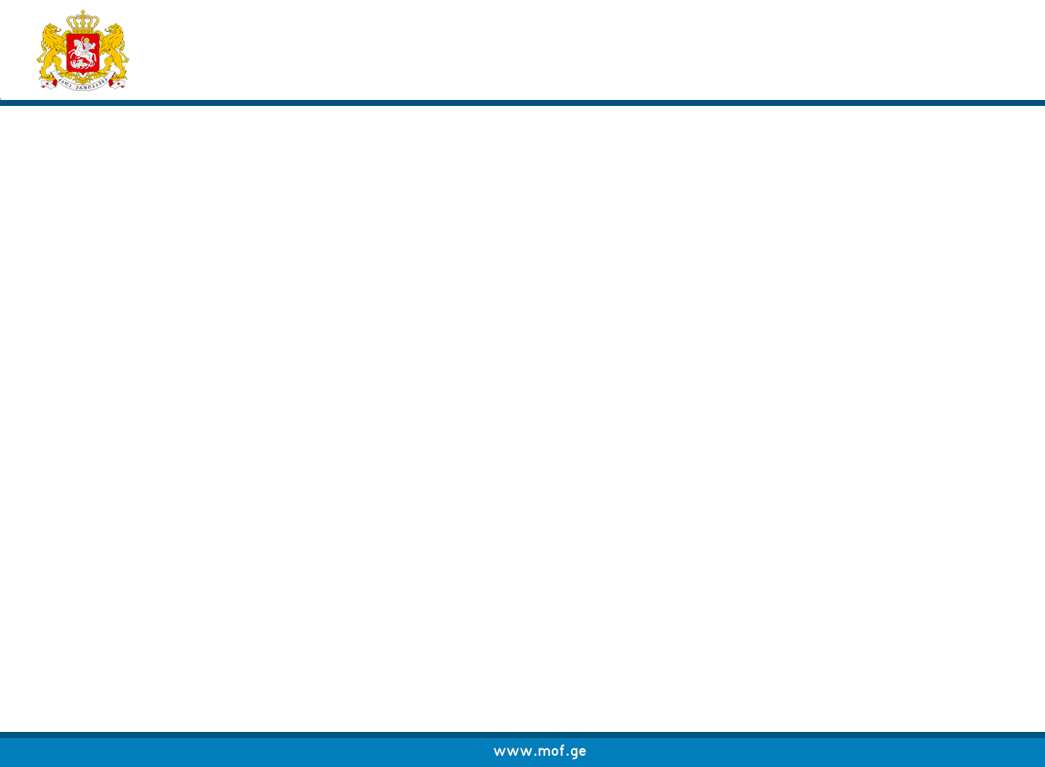
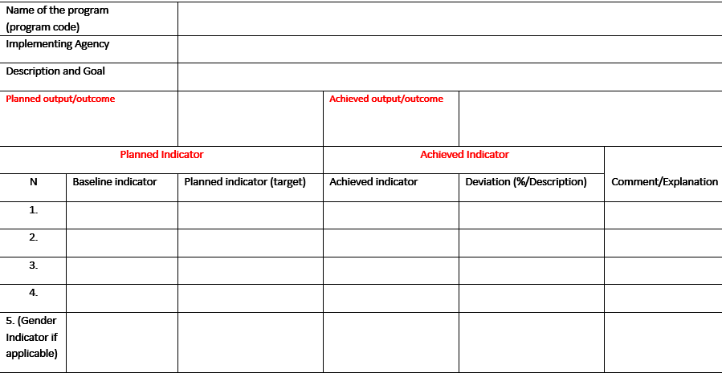
Program Budget Execution Report

Slide 10
Next Stages in the process of Implementation of Program Budgeting in Georgia
Program Budget Methodology:
Role of Internal Financial Management and Control reform as a mechanism of better planning;
Linkages between sector strategies and action plans including line ministries’ action plans and budget documents, as well as compliance with international best practices and recommendations issued by the different International organizations;
Clearly defined new initiatives/new policy and assessing their impact on Budget revenues and expenditures;
Costing the activities related to policy planning and regulation (administrative type of program).
Local Budgets:
Improve the role of Priority Documents to become a framework for effective planning;
Introducing medium-term action plans, where the budget program/sub-program is further broken down into activities and costed;
Program budget structure updated as it was presented for the state budget with broader indicator system (baseline and target indicator, possible risks and possible deviation);
Program budget Reporting format changed – links between planned and achieved outputs/outcomes and indicators improved.

Slide 11
Challenges in Program Budget Implementation process
Improve linkages between strategy documents (Government Program, BDD, sector strategies and action plans and other strategic documents) and budget documentation (program budget and medium term action plans);
Clearly defined outputs and outcomes and measurable indicators as well as descriptions and goals of the programs/sub-programs;
improve the quality of Medium-term action plans of the line ministries; costing of all activities are prepared and in compliance with BDD and Annual Budget law;
Improve monitoring system of program budget execution and in parallel to improve planning and reporting.

Slide 12
Medium-Term Planning
Sector Strategies
Annual Budget
Mid-Term Action Plans
Government Programme “FREEDOM, RAPID DEVELOPMENT, PROSPERITY”
Basic Data and Direction (BDD) document
Medium-Term Action Plans of Line Ministries
Role of MOF and the
Administration of
Government of Georgia
Annual Budget
Detailed Action Plans
Aggregate Framework

Slide 13

PFMS Modular Structure
eBudget
RS
eHRMS
SPENDING UNIT
eTreasury
eCustoms
eDMS
NBG

Slide 14
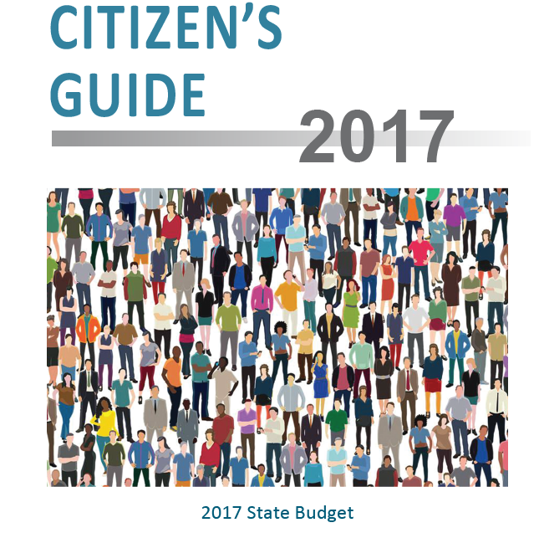
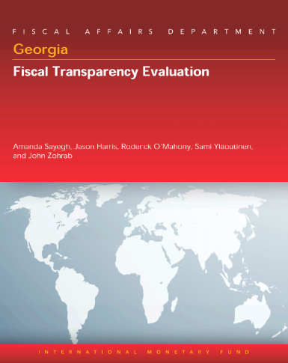

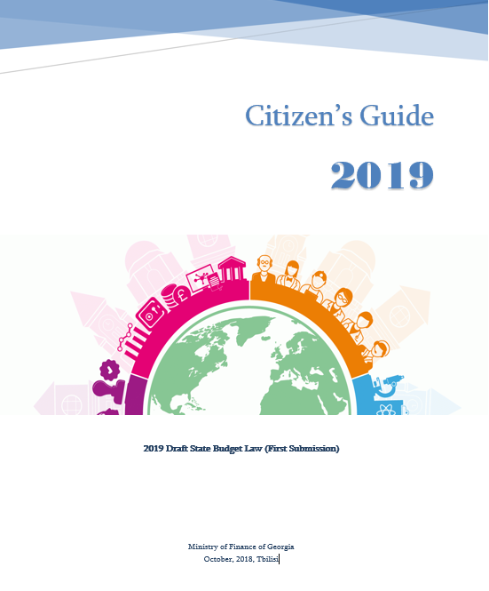
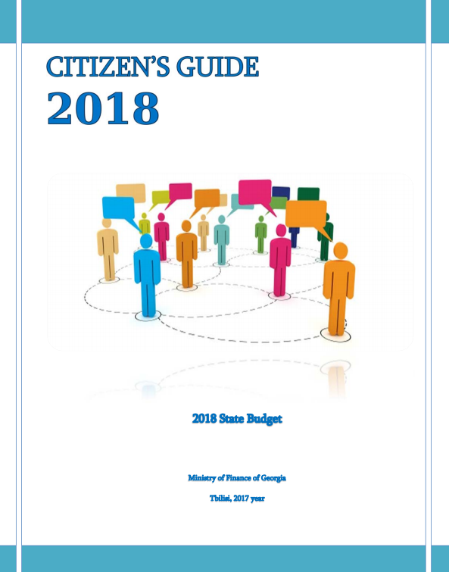

Budget Transparency
Started to publish budget documentation in a machine readable format in 2018

Slide 15

THANK YOU

