Slide 1

Philippine Cash Management Operations
26 May 2023
KENNETH A. FRANCISCO
Bureau of the Treasury
Republic of the Philippines
Notes:
Good morning!
First, please let me express my gratitude to PEMPAL for inviting my institution to join this conference. I have certainly learned a lot from the sessions we had so far over the last 3 days.
My name is Kenneth Francisco; I am the Director of Asset Management at the Bureau of the Treasury of the Republic of the Philippines.
For proper context, the Treasury is it’s own Bureau under the Ministry of Finance, Headed by the National Treasurer who reports to the Minister of Finance.
Our primary responsibility is to undertake the fiscal agency functions of the Central Government, which in short means we ensure that the cash requirements of the entire government are fully funded, either by revenues collections or through borrowings, which the Treasury also undertakes.
For the next several minutes, I will provide a cursory overview of how cash management operations is being handles in the Philippines, touching upon the processes and on some of the issues that we face.

Slide 2
Outline of Presentation
Treasury Single Account (TSA)
Revenue Collection Process and Its Issues
Budget Execution
Modified Disbursement Framework (MDS)
Implications on Cash Management
Notes:
This presentation is organized as follows:
Treasury Single Account (TSA)
Revenue Collection Process and Its Issues
Budget Execution
Modified Disbursement Framework (MDS)
Implications on Cash Management

Slide 3
I. Treasury Single Account
Implementation of the Treasury Single Account (TSA) Initiative
  In 2013, the Philippine Treasury implemented the TSA initiative to improve its cash management operations.
  The TSA is both an account maintained in the central bank and a framework for a unified structure of government bank accounts enabling consolidation and optimal utilization of the National Government’s cash resources.
Before the TSA | After the TSA
Extended “Float” period for tax collections | Tax collections must be remitted after one business day. (fee-based compensation)
Implementing agencies can easily open new bank accounts. | Stricter approval process before agencies can open bank accounts.
Weak monitoring of bank accounts outside TSA | Regular reports by banks of existing government bank accounts. Active efforts to close unnecessary accounts.
Notes:
The implementation of our Treasury Single Account is fairly recent. It was adopted only in 2013.
Before the TSA, the Philippine government has a very fragmented system for handling government receipts and payments.
There were 323 accounts owned by the Treasury, 6317 accounts owed by ministries, and 367 off-budget accounts.
All these accounts were used for different revenue collections and disbursements purposes.
So, there was no unified view of available government cash resources, leading to poor cash management decisions.
The TSA that we have right now is both an account maintained with our central bank and a framework for a unified structure of government bank accounts.
Its principal objective is to enhance the consolidation and optimal utilization of the government cash resources
By centralizing cash resources into a single account, the TSA facilitates better control, monitoring, and efficient utilization of funds.
There are other changes to our banking arrangements that were implemented through the TSA:
First, we shifted from an extended float-based to a fee-based scheme for compensating our agent banks that are doing revenue collections on behalf of government.
Before, agent banks were allowed to hold their collections for 5 to 11 days as compensation for their services.
However, this was estimated to be more costly because of the need to borrow from the money market while waiting for the collections to be remitted to the government.
So, we enforced a T+1 remittance schedule and opted instead to pay a small fee per transaction to the agent banks as compensation (P40/ OTC and P10/ electronic transactions).
Second, we centralized the opening of new bank accounts with the National Treasury.
Through several executive orders, ministries and implementing agencies can open bank accounts only upon receiving written approval from the National Treasurer.
And to get approval for maintaining accounts outside of the TSA, the requirement is to have clear legal basis, typically in the form of a special provisions in the budget or a new legislation, which is difficult for the agencies to secure.
Lastly, the implementation of the TSA has provided the Treasury with enhanced visibility into the bank balances of Ministries.
For agencies that are allowed to open new accounts outside of the TSA, they are required to submit waiver of bank confidentiality.
And for agencies with existing accounts outside the TSA, they are required to provide regular reports on the balances of their maintained accounts.
The ability to monitor these balances enable the Treasury to swiftly reallocate funds, especially during periods of emergencies such as during the COVID-19 pandemic when the national government faced immediate need for large funding.

Slide 4


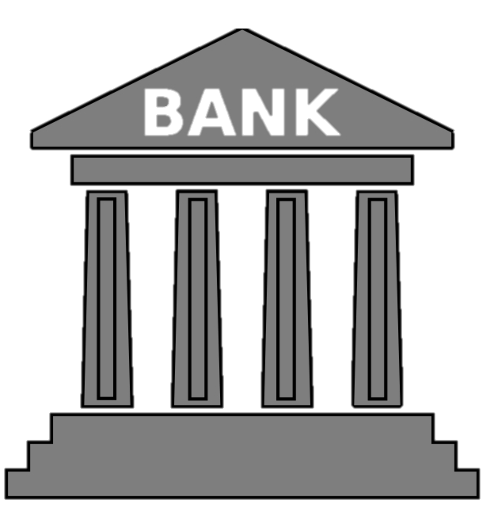

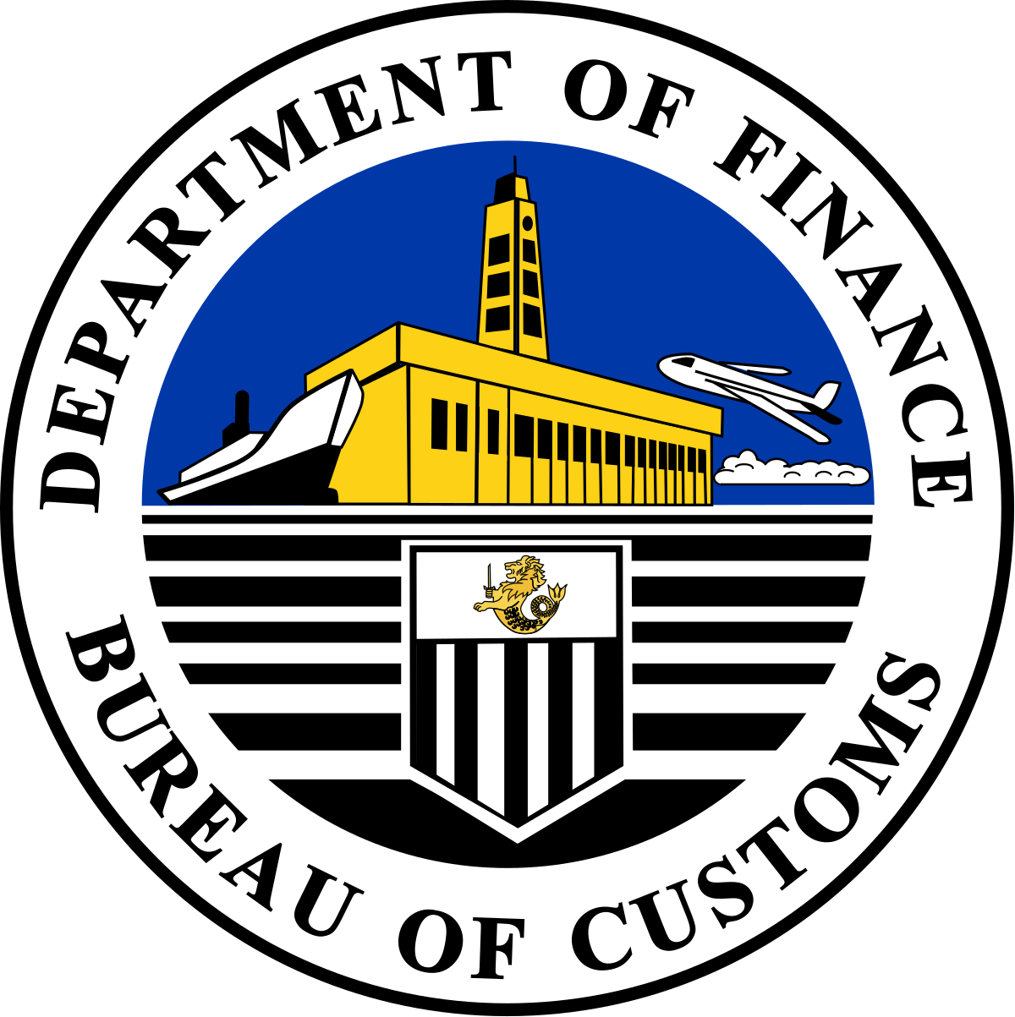
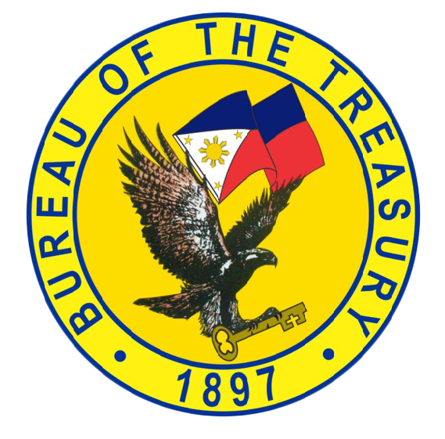
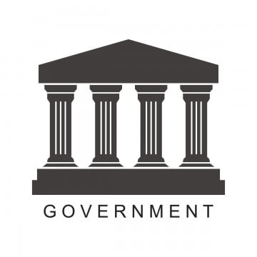
II. Revenue Collecting Process
TSA
Taxes
EFPS
LBDES
Payment
Remittance NLT 11:30AM NBD (T+1)
Monthly Reconciliation
PhilPaSS Viewing Access
LBDES Report
Custom Duties
File & Pay
E2M
PASS5
Payment
Taxpayer/Client
AAB/AGDB
Report NLT 4:00PM NBD
Monthly Reconciliation
Field Offices
Collection Report/Online Viewing Facility
Head Office
Mode of Collection
Payment
Database Systems
ELE
OTC
Monthly Reconciliation
NGCDS Report
Notes:
This an overview of our revenue collections process.
There are three broad sources of revenues:
The tax collection of our Bureau of Internal Revenues on top.
The collection of custom duties of our Bureau of Customs in the middle.
And the collection of fees and charges by many government agencies at the bottom.
And what is important to emphasize here is that the collection is being done by the agencies themselves, through a conduit authorized agent bank.
The collection system can either be electronic, manual or hybrid, depending on the collecting agency, and the collection is first aggregated in the collecting agencies conduit bank before being remitted to the Treasury Single Account no later than 11:30 am of the next business day.
The conduit bank is also required to provide a remittance report to the National Treasury no later than 4:00 pm of the next business.
The second point that I would like to emphasize here is that, because the collections are being handled by the agencies, the source of truth with regards to the nature of the collections and real amount that should be collected is the report submitted by the collecting agency to the Treasury’s data base system, which is reconciled with the reports coming from the agent banks on a monthly basis.
Taxpayers file taxes for the Bureau of Internal Revenue through eFiling and Payment System (eFPS), LImited Bank Data Entry System (LBDES), or ePay; or pay customs duties for the Bureau of Customs through various electronic systems like Electronic to Mobile (E2M) or Payment Application Secure System v.5/6 (PASS5/PASS6), meanwhile for fees and charges (such as applying for driver’s license, passport, birth certificate, etc.) clients go directly to either government’s frontline office or through a third-party service providers.
Payments can be made using various methods (over-the-counter / digital payment). Authorized agent banks of BIR & BOC collect and remit taxes and custom duties on behalf of the National Government. Meanwhile, National Collecting Officers of NGAs deposit fees and charges to authorized government depository banks. These banks must remit collections to the Treasury Single Account (TSA) with the Bangko Sentral ng Pilipinas by 11:30 AM the next banking day from the collection date. They must also report collections to the BTr through a reporting and monitoring system (TRAMS and NGCDS) by 4:00 PM the next banking day, or face penalties. The collecting agencies are required to reconcile with the BTr on a monthly basis.
Note: BIR – 20 AABs; BOC -36 AABs. Banks need accreditation from BIR and or BOC to be an AAB.
TSA Reporting And Monitoring System (TRAMS)
The TSA Reporting And Monitoring System (TRAMS) is a part of suite of banking services provided to BTr to support the TSA implementation. It is a web-based application accessible through a secure FTP site and provides BTr with up-to date information on BIR/BOC/Other NGA collections and to support Treasury cash management activities.
TRAMS, as part of the initiative to implement the TSA, was developed for the purpose of providing BTr with a consolidated view of its cash position through the acceptance of report from the AABs and AGDBs via a secure File Transfer Protocol (FTP) site. Moreover, TRAMS shall equip the Bureau of the valuable tool for a simplified and efficient electronic monitoring of collections and generate desired reports that are necessary for decision-making. (TC No. 03-2013) (Dec/11/2013)
The system went live on January 2014.
Features:
Collection Module – captures remittances of taxes, custom duties and nontax collections to TSA
Disbursement Module – covering all NGAs MDS accounts disbursements including BTRs interest payments beginning 2015
Note: Treasury Circular No. 03-2013 – Implementing Guidelines of the Memorandum of Agreement for Authorized Agent Banks (AABs)/Authorized Government Depository Banks (AGDBs) in the collection and remittance of National internal Revenue Taxes/Custom Duties/Other National Collections under the TSA Framework.
National Government Collection and Disbursement System (NGCDS)
The National Government Collection and Disbursement System (NGCDS) is the Bureau of the Treasury’s (BTr) new collection and disbursement system. The web-based system was developed to help streamline the processes, ensure compliance with the Unified Accounts Code Structure (UACS), and provide a more efficient reporting and monitoring of collection and disbursement of various National Government Agencies. With the NGCDS, the BTr can more easily monitor and verify remittances of government agencies as daily and monthly collection reports from Authorized Government Depository Banks (AGDBs) are uploaded directly to the BTr’s database systems.
AGDBs shall ensure that all deposited collections /remittances through Regular Deposit, Online Collections, Electronic Payment Scheme, Direct Remittance, LDDAP-ADA, Letter request to credit/ Fund Transfer Advice and other type of remittances are included in the Daily Summary of Collection Reports uploaded in the NGCDS. Also, they shall submit to BTr a daily collection in Comma Separated Value (.csv) file format, through the uploading facility access in the NGCDS not later than 7:00 PM of the succeeding banking day from the date of collection.

Slide 5
II. Revenues - Key Operational Issues
Decentralized Collections
  The Treasury simply accepts the remittance of revenue collecting agencies. The main task is to ensure the timely remittance by the banks to the TSA.
  Each collecting agency is responsible for setting up its collection systems and validating the correctness of the amounts paid by tax payers/clients. Main challenge in widespread adoption of digital collections.
Proper Classification of Inflows to the TSA
Inflows must be identified if revenues or trust receipts. Whether earmarked for specific expenditures or not.
Substantial investment by the Treasury in IT systems that can be integrated with collecting banks to properly capture the nature of each collection transaction.
Extensive coordination and reconciliation process with banks and other government agencies.
Notes:
There are significant challenges to the current revenue collection system.
First, because there is no centralized payment system such that each collecting agency have some form of autonomy in the design of their own collection systems, the immediate information available to the National Treasury is limited to amount that is remitted to the Treasury Single Account.
It does not know right away whether the remitted amount transferred to the TSA represents full tax payment owed to the government.
This information is only available to the collecting agencies themselves.
Because the responsibility of collection is with the agencies, it has given rise to non-uniformity in terms of collection systems. For example, some agencies have implemented full electronic collections, while some are still stuck with manual cash registers, while others have adopted hybrid systems that allow for both.
And the diversity in collection systems have multiplied with the widespread adoption of digital collections since there are plenty of digital collection providers that the agencies can engage – from digital banks to digital payment gateways to electronic money issuers, to mention a few. Some agencies even developed their own collection portals to interface with those of the solution providers.
The problem here is that the terms of engagements are non-standardized. For example, convenience fees charged for electronic payments tend to vary per provider and per region, as well as the transaction reports that can be generated.
To address this, the National Treasury has imposed a standardized memorandum of agreement. It is a four-party agreement between the BTr, the collecting agency, the digital collections provider, and the government settlement bank to harmonize some of the terms and conditions of these digital collection engagements.
Now, because the BTr itself does not own the collection process, we have difficulty in breaking down the types of collections remitted to the Treasury Single Account.
The most important of which is the identification of “trust receipts” which cannot be co-mingled with the general fund because they have their own specific use outside of the budget, as well as the identification of “earmarked revenues” which are revenues that by law have very specific programs to fund such as military modernization and subsidies to the universal healthcare program.
Thus, there are two implications for this.
First, the BTr needs substantial investments in IT infrastructure, to embed in the payment and transfer processes the capture of the correct information with regards to the nature of each collection transaction;
And Second, there is extensive dependency with the agent banks and the collecting agencies for the validation and correctness of the amounts and timeliness of the remittances to the TSA.

Slide 6
III. Budget Execution in the Philippines
Annual Appropriations approved by the Legislative Branch
  Validity of appropriations may be extended by one (1) year.
The Department of Budget and Management (DBM) is responsible for over-all budget execution
  The DBM is the agency that issues allotments to implementing agencies to incur obligations or commitments;
  The DBM is also the agency that grants disbursement authority to implementing agencies in the form of the Notice of Cash Allocation (NCA).
Implementing agencies initiate and authorize budget obligation/commitments based on allotments issued
  All obligations are reported to the DBM and the state auditor on a regular basis for consolidation.
Implementing agencies initiate and authorize disbursements based on the NCAs issued
  All disbursements are reported to the DBM and the state auditor on a regular basis for consolidation.
  It is the Treasury’s role to fund the disbursement transactions of all National Government agencies.
Notes:
Going into our budget execution, it is likewise decentralized.
For one, we have an entire separate ministry called the Department of Budget and Management or DBM that oversees budget preparation and execution.
This agency is of course independent from the National Treasury and the Ministry of Finance.
Our annual appropriations or budget is prepared and consolidated by the DBM based on the submissions of hundreds of ministries, line-ministries, bureaus and offices of the Philippine government for approval of the legislative branch.
The validity of appropriations, which is on a calendar year basis, is generally for 1 year.
However, there are some spending items that are allowed to be carried over to the next calendar year, such as operating expenditures which can be extended by 6 months and capital expenditures which can be extended by 12 months.
The extension is specified in the budget law itself or in some cases when it is not, the congress may pass another law for its extension as was the case in 2021 at the height of the pandemic.
Hence, it is possible that in some years, more than one budget is being implemented which makes the review and evaluation of the budget execution significantly more challenging.
Since the Philippines is observing a deficit target, some expenditures in the current year’s appropriation may have to be deferred.
The major steps in the execution of the budget is under the control of the DBM.
They have ownership on the issuance of allotment release orders that give implementing agencies the authority to incur obligations and commitments.
As well as ownership on the issuance of disbursement authority that allows implementing agencies to instruct servicing banks to transfer cash payments to their suppliers and contractors.
This is through an instrument called Notice of Cash Allocation or NCA.
However, the implementing agencies themselves are the ones delegated with the responsibility for commitment controls.
They issue the document that certifies that the budget allotment has been committed or obligated which are then submitted to the DBM and to the state auditor on a regular basis.
This implies that the availability of consolidated information regarding how much of the total allotments of the government are already committed relies on the accuracy and timeliness of the agency submissions. Again, I would like to emphasize that there are hundreds of such agencies.
The implementing agencies are also responsible for initiating the payments with their servicing banks through the issuance of fund transfer instructions or checks based on the disbursement authority or NCA issued to them.
They are likewise required to provide disbursement report the DBM and the state auditor on a regular basis for consolidation.
Since the NCA is delivered by the DBM directly to the implementing agencies, with a corresponding notification to the National Treasury, the Treasury’s role in the budget execution process is limited to the funding of payment instructions which is consolidated through our Modified Disbursement System, which I will discuss in the next slide.

Slide 7
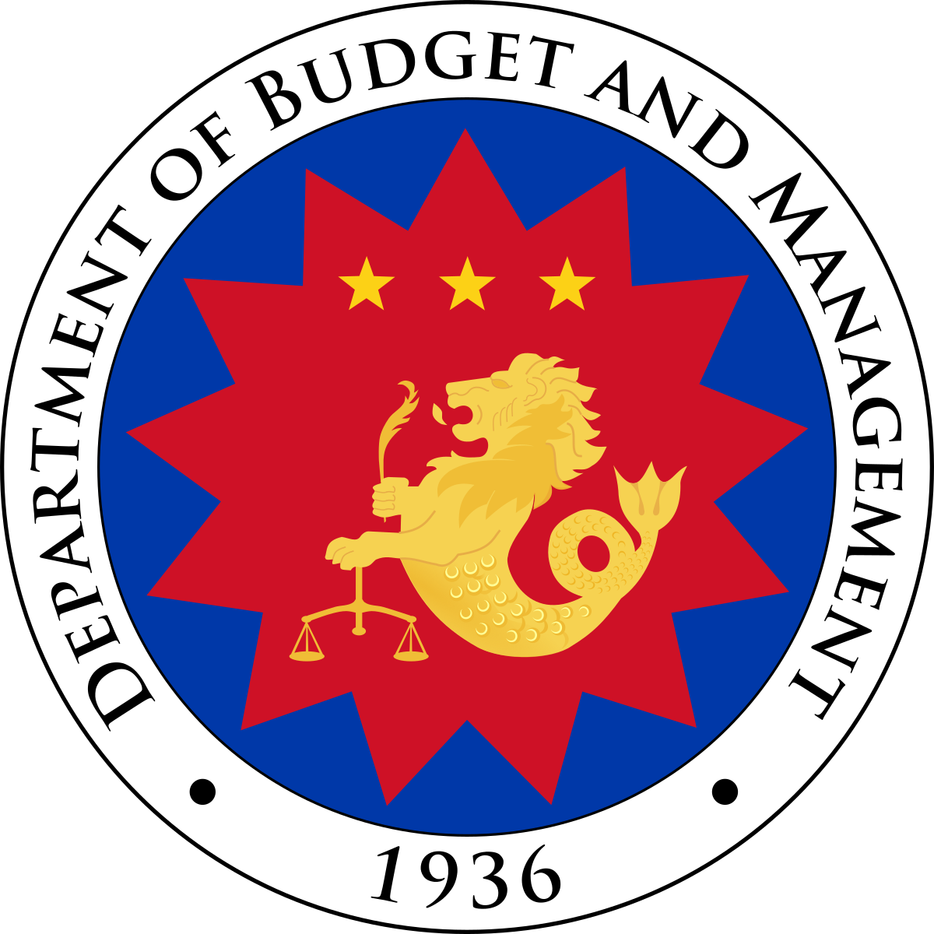
IV. The Modified Disbursement System (MDS)
Request for Funding
NCA – Notice of Cash Allocation
ANCAI – Advice of NCA Issued
MDS – Modified Disbursement System/Scheme
Issue NCA
Implementing Agency
Provide copy of NCA
Provide ANCAI
Maintain/Replenish MDS Seed Fund
Credit MDS Sub-Account
Head Office
Servicing Bank Branch
Notes:
This slide illustrates the disbursement process under our Modified Disbursement System framework.
The Modified Disbursement System (MDS) is a cash management system adopted by the Philippine government to make our decentralized budget execution process become more efficient and less costly.
There are four parties involved in the process: the implementing agencies, the DBM, the MDS servicing bank, and the National Treasury.
At this point I should clarify that the MDS-servicing bank is not our Central Bank.
These are instead government financial institutions which are the only banks outside of our central bank that are allowed by law to maintain government accounts.
Going into the process:
First, the disbursement is initiated when an implementing agency submits a disbursement authority request to the DBM (blue line).
The DBM then evaluates the request based on necessity and consistency with the fiscal program.
If the request is granted, the DBM releases the disbursement authority called the Notice of Cash Allocation (NCA).
Second, the DBM then forwards the copy of the NCA to the implementing agency and to the implementing agency’s MDS-servicing bank.
A corresponding document called Advice of NCAs Issued (ANCAI) is also forwarded to the National Treasury to notify that there is going to be a need for funding. (red line)
Third, upon receipt of the NCA, the MDS servicing bank will top up the balance of the MDS-sub account of the implementing agency by the amount indicated in the NCA.
At such point, the implementing agency may already issue a fund transfer instructions or MDS checks to the MDS servicing bank.
After which, the MDS servicing bank will debit the MDS sub-account and disburse the payments directly to the suppliers’ or the contractors’ bank account (yellow line).
And lastly, after the transaction is settled, the MDS-servicing bank will request the National Treasury for reimbursements.
Only then does the National Treasury transfer funds out of the TSA and into the account with the MDS servicing bank (green line).
Hence, what goes out of the TSA is only the exact amount of cash needed to cover the actual daily disbursements.

Slide 8
V. The Modified Disbursement System
IV. The Modified Disbursement System (MDS)
Use of MDS accounts for disbursements
  Special accounts with “virtual” balances that represent disbursement ceiling (NCA);
  Funds are transferred directly to suppliers and creditors. Agencies do not receive any cash;
  Allows for decentralized disbursement framework while economizing on cash resources
Extensive reliance on government banks
  The Treasury has to rely on the government banks for information on the daily disbursement requirements of the National Government;
  Twenty-four (24) to Forty-Eight (48) hours before disbursement instructions are executed/settled by the government banks. Significant reduction in risk of overdraft.
Continued efforts by the Treasury to reduce reliance on check payments
  Check payments have uncertain settlement dates and substantially complicates cash management operations.
  Three (3) month validity of checks issued by implementing agencies. All checkbooks ordered by government agencies have to be approved by the Treasury.
Notes:
Talking more about the MDS framework, it was implemented because of very specific benefits:
First, the MDS-sub accounts only have “virtual balances,” which means the National Treasury can hold on to its cash resources in the TSA until there is actual need for payment.
And these virtual balances are limited to the amounts indicated in the disbursement authority issued to the implementing agencies, so the observance of disbursement ceilings is already built into the system.
Second, despite the budget execution process being fragmented, the MDS framework at least allows the disbursement process to be streamlined and centralized, such that the funds are released directly to the accounts of the suppliers and creditors, without going through the implementing agencies.
This avoids the scenario where implementing agencies accumulate idle cash.
And lastly, because funds leave the TSA only when there is actual need for it, the National Treasury is able to economize on its resources.
There is no need to borrow earlier than needed and the excess funds will continue to earn interest in the TSA.
---
However, the MDS framework also has it challenges:
The National Treasury knows how much outstanding NCA was already issued because of the Advice of NCA Issued forwarded by the DBM, if you recall from the previous slide. However, the National Treasury does not know when exactly the implementing agencies will execute their payments.
The NCA itself has a validity of three (3) months.
Moreover, there is till prevalent use of MDS-checks because it is the preferred mode of payment of many suppliers, especially for large amounts.
And these checks can be encashed on any banking day within a three (3) months validity period.
Hence, for the National Treasury’s estimate of daily cash requirement, there is extensive reliance on the MDS-servicing banks since they are the ones who receive the payment instructions from the implementing agencies.
We have an entire division that gathers and consolidates information from the hundreds of MDS-servicing bank branches on the fund transfer requests of the implementing agencies.
And one way to ensure that we have sufficient cash to fund the transfer instructions is the imposition of a twenty-four (24) to forty-eight (48) hours waiting period before these fund transfer requests can be executed or settled.
---
As for the MDS-checks, it is still a problem because even the MDS-servicing banks do not know when exactly this checks will be negotiated.
And because these checks are typically for very large amounts, they substantially complicate our cash management operations.
So, our solution is to issue an administrative order requiring all implementing agencies to seek the National Treasury’s approval before they can order checkbooks.
And since then, the use of MDS-checks have already declined significantly.

Slide 9
V. Implications for Cash Management
Conservative cash flow forecasts and scenarios
  Lower than target revenues, but higher than target disbursements
Substantial cash balance buffer
  Calculating optimal cash balances is challenging given uncertainties in the timing of revenues and disbursements;
  Buffer generated by borrowing activities. Potentially costly under higher interest rate environment;
Investment Management Operations
  Excess cash balances to be invested in Government Securities and high yield term deposits to defray the cost of carry
  Income from investments generates fiscal resources to unlock standby appropriations.
Necessity of Integrated Financial Management System for Budget Execution
  Efficiency gains from centralizing commitment control
  Enables stronger oversight on the disbursement activities of implementing agencies
  Facilitates timely generation of budget and accounting reports
Notes:
So, here I summarize the implications of our decentralized revenue collections and disbursement execution process on the Cash Management Operations of the National Treasury.
Recall that the Treasury only receives aggregate information on how much was remitted by the collection agencies to the TSA and that we do not have control on budget execution since we have a Ministry of Budget that handles it independently.
So, to fulfill our mandate of providing adequate funding for the needs of the central government, we tend to be very conservative when in comes to our cash flow forecasts and scenario building exercises.
To make sure that we are prepared for the worse, we adopt the lower-bound for our revenue collection estimates and use the upper-bound for our disbursement projections.
This often leads to the overestimation of our cash requirements, which result in our accumulation of cash buffers.
Because of our tendency for making conservative estimates, we schedule our borrowings earlier than needed, leaving us with comfortable cash buffers for most of the year.
And since this buffers are sourced from borrowings, they have a negative carry that makes it costly, especially under a high interest rate environment.
To make up for this negative carry, we actively invest our excess cash balance, not only in the TSA, but also in higher yielding term deposit facilities, as well as through investments in liquid Government Securities.
These investments typically exceed their annual income targets and in such instances, whenever there is overperformance of income from Treasury investments, some expenditure items that are lodged under our standby appropriations are unlocked.
So these investments are also a way generate fiscal resources.
And for my last point, I would like to emphasize that having an integrated financial management system will go a long way towards addressing the many challenges that comes with our decentralized budget execution set up.
For example, having real time aggregate information on the status of budget commitments will enable better disbursement planning and more accurate cash forecasting.
Right now this is not possible because commitment controls are being handled by each implementing agency, and consolidation of their reports takes time because of the sheer number of implementing agencies.
But with an IFMIS, since this reports will be linked to a system, and updated in real-time, the National Treasury will be able to generate updated commitment reports to know exactly how much is the cash requirement without the need for coordination with the servicing banks.
There have been several attempts to establish an IFMIS in the Philippines; there is one that is currently ongoing. However, the difficulty stems from having very important legacy systems that is at risk of being compromised if not integrated carefully, such as accounting systems and debt monitoring and servicing systems.

Slide 10
Thank you

Slide 11
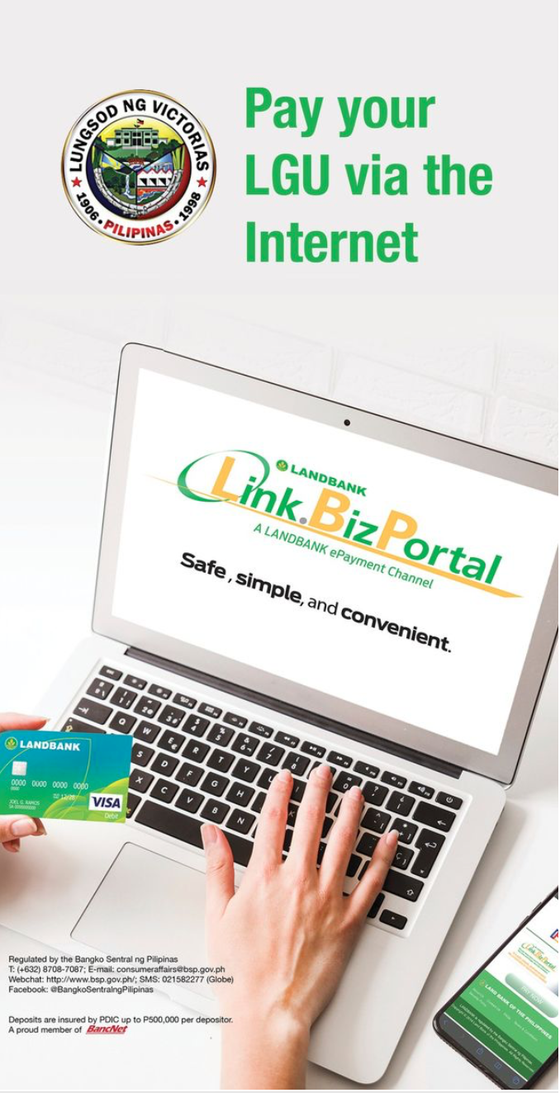
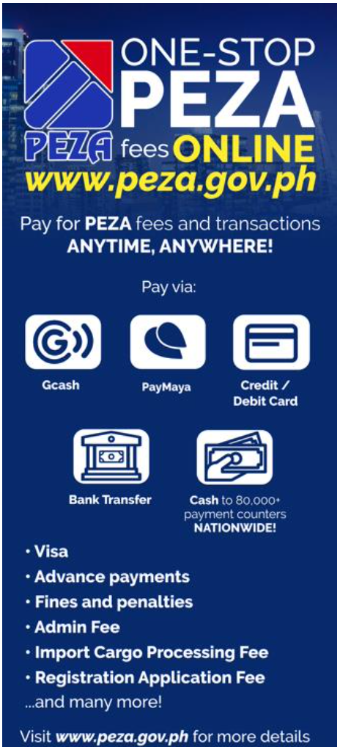

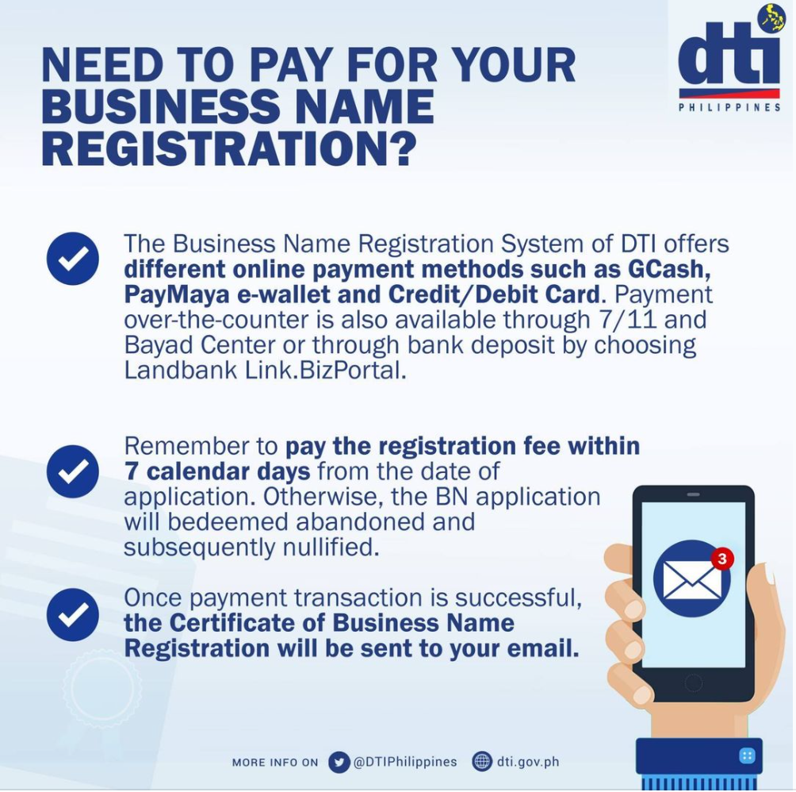
Towards Greater Adoption of Electronic Collections
Continued Public Awareness Campaigns of Available Digital Collection Platforms

Slide 12
Updates on the Implementation of EO 170
Remaining Challenges
A sizable number of government agencies still do not offer electronic collection systems
High convenience fees discourage the use of electronic collection systems by the paying public
Non-issuance of electronic official receipts
  Absence of centralized eOR reference numbering system
Solutions
DICT to launch the E-Gov Pay, an online payment system platform for use of government agencies (May 2023).
The system will provide a centralized e-payment aggregator service which can help government drive down convenience fees. The system is envisioned to issue eORs using the NPO-approved reference numbering system.
In parallel, the National Printing Office (NPO) is currently developing its E-Receipts System (launch date in November 2023). As an interim solution, NPO will provide/assign a predetermined number series for eORs to NGAs.
Landbank will use the E-Gov Pay System to upgrade its existing Linkbiz e-payment solution.

Slide 13
Towards Greater Adoption of Electronic Collections
Tax and Non-Tax Revenues |  | Jan-Dec 2022 |  |  | Jan-Feb 2023
(in Php Millions) |  | Total | Thru AABs | Thru AGDBs | Total | Thru AABs | Thru AGDBs
Bureau of Internal Revenues |  | 1,939,375 | 1,918,875 | 20,500 | 291,505 | 288,170 | 3,334
 |  | (100%) | (100%) | (100%) | (100%) | (100%) | (100%)
 | Over-the-Counter | 286,453 | 265,972 | 20,481 | 41,433 | 38,100 | 3,334
 |  | (14.8%) | (13.9%) | (99.9%) | (14.2%) | (13.2%) | (100%)
 | Electronic | 1,652,922 | 1,652,903 | 19 | 250,071 | 250,071 | 0.49
 |  | (85.2%) | (86.1%) | (0.1%) | (85.8%) | (86.8%) | (0%)
Bureau of Customs |  | 864,765 | 838,712 | 26,053 | 133,905 | 130,344 | 3,457
 |  | (100.0%) | (100.0%) | (100%) | (100%) | (100%) | (100%)
 | Over-the-Counter | 23,333 | 4,888 | 18,445 | 2,185 | - | 2,185
 |  | (2.7%) | (0.6%) | (70.8%) | (1.6%) | (0%) | (63.2%)
 | Electronic | 841,431 | 833,824 | 7,608 | 131,607 | 130,344 | 1,272
 |  | (97.3%) | (99.4%) | (29.2%) | (98.3%) | (100%) | (36.8%)
Other NGAs |  | 151,793 | 0 | 151,793 | 28,604 | 0 | 28,604
 |  | (100%) |  | (100%) | (100%) |  | (100%)
 | Over-the-Counter | 142,975 | 0 | 142,975 | 25,244 | 0 | 25,244
 |  | (94.2%) |  | (94.2%) | (88.3%) |  | (88.3%)
 | Electronic | 8,819 | 0 | 8,819 | 3,360 | 0 | 3,360
 |  | (5.8%) |  | (5.8%) | (11.7%) |  | (11.7%)

Slide 14







































Updates on the Implementation of EO 170
LAUNCH OF DICT E-GOV PAY SYSTEM
NOW
PROPOSED
Banks
Online banks
e-Wallets
eCards
Cash Payments
Kiosks
Banks
Online banks
e-Wallets
eCards
Cash Payments
Kiosks
Agency A
Agency B
Agency C
Agency D
Agency E
Agency A
Agency B
Agency C
Agency D
Agency E
Integration Complexities
Lack of Transparency
Easy Integration
Standard Process and Fees
Collection Complexities
Decentralized Reports
Automated Reports
Reduced Cost
Transparency
No Official Receipt
Overpriced Fees
Cost Intensive
Notes:
DICT is scheduled to launch an e-payment aggregating system for National Government Agencies (NGAs) on March 2023 (DICT to pilot the system)
Landbank has expressed interest in using the system as a potential upgrade of their existing Linkbiz e-payment solution
The proposed e-gov pay will dramatically ease the IT burden on NGAs for EO 170 electronic collections compliance

Slide 15




































Banks
Updates on the Implementation of EO 170
eCards
Online banks
Cash Payments
Kiosks
e-Wallets
Kiosk
mobile
POS
eGovPay can help Government to simplify their payments processing, reduce costs, improve data management, enhance customer experience, make it easier to reconcile transactions and support a wide range of payment methods.
Notes:
Aggregating all
payment channels and
gateways in a single
system. This will
simplify and
standardize all
payment processing
and transactions.

