Slide 1
Developments, Achievements, and the Way Forward
Arman Vatyan, World Bank

Slide 2
Internal Audit COP
PEMPAL
Steering Committee
Bank TL
Guidance/Fiduciary
Lead of the
Community
Executive Committee
led by Chair and two VCs
Internal Audit Community of Practice
Leadership Coordination
Audit in
Practice
logistical support
Thematic
meetings
(role of CHU)
Internal
Control
(ICWG)
(AiP WG)
Secretariat (Kristina Zaituna)
World Bank (WB)
Funding, professional support
Professional support
Information
Information
Russian Federation MoF, SECO, Dutch Academy, and others
Resource people, organizations, professional associations (ИВА IIA, CIPFA, etc.)

Slide 3
IACOP
For details: Welcome to PEMPAL IACOP document

Slide 4
IACOP Enabling Groups
Agenda Activists: to identify and prioritize
the topics, themes and activities that will
help shape future events
External Messengers: prepare a communiques to bring people and knowledge together across CoPs and beyond
Quality friends: reflect on what is working well during IACoP events and between
Value Detectives: collect stories that show the value of IACOP activities for different stakeholders

Slide 5
Knowledge Repository in Wiki – transferring to groups.io

Slide 6
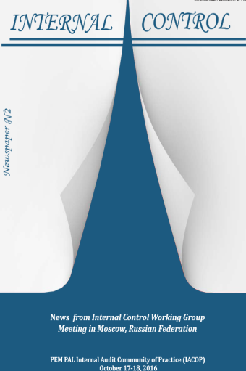
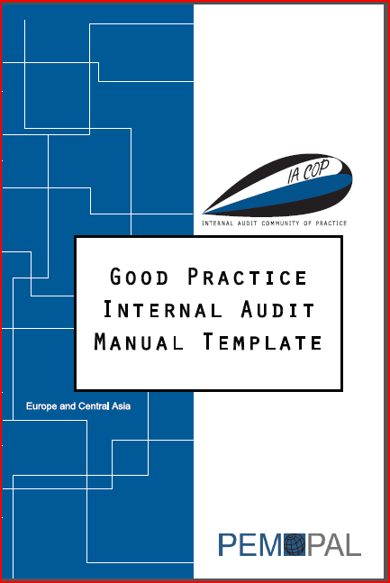
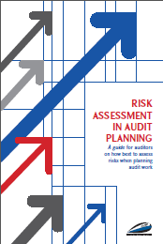
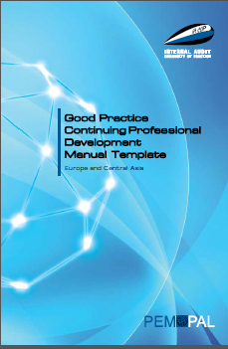
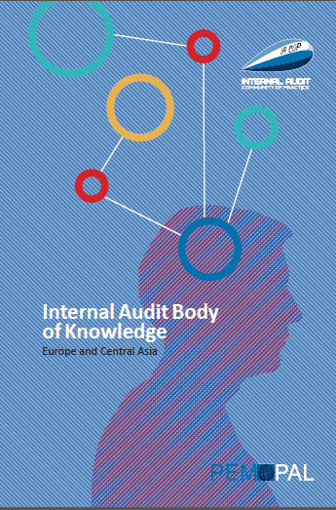
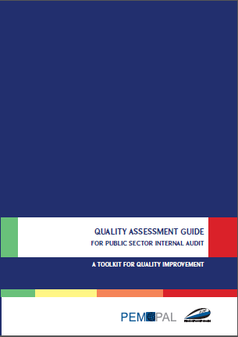
IACOP Good Practice Products
Good Practice IA Manual Template
Good Practice CPD Manual Template
Internal Audit Body of Knowledge
Risk Assessment in Audit Planning
Concept Note on RIFIX (Relationship of Internal Audit with Financial Inspection and External Audit)
Quality Assessment Guide
Newspapers, Communiqués and 100+ other knowledge products

Slide 7
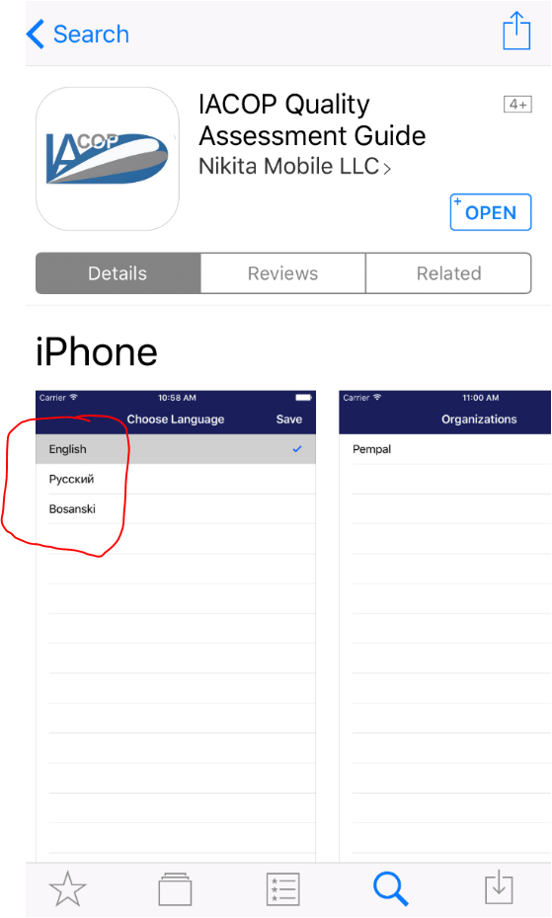
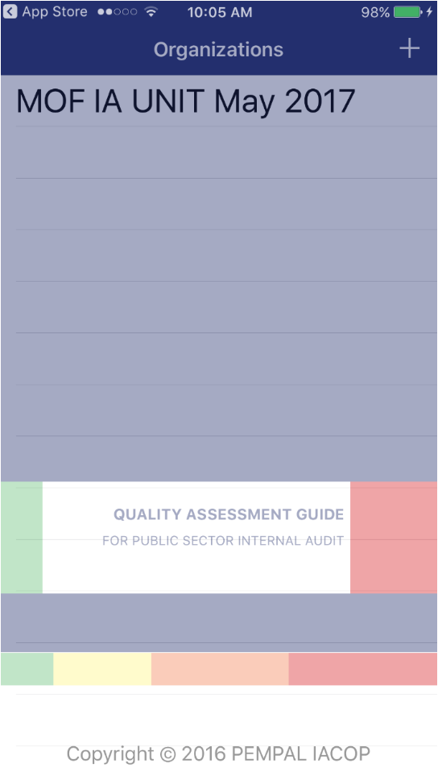
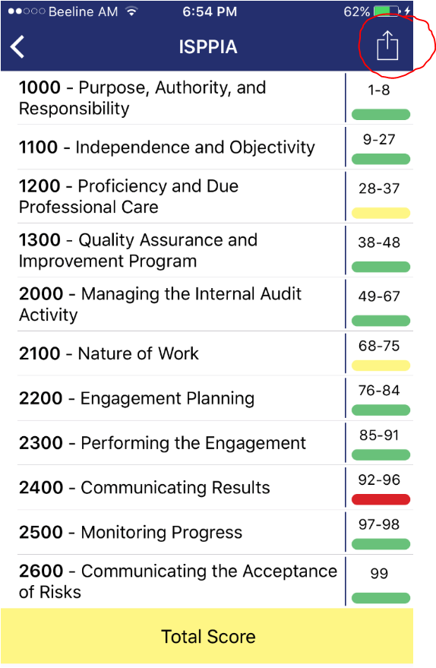
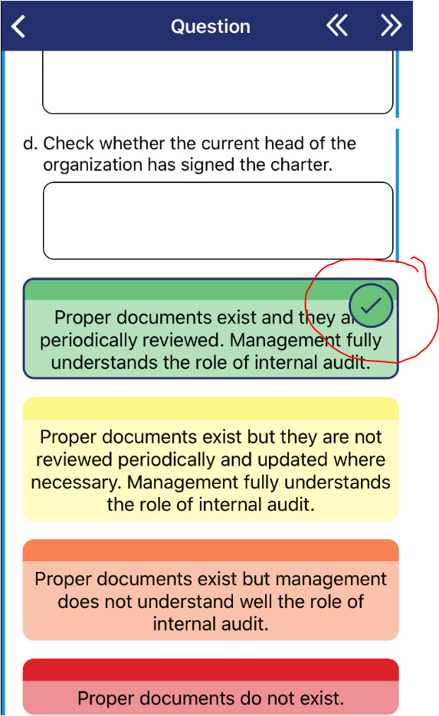
Our Quality Assessment App

Slide 8
IACOP Impact

Slide 9
Reform Progress

Slide 10
IACOP priority themes for the FY 2019-2022
Improved value and impact of internal audit
Public Internal Control - the role of CHU and internal auditors (ICWG)
Synergy: PIC with emphasis on integrity management and anti-corruption
Practical implementation of audit cycle, different types and operational models of audits, including IT solutions (AiP WG)
The role of CHU in public sector reform coordination and CHU’s challenges and functions at different stages of the reform
Promotion of IACOP and dissemination of its knowledge products and experience gained in ongoing and previous working groups: RIFIX, T&C, CPD, RA, QA, IC, AiP

Slide 11
PEMPAL professional Family

