Slide 1

PROGRESS OF the ICWG
Edit Nemeth, Leader of WG

Slide 2
1st meeting of ICWG – Prague, 2016 March
Objectives & achievements:
Introduce the new Internal Control Working Group (ICWG)
Share key principles and understanding of the Public Internal Control (PIC) from the EU among members – European Commission, Georgia, The Netherlands, Russia
Clear understanding of definitions and important players in PIC area
Agreement on the next steps in the ICWG
Agreement to make a glossary for important definitions

Slide 3
2nd meeting of ICWG – Moscow, 2016 October
Objectives & achievements:
Share member countries’ good practices in internal control (IC), and learn how countries have addressed implementation challenges – Belarus, South Africa
Enhanced understanding of internal control terminology and the COSO Framework’s 17 principles applied in the public sector
Knowledge of the IC good practices and potential challenges in implementation
Clarity on the next steps in the ICWG

Slide 4
3rd meeting of ICWG – Budapest, 2017 March
Objectives & achievements:
Learn the key recent developments on Public Internal Control (PIC) reforms in the ECA region and beyond – European Commission, Brazil, South Africa
Understand the internal and external factors for establishment of sound accountability through the three lines of defence
Contrast the accountability concept applied in centralized vs decentralized public administration systems, sharing member countries’ good practices in addressing implementation challenges
Enhanced understanding of accountability concept and its implementation in practice
Solid understanding of the role of CHU and internal auditor in establishment of sound accountability
First draft of the glossary

Slide 5
4th meeting of ICWG – Brussels, 2018 February
Objectives & achievements:
Learn the key recent developments and good practices from the European Commission (EC) and Belgium in implementing public internal control (PIC)
Share good practices on implementing internal control, with emphasis on the key elements and facilitating factors of managerial accountability
Understand how to assess internal control including managerial accountability implementation, and discuss the roles of internal auditors and Central Harmonization Units (CHU)
Review the progress made with PIC glossary and its translation
Establish PEMPAL criteria for assessment of the managerial accountability of a budget organisation
Understanding of good practices in implementing and assessing PIC including managerial accountability in the EC, Belgium, PEMPAL member countries and beyond
Agreed PEMPAL criteria for assessment of the managerial accountability of a budget organization
Updated PIC Glossary including its translation

Slide 6
5th meeting of ICWG – Tbilisi, 2018 October
Objectives & achievements:
Understand control environment and application of related COSO principles in the public sector context
Identify interlinkages with other COSO principles and the three lines of defence model
Share good practices and practical tools for establishment of sound internal control environment in a public sector organisation
Establish criteria for assessment of control environment in the public sector context
Common understanding on how to apply or adapt the COSO principles related to Component 1 (Control Environment) and establish a sound control environment in the public sector
Collect good practices and practical tools for establishment of sound internal control environment in a public sector organization
Draft discussion paper on control environment
Draft criteria for assessment of control environment in the public sector

Slide 7
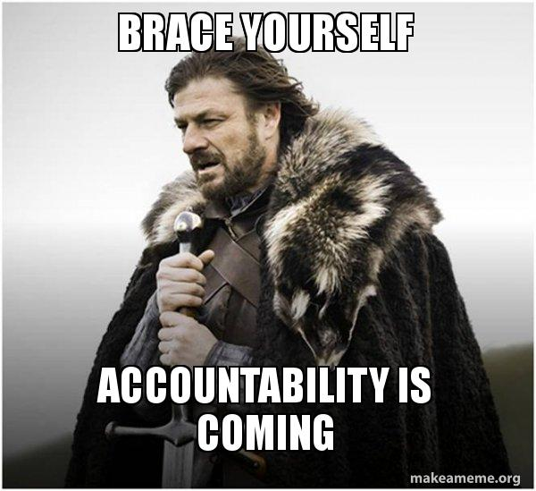

Events:
Prague, Czech Republic – 2016 March
Moscow, Russia – 2016 October
Budapest, Hungary – 2017 March
Brussels, 2018 February
Tbilisi, 2018 October
Outputs:
Knowledge on basics: IC terminology, COSO Framework, The three line of defense
Public sector specifics in internal control systems, how to apply standards and good practices
Clear understanding the EU approach to PIC
Accountability – concept and implementation
Shared country experiences
Role of IA and CHU in establishment of sound accountability
Draft glossary – future knowledge product
PEMPAL IACOP criteria for assessment of managerial accountability – future knowledge product
PEMPAL draft Discussion Paper on the Control Environment

Slide 8
Thank you for your kind attention!

