Slide 1
Spending Reviews in Ireland
Annette Connolly
Department of Public Expenditure and Reform

Slide 2
Background
Spending reviews have played an important role in Ireland’s efforts to restore expenditure policy to a more sustainable footing.
Primary focus – reducing expenditure to meet fiscal targets at a time of unprecedented fiscal consolidation.
Three comprehensive reviews of expenditure conducted since 2009.

Slide 3
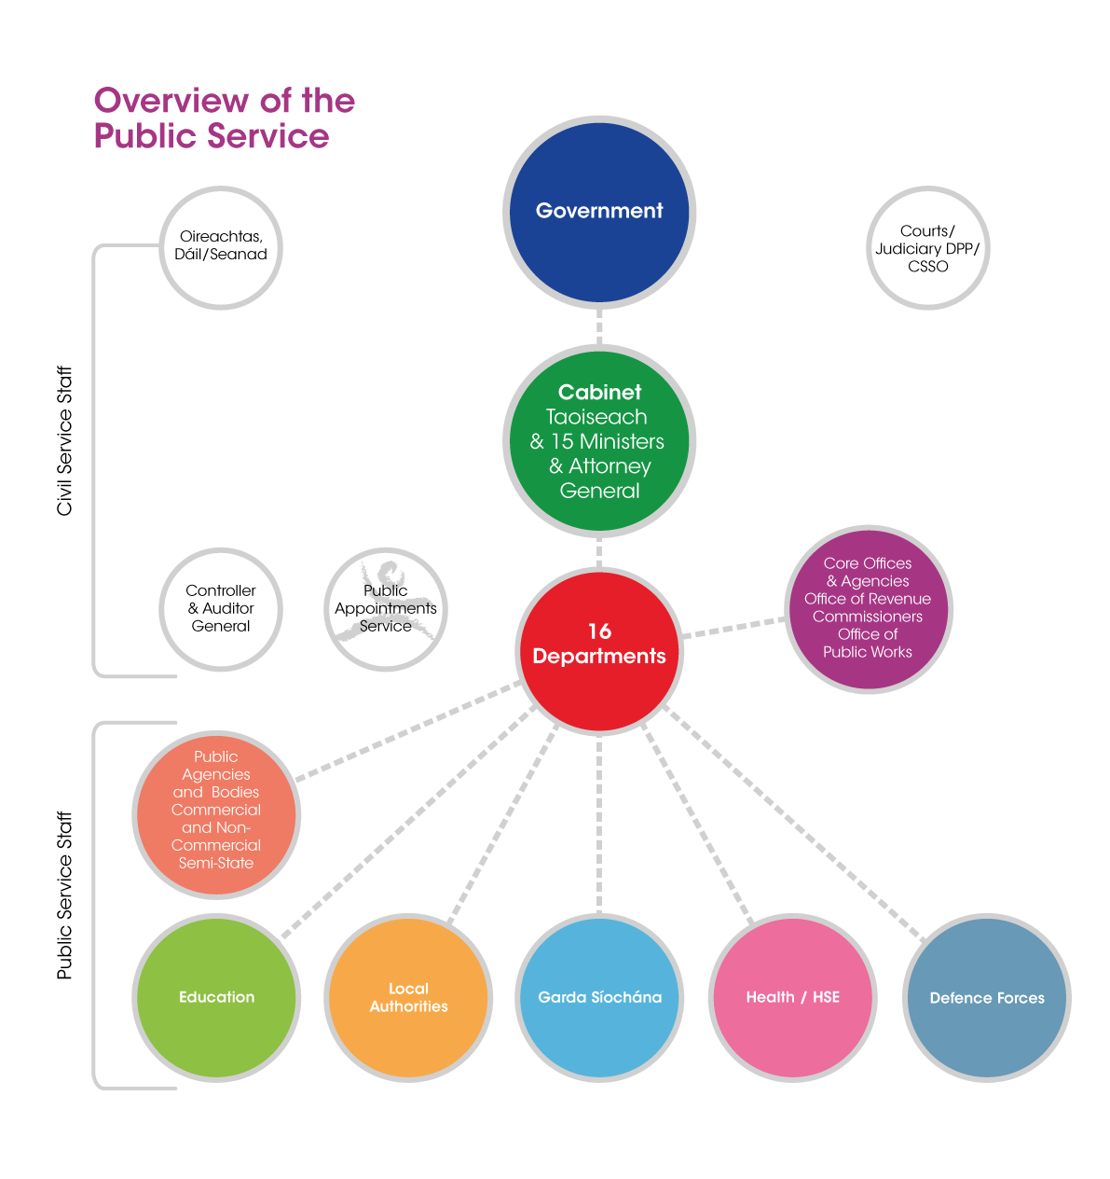
The Irish Public Service: Overview

Slide 4
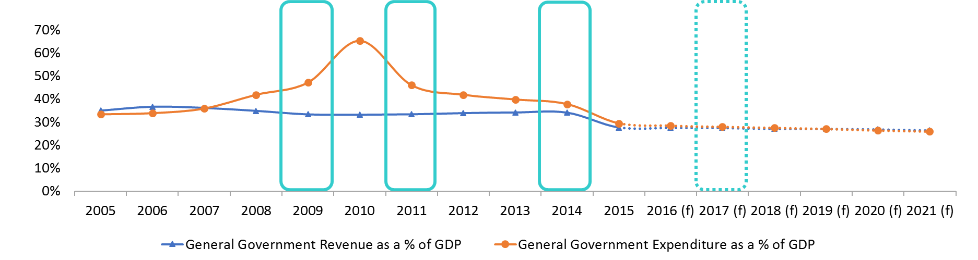
Context of Spending Reviews
Goal: From deficit reduction ➔ increasing fiscal space

Slide 5
Collapse in Economic Output post-2007

Slide 6
Impacts on the Public Finances

Slide 7
Widening General Government Deficit

Slide 8
Breakdown of Expenditure by Department
Three big spending Departments generally spend 75-80% of total expenditure.

Slide 9
Special Group – “McCarthy Report” (2009)
Preceded by a round of administrative efficiency measures in 2008 – still an urgent need to find savings
Objective:
Review the scope for reducing or discontinuing Expenditure Programmes with a view to eliminating the current budget deficit by 2011.
6 month timeframe – no explicit savings target identified
External Membership – Six Members of the Group chaired by Mr Colm McCarthy, School of Economics University college Dublin.

Slide 10
Methodology
Each Department was invited to meet the Group and to submit an evaluation paper in advance – structured template provided in advance.
In parallel with this process, the Department of Finance Vote sections (which monitored spending in the various Departments) prepared independently their own evaluation papers with recommendations and options for expenditure and staff reductions.
Both sets of evaluation papers were considered in advance of meeting the management teams of each Department.

Slide 11
Outcome
The Special Group identified potential expenditure savings of €5.3bn in a full year, with associated reductions of over 17,300 in public service numbers.
The breakdown of savings, amounted to 9.3% of relevant expenditure
Most but not all of the savings identified were potentially deliverable in 2010, as some options would deliver full savings over a number of years.

Slide 12
A New Direction
The Department of Public Expenditure and Reform (DPER) was established in 2011
The new Department was comprised of the Sectoral Policy and Public Service Management Divisions of the Department of Finance with units assigned from the Public Service Modernisation Division of the Department of the Taoiseach.
Since 2011 DPER has driven and had oversight of the Comprehensive Reviews of Expenditure.

Slide 13
Comprehensive Reviews of Expenditure
Conducted in 2011 and 2014
Planned reviews undertaken on a periodic basis
Integrated in the reformed expenditure framework
Final decisions made by Government and presented to the Oireachtas as part of the annual budget process.
The next Comprehensive Review of Expenditure is due to take place in 2017.

Slide 14
Comprehensive Review of Expenditure (2011)
Objective
  re-align spending with the revised Programme for Government priorities;
  meet overall fiscal objectives; and
  explore new and innovative ways of delivering Government policy in a reformed Public Sector.
Result of analysis to be used to develop multi-annual budget plans with a 3 year time horizon.
Internally led – high-level steering group chaired by the Department of Public Expenditure and Reform

Slide 15
Comprehensive Review of Expenditure (2011)
Departments had responsibility for evaluating every budget programme under their responsibility.
Templates were provided by DPER – three value for money tests:
  Purpose of the Programme
  Effectiveness
  Efficiency
Submissions were invited from members of the public and were passed on to the relevant Department for consideration.

Slide 16
Comprehensive Review of Expenditure (2014)
First Spending Review to ask Departments to identify a certain volume of savings – 5% of the expenditure ceilings for 2015.
Similar methodology to the 2011 CRE with the addition of a Working Group of Senior Officials to support the High Level Steering Group.
The Working Group managed the day-to-day operation of the CRE process allowing the Steering Group to have an overview of how the CRE was progressing.

Slide 17
Departmental expenditure growth:
Three-year intervals

Slide 18
Lessons Learned (1)– Be Prepared to Invest
Spending Evaluations are resource intensive.
Important to be aware of the necessary commitment and time investment required at the outset
Crucial that staff have the necessary expertise – can’t be driven entirely by the central expenditure function, Departments need to have the internal capacity to conduct the necessary analysis.

Slide 19

Lessons Learned (2) – Leadership and Ownership
There must be buy-in at a political level and among senior management.
External leadership was important at outset
  Special Group provided an external viewpoint
  External Recommendations - helped implementation
After initial stage, important that ownership of the process shifted back to public service – embed the culture of evaluation
Challenge going forward is sharing ownership with line Departments – shared responsibility

Slide 20
Lessons Learned (3) – Central Budget Office Plays a Key Role
Key role in designing the spending review framework and advising political level on selection of parameters
Provide templates and guidance to Departments
Clearly designated ‘command centre’ is needed to co-ordinate the review and take on a challenge role where necessary.
Vital that the Central Budget Office has a cohort of staff with not just financial or public knowledge but also relevant policy experience.
Crucial that evaluation and performance information is available and relevant

Slide 21

Lessons Learned (4) – Structure and Goals
At the outset it is important to be clear about what it is hoped the spending review will achieve.
The target and focus of the spending review should be specifically articulated.
A focus on creating appropriate templates and a consistent methodology at the beginning of the process will pay dividends.

Slide 22

Lessons Learned (5) - Greater Incorporation of Performance Information
Performance indicators by themselves are insufficient to assess whether a specific policy is effective.
Need to ensure that the budget preparation process is designed so that information from evaluations is available at the right time in the right format in order to assess new proposals and ongoing programmes.

Slide 23

Continued…Lessons Learned (5) - Greater Incorporation of Performance Information
It is a challenge to ensure that performance information becomes embedded into resource allocation and decision making.
The spending review process plays a key role in developing the culture of evaluation by demonstrating the importance of this information in creating fiscal space for new policies within the budget process.

Slide 24
Lessons Learned (6) Continued Development of an Evaluation Culture
DPER has a central role in continuing to promote a culture of output and evaluation information
  Public Spending Code review
  Performance Reports
  Expanded IGEES
Evaluation/ analysis for spending review are a subset of overall evaluation/analysis
Focus on impact and implementation of potential policy decisions

Slide 25
QUESTIONS?

