Slide 1
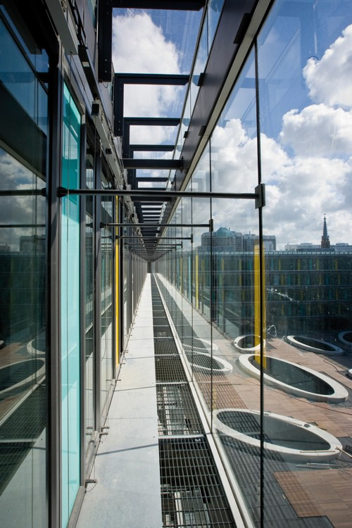
Spending Reviews in the Netherlands
Presentation at the Performance and Program Budgeting Working Group
PEMPAL, 23 November 2016
Marjon Schols
Senior advisor,
Strategic Analysis Unit
Ministery of Finance
Notes:
Questions from the working group on performance and program budgeting:
How the approach is technically designed and implemented
As well as additional technical details and practical lessons learns from efforts to increase the use of performance information in spending reviews and blending elements of the spending reviews into the performance budgeting process.

Slide 2
Definition of spending review
Report with options for savings or better spending
Key elements:
Theoretical analysis: role of the government
Objective assessment of strengths and weaknesses current policies
Options for savings and/or for more value for money
Impact of options on society & budget (implementation costs)

Slide 3
Definition of a successful spending review
1. Connected
ongoing part of budget preparation process
2. Completely independent
independent working group;
irrespective of current policies and views of policy makers
3. Creative
thinking out of the box
Using different sources en perspectives
Notes:
3

Slide 4
Contents
Spending review procedures in the Netherlands
Brief history
Key elements to a successful spending review (connected, independent, creative)
The 2010 spending review round

Slide 5
Spending reviews in the Netherlands:
A brief history

Slide 6
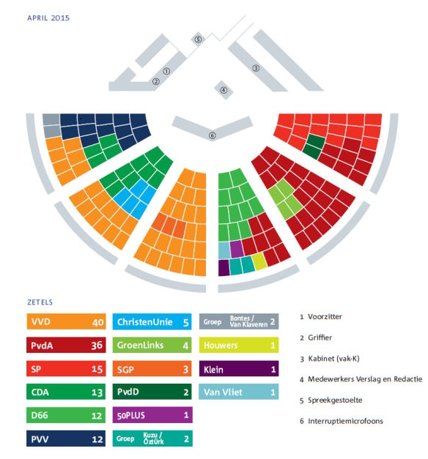
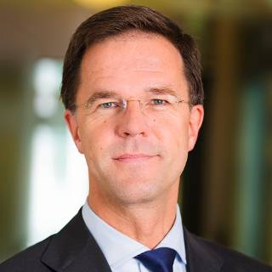
Political context
Parliament with multi parties;
Multi party coalitions
Four year government term
(cabinet period);
Recent cabinet:
- Liberal party and Socialistic party
- 13 ministers, on equal foot and
own budget budget
Mr. Rutte
Prime minister of The Netherlands

Slide 7
Dutch evaluation system
Studies and evaluations
I. Ex ante evaluations
II. Ex post evaluations
III. Savings and reform options
Social cost benefit Analyses
Policy reviews
Spending Reviews
Cost effectiveness studies
Impact evaluations
Comprehensive Spending Reviews
Other evaluations
Others: i.e. Task Force Controlling Health Care Costs

Slide 8
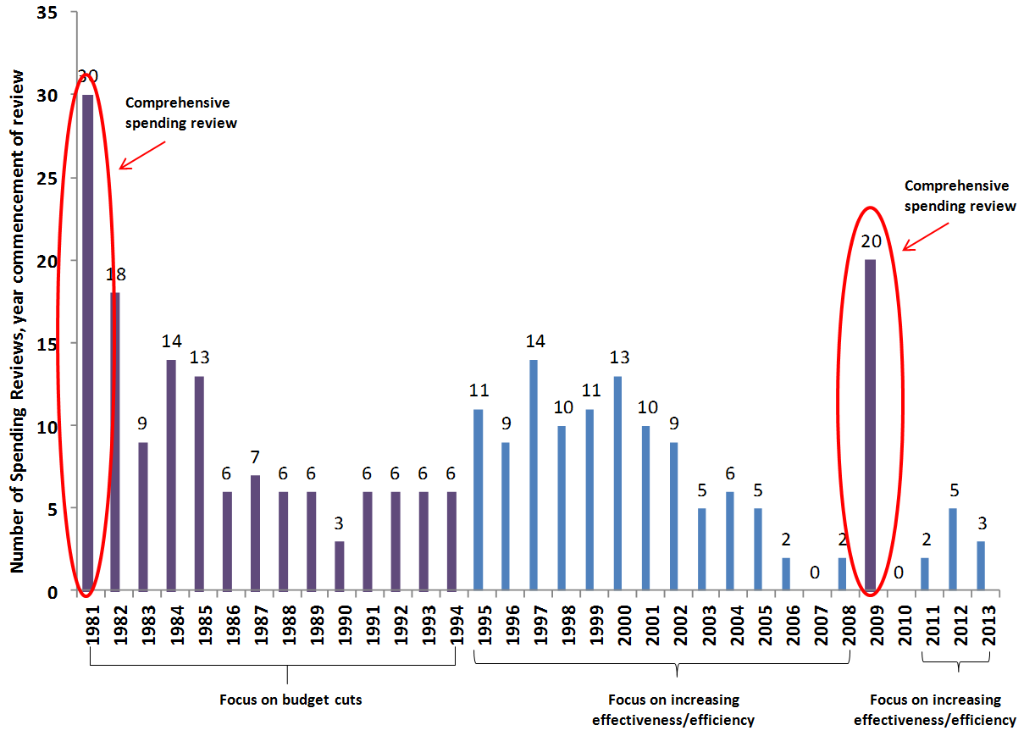
Number of spending Reviews: 1981-2015
Spending Reviews
2014 and 2015
Weapon systems
Pensions Public sector
Self-employed persons
Police
Traffic enforcement
Social Housing
Cost efficiency of Co2 reduction options
Risk control with treasury banking
Health prevention
Tax revenue service
Infrastructural planning
Effectiveness of education

Slide 9
Spending reviews in the Netherlands:
Key elements to a successful spending review

Slide 10
Spending Reviews: Connected to budgetary process

Slide 11
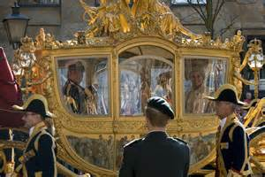
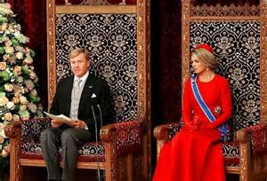
Policy and budget decision-making
Coalition agreement at start Cabinet
Annual update of plans and budget
=> Need of information about relevance, effectiveness, efficiency and cost of future policies

Slide 12
Spending reviews: Connected to budgetary process
Negotiations on topics are anchored to the budget negotiations
Ministry of Finance coordinates instrument
Cabinet decides on terms of references
Terms of reference are published in budget memorandum
Reports are finished just before start of budget negotiations in spring

Slide 13
Terms of reference
Background and rationale
Scope
Description of what at least one policy option must entail (-20%)
Composition of the working group, including external experts
Date by which report needs to be completed

Slide 14
Types op topics
A broad policy area
Agricultural policy
Specific topic of one ministry
Governmental loans for educational institutions
Weapon systems
Innovation in health care
Interdepartemental topic
Traffic enforcement
Social housing market
Pensions
Horizontal topic
Governmental communication
Subsidies
Notes:
Identfiy 4 typtes of topics.
Selection of topics can be based on:
There is a financial problem
Relevance for line ministry/society
No consensus
Political taboo
-> Make sure to define the topic well; not too small -> already in terms of reference
Overall: balance in topics between ministries

Slide 15
Spending reviews: Completely (?) independent
Notes:
15

Slide 16
Spending reviews: Completely (?) independent
Independent, non-political working groups (high-level civil servants and external experts);
Chaired by senior officials not responsible for the policy at hand, but who understand “how things work in The Hague”
Report written by (independent) secretary (MoF and line ministry)
Reports have an objective, analytical, non-political status
Policy options can be inconsistent with political preferences and plans of Cabinet
Non veto on policy options

Slide 17
Spending reviews: Completely (?) independent
Distinction between ‘technocratic’ en ‘political decision making’ phase
Quality check by spending review committee
Politial respons by Cabinet
Report and respons go public

Slide 18
Spending review committee
Members of the committee:
Chairperson: Director-General of the Budget
Members: economic think tanks of the larger ministries
Tasks are:
Topic selection
Quality assurance
Arbitrator by conflict in working group

Slide 19
Spending reviews: Creative
19

Slide 20
Spending reviews: Creative
Much more than “list of technical savings options”
Combine mulitple sources and multiple perspectives:
E.g. empirical evidence, performance of policies, economic theory on role of government, future challenges, experiences abroad, incentives and disincentives in finance systems, expected future budgetary risks, data on current use of instruments.
Policy options are based on analysis of strengths and weaknesses; distinguish no regret elements and strategic choices.
Options that can be carried out in practice, describing the (positive or negative) impact on society and budget.
-> As spending reviews have been done since 1981, the process is well-understood

Slide 21
Special case:
Comprehensive spending reviews 2009/2010

Slide 22
Need for comprehensive spending review 2009/2010
Start financial crisis in 2008
From budget surplus to
5.5% GDP budget deficit
Assignment by Cabinet
“Provide insight into different
cutback options and their effects”

Slide 23
Timetable
September 2009: Spending Review Working Groups started
February 2010: Collapse of Cabinet, early elections announced
April 2010: 20 reports sent to Parliament (without Cabinet Responses)
June 2010: National elections

Slide 24
Comprehensive Spending Review 2009/2010
20 topics
Theme-based: across departments
One compulsory policy option: 20% reduction in spending and/or tax expenditures
External expertise of Netherlands Bureau for Economic Policy Analysis
Exercise overseen by Prime Minister and the two Vice Prime Ministers
In total reports identified €35 billion in possible savings.

Slide 25
Topics comprehensive spending review 2009/2010
Energy and Climate Change
Environment
Transport and Water Management
Housing
Productivity in Education
Higher Education
Child benefits
Innovation and Applied Research
Income support & Employment Programmes for People with Few Skills
Unemployment benefits
Curative Healthcare
Long Term Healthcare
Official Development Aid
Immigration, Integration and Asylum
Public Safety and Terrorism
Tax Administration
Administration of Income Support
Public Administration
Operational Management in the Public Sector Institutions
International Security

Slide 26
Outcome
Substantial influence of Spending Review Reports on 2010 election programmes of Dutch political parties!
% uptake measures from Comprehensive spending review in election programmes
Political parties

Slide 27
Spending reviews have significant impact
The analysis chapter tends to result in significant public discussion;
Substantial influence on election programmes of Dutch political parties;
Many proposals of spending reviews have been adopted;

