Slide 1
Internal Audit
Community of Practice

Slide 2
Our Mission
IA COP offers support to its member countries
in establishing modern and effective Internal Audit system that
meets international standards and best practices and
is a key for good governance and accountability in the public sector
Our Core Values
Professionalism, dedication to reforms, commitment to sharing knowledge
and experience with the community (as professional family of peers),
trust, unity and respect to diversity of 23 member countries
Our Motto
UNITY IN DIVERSITY
Our Hymn
PEMPAL – my team, my dream, my love!
You give me everything that drive!
PEMPAL my family forever,
You are the guiding star in all my life.

Slide 3
Balanced Scorecard
Internal Processes
To maintain and develop a
volunteer network of internal audit professionals through ‘peer’ learning,
knowledge management
with range of activities
Customer
To serve our
governments
Financial
Accomplish donors’ needs and make best value for money of PEMPAL with the help of Secretariat
Learning and Growth
Develop the volunteering, Executive Committee leadership, self sustainability
of IACOP Working Groups, coordination with Steering Committee and other COPs

Slide 4
PEMPAL
Steering Committee
Bank TL (Elena)
SC member (Marius)
Guidance/Fiduciary
Lead of the
Community (Arman)
logistical support
Executive Committee
led by Chair
Secretariat
Internal Audit Community of Practice
(23 member countries)
Leadership+ Funding
Internal
Control
WG
Audit in
Practice
(AiP)
World Bank (WB)
Funding, professional support
Information
Professional support
Information
SECO, Russia, Dutch Academy and others
Organizations and professional associations (the IIA, CIPFA, etc.) and resource people

Slide 5
Strategic Priorities
Priority themes in FY 2016-2017 and within the next five years:
Public Internal Control - FMC implementation with emphasize on accountability and transparency (new ICWG)
RIFIX WG - Relationship of Internal Audit with Financial Inspection and External Audit (continuing working group to be closed in FY 2017)
Audit in Practice - Practical implementation of audit cycle, different type and models of audits, including IT solutions (AiP - new WG)
Central Harmonization Units: challenges at different stages of reform
Promotion of IACOP, including the existing knowledge products and experience gained in ongoing and previous working groups: T&C, CPD, RA, QA, Body of knowledge
The format of events proposed:
Plenary, working group, thematic meetings, ExCom members and leaders’ meeting, study visit
Promotion activities, including distribution and of existing knowledge products
IACOP peers’ advisory missions and reverse study visit (type of thematic meeting)
Videoconferences, webinars (for thematic meetings)

Slide 6
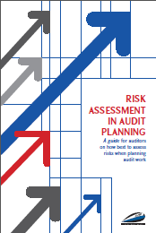
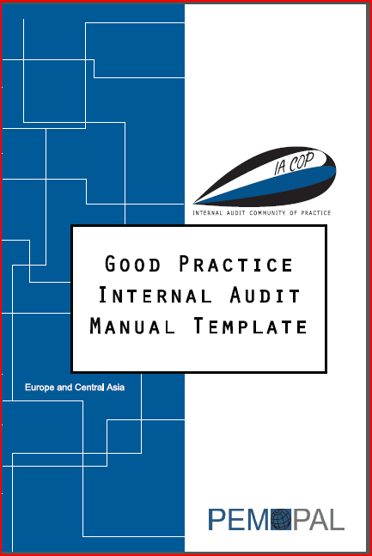
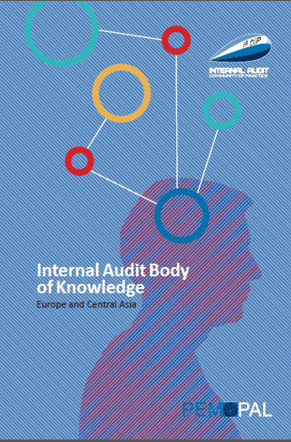
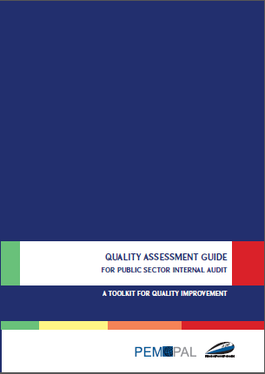
Good Practice Products

Slide 7
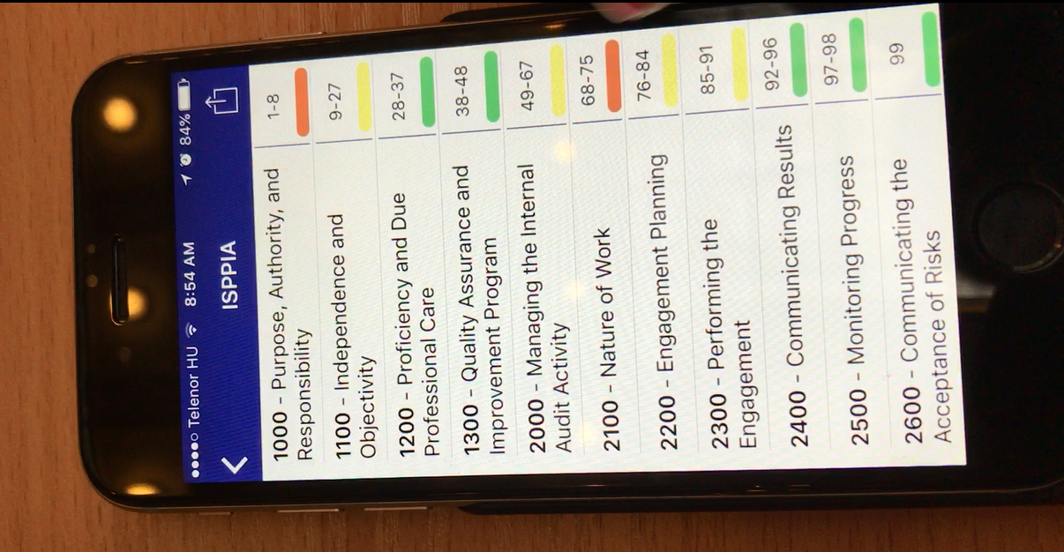
Quality Assessment Application

Slide 8
Community enabling groups
Agenda activists: identify new topics
Quality’ s friends: identify strong & weak points improving for futures
Social reporters: collect memories form social events, but not only
External messengers: prepare communique or resolution to make us visible
Value detectives: explore created values shown outputs and impact
Community keepers: find solutions for sustainability: welcoming new members, contacts with photo on wiki, thank letters

Slide 9
Quality friends
If nothing bad is ever said, nothing good will ever get done!
Positive feedback:
Things that need to be improved:

Slide 10
Value Detectives
Explore created values
Collect evidence of impact
Record evidence in attractive way

Slide 11
Key questions
What value do members gain from participating in the activities?
What value is being generated by the knowledge products?
How do people use the knowledge products, how their work as a reform leader in the area of Internal Audit is improved?
How has the application of knowledge and other products contibuted to PFM reforms in member countries?

Slide 12
http://pempaltc.wikispaces.com/37th+IACOP+meeting+-+Plenary –RESULTS – value detectives
Structured database
Country | PEMPAL documents / experience | Outputs | Impacts
Moldova | Quality Assessment Guide | There was developed the Draft Regulation on EQA | 5 internal audit units assessed in 2017
Albania | Manual for Continuing Professional Development | Discuss and share experience with others countries | Have to prepare the IA Continuous Program training in public sector
Bulgaria | Discussion and presentations QA and RIFIX, Document for EAA (External Audit Assessment) | Cooperation Agreement MOF- SAI –FI (upgraded methodology) Useful questions from the questionnaire | Improvements of the IA and FMC system
Kyrgyz Republic | Internal Audit Manual Template Risk Assessment Guide Quality Assessment Guide Experience from peers: legislation, methodology from PEMPAL member states | Draft internal audit manual Draft risk assessment guide Draft of quality assurance program | It influenced the development of internal audit function in the country and also the effectiveness of public institutions
The Russian Federation | Quality Assessment Guide RIFIX concept paper Risk Assessment in Audit Planning | Approach to be used, indexes Collaboration and relationship between IA and FI Partially used | Could be implemented and used Is used in regulating the relationship, using the results of audits Decided to be used by internal audit units

Slide 13
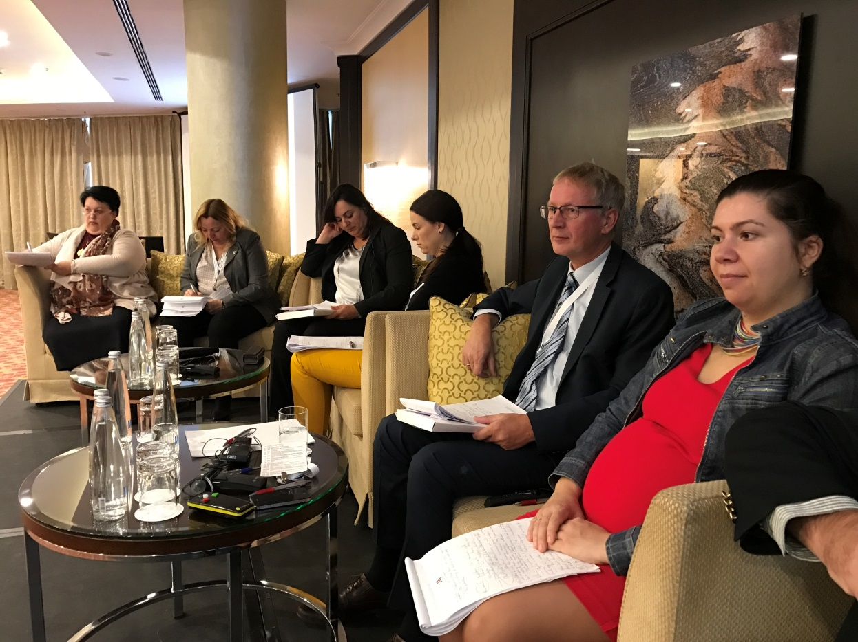
Newspaper & talk show

Slide 14
Tools, competencies and logistics
Simple office stationery
Few a little bit more advanced gadgets
Enthusiastic, creative and dedicated people

Slide 15
Latest feedbacks
„I would just like to take the time to say thanks to all of you, firstly for having invited me to take part in last week's PEMPAL meeting and of course secondly for the very warm welcome that I received whilst there.
The European Commission places high importance to the improvement of Internal Control in the countries that we deal with and we have considerable experience in coaching and monitoring reform efforts.
It was my pleasure to contribute to the meeting from this perspective and I certainly came away impressed with the quality of debate at the event. I was also impressed by the standard of knowledge products that PEMPAL has already produced.
More importantly, the sense of enthusiasm that you three (in particular) demonstrate was clear for all to see, and you deserve many congratulations for your efforts to lead this PEMPAL 'family'.”
Raymond Hill, European Commission
„I would like to thank you again for the warm welcome and all the arrangements in Budapest. The Conference was a success with a good mix of presentations and interactive debates and workshops.
I will ask for the possibilities to organize a Conference in Brussels in February next year.”
Katleen Seeuws, Belgium

Slide 16
THANK YOU FOR YOUR KIND ATTENTION!

