Slide 1

France’s LOLF lessons learned and perspectives
Public Expenditure Management Peer-Assisted Learning Program
Paris, November 23rd 2016
Véronique FOUQUE, Head of the Performance Departement
Budget Directorate, Ministry of Economy and Finance

Slide 2
Summary
The changes provided by the new law for Finance Laws
Origin of the LOLF
A budget structure by destination
The performance framework
The management dialogue
Impact of the performance framework, recent evolutions
Mitigated results
Simplification and clarification
Link with political objectives
Thoughts for future steps
Make a distinct use of outcome and “output” indicators
Some feedback for a useful performance framework

Slide 3
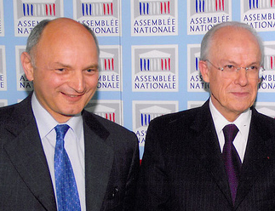




Origin of the LOLF : a new framework for budget
Bill in Parliament
(on the influence of Didier Migaud and Alain Lambert)
June 2000
Enactment of the LOLF
August 2001
First annual performance project (PAP)
October 2005
Une comptabilisation fiabilisée
3 niveaux de comptabilités : budgétaire, patrimoniale, en coût complet
The LOLF takes effect : first budget applying LOLF’s rules
January 2006
First audit by the Cour des Comptes
May 2007
First annual performance report (RAP)
June 2007
Notes:
Un contexte qui appelait un changement profond dans la gouvernance des finances publiques
Les évolutions politique, institutionnelle et européenne rendent les règles budgétaires et comptables datant de 1959 obsolètes
Texte très juridique, déresponsabilisant pour les gestionnaires, peu impliquant pour les parlementaires et qui n’incitait donc pas au bon usage de l’argent public.
Pour l’anecdote, Edgar Faure, lorsqu’il évoquait la discussion budgétaire au Parlement évoquait un triptyque : « Litanie, liturgie, léthargie » qui illustre bien les problèmes de cette époque.
Les principaux pays de l’OCDE ainsi que nos grands voisins européens ont également entrepris une réforme budgétaire
Un contexte favorable et un consensus politique exceptionnel
Après de nombreuses tentatives infructueuses pour faire évoluer le cadre de l’O59, un consensus transpartisan a permis de rénover le cadre de la gestion des finances publiques avec la promulgation de la LOLF en 2001. Une véritable révolution… qui mettra 4 ans à se mettre en oeuvre. (premier budget voté en mode LOLF en 2006)
Le texte de loi organique a été discuté entre le 7 février et le 28 juin 2001 et validé par le Conseil constitutionnel le 25 juillet 2001
La LOLF a été promulguée le 1er août 2001 pour entrer pleinement en action le 1er janvier 2006
Un cadre budgétaire renouvelé
La mise en pratique de la LOLF aura duré quatre années
La loi de finances 2006 a été la première intégralement préparée, adoptée et exécutée selon le nouveaux cadre budgétaire

Slide 4




Origin of the LOLF : three different target populations
The Parliament
  To have a better view on the budget and more transparency about its enforcement ;
  To be able to modify the appropriations given to public policies ;
People as …
  Citizens : to know the use of public means
  Users: to estimate the capability of administration to answer his needs ;
  Taxpayers : to check that taxes are well and effectively used ;
Civil servants
  To get clear targets ;
  To have a greater capacity to adapt the use of their budget.

Slide 5
Origin of the LOLF : the changes
Clarity and transparency
Public policies are organised and presented around « programs »
A more comprehensive budget
Increased disclosure including fiscal cost, analytical justifications, agencies information, …
A results-oriented budget
For each « program » : a strategy, objectives, and performance indicators and targets
More reliable accounts
Accounts based on 3 views: budgetary, accrual accounting, full cost analysis
« Renewed public management »

Slide 6
The changes provided by the LOLF :
A budget framework organized according to the main public policies
The 2016 State general budget *
31 missions
122 programs
* Figures from the 2016 Budget Plan
573 actions (« sub-programs »)

Slide 7
The changes provided by the LOLF : a stable budget structure by destination in missions and programs
State missions are structured around Programs
31 missions, 122 programmes, 573 actions (General Budget 2016)
  Almost 4 programs / mission
Mission
Program
Program
Objectives
Actions (« sub-programs »)
Objectives
Actions (« sub-programs »)
Indicators
Indicators
Performance structure
Budgeting structure
Performance structure
Budgeting structure

Slide 8
Three dimensions for performance
SOCIAL-ECONOMIC EFFICACY (citizens’ view)
Healthcare
Security
SERVICE QUALITY (users’ view)
EFFICIENCY (taxpayers’ view)
Economic development
Satisfaction rate
Waiting times
Accessibility
Productivity
Unit cost
Cost management
Leverage
EFFICACY
46%
QUALITY
19%
EFFICIENCY
35%

Slide 9
The changes provided by the LOLF :
Structure of the “Education” mission
Education (67 Mds €)
MISSION
6 PROGRAMS
Public Primary schools
Public Secondary schools
Student life
Private schools
Support program
Agricultural schools
Performance structure
2 Objectives
3 Objectives
2 Objectives
4 Objectives
3 Objectives
2 Objectives
6 Indicators
14 Indicators
6 Indicators
14 Indicators
11 Indicators
4 Indicators
Credit structure
7 Actions
(20,2 Mds €)
13 Actions
(31,3 Mds €)
6 Actions
(4,8 Mds €)
12 Actions
(7,2 Mds €)
10 Actions
(2,1 Mds €)
5 Actions
(1,4 Mds €)

Slide 10

Example: with program 140 of ‘Education’ mission
PGM 140 : Public primary schools
2 Objectives – 5 Indicators
7 Actions (« sub-programs »)
Objectif 1 : Conduire tous les élèves à la maîtrise des connaissances et compétences du socle commun exigibles au terme de la scolarité primaire
……….
Pre-elementary education
Teachers continued training
Elementary education
Management and educational supervision
Indicateur 1.1 : Proportion d’élèves maîtrisant, en fin de CE2, les principales composantes du domaine 1 « les langages pour penser et communiquer » du nouveau socle commun
Indicateur 1.2 : Taux de redoublement
Indicateur 1.3 : Proportion d’élèves entrant en 6ème avec au moins 1 an de retard
……….
Teachers in diverse situations
Substitute teachers
No direct link between performance and budgeting
Specific educational needs

Slide 11
A new chain of responsibilities
Mission a field of public policies
MINISTER
49 missions in 2017 (31 for total Budget)
90 indicators (including 23 specific indicators)
Political
level
controlled by
PARLIAMENT
Program : two major parts: credits structured by destination (actions) and performance framework
171 programs in 2017 (122 for Gal Budget)
378 objectives
736 indicators
RPROG
RPROG
Executive
level
The Program’s Operational Budget is the operational version of the program at a local level (often territory)
about 2000 BOP :
300 central
1700 : local
- 160 inter-regions,
- 1200 regions
- 300 departments
BOP
BOP
Central or
Deconcentrated level
UO
UO
The Operational Unit is the detailed version of the BOP (local or object)

Slide 12
Prisons program 107: consistency between « PAP » objectives and management dialogue
2016
2017
Favoriser la réinsertion
Améliorer les conditions de détention des personnes sous main de justice et les conditions de travail des personnels pénitentiaires
Renforcer la sécurité des établissements pénitentiaires
Favoriser la réinsertion
Améliorer les conditions de détention des personnes sous main de justice et les conditions de travail des personnels pénitentiaires
Renforcer la sécurité des établissements pénitentiaires
Objectifs
PAP
1. Prévenir et lutter contre les comportements auto et hétero-agressifs ;
2. Développer l’activité des SPIP et accompagner la mise en œuvre de la loi relative à l’individualisation des peines et renforçant les sanctions pénales ;
3. Améliorer les conditions de détentions ;
4. Assurer de bonnes conditions de travail ;
5. Parachever la mise en œuvre de la loi pénitentiaire
6. Maitriser les heures supplémentaires ;
1. Prévenir et lutter contre les comportements auto et hétero-agressifs ;
2. Développer l’activité des SPIP et accompagner la mise en œuvre de la loi relative à l’individualisation des peines et renforçant les sanctions pénales ;
3. Améliorer les conditions de détentions ;
4. Assurer de bonnes conditions de travail ;
5. Mettre en place le plan de lutte anti-terroriste ;
6. Maitriser les heures supplémentaires ;
7. Engager la DAP dans une démarche de développement durable ;
Objectifs
DAP
NEW

Slide 13
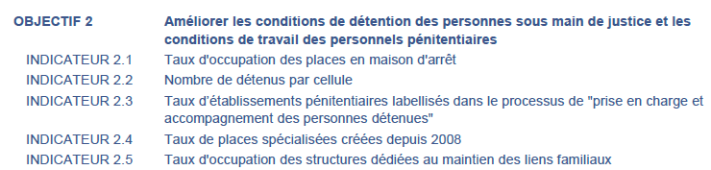
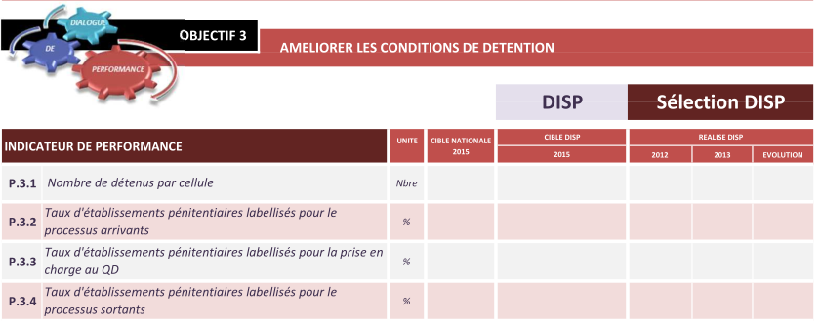
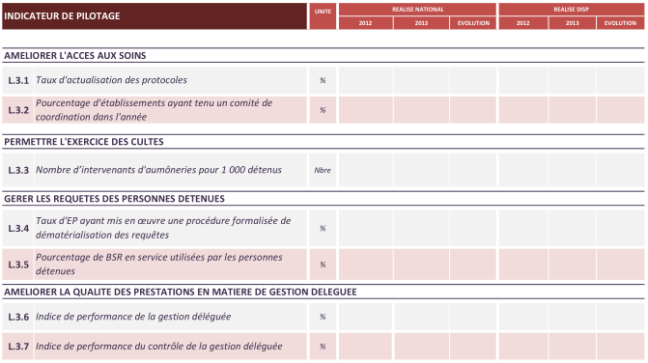
Use of the performance framework : example of management dialogue (Prison program 107)
Objectives and indicators in budget documents :
Objectives and indicators used by prison administration :
Objectives and indicators are partly reused at micro-level (e.g. ‘improve prison conditions’, ‘number of detainees / cell’, etc.)

Slide 14
Summary
The changes provided by the new law for Finance Laws
Origin of the LOLF
A budget structure by destination
The performance framework
The management dialogue
Impact of the performance framework, recent evolutions
Mitigated results
Simplification and clarification
Link with political objectives
Thoughts for future steps
Make a distinct use of outcome and “output” indicators
Some feedback for a useful performance framework

Slide 15
What impact of the performance framework?
Towards Parliament
Management practices
Transparency towards Parliament and citizens on resources and results
Accountability?
  Vs ministers?
  Fragile accountability on public policies, because numerous costs are shared between departments or with local authorities
  limited impact in
Insufficient use in budget debates
  The Program director makes a link between political and management responsibilities ;
  An auxiliary to manage services
  Operators : link with public policies and potential between resources and results ;
  But no formal link between performance results and career paths
Window dressing may complicate the framework ;
No incentives for departments to play the game
Remaining asymetry of information in spite of numerous indicators
With CBA
No direct link can be made between performance results (outcomes) and budget decisions (closer link with outputs): more of a warning to develop further evaluation

Slide 16
Evolution and simplification of the performance framework: to be continued...
An important simplification of the framework to make the performance data more transparency and more meaningful to the Parliament
- 24%
- 20%

Slide 17
The performance framework aims to make a link with strategic objectives at the political level…
122 Programs
31
Missions
1
Dashboard
of strategic indicators
382 objectives
738 indicators
80 objectives
90 indicators
Including 22 ad hoc indicators
3 key areas
10 indicators
+ OPERATIONAL
+
POLITICAL

Slide 18
Setting 10 key national indicators (KNI) of wealth
Theme | Government’s indicators | Mission’s indicators in the PLF
 |  | 2016 | 2017 | 2018 (target)
Economic development | Employment rate | - | ✓ | ✓
 | Research effort | - | ✓ | ✓
 | Total debt | - | - | -
Social development | Life expectation in good health | - | State of health perceived | ✓
 | Satisfaction in life | - | - | -
 | Inequalities of income | - | - | -
 | Poverty in quality of living | - | - | -
 | Early leavers of school system | ✓ | ✓ | ✓
Sustainable development | Carbon footprint | - | Gas emission per inhabitant | ✓
 | Artificialization of land | - | Share of cultivated area used for biological agriculture | ✓
The CBA has invited ministries to adopt the related KNI as mission indicator when possible
But endorsement by ministers remains limited

Slide 19
Summary
The changes provided by the new law for Finance Laws
Origin of the LOLF
A budget structure by destination
The performance framework
The management dialogue
Impact of the performance framework, recent evolutions
Mitigated results
Simplification and clarification
Link with political objectives
Thoughts for future steps
Make a distinct use of outcome and “output” indicators
Some feedback for a useful performance framework

Slide 20
Inform citizens on the results of public policies « value for money » and build management tools to improve decision making
Make a distinct use of outcome and “output” indicators
Performance framework inputs
Performance results analysis
Consequences
Few direct links between budget and performance results
Should be used as an alert in a wider evaluation process
Redefinition of public policies, objectives and targets
Efficacy
Structural reforms : better communication on performance results to the Parliament to prepare legislative debate
Efficiency
Budgetary impacts
Program management and budget decisions
Improve decisions and processes
Define incentive mechanisms for departments and their managers
Service quality

Slide 21
Some feedback for a useful performance framework
To define precisely the objectives : a single tool can’t do everything ;
To aim simplicity :
  Should the method of performance cover all programs equally or should it vary according to some criteria ?
    Budget stake ;
    Ability to quantify the notion of « performance » ;
  The number of indicators should remain “reasonable” ;
To link the performance to main political objectives ;
To define incentive mechanisms for departments and their managers ;
To think of communication, at the very beginning and use “new tools” (open government, evaluation results,…)

Slide 22
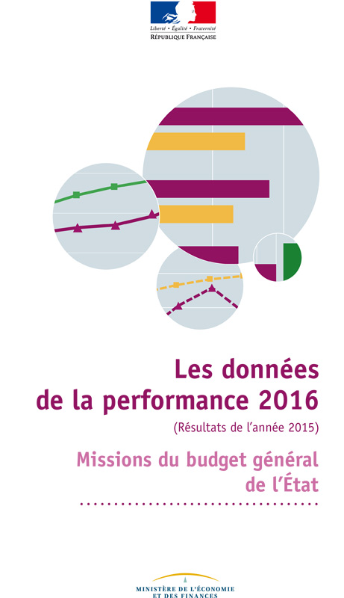
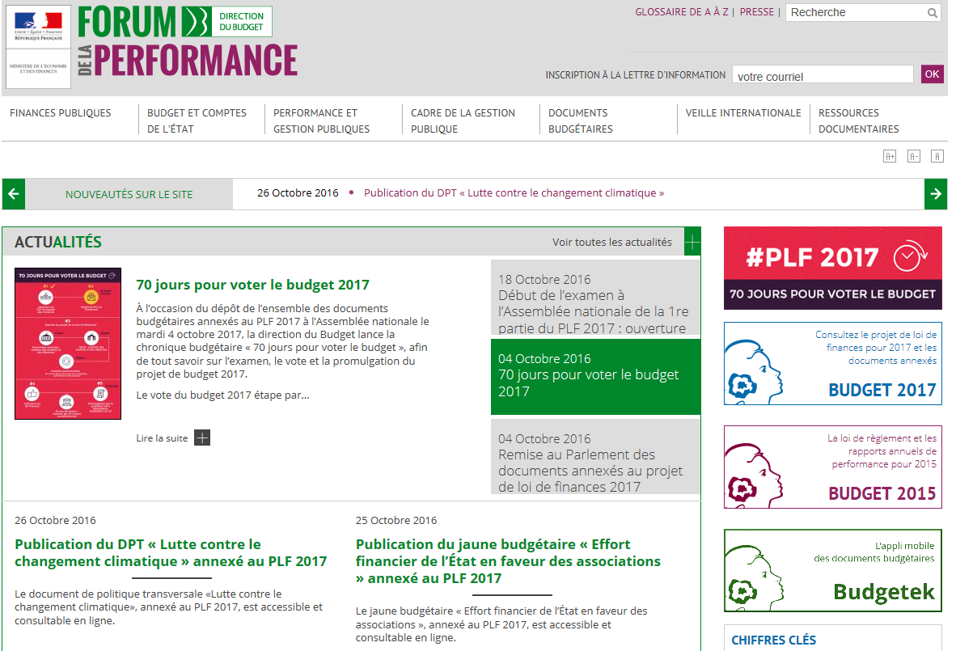
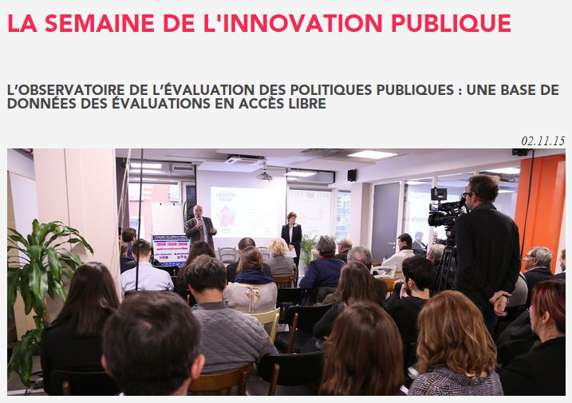
Inform citizens about public policies
Total
BG

Slide 23
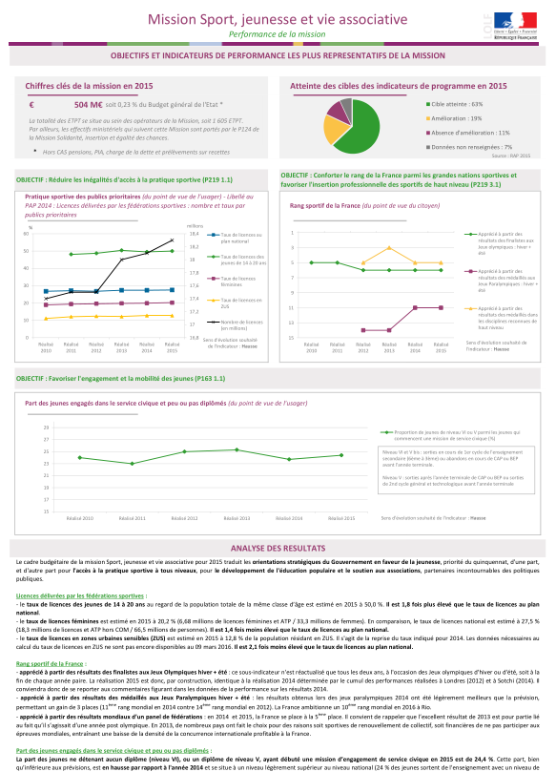
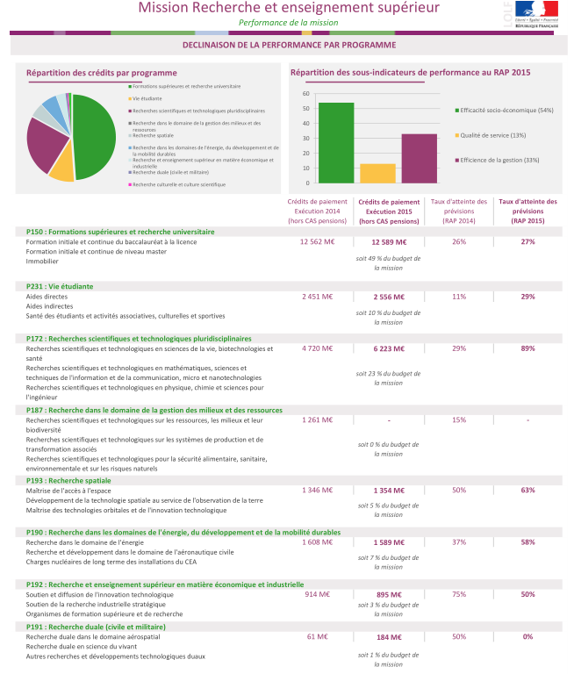
Communication and promotion about the results of public policies : les “Données de la performance”
Key data (spending, human resources)
Rate of achievement of the indicators
Strategic objectives and indicators
at the mission level
Graphic representation on a multi-year basis (2010-2015)
Analysis of the main results
obtained in 2015
MISSION LEVEL
Indicators breakdown between
3 categories :
socioeconomic effectiveness (citizen)
service quality (user)
managerial efficiency (taxpayer)
For each program
2014-2015 comparisons of :
spending
rate of achievement
of the indicators
PROGRAMS LEVEL

Slide 24
Thanks for your attention ! veronique.fouque@finances.gouv.fr
http://www.performance-publique.budget.gouv.fr/

