Slide 1
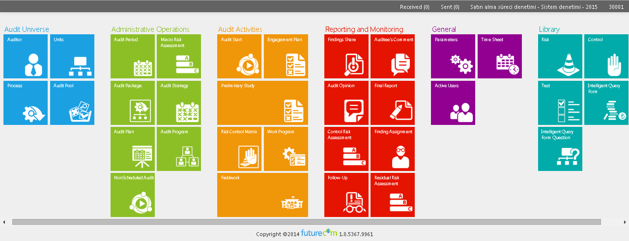
Risk Assessment via the Audit Management Tool (IcDen©)
Halis KIRAL, CIA, CCSA, CGAP
Head of Department for Internal Audit CHU

Slide 2
General Features
İçDen is a comprehensive, highly configurable, powerful and easy to use Audit Management Tool, the audit management system tool of the Internal Audit Coordination Board (IACB), is a customized software product developed between 2013 and 2014.
IACB made the final decision in favor of using this tailor-made Audit Management System (AMS) tool due to its high level of adaptability and flexibility which enables to meet all the requirements of the IACB and its member institutions audits.

Slide 3
Project Schedule
November-December 2013
3-day IcDen Training for 45 IAUs and 400 IA
Prepairng internal audit plans of IAU via IcDen
June-September 2012
Scenario Building
Interview with firms
ToR and Contract
Firm Choice
March-May 2013
Prototype experiment in various IAUs
March-June 2013
Preparing web application
January 2014 –….
Carrying out IAA via IcDen for 45 IAU
October-December 2012
Scenario Analysis
Interview with IAUs
Needs analysis and software development
January 2015 –…….
Carrying out IAA via IcDen for 105 (45+60) IAUs out of…
And 636 internal auditors out of 820 internal auditors
October-November 2014
2-day IcDen Training for 60 IAUs and internal auditors incuding milittary and police departments

Slide 4
Project Cost
SOFTWARE
347.000 $
HARDWARE
185.000 $
Storage Area Network (SAN)
Windows Server 2012
Database Server
SQL Server 2012
Firewall
Other equipment

Slide 5
Key Features of IcDen I
Single Application Multi Database; IACB and its member institutions are using the same application and own database,
Web based application,
Generic structure and configurable; each institution apply their own methodology,
Role Based Security Model; all procedures and modules are connected to a role and roles are assigned to user groups.

Slide 6
Key Features of IcDen II
Metro Style User Interface; easy to use and effective user interface,
Secure Host; has passed the security tests by TUBITAK (The Scientific and Technological Research Council of Turkey),
Multi-Language; supports English and Turkish.

Slide 7
Benefits of IcDen I
Icden has already helped the IACB and its member institutions achieve following benefits;
Improving efficiency and effectiveness,
Carrying out timely audits,
Measuring the planned of audits in order to improve programming and processes

Slide 8
Benefits of IcDen II
Providing a high level of standardizations among the works of all audit teams completely in line with regularity audit manual,
Establishing a better quality control review system,
Producing timely management information to help senior management monitor audits and take necessary decisions,
Facilitating information sharing in systematic way among auditors.

Slide 9
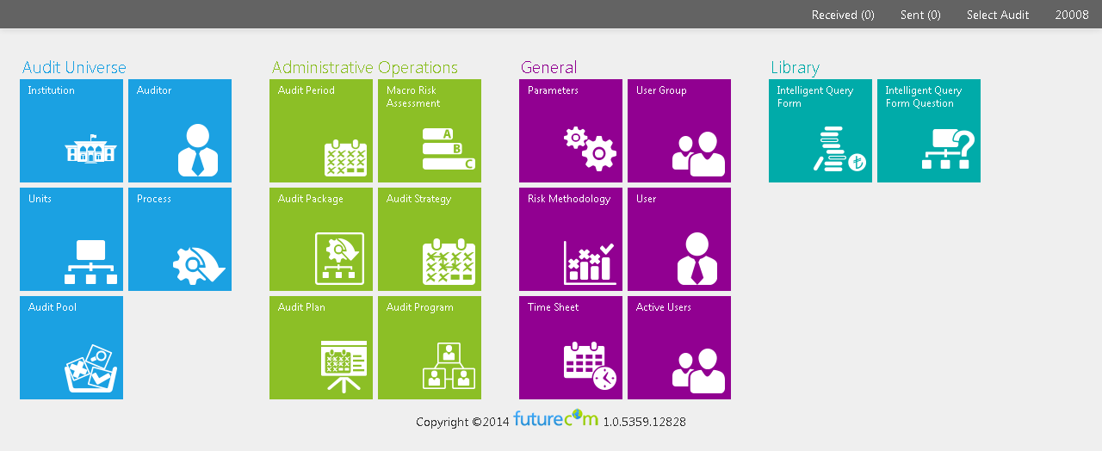
User Groups - CHU

Slide 10
User Groups - CAE

Slide 11
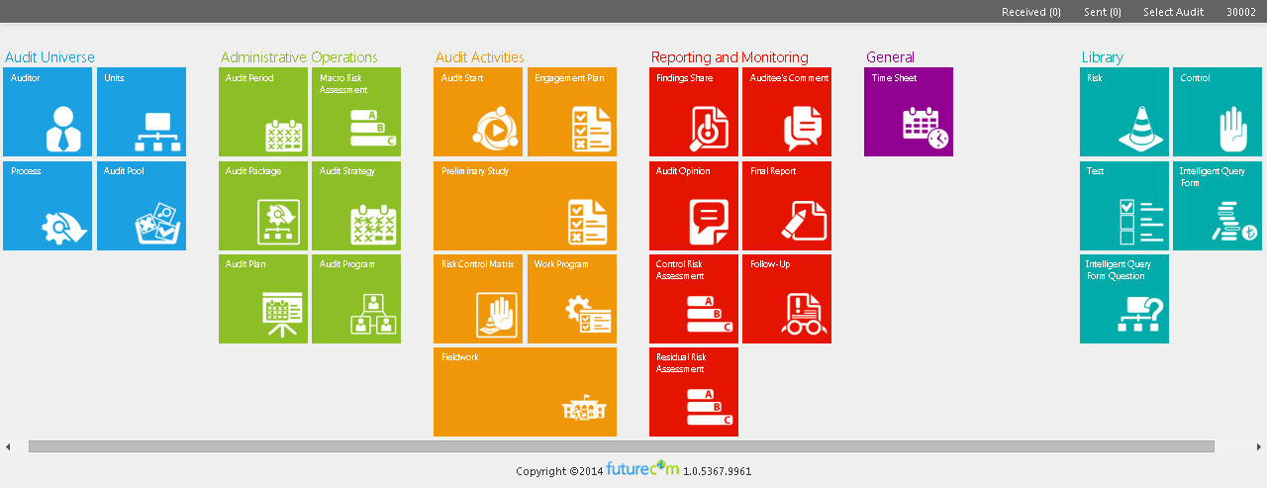
User Groups – Internal Auditors

Slide 12
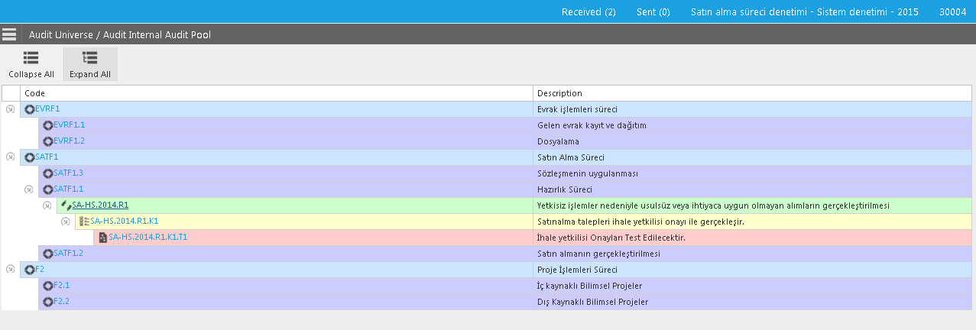
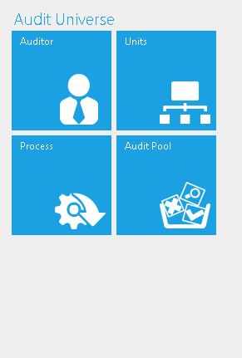
Risk Assessment via IcDen
Audit Universe
Audit Universe
Macro Risk Assessment
Audit Package
Program

Slide 13
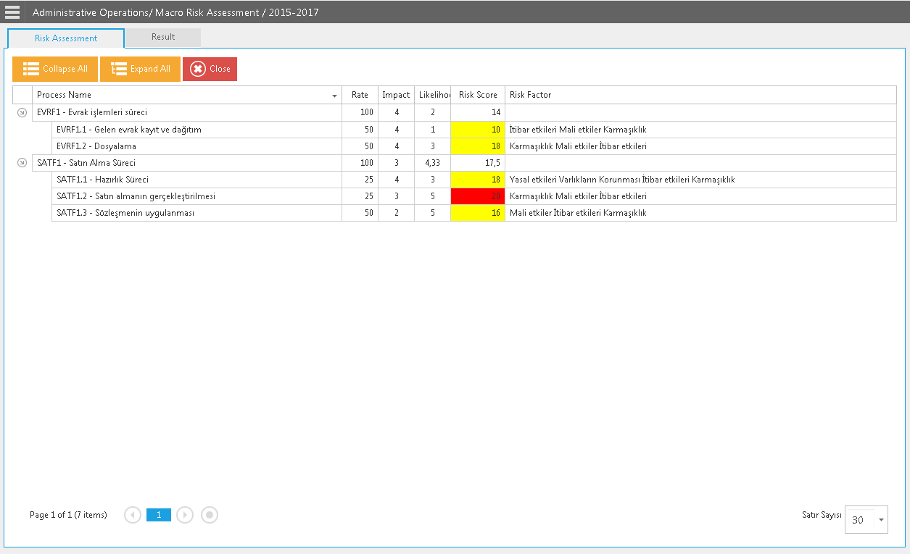
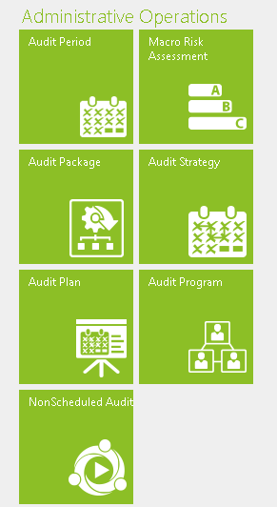
Macro Risk Assessment
Audit Universe
Macro Risk Assessment
Audit Package
Program

Slide 14
Audit Package
Audit Universe
Macro Risk Assessment
Audit Package
Program

Slide 15
Audit Program
Audit Universe
Macro Risk Assessment
Audit Package
Program

Slide 16
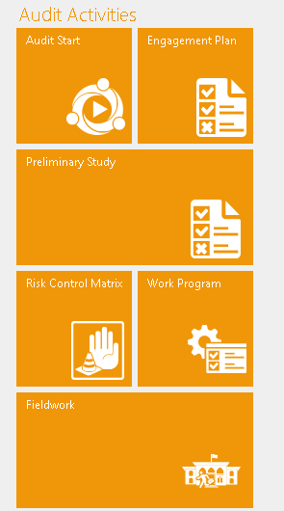
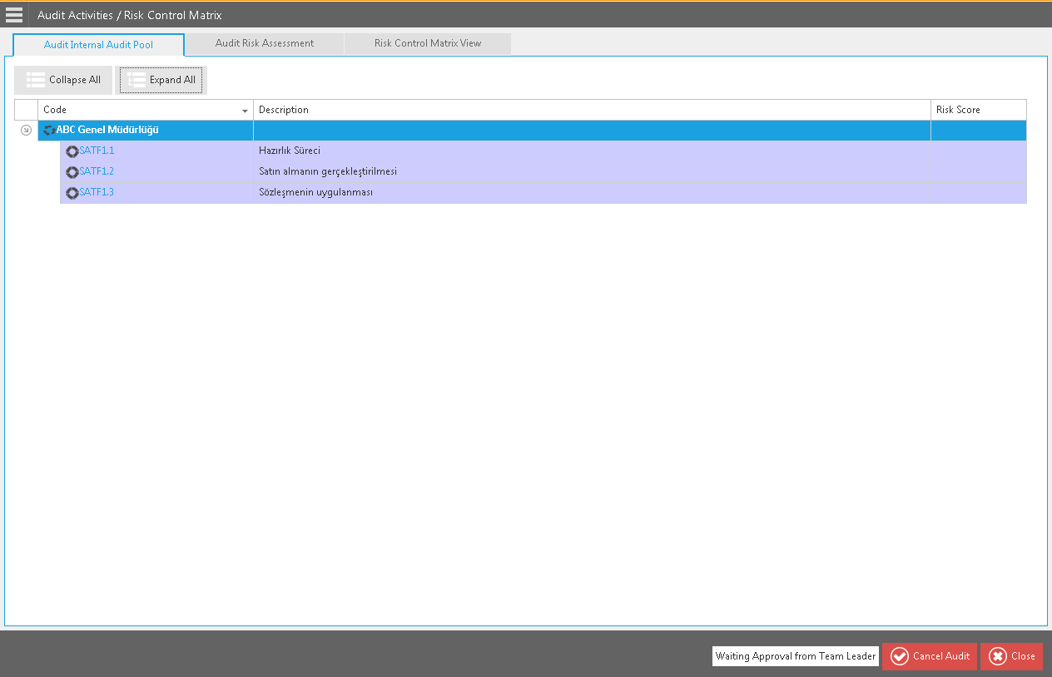
Audit Activities – Risk Control Matrix
Preliminary Study
Risk Control Matrix
Field Work
Findings
Reporting

Slide 17
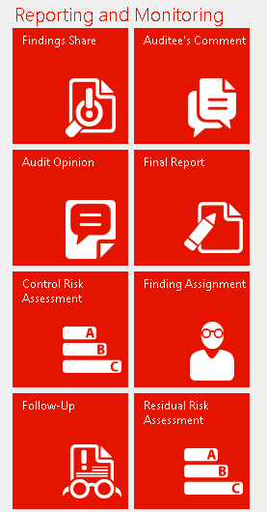
Reporting and Monitoring

Slide 18
Risk Assessment

Slide 19
Risk Updating
Enhanced Risk Assessment; first step macro Risk Assessment (MRA) for each process.
Second step Inherent Risk Assessment before audit fieldwork.
Control Risk Assessment after final report and then Residual Risk Assessment after monitoring.
These assessment are automatically reflected in the MRA.

Slide 20
Risk Updating

Slide 21
Many thanks…

