Slide 1
Risk based auditing – national experience
Ministry of Finance of the Czech Republic
Lukáš Wagenknecht
1.st Deputy Minister at Ministry of Finance of the Czech Republic

Slide 2
Agenda
Introduction
Lukáš Wagenknecht
Ministry of Finance of the Czech Republic
Internal Audit
3 lines of defense
Importance of Audit Committees roles
Audit planning
Process mapping
Risk Heat Maps
Strategic plan
Ministry of Finance of the Czech Republic

Slide 3
Lukáš Wagenknecht
Ministry of Interior 2003 – 2006
Foxconn 2006 – 2007
Regional council of cohesion region 2007 – 2009
Deloitte 2009 – 2013
Vice President of Institution of Internal Auditors 2009 -2013
The Prague Public Transport Company 2013 -2014
Ministry of Finance of the Czech Republic 2014 - ?
Agenda on Ministry of Finance
ICT
Audit Authority
Control Department
Central Harmonization Unit
State Treasury, public sector controlling and accounting
Ministry of Finance of the Czech Republic

Slide 4
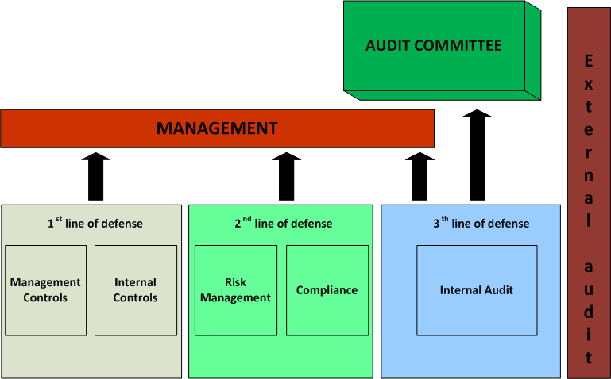
The 3 line defense model
Ministry of Finance of the Czech Republic

Slide 5
Importance of Audit Committee
Roles
Oversee Internal Audit
Ensure independence
Assess quality
Direct reporting line
Assess quality external Auditor
Review risks
Oversee financial reporting
Coordinate assurance functions
Review internal control framework
Ministry of Finance of the Czech Republic

Slide 6
Audit planning
Audit Universe
Process mapping
Risk analysis
Interviews
Questionnaire
Assessing and scoring
Ministry of Finance of the Czech Republic

Slide 7
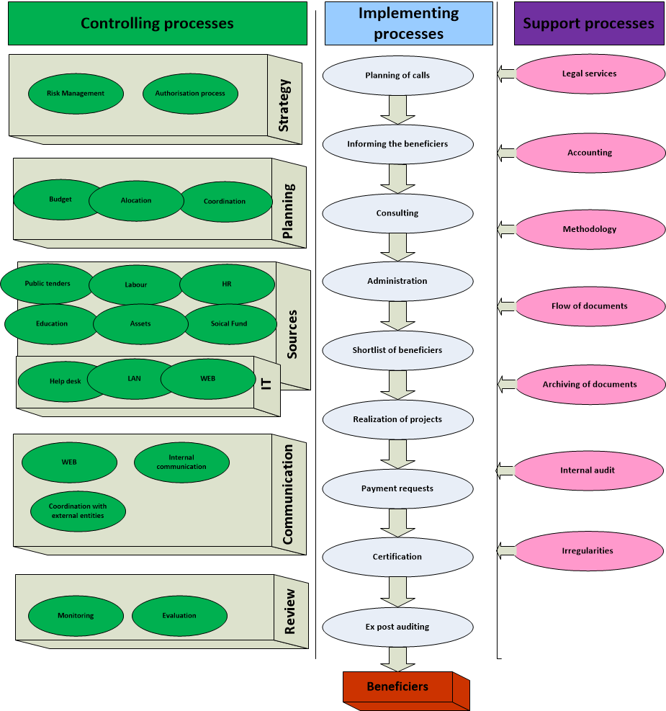
Process mapping
Ministry of Finance of the Czech Republic

Slide 8
 | Likelihood | Impact | Scoring
Financial management | 3,67 | 4,33 | 15,89
Public tenders | 3,83 | 3,67 | 14,06
ICT | 3,17 | 3,83 | 12,14
Controlling of operational program | 2,83 | 3,50 | 9,92
Communication | 3,00 | 2,83 | 8,50
Assets | 3,17 | 2,67 | 8,44
Technical assistance | 2,17 | 3,33 | 7,22
Wages | 3,33 | 2,17 | 7,22
HR | 2,33 | 2,67 | 6,22
Education | 1,33 | 2,50 | 3,33
Social Fund | 1,83 | 1,17 | 2,14

Slide 9
Strategic plan
Based on Audit Universe and Risk Heat Map
On 3 years basis
Gaps for Ad – Hoc audits and consulting
Keep up to date
Ministry of Finance of the Czech Republic

Slide 10
Questions ?
Ministry of Finance of the Czech Republic

