Slide 1
Components of Internal (Operational) Risk Management System at the Federal Treasury
Deputy Head
of the Federal Treasury
А.Demidov

Slide 2
TYPES OF INTENAL CONTROL AND INTERNAL AUDIT AT THE FEDERAL TREASURY
Internal Control
Internal Audit
Functional control
Functional audit
Administrative control
Administrative activities audit
Reliability
Procurement control
Procurement audit
ASSESSMENT
IT control
IT audit
Financial control
Financial audit
Internal Control Maps
Internal Risks Classifier

Slide 3
FUCNTIONING OF INTERNAL CONTROL AND INTERNAL AUDIT SYSTEM AT THE FEDERAL TREASURY
Internal Control
Follow-up operational internal automated control
Functional control
Administrative control
Procurement control
IT control
REPORTING:
Financial control
quantity
Internal Audit
systemic nature
volume of financial violations
Internal Risks Classifiers

Slide 4
FUNCTIONING OF THE INTERNAL (OPERATIONAL) RISK MANAGEMENT SYSTEM AT THE FEDERAL TREASURY
Internal control
Internal audit
Identification of risk-prone activities
Administrative work
…
Procurement of goods, works, services
possible risks:
financial losses
failure to meet objectives
corruption
application of risk management tools
(development of internal control maps, risk classifiers etc.)

Slide 5
COMPONENTS OF THE INTERNAL (OPERATIONAL) RISK MANAGEMENT SYSTEM AT THE FEDERAL TREASURY
REGULATIONS
Internal control standard
Internal control and internal audit standards
Follow-up operational internal automated control standard
Procedure for integral assessment
Procedure for external assessment
Ordinance on the format and deadlines for reporting inspection outcomes
SOURCES OF RISK INFORMATION
Lists of operations and actions done at the unit
Internal control and internal audit outcomes
Outcomes of regulatory and legal framework review, by area of activity
Outcomes of inspections performed by regulatory and supervisory authority
Outcomes of questionnaire survey and external assessment
Control and audit activities reports
Risk classifiers

Slide 6
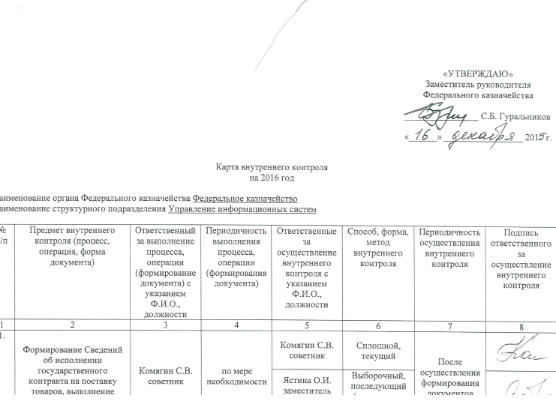
INTERNAL CONTROL CARD GENERATION
AT THE FEDERAL TREASURY: AN EXAMPLE
Analysis of the subject of control
List of operations performed by the unit
changes in regulatory framework
lists of identified violations
internal risk classifiers
Assessment of control actions effectiveness
Internal control map for the current year
complaints and requests from citizens and organizations
automated
other information
visual
combined
EXAMPLE:
Generating information on contract execution | I.Ivanov | As needed | I.Ivanov | Detailed self-control | Upon generating a draft document | Signature
 |  |  | N.Petrova | Detailed self-control by reporting level
 |  |  |  |  |  | signature

Slide 7
INTERNAL (OPERATIONAL) RISK CLASSIFIER GENERATION
AT THE FEDERAL TREASURY: AN EXAMPLE
Internal risk identification
Objects exposed to risk
changes in regulatory framework
lists of identified violations
IC and IA outcomes reports
Internal risk assessment
Internal (operational) risks classifier
outcomes of integral assessment
importance
complaints and requests from citizens and organizations
probability
risk level
other information
EXAMPLE:
№№ п/п | Code |  |  | Risk description | Risk importance
 |  |  |  |  | 0.5 | 0.8 | 1.0
 | 14 | 26 | 0 | Failure to meet the established requirements to the procedure of furnishing information and details to be included into the registry of contracts entered into by customers. | – | – | X

Slide 8
TAKEAWAYS
Risk management should:
1. given limited resources, be performed by focusing on the most important activity areas;
2. ensure stable functioning of the organization.

Slide 9
Thank you!

