Slide 1
School Participatory Budget
Portugal

Slide 2
Some key education outcomes insofar (2014-2018)…
Reduction of school retention/dropout in basic education (10.0% to 5.6%)
Decrease of the Early Leaving from Education and Training (17.4% to 12.6%)
Drop of the unemployment rate (13.9% to 6.7%), especially youth unemployment (34.8% to 19.7%)
Increasing investment from companies on education & training (since 2016)
Increasing adults in qualification programmes: recognition, education and training (20,000 to 96,000)

Slide 3
Main goals: to promote students’
School Participatory Budget (2017 - … )
democratic competences and participation
well-being, engagement in governance and sense of belonging to their schools
financial skills, project development and entrepreneurship

Slide 4
Main features
Legislation published in January 2017
Two editions insofar (2017 & 2018)
Scope: all public schools with lower and/or upper secondary (including, VET)
Each school has an extra amount in their annual budget, only able to be used according to the School Participatory Budget rules

Slide 5
School Participatory Budget (2017 - … )
Each public school budget has a supplementary amount provided by the State, according to the number of students and only able to be used if the SPB rules are followed;
This amount may be complemented by school own funds, municipal or other community contributions;
All students from lower and upper secondary shall be informed, by their schools, about the initiative and supported in their will to participate;
Proposals must be designed, submitted and voted by the students;
Proposals shall benefit school services, equipment and/or educational activities, being a resource for the whole school community;
These proposals must be endorsed by at least 5% of the students, and to be viable, considering the budget available, the existing rules and the school projects, and they shall in the referred education levels;
The proposal with more votes shall be selected and implemented (if the budget enable it, the following more voted ones may also be selected)

Slide 6
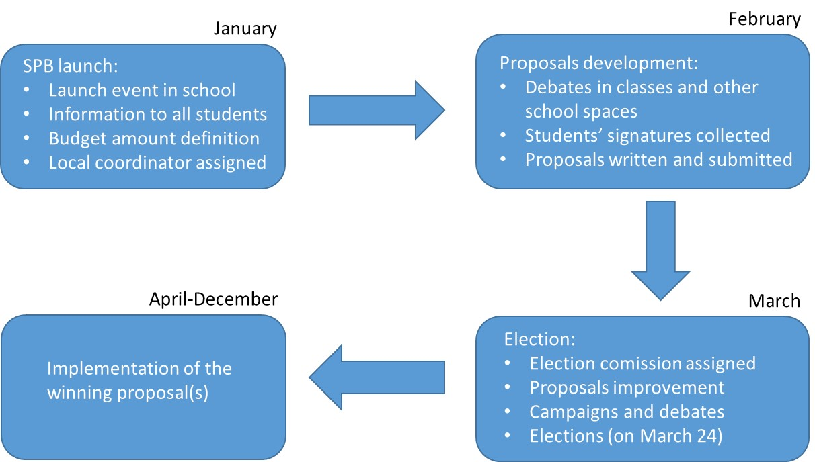
School Participatory Budget (2017 - … )

Slide 7
School Participatory Budget (2017 - … )
DG Schools: support and monitoring
Institute of Financial Management for Education:
Inspection: Monitoring
National agencies
Local coordinators
Teachers
Electoral commission: composed by elected students
Local supporters
Media campaign to raise awareness and participation

Slide 8
1st edition: some key figures
1 046 schools implemented the SPB (93%)
4 371 proposals were submitted by students (80% considered acceptable by schools)
1 021 schools democratically elected students’ proposals (91%)
221 063 students have voted for SPB (46%)
69% principals stated that “SPB meant an effective improvement on students’ rights and participation in the school life”.

Slide 9
School Participatory Budget (2017 - … )
An innovative and effective instrument of an encompassing strategy for reinforcing democracy, accountability and project development in schools

Slide 10
Thank you!
Lisbon, 16 October 2018
Pedro Abrantes
Expert Advisor from the Minister of Education Cabinet
Email: pedro.abrantes@medu.gov.pt

