Slide 1


Treasury Information Security
Business - Information - Technology + Security

Slide 2
Development of a methodology for security procedures and processes
EISA (Enterprise Information Security Architecture) - detailed description of security processes and procedures to develop compliance with strategic goals of the enterprise.
EISA implies optimization of business-processes, answers the questions when architecting business security, establishment of a secure network infrastructure, development of security policies and procedures, etc.
Due to introduction of EISA, we lay the groundwork to create flexibility within our organization, to adjust our system to a coming change.

Slide 3
Unification of the development tools
Unification of DBMS being used
Unification of the development environment
Transition to web-services
RBAC + SoD
Dev –> QA –> Prd

Slide 4
Building a secure infrastructure
Threat source:
    DDoS;
    Hacktivists
    Opponents using software like Stuxnet, Shamoon
    Special services
Vulnerable users:
    Executive directors
    Heads of Departments
    Head of IT
    Super users

Slide 5


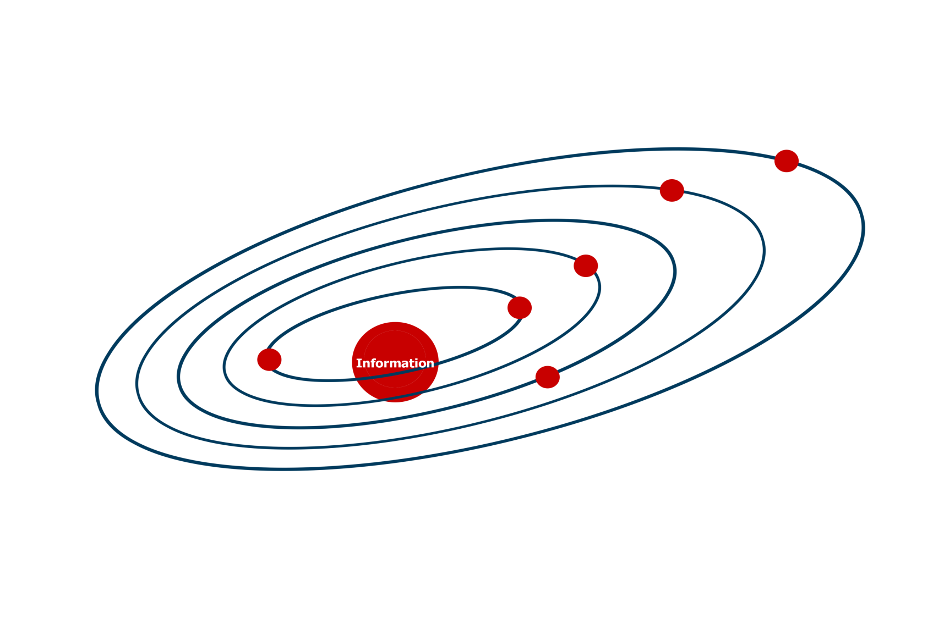




Physical
External Users
Server/Operating System
Database
Internal Users
Network
Application
Documents/Records/Email

Slide 6


Internal Users

Slide 7



Build sustainable compliance programs
Reduce risk of insider threat and attacks
Identity
Access
Data Protection

Slide 12
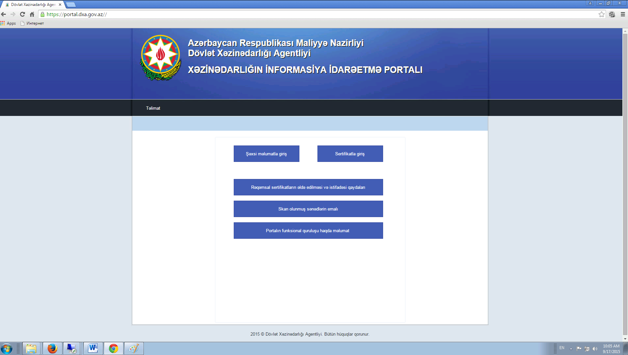
Receipt, use of THE digital certificate

Slide 13
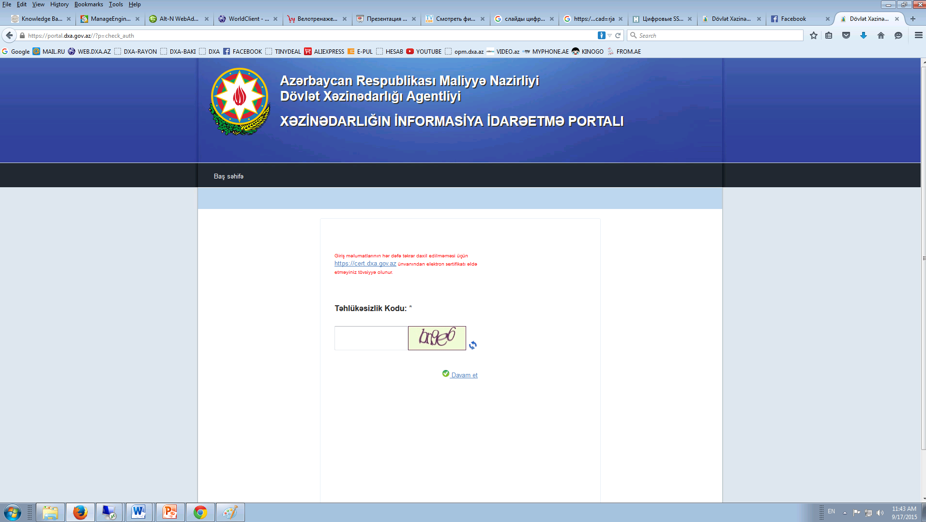
  After conclusion of the contract with the State Treasury Agency, an organization’s email address receives an email with the link.

Slide 14
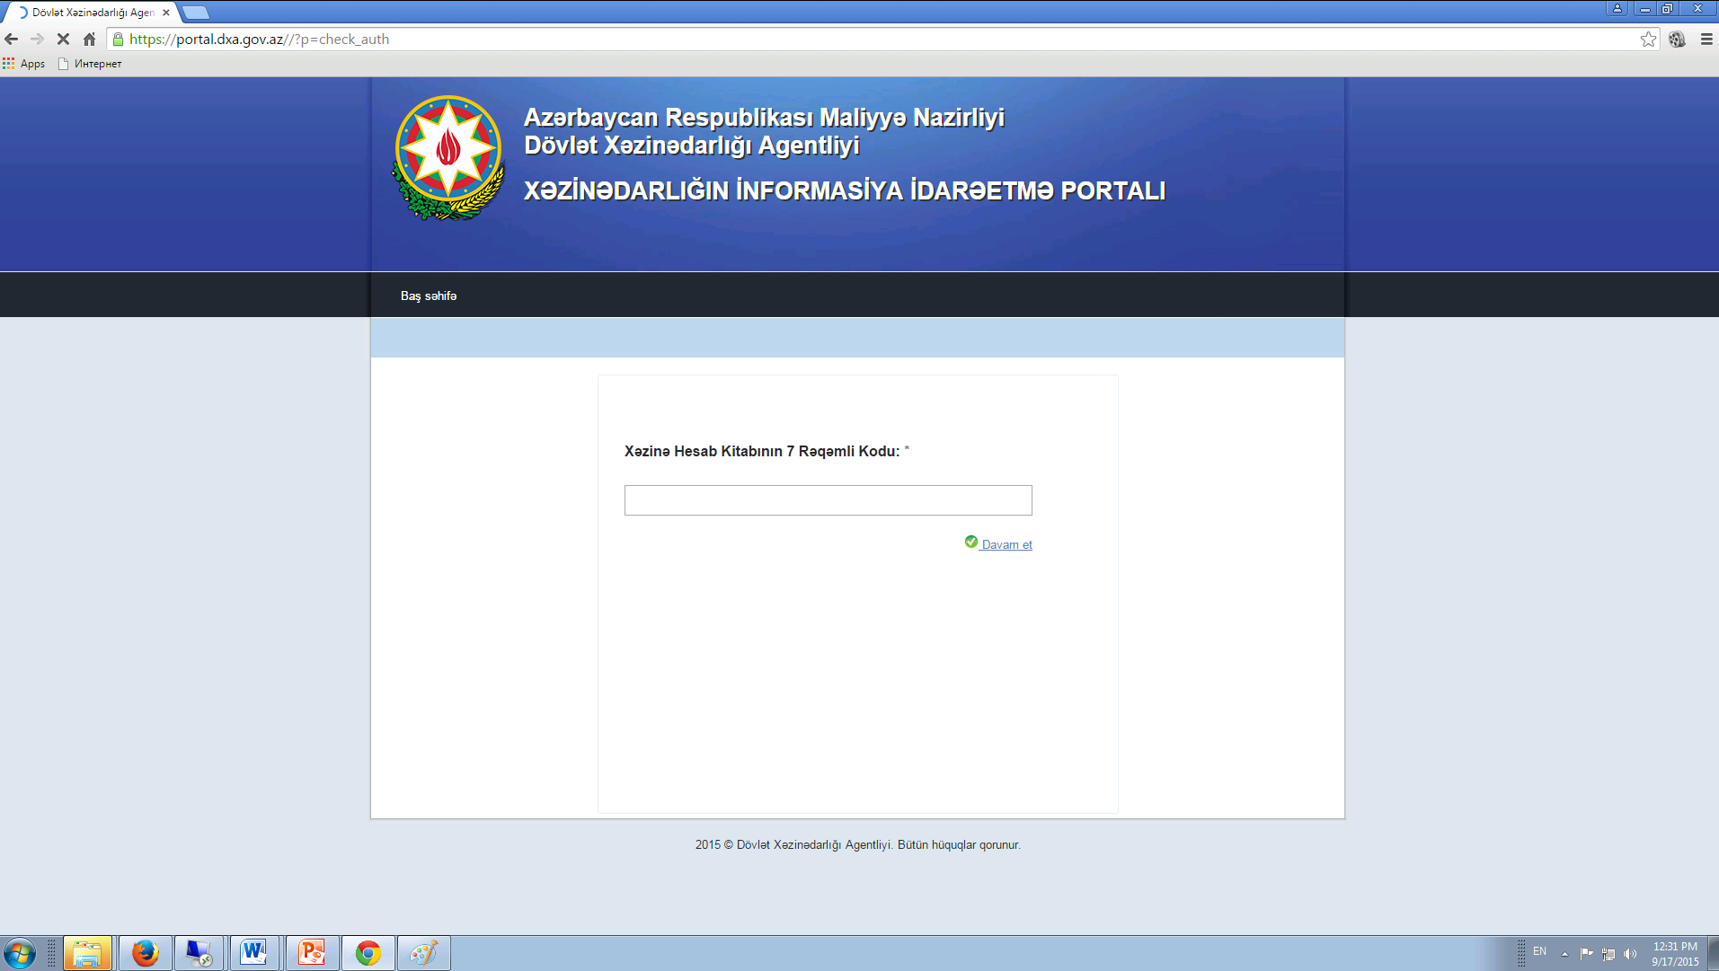
Unique 7 digit number of the organization

Slide 15
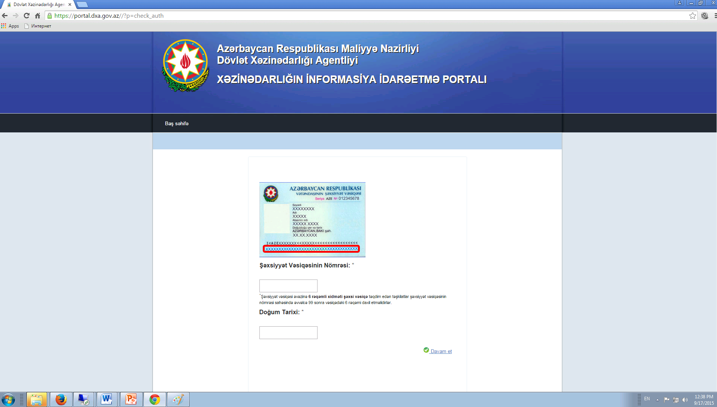
ID data is entered

Slide 16
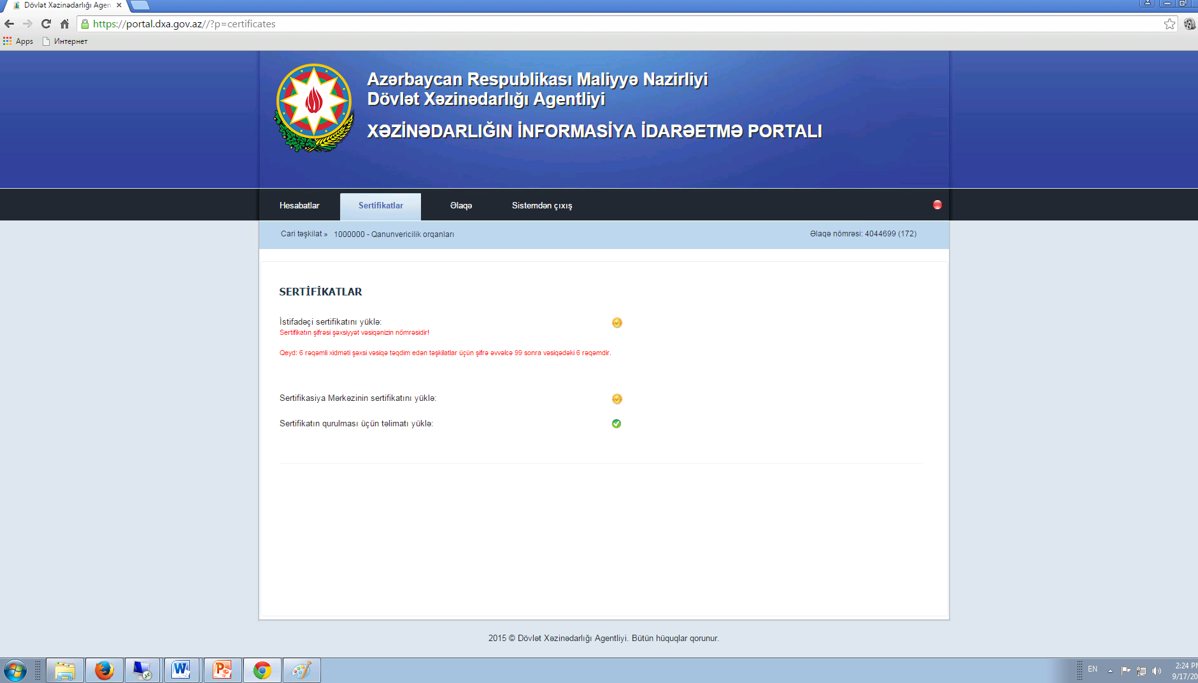
certificate download section and setup manual
User certificates setup
SC certificate setup
Setup manual

Slide 17
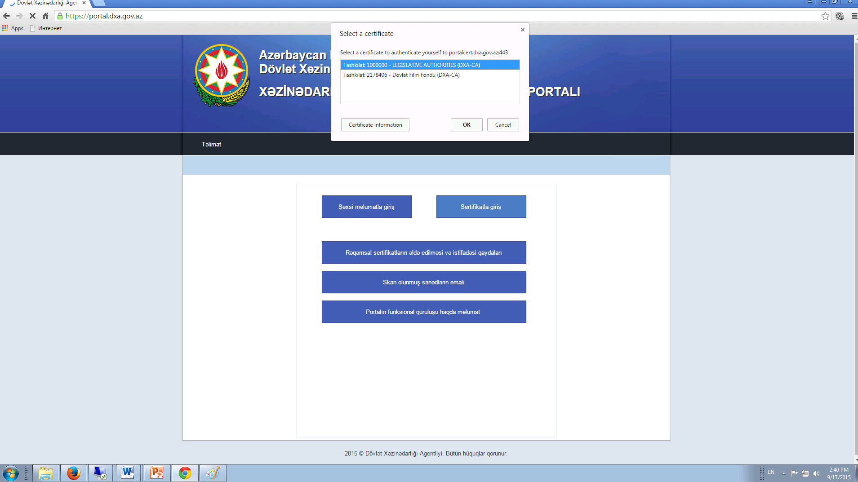
  After setting up the certificates, log on is done via a personal certificate.

Slide 18
Thank you for attention!

