Slide 1
THE SCOPE OF TRESURY SINGLE ACCOUNT
REPUBLIC OF SERBIA
MINISTRY OF FINANCE
TREASURY DIRECTORATE

Slide 2
(BUDGET) PREPARATION, EXECUTION, ACCOUNTING AND REPORTING SYSTEM
The (budget) preparation, execution, accounting and reporting system – PEARS (SPIRI in Serbian) is an IT system providing integrated support for all Republic of Serbia’s budget-related activities of the Ministry of Finance and Treasury Directorate, including budgeting and preparation of consolidated annual financial statements. All direct budget users, and a majority of indirect budget users, operate within the TSA, i.e. their revenues and expenditures are paid as budgeted in accordance with the Budget Act over the Budget Execution Account 840-1620-21.
Every month the TSA users enter their financial plans into the system on a monthly basis until the end of the year, which consist of their monthly quotas, i.e. the amounts that a specific Ministry or its indirect user plans to pay in a given month. No payment can be made in the system unless the user has a monthly quota available as provided for the given appropriation for such payment.

Slide 3
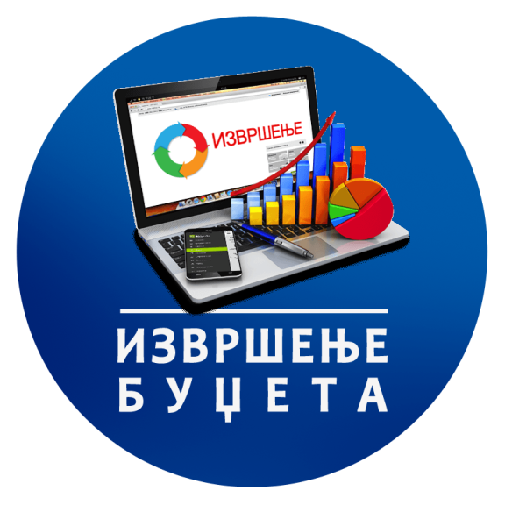
REPUBLIC OF SERBIA
MINISTRY OF FINANCE
TREASURY DIRECTORATE
PEARS (SPIRI in Serbian)
Budget execution
The system supports monitoring of the Ministry of Finance and Treasury Directorate budget execution-related activities:
Recording of appropriations and approval of appropriation amendments during the year
Allocation of appropriations to indirect budget users
Financial planning of expenditures of budget users
Determination of appropriation quotas financed from the budget revenues
Approval of quota amendments during the year
Execution of commitment transaction payments
Receipt and processing of incoming revenue transactions
Monitoring of payment schedule for revenues and expenditures
Budget current liquidity management
Management of the consolidated budget execution account of the Republic of Serbia and of the system of recorded budget execution accounts
BUDGET EXECUTION

Slide 4
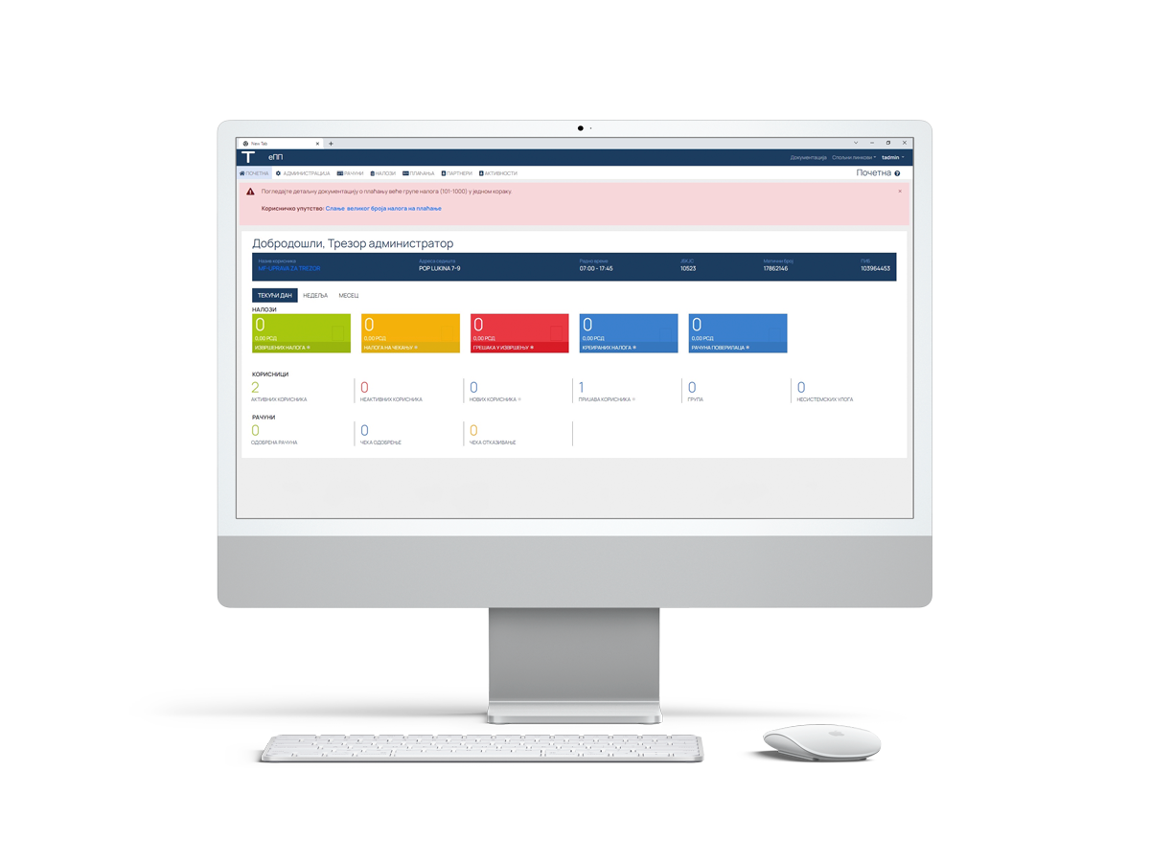
The process of integration of remaining indirect users with the PEARS (SPIRI in Serbian)
REPUBLIC OF SERBIA
MINISTRY OF FINANCE
TREASURY DIRECTORATE
The Treasury Directorate is currently implementing activities to integrate indirect budget users of the Ministry of Education into the budget execution system, which will enable all budget users at the level of the Republic of Serbia to operate over the budget execution account.
Since January 1, 2023, the Budget Execution System includes primary, secondary and tertiary education institutions.
From January 1, 2024, the plan is to integrate secondary schools (454), and from January 1, 2025, primary schools (1,303), as well as tertiary education institutions. In 2023 all the above-mentioned users have been operating in the test mode.

Slide 5
REPUBLIC OF SERBIA
MINISTRY OF FINANCE
TREASURY DIRECTORATE
LSGU
LOCAL SELF-GOVERNMENT UNITS’s BUDGET EXECUTION SYSTEM
The local self-government units (LSGUs)’ budget execution monitoring, control and reporting system.
Based on the software model, the system provides insight into the LSGUs’ budgets, funds available by appropriations and payment control over available amounts.
Expenditure recording in accordance with payment data enables daily monitoring of the use of funds in compliance with the adopted budget decisions.
Instead of ex-post, the ex-ante method is noticeably applied, which prevents payments from budget accounts above the appropriation threshold. This does not encroach the local government’s competence concerning budget execution but enables suspension of payments that are not in accordance with the law, i.e. with the local self-government budget decision.

Slide 6
FUNDS, AGENCIES, INSTITUTES AND OTHER REGULATORY BODIES
REPUBLIC OF SERBIA
MINISTRY OF FINANCE
TREASURY DIRECTORATE
REPUBLIC OF SERBIA
MINISTRY OF FINANCE
TREASURY DIRECTORATE
Agencies, institutes, regulatory bodies and SOEs use accrual accounting in their operations, and for that reason cannot be integrated into the budget execution system.
Thus, a standardized data collection template was designed for agencies, regulatory bodies and other legal entities. During the first 6 months of 2023 the activities were actively carried out in order to automate the above-mentioned reports. Accordingly, the report delivery and preparation process has been nearly fully automated, with expected ongoing improvements.
REPUBLIC OF SERBIA
MINISTRY OF FINANCE
TREASURY DIRECTORATE

Slide 7
THANK YOU FOR YOUR ATTENTION!
REPUBLIC OF SERBIA
MINISTRY OF FINANCE
TREASURY DIRECTORATE

