Slide 1
STRENGTHENING NTERNAL AUDIT CAPACITIES IN THE HUNGARIAN PUBLIC SECTOR

Slide 2
HUNGARY AND THE EUROPEAN UNION
European Union of (now) 28 countries
European Commission, Council and Parliament
Accession of Hungary in 2004
Systems and legislation had to be harmonized to EU law
Subsidies from EU to MSs

Slide 3
CONDITIONS FOR SUCCESS OF CHU
Changes cannot happen over night and should be planned very carefully and realistically
Broad discussion of the reform
Understanding and acceptation of why changes are needed. External factors stimulate reforms but success depends on the ability to change and think in a new way → ownership!
Political will and support
Trained staff familiar with international standards and good

Slide 4
Human resource management

Slide 5
Auditors need a different viewpoint

Slide 6
HISTORY
Project: Improving Public Internal Financial Control system, Audit Mechanisms and Skills
The wider objective of the project is to increase Sound Financial Management (effectiveness, efficiency and the economy of the Hungarian Public Internal Financial Control System (PIFC system) – based on COSO principles
One of the main means of the developments is to organize professional trainings for internal auditors and financial managers in budgetary organizations in order to keep their knowledge up-to-date
In order to achieve the above mentioned aim the objective of the project was to establish a PIFC Methodological and Training Centre

Slide 7
ESTABLISHING THE SYSTEM
As a first step the trainers’ selection for the centre and their training were carried out – 45 trainers („train the trainers”)
The next step was to create and develop an e-learning framework system and the preparation of e-learning modules in order to satisfy the needs to provide flexible, mass-training for a great number of (eventually remotely located) participants
After that the MoF has ensured needed equipment for the trainers (laptop) and MTC
Important step was the establishment of the legal obligation of the continuous training

Slide 8
LEGAL BASIS
The Minister of National Economy (MNE) is responsible for the establishment, operation and professional management of the MTC
Public Finance Act (PFA) declares that an internal auditor of a public budgetary organisation has to be licensed by the MNE, which means that the auditor has to be registered
In accordance with the regulations of the PFA the PBO’s Chief Financial manager and the Head of the PBO shall also attend professional PIFC related training regularly
Ministerial Decree on the registration and continuous professional training of internal auditors contain the rules for vocational training for the public sector internal auditors

Slide 9
HOW THE SYSTEM WORKS?
Currently the MTC works within the organisation of the National Tax and Customs Administration’s Training, Health and Cultural Institute
Internal auditors are obliged to attend vocational training in regularly
At the first time internal auditors should take an exam in the subject of the „Public Internal Financial Control I.” (with three obligatory modules) in the next year of their registration
Then they shall perform one freely selected module from the modules of the „Public Internal Financial Control II.”
Failing to complete these obligations, the internal auditor will be deleted from the registry – that means they lost the permission of the MNE
The trainees can choose from the following two forms of training: e – learning and face-to-face training
On the basis of the cooperation agreement between the MNE and MTC the infrastructural background of the Centre is provided by the central and 6 regional establishments of the MTC

Slide 10
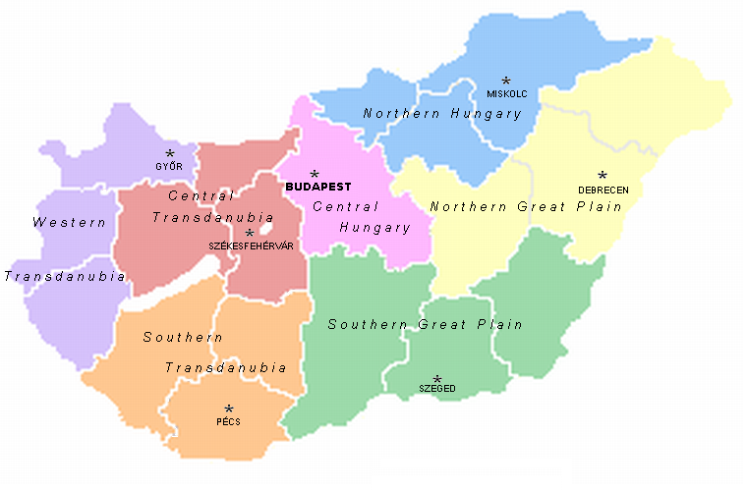
SITES

Slide 11
„PIFC I.”
Introduction general module
1. Public finances
2. European Union and Hungary
3. Control system of the public administration
General internal audit module
1. Legal basis of PBO’s internal audit
2. Guidelines relating to internal audit issued by Ministry of Finance
3. Internal audit’s standards and practice advisories
4. New methodologies in the area of internal audit
Public Internal Control System (PIC) module
1. Corporate governance
2. The COSO model
3. PIC in Hungary
4. Managerial accountability

Slide 12
„PIFC II.”
Optional modules:
Value for Money Audit
System Audit
Control of subsidies from the European Union
Control of public procurement
Audit of IT systems
Control of public accounting
Risk-based audit planning (training)
Risk management (training)

Slide 13
E-LEARNING
The e-learning course contains 265 recommended lessons
The access to the electronic learning material (curriculum) in ILIAS is provided for the participants of the training for 60 days
During this period of time the trainee can open the electronic curriculum via the Internet either at home or in the office at any time and he/she can acquire it by self-training or if it is needed – with tutoring assistance
After processing each of the learning material and completing the three end of module tests the participants may try to pass the exam
The ILIAS makes possible to carry out the tests related to learning material and end of module tests
The last day of the training the trainees who chose the e-learning training take their end of course test at the selected place and in the exam-group having chosen during the registration for the training

Slide 14
FACE-TO-FACE TRAINING
For internal auditors take 3 days - 21 lessons including 20 x 45 minutes lectures
For Heads of PBOs and Financial managers: 1 day – 8 x 45 minutes lectures – only the third module of the „PIFC I.”
Presentations by trainers at the selected date and place having chosen during the registration for the training
At the end of each course there is an exam, which lasts 1 hour (60 minutes)
The supervised exams will take place at the chosen course-place, through the ’ILIAS’ learning management system.

Slide 15
MANAGEMENT OF THE MTC
Annual Training Plan - financed by national budget (in Chapter of MNE) – only the e-learning is free
The MTC register all applicants for the trainings and signs teaching and tutoring contract with the trainers appointed by the MNE
Exams are held at MTC in every case (passing limit: 60 %) and there is a possibility to perform an „ex-ante” exam – 80% - if somebody succeeds he/she is exempted from training
The training materials are updated yearly

Slide 16
AN AVERAGE YEAR
Modul | Type | Number of courses | Number of applicants | Number of issued certification
PIFC I. – Internal auditor | F2F | 2 | 48 | 47
 | E- learning | 8 | 162 | 140
PIFC I. – financial manager and head of budgetary units | F2F | 20 | 632 | 609
 | E- learning | 4 | 851 | 791
PIFC II. – Audit of public procurement | F2F | 6 | 169 | 162
 | E- learning | 3 | 158 | 153
PIFC II. – System audit | F2F | 12 | 365 | 349
 | E- learning | 3 | 273 | 269
PIFC II. – Value for money audit | F2F | 10 | 254 | 248
 | E- learning | 3 | 161 | 159
PIFC II. – Control of EU funds | F2F | 8 | 209 | 204
 | E- learning | 3 | 170 | 168
Total: |  | 82 | 3452 | 3299

Slide 17
Small CHU can achieve significant results

Slide 18
FUTURE
Further development of modules (more examples and case studies)
Local government specific modules
Sustainability

Slide 19
THANK YOU FOR YOUR ATTENTION!
ANY COMMENTS, QUESTIONS?

