Slide 1
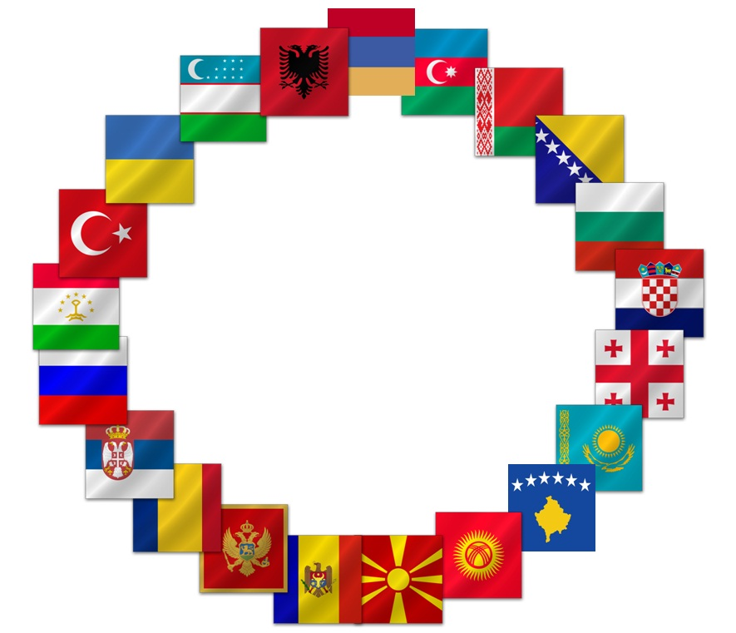

TCOP Virtual
Activities
Since April 2020
2021 TCOP Annual Plenary Meeting Day 1: June 1, 2021

Slide 2
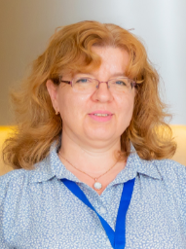
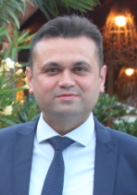
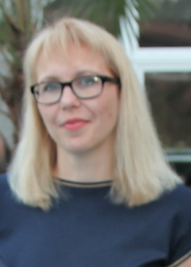
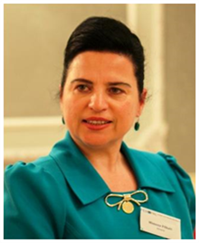
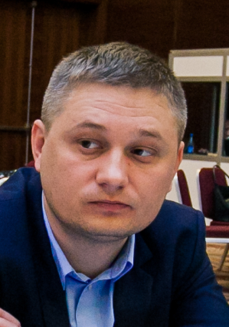
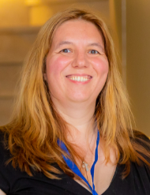
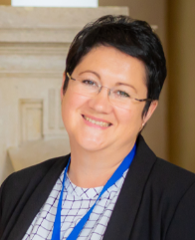
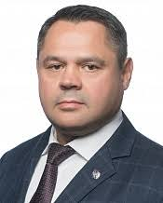
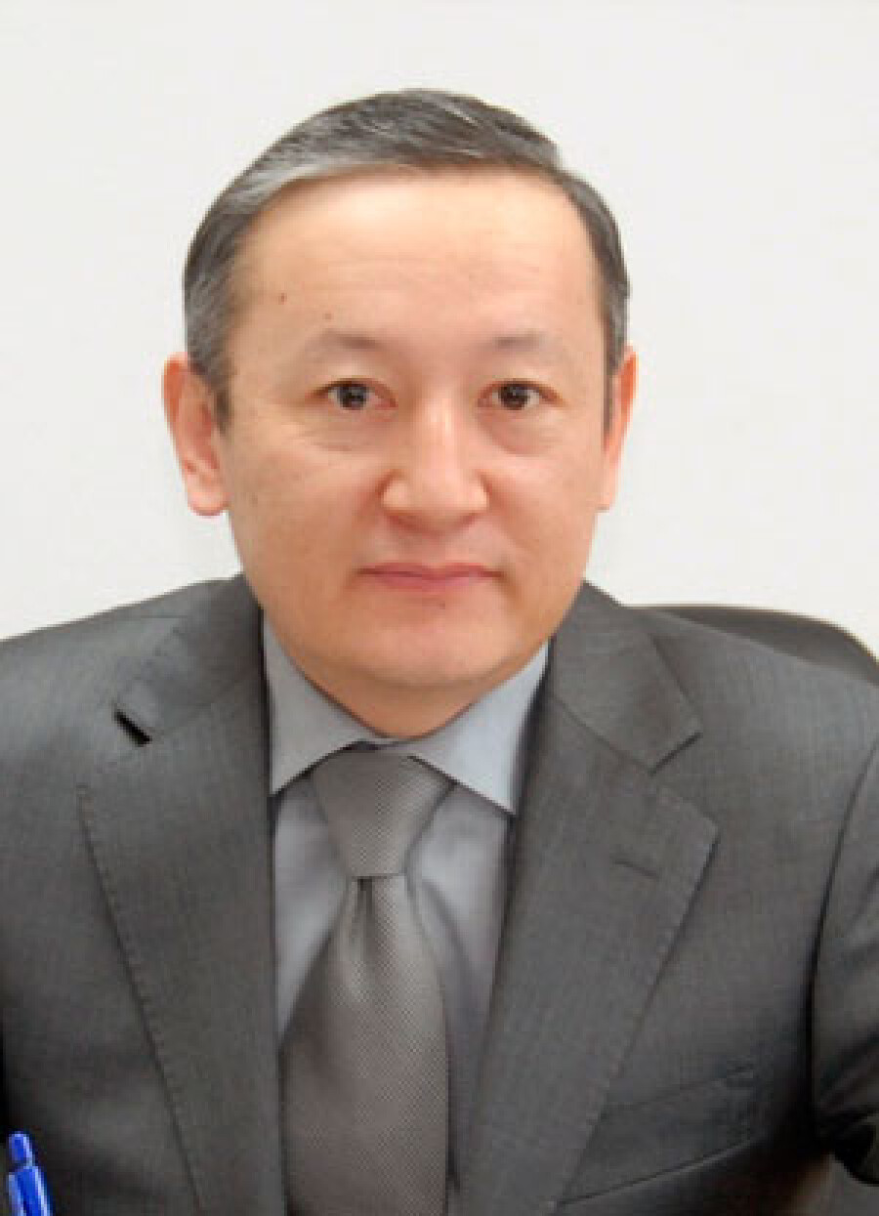
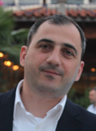
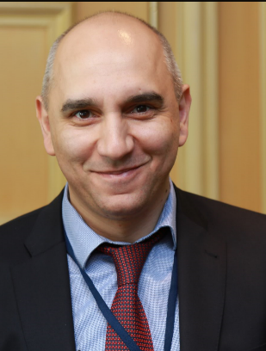
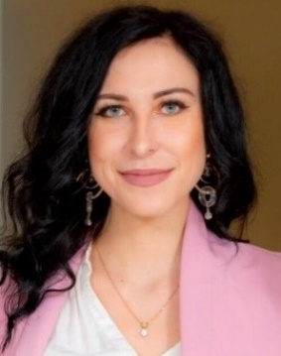
Elena Nikulina,
Resource team leader
Lyudmila Guryanova
TCOP Chair,
Deputy Head
State Treasury
Belarus
Mimoza Pilkati
Department Director,
DG of Treasury
Albania
Galina Kuznetsova
Resource Team
Ilyas Tufan,
TCOP Vice Chair,
Department Head, Ministry of Treasury & Finance, Turkey
Maxim Ciobanu
Head
State Treasury
Moldova
Executive Committee
Treasury Community of Practice
Yelena Slizhevskaya
Resource Team
Ekaterina Zaleeva
PEMPAL Secretariat
Alexander Demidov,
Deputy Head
Federal Treasury,
Russia
Anuar Dzhumadildaev
Chair of the Treasury Committee
Ministry of Finance,
Kazakhstan
Levan Todua
Department Head, State Treasury, Georgia
Nazim Gasimzade Department Head, State Treasury Agency,
Azerbaijan

Slide 3
TCOP Action Plans
Are developed in accordance with :
  PEMPAL Strategy for 2017-2022
  Results of TCOP member surveys (the last one collected during 2019 Budapest plenary) and post event surveys after virtual events
Are aimed at achievement of PEMPAL TCOP strategic goals:
  Promotion of PFM reforms of high priority for TCOP members, with the focus on reforms of national treasuries
  Provision of TCOP members with high quality resources and knowledge services
  Establishment of highly professional community of treasury specialists in TCOP countries
  Gaining support for TCOP activities and for activities of PEMPAL as a whole from top management of treasuries from member countries
Were adjusted for the pandemic:
  All events moved to the online format using the KUDO platform with the simultaneous translation into PEMPAL languages;
  To include discussions of the challenges related to COVID-19 and countries’ responses in respective thematic areas

Slide 4
TCOP continues to operate 4 key thematic groups
Treasury
Function
Evolution of treasury role and functions
IT
Use of information technologies in treasury operations
Cash
Cash management
A/R
Accounting and reporting in the public sector

Slide 5
Activities implemented between April 2020 - June 2021
Thematic videoconferences
9 videoconferences with participation of 292 TCOP members (from 11 to 17 countries each)
Executive Committee
4 ExCom meetings
(via videoconferences)
Knowledge Products
  Optimizing the Unified Chart of Accounts Design: Tips for PFM Practitioners (2020)
  Launch of 2021 Treasury Single Account and Cash Management Survey
  Interviews with senior officials of the member countries and Executive Committee members, survey of network members
External Evaluation of PEMPAL Program

Slide 6
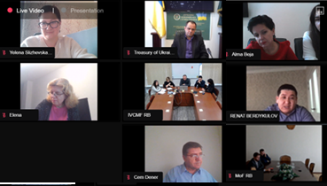

Slide 7



What We Discussed
April 29, 2020 discussion on Treasury response to COVID-19 challenges revealed that advanced state of electronic payment processes and information systems resulted in TCOP countries being well placed to support more responsive government and accommodate emergency payment requests
June 24, 2020 event familiarized participants with sound practices exercised by the Swiss Federal Treasury in integration of cash and debt management, coverage of the Treasury Single Account and close monitoring of the cash flows based on long-horizon cash flow forecasts
During September 15, 2020 event the participants learned about operation and recent reforms of the Treasury Committee of Kazakhstan, including performance management framework, evolution of Treasury-Client information system and its interoperability and data exchange with other systems.

Slide 8


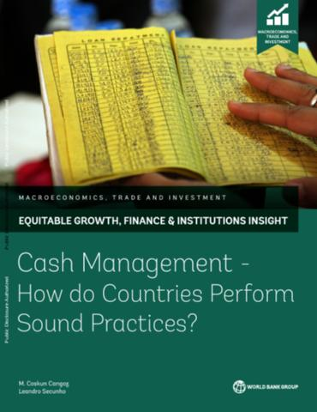
What We Discussed (cont.)
During October 13, 2020 meeting TCOP members from Albania, Belarus, Kazakhstan, Moldova, and Tajikistan presented updates on the ICT agenda topical for their national treasuries paying attention to developments accelerating as a result of the COVID-19 pandemic
November 19, 2020 - colleagues from Albania explained the overall architecture and core functionality of the AFMIS as well as the key integration links between the treasury information system (AGFIS) around which the AFMIS is built and the new modules and government information systems. The presentation was followed by a demo session
February 11, 2021 event familiarized participants with recent paper by M. Coskun Cangoz and Leandro Secunho “Cash Management: How do Countries Perform Sound Practices?”. The launch of “2021 Survey on TSA and Cash Management and Forecasting Practices in PEMPAL Countries” was also announced

Slide 9
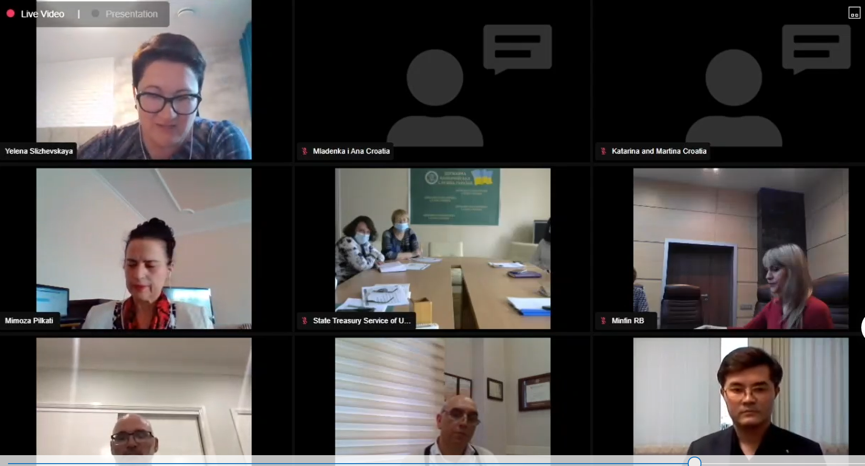
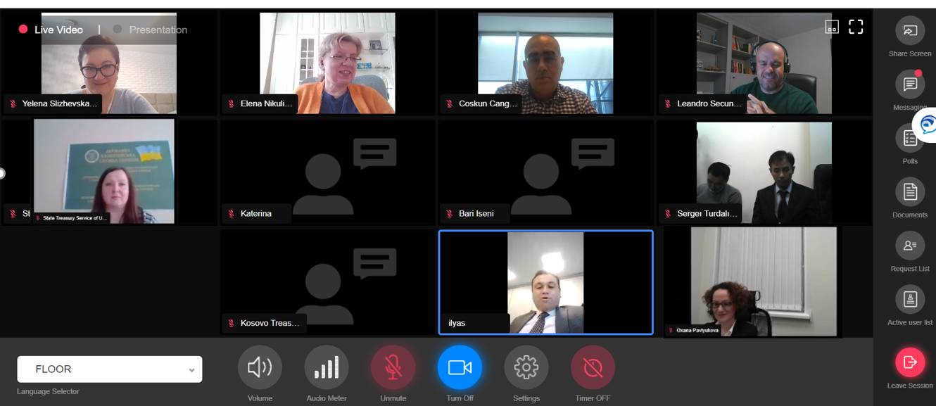

Slide 10

What We Discussed (cont.)
During June 4, 2020 videoconference the participants reviewed the draft of the knowledge product on optimization of the Chart of Accounts design and provided their comments. They also discussed how COVID-19 revenues/expenditures are tracked in their countries
On December 10, 2020 the final version of the new knowledge product on optimization of the Unified Chart of Accounts Design was presented to the members of the World Bank’s FMIS Community of Practice. The event was attended by 83 participants from 35 countries and stirred a lot of interest from the audience
During April 15, 2021 videoconference the participants got acquainted with (i) the experience of the Treasury Committee of Kazakhstan to prepare consolidated financial statements of the republican budget; and (ii) the approach taken by the State Treasury of Belarus to pilot the new Unified Chart of Accounts.

Slide 11
TCOP Knowledge Products, FY2020-2021
Optimizing the Unified Chart of Accounts Design: Tips for Public Financial Management Practitioners (2020)
https://www.pempal.org/knowledge-product/optimizing-unified-chart-accounts-ucoas-design-tips-public-financial-management
Special thanks for review and contributions to
Mimoza Pilkati (Albania);
Firuza Abdullayeva (Azerbaijan); Lyudmila Guryanova, Natalia Rusakevich (Belarus);
Mladenka Karačić (Croatia);
Zurab Tolordava (Georgia);
Angela Voronin, Nadejda Slova,
Svetlana Placinta (Moldova);
Anton Dubovik, Svetlana Sivets
(Russian Federation);
Nataliya Botsman (Ukraine); and others
2021 Treasury Single Account and Cash Management Survey (preliminary results)
Invaluable help was provided by
Lyudmila Guryanova (Belarus),
Levan Todua (Georgia),
Ekaterina Semenova (Russian Federation) and Ilyas Tufan (Turkey) during the design, review and testing of the survey

Slide 12
External Evaluation of the PEMPAL program
The evaluation was commissioned by the PEMPAL Steering Committee, to feed into the mid-term review (MTR) of the PEMPAL 2017-2022 strategy. It used existing PEMPAL monitoring data as well as additional research tools, such as interviews with senior officials, mini-country case studies and a survey of network members.
11 senior officials, including members of TCOP Executive Committee were interviewed, 48 TCOP members took part in the on-line member survey. Belarus, Georgia, Moldova and Uzbekistan represented TCOP country case studies.
The evaluation noted the breadth of Treasury functions covered by the work of the TCOP, compared to the BCOP and the IACOP, and that the more frequent use of VCs prior to the COVID-19 pandemic helped members adapt better to the new virtual reality.
MANY THANKS to everyone who participated!
Overall, the evidence of this evaluation points to the current PEMPAL model working very well and creating value for member countries, the region, and donors at relatively low cost. The adjustments made by the COPs to cover topics related to public financial management during the COVID-19 pandemic were highly relevant to members.

Slide 13
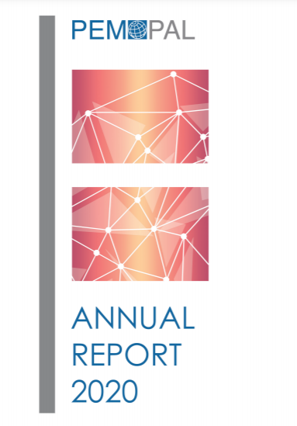
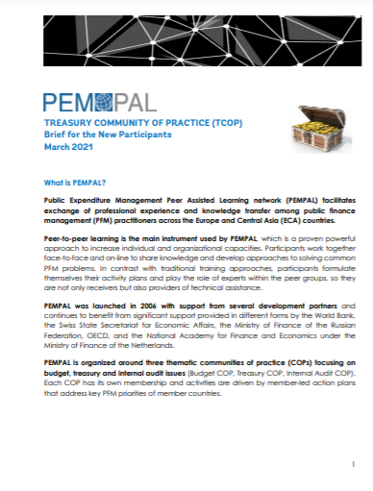
Find more details on TCOP activities in:
TCOP Factsheet (Brief) for new participants https://www.pempal.org/sites/pempal/files/eng_tcop_guide_march_2021.pdf
PEMPAL Annual Report FY20
https://www.pempal.org/reports
htt

Slide 14
Further Steps
Confirm TCOP thematic priorities for the upcoming period and collect proposals for TCOP future activities (through the survey and plenary thematic discussions)
Prepare TCOP Action Plan for FY2022:
  Budget allocation is $200,000
  Assume that face-to-face events resume in CY2022

