Slide 1

PEMPAL Treasury COP Virtual Activities
During the Pandemic
OVERVIEW
Almaty, Kazakhstan
May 23, 2023

Slide 2
TCOP Action Plans
Were developed in accordance with :
  PEMPAL Strategy for 2017-2022
  Results of TCOP member surveys and feedback provided through the post-event surveys
Are aimed at achievement of PEMPAL TCOP strategic goals:
  Promotion of PFM reforms of high priority for TCOP members, with the focus on reforms of national treasuries
  Provision of TCOP members with high quality resources and knowledge services
  Establishment of highly professional community of treasury specialists in TCOP countries
  Gaining support for TCOP activities and for activities of PEMPAL as a whole from top management of treasuries from member countries

Slide 3
TCOP continues to work in 4 thematic areas
Treasury
Function
Evolution of treasury role and functions
IT
Use of information technologies in treasury operations
Cash
Cash management
A/R
Accounting and reporting in the public sector

Slide 4
Activities implemented between March 2020 - April 2023
TCOP Plenary meeting
1 TCOP Virtual Plenary meeting with participation of 100+ members from 17 countries (2021)
Thematic videoconferences
15 videoconferences with participation of 700+ members
Knowledge Products
Optimizing the Unified Chart of Accounts Design: Tips for Public Financial Management Practitioners (2020)
Executive Committee
11 ExCom meetings
Roles and Functions of the Treasuries in PEMPAL countries (under preparation)
Treasury Single Account and Cash Management in PEMPAL countries (2021)

Slide 5
Role and Functions of the Treasury Thematic Group -1
April 29, 2020
Discussion on how treasury operations in PEMPAL countries evolved in response to the pandemic
June 24, 2020
Familiarization with operation of the Swiss Federal Treasury, including cash management and liquidity planning
September 15, 2020
Familiarization with organizational set up, operation and key reforms of the Kazakhstan Treasury
29 participants from 11 countries
31 participants from 11 countries
43 participants from 17 countries
Familiarization with the WB note on Agile Treasury Operations during COVID-19

Slide 6
Role and Functions of the Treasury Thematic Group -2
November 10, 2022
March 16, 2023
Preparations for this plenary meeting
40+ participants from 12 countries
29+ participants from 13 countries
Albania: regulatory and methodological framework for risk management, Treasury operational risks and how the risks are addressed through business processes
2022 Survey on the Functions of the Treasuries in PEMPAL Countries – presentation of preliminary results

Slide 7
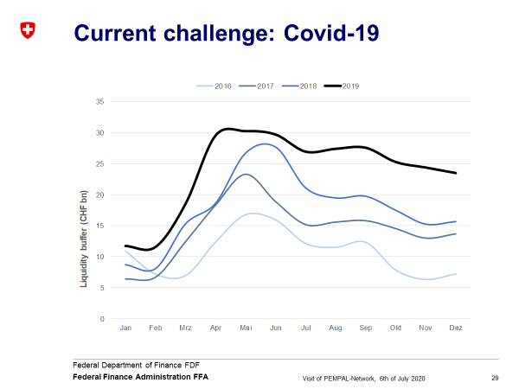
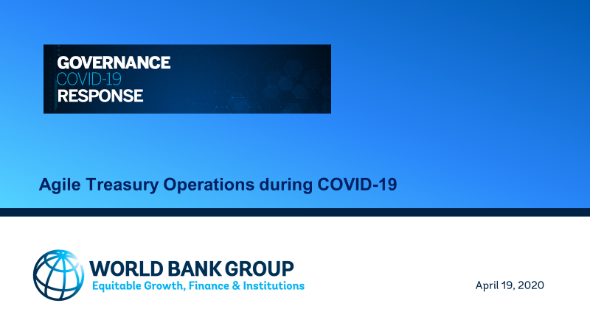

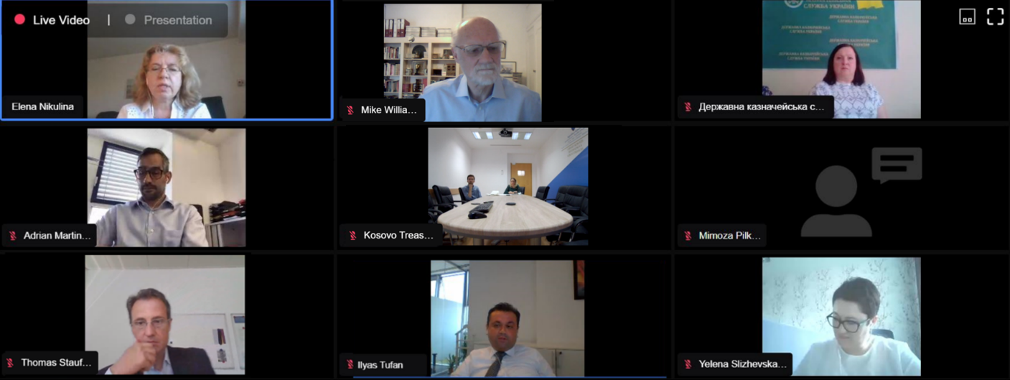
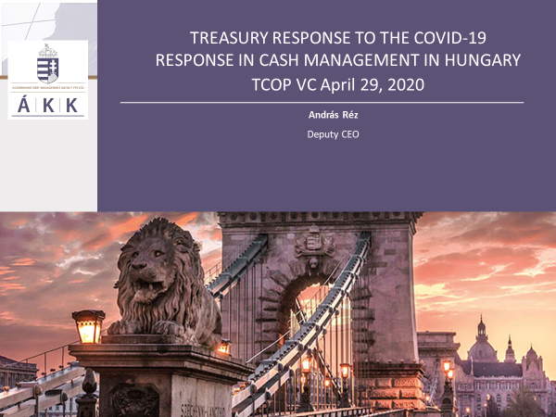

Slide 8
Cash Management Thematic Group
February 11, 2021
Presentation of a WB paper “Cash Management – How Do Countries Perform Sound Practices?”
October 20, 2021
September 28, 2022
Invited experts commented on the findings of the TCOP 2021 TSA and Cash Management and Forecasting Survey
Survey on TSA and Cash Management and Forecasting in PEMPAL countries – draft report discussed
31 participants from 14 countries
38 participants from 13 countries
Survey on TSA and Cash Management and Forecasting in PEMPAL countries - launch
25 participants from 11 countries
Conducted jointly with the WB Public Expenditure and Financial Management COP
Georgia: TSA set-up and TSA balance management

Slide 9
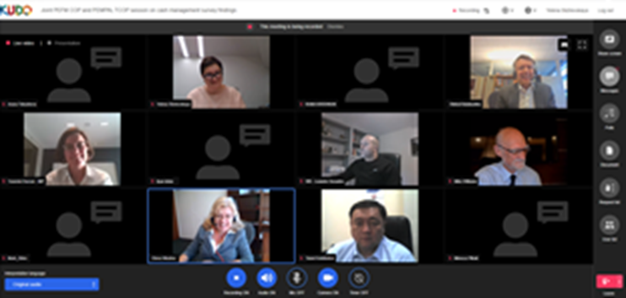
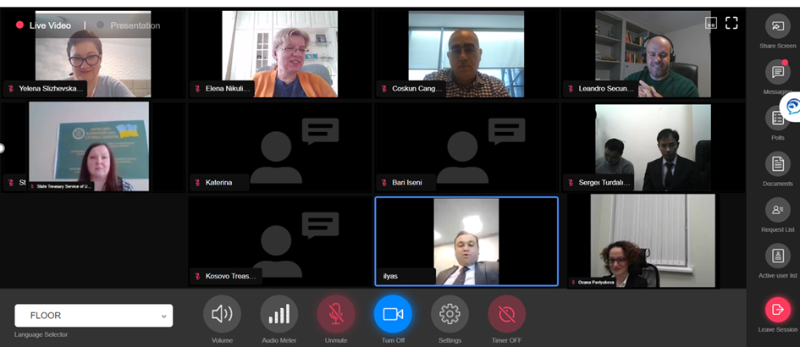
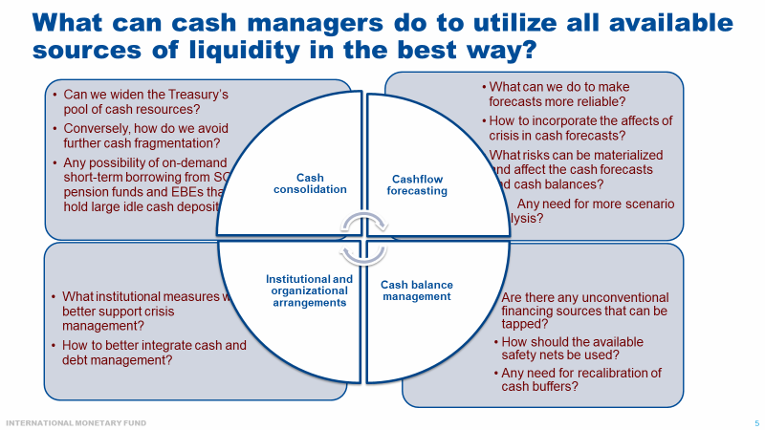
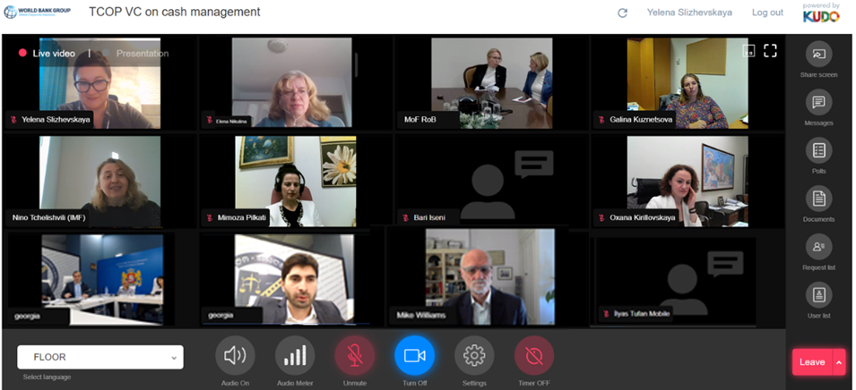

Slide 10
Use of IT in Treasury Operations Thematic Group -1
October 13, 2020
Country news on the progress of IT during COVID-19 (remote access to systems for the treasury staff, systems integration, digital signature, e-documents management)
November 19, 2020
Albanian Integrated Financial Management Information System: architecture, core functionality, and key integration links between the treasury information system and other modules
December 10, 2020
Presentation of the new knowledge product on Optimizing the Unified Chart of Accounts Design to members of the World Bank’s Financial Management Information Systems COP and GovTech Global Solutions Group
26 participants from 10 countries
37 participants from 10 countries
83 participants from 35 countries
Overview of the Korean Public Finance Information Services (KPFIS) capacity building program

Slide 11
Use of IT in Treasury Operations Thematic Group -2
April 15, 2021
(jointly with PSA thematic group)
Consolidation of financial statements of the republican budget by the Treasury of Kazakhstan
November 18, 2021
Familiarization with Korea Public Finance Information Service (KPFIS) operation
64 participants from 14 countries
54 participants from 11 countries and 34+ observers
Piloting the structure of the Unified Chart of Accounts in Belarus
Contract management in dBrain
Korean Integrated Financial Management Information System (dBrain) and expected capabilities of its next generation

Slide 12
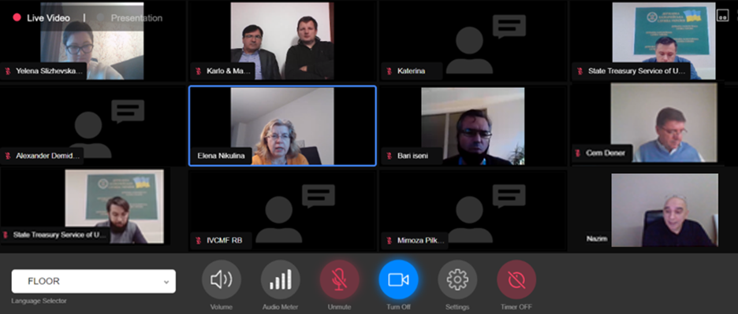
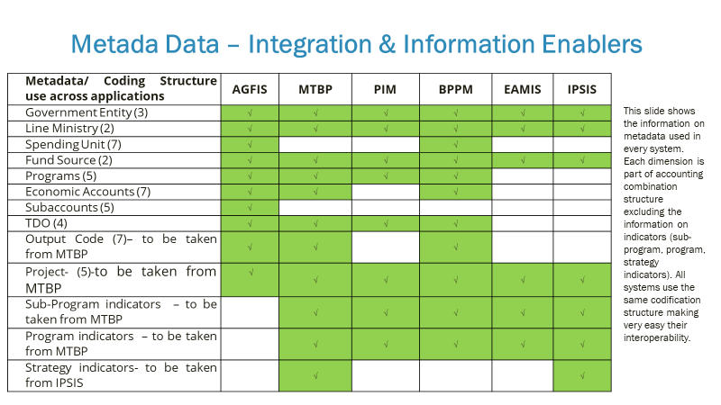
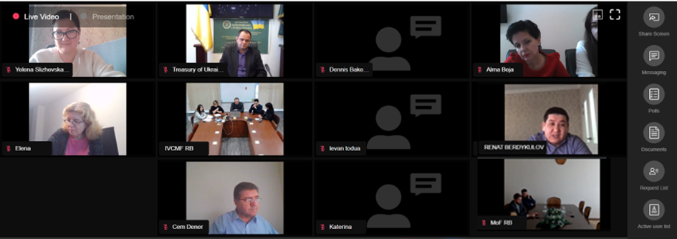


Slide 13
Public Sector Accounting Thematic Group
February 9, 2022
Familiarization with the results of piloting centralized accounting and reporting at the federal government level (Russia) and approach of the Federal Treasury for systems integration, provision of standard IT solutions, etc.
April 15, 2021
(jointly with IT thematic group)
Consolidation of financial statements of the republican budget by the Treasury of Kazakhstan
June 4, 2020
Presentation of the new knowledge product on Optimization of the Chart of Accounts (CoA) Design and collection of member countries comments to inform the final paper
Piloting the structure of the Unified Chart of Accounts in Belarus
64 participants from 14 countries
48 participants from 12 countries
29 participants from 10 countries
Discussion on how national treasuries were adapting CoAs to track COVID-19 revenues and spending

Slide 14
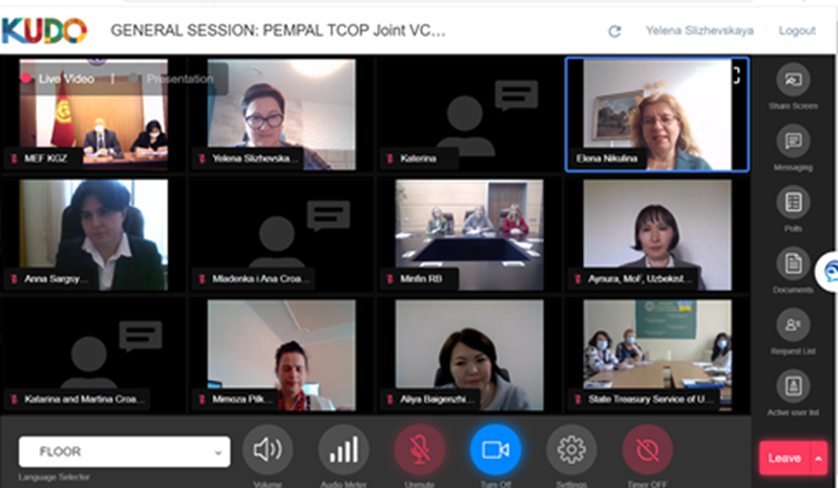
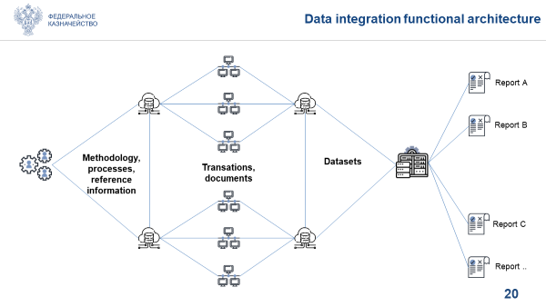

Slide 15
TCOP Virtual Plenary Meeting Series
June 1-9, 2021
Event Objectives
To allow members to share operational experiences from the COVID-19 period, identify lessons learnt, and discuss the implications for the further development of treasury systems and processes
Key Outcomes
June 1: Senior management shared thoughts and experience on technological and organizational adjustments as well as transformational impact of the pandemic on enhancing treasury operations
Participants
100+ participants from 16 countries, IMF and WB experts
June 9: International experience in ensuring transparency and accountability of COVID-19 responses. PEMPAL countries’ approaches for tracking, accounting, and reporting of emergency measures.
June 3: Trends in cash management and forecasting
June 7: Transformational role for information technologies to ensure business continuity of treasury operations during the pandemic.

Slide 16
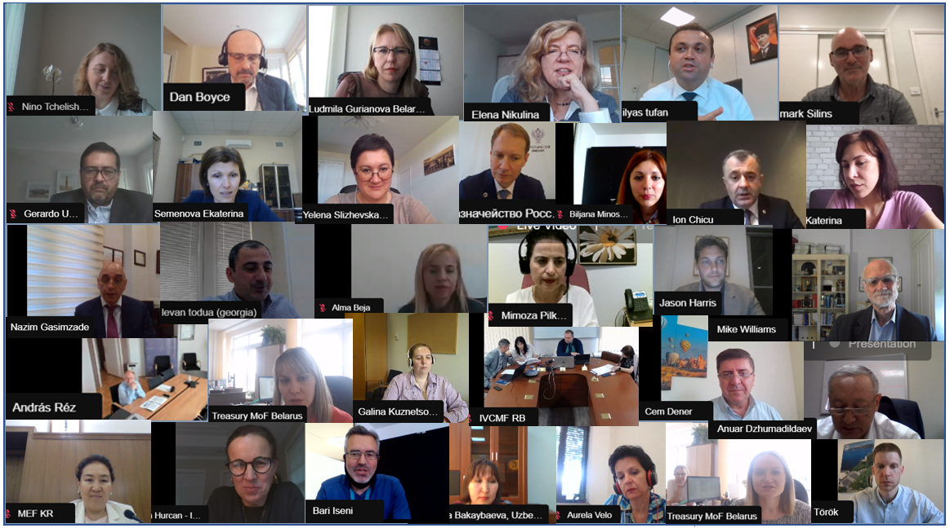

Slide 17
Knowledge Products
Report on the results of the survey on Treasury Single Account and Cash Management and Forecasting Practices in PEMPAL member countries, 2021
Report on the results of the 2022 Survey on the Role and Functions of the Government Treasuries in PEMPAL Countries:
- Aims to provide a snapshot of functions performed by the national treasuries of the PEMPAL countries and document the recent changes in the scope and content of functional responsibilities of participating institutions
- 18 countries
under preparation
Optimizing the Unified Chart of Accounts Design: Tips for Public Financial Management Practitioners (2020)

Slide 18
Attendance of the Virtual Events during the Pandemic

Slide 19
External Evaluation of the PEMPAL program, 2021
The evaluation was commissioned by the PEMPAL Steering Committee, to feed into the mid-term review (MTR) of the PEMPAL 2017-2022 strategy. It used existing PEMPAL monitoring data as well as additional research tools, such as interviews with senior officials, mini-country case studies and a survey of network members.
11 senior officials, including members of TCOP Executive Committee were interviewed, 48 TCOP members took part in the on-line member survey. Belarus, Georgia, Moldova and Uzbekistan represented TCOP country case studies.
The evaluation noted the breadth of Treasury functions covered by the work of the TCOP, compared to the BCOP and the IACOP, and that the more frequent use of VCs prior to the COVID-19 pandemic helped members adapt better to the new virtual reality.
Overall, the evidence of this evaluation points to the current PEMPAL model working very well and creating value for member countries, the region, and donors at relatively low cost. The adjustments made by the COPs to cover topics related to public financial management during the COVID-19 pandemic were highly relevant to members.

Slide 20
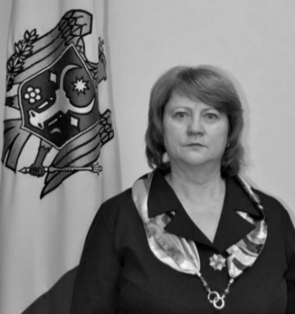
Our Loss
One of the key TCOP members was Ms. Angela Voronin. Ms. Voronin had become the head of the Moldova Treasury back in 2007 and joined the PEMPAL network right from the start of the program. She joined the TCOP Executive Committee in 2012 and was successfully reelected as its Chair starting with 2017 and until her sudden death in 2020. It was Angela’s professionalism, hard work and dedication to the concept of the peer learning that helped to shape the TCOP and to develop the network into one of the most successful examples of the regional peer learning initiatives.

Slide 21

Further Steps
Confirm TCOP thematic priorities for the upcoming period and collect proposals for TCOP future activities (thematic survey!)
Prepare TCOP Action Plan for FY2024
  identify specific topics of the next year’s activities
  identify location and timeline of the face-to-face events, including the 2024 TCOP Plenary Meeting
  Expand the Leadership of the TCOP
  (vacancy in the Executive Committee)

Slide 22
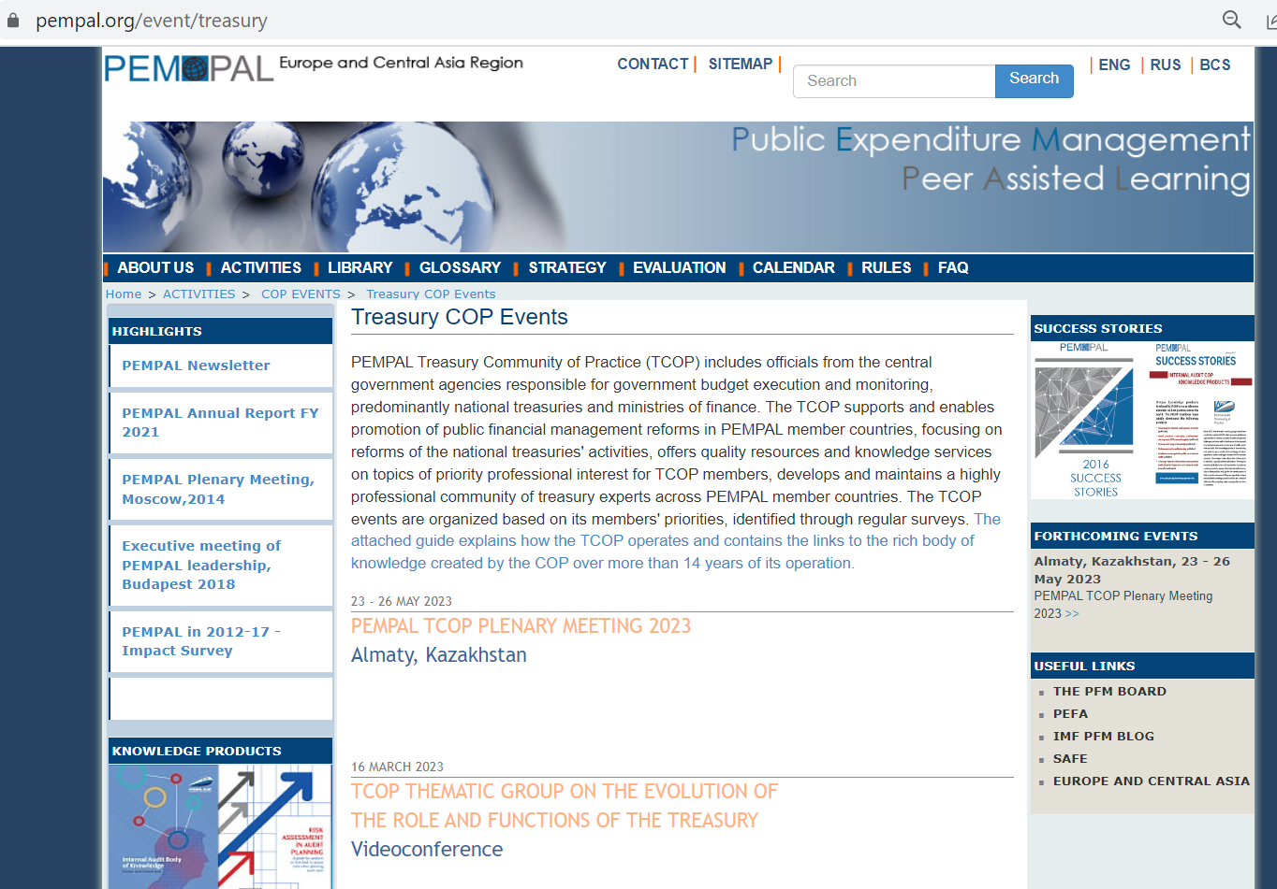
Information on TCOP Activities

