Slide 1
PEMPAL Treasury COP
Cash Management Thematic Group
Virtual Activities
During the Pandemic
Vienna, Austria November 27-29, 2023
Notes:
this is the full set of flags, not all the countries are in the WG

Slide 2
TCOP works in 4 key thematic areas
Function
Evolution of treasury role and functions
IT
Use of information technologies in treasury operations
Cash
Cash management
A/R
Accounting and reporting in the public sector

Slide 3
Background of the Cash Management Group
February 9, 2014 (TCOP ExCom, Tbilisi, Georgia) – Georgia and Moldova propose to establish new working group
April 24, 2014 - TCOP ExCom meeting makes the decision
May 15, 2014 – first VC of the group - Georgia and Moldova highlighted priority needs and activities to inform working group action plan
13 countries initially: Albania, Azerbaijan, Belarus, Croatia, Georgia, Kazakhstan, Kyrgyzstan, Montenegro, Moldova, North Macedonia, Russia, Tajikistan, and Turkey
During the pandemic the TCOP moved beyond the initial membership in the group opening participation for all interested COP members

Slide 4
Overview of CY2020-2023 Activities
One thematic workshops
Vienna 2023 (1st f2f meeting after 2018 Vienna one) – Consolidation of Government Cash and Techniques to Prepare Reliable and Timely Cash Forecasts
Four
thematic video-conferences
September 21, 2023 – Cash Flow Forecasting and Analysis Tool (IMF)
Discussions during plenary meeting
2021 Virtual Plenary (June 2 session) – How the pandemic affected cash management and forecasting and what cash managers could do to utilize all available liquidity in emergency situations
September 28, 2022 – invited experts commented on the findings of the TCOP 2021 TSA and Cash Management and Forecasting Survey
October 20, 2021 – Georgia: TSA set-up and TSA balance management. Draft survey report discussed
February 11, 2021 – Presentation of a WB paper “Cash Management – How Do Countries Perform Sound Practices?”. TSA and Cash Management Survey launched

Slide 5

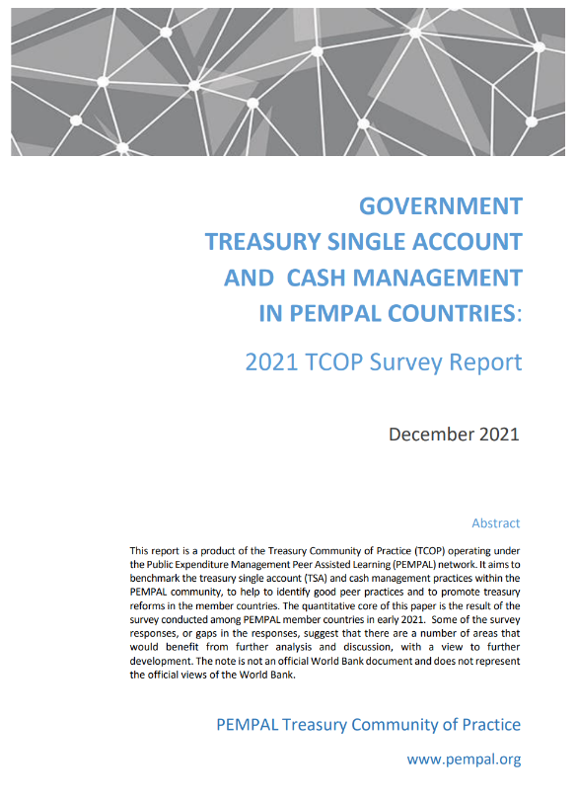
Third Knowledge Product Prepared
Link to the report

Slide 6
2021 TSA and Cash Management Survey Report - 1
All TSAs were in central banks (CB). 13 out of 16 countries transferred subnational government accounts into TSAs (some nuances)
TSAs were single or consolidated bank accounts – greater use of FMIS ledger coding
More than half of countries had other funds in their TSAs (extrabudgetary, grants and loans, etc.)
Revenues went directly to the TSA (only 2 countries did not deposit fund into the TSA the same day)
15 out of 16 countries made government payments directly from TSA
10 out of 16 were members of the Real Time Gross Settlement system
Almost all documented their relationship with their CB, 10 out of 16 received interest on at least some cash balances at the CB
12 out of 16 reported high-level cash management objectives (most focused on supporting budget execution, rather than efficient use of cash
Only 3 countries had a formal cash buffer target

Slide 7
2021 TSA and Cash Management Survey Report - 2
Variety of practices on cash forecasting
Treasury and debt management functions institutionally separated in many cases. Only 7 out of 16 countries had a formal high-level cash coordination / liquidity management committee
Concerns about coordination and consistent interactions with money markets
Most countries used Treasury bills as a short-term borrowing instrument (sometimes also seen as a debt management instrument with a regular issuance program)
Half were able to place deposits with CB, half – with commercial banks. Only 3 countries borrowed and lend through REPO
10 out of 16 acknowledged PEMPAL’s contribution to the reform agenda
Areas to explore:
* TSA Structures (IFMIS, UCoA, ICT) * TSA coverage * Cash Management Objectives * Cash Buffer Targets / Safety Nets * Investing Surplus Cash *

Slide 8
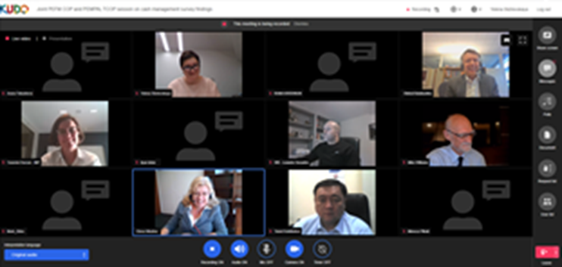
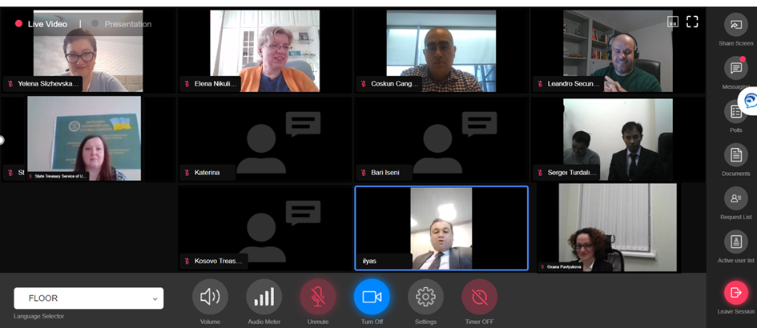
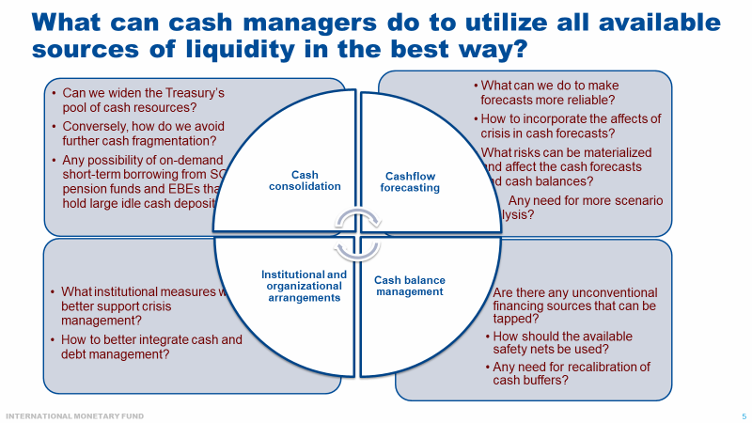
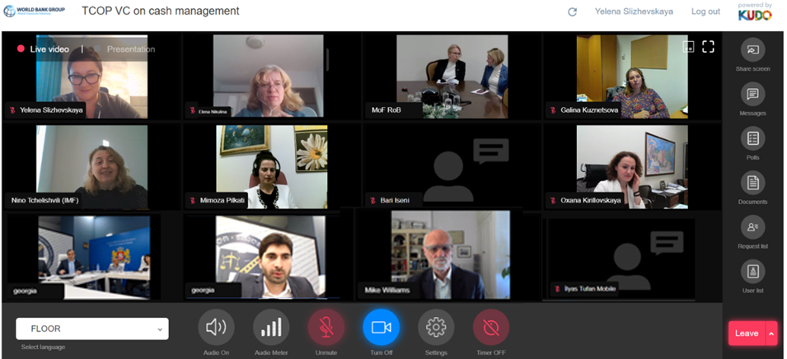
Notes:
to reconsider date of establishment and to add knowledge product

Slide 9
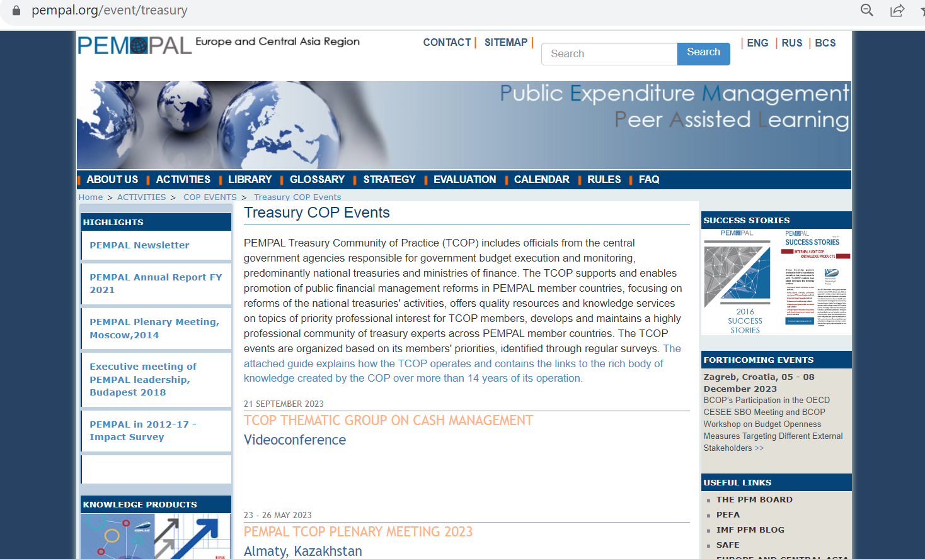
Information on TCOP Activities
Notes:
to reconsider date of establishment and to add knowledge product

Slide 10
ANNEX: Overview of CY2014-2019 Activities
Four thematic workshops
Vienna 2018 – Cash Flow Forecasting
Chisinau 2017 – Cash & Debt Management: Interaction and Coordination
Moscow 2017 – Targeting TSA; Interaction with Central Bank
Ankara 2016 – Selected Issues in Liquidity Management
Eight
thematic video-conferences
October 19, 2016 – Financial Instruments for Cash Mgmt
Discussions during plenary meetings
Chisinau 2016 plenary – Case of Moldova discussed
October 29, 2015 – Extending TSA coverage
April 9, 2015 – Cash Management in Azerbaijan
December 16, 2014 – Cash Management in Russia
September 11, 2014 – Cash Management in Türkiye
Tirana 2015 plenary – Selected Issues in Liquidity Management and Treasury Controls
December 3, 2019 – Liquidity Buffers in Türkiye
September 18, 2018 – Preparations for 2018 Vienna f2f
May 15, 2014 – discussion on the action plan

