Slide 1
Introduction of the SGB.net System
Atilla ÇAKIR
Ezgi DÜLGER

Slide 2
Overview
Sgb.net
is a web-based system;
is written in C# language on Asp.net framework
compatible with all data bases.
uses outsourced software development, and in-house expertise.
can serve centrally, but was transferred to individual institutions.
is used in the central and provincial units of the Ministry of Finance.
as used in 81 provincial and 980 district units; and was transferred via protocols to 175 public administrations.
The Ministry of Finance of Turkey uses SQL server.
About 11,000 operators use this system in the Ministry of Finance.
Disaster recovery service is provided by the Turkish Telecom company.

Slide 3
SGB.net Functions
Comprehensive approach rather than separate systems.
Strategic plan
Management of expenditures
Management of movable property
Performance
based program
Performance based budget
Financial plans and reports
Planning
Practice
Control over cash collection
Transfer of allocations
SGB.net
Reports on activity
Performance
\reporting
Control
Monitoring
Assessment
Preliminary
Financial control
Activity reports
Internal
control
Financial reports

Slide 4
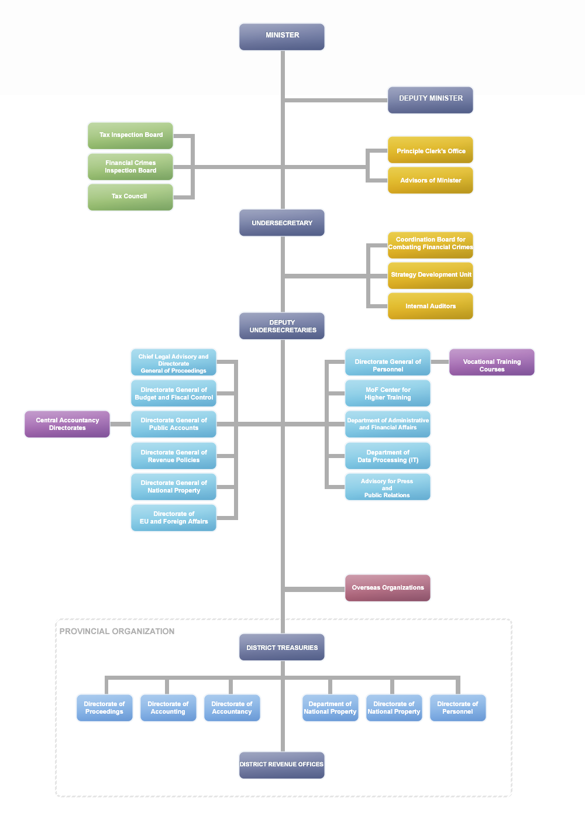

Slide 5
Organization of IT Support Function
General Directorates such as DG Public Accounts, DG Budget and Fiscal Management, Chief Legal Advisory and Directorate General of Proceedings and DG National Property have their own ICT units, which are respectively operating in the fields of State Accounting Records and Reporting, Budget Preparation and Execution, Legal Proceedings concerning the State, and State Properties Transactions.
These general directorates conduct their own policy making, implementation and technical support processes.
These ICT units have centralized structure.
The total number of ICT officials is around 300 personnel.
There is not a single and all-encompassing ICT unit is present in the ministry.
It was understood that this causes a problem, and studies have been initiated this year to address this.
The aim is to create a single ICT unit within the ministry and ensure that it works in coordination with other units.

Slide 6
ICT Unit in Strategy Development Unit (SDU)
Sgb.net support unit is located in the Ministry of Finance.
Software development is outsourced.
The ICT unit is under a department reporting to the Strategy Development Unit.
The expert staff of the department determines the policy, and the technical team conducts technical, security and support services.
The ICT unit and its function are carried out centrally.
8 experts, 3 statisticians and 5 IT personnel are employed in-house. Also, certain software services are outsourced.
6

Slide 7
Problem Management
A call center has been established in order to address the technical and non-technical problems of users.
Problems are conveyed to the center and resolved by call center officials.
The officials convey the questions they could not answer to the expert team.
Software problems are evaluated by the technical team and necessary solution proposals are developed..
Proposals regarding emerging needs are evaluated and resolved by the expert team.
7

Slide 8
Security of the system
The security of the SGB.net system is controlled by hardware firewall / virus alerts (IPS-IDS), security gaps scanner, report/monitoring log.
Communication between operators and the system is ensured by robust SSL certificates.
System control is performed in line with Turkish Standard Institute (TSE) on the basis of ISO 27001 (penetration tests, physical security, passwords security and etc.

Slide 9
Kind regards,
9

