Slide 1
Turkish Public Accounting System
PEMPAL TCOP
Thematic Group Workshop
Minsk, 2 October 2016
T.R. MINISTRY of FINANCE GENERAL DIRECTORATE of PUBLIC ACCOUNTS

Slide 2
BACKGROUND
Overview of the Turkish Public Accounting System:
2016
2015
Project on Accounting Reform on Accrual Basis sponsored by World Bank
The Public Financial Management and Control Law
Accrual base accounting was started
2007
Ongoing works on other IPSASs
25 National Standarts was published based on IPSASs
2006
2004
Public Accounting Standards Board was established under MoF
1995-2003
1
Turkish Ministry of Finance, General Directorate of Public Accounts - 2 October 2016

Slide 3
BACKGROUND
Objectives :
To prepare a framework chart of accounts and to adapt the internationally accepted accounting and reporting standards,
To record and report fixed assets in the accounting system,
To use time separated accounts to show short-term & long-term assets & liabilities
To use computer technology(say2000i) effectively
To provide prompt information to related parties in predetermined periods
Scope :
General Budget
Central Government
Special Budget Institution
Regulatory & Supervisory Institution
General Government
Social Security Institution
Local Governments
Municipalities
2
Turkish Ministry of Finance, General Directorate of Public Accounts - 2 October 2016

Slide 4
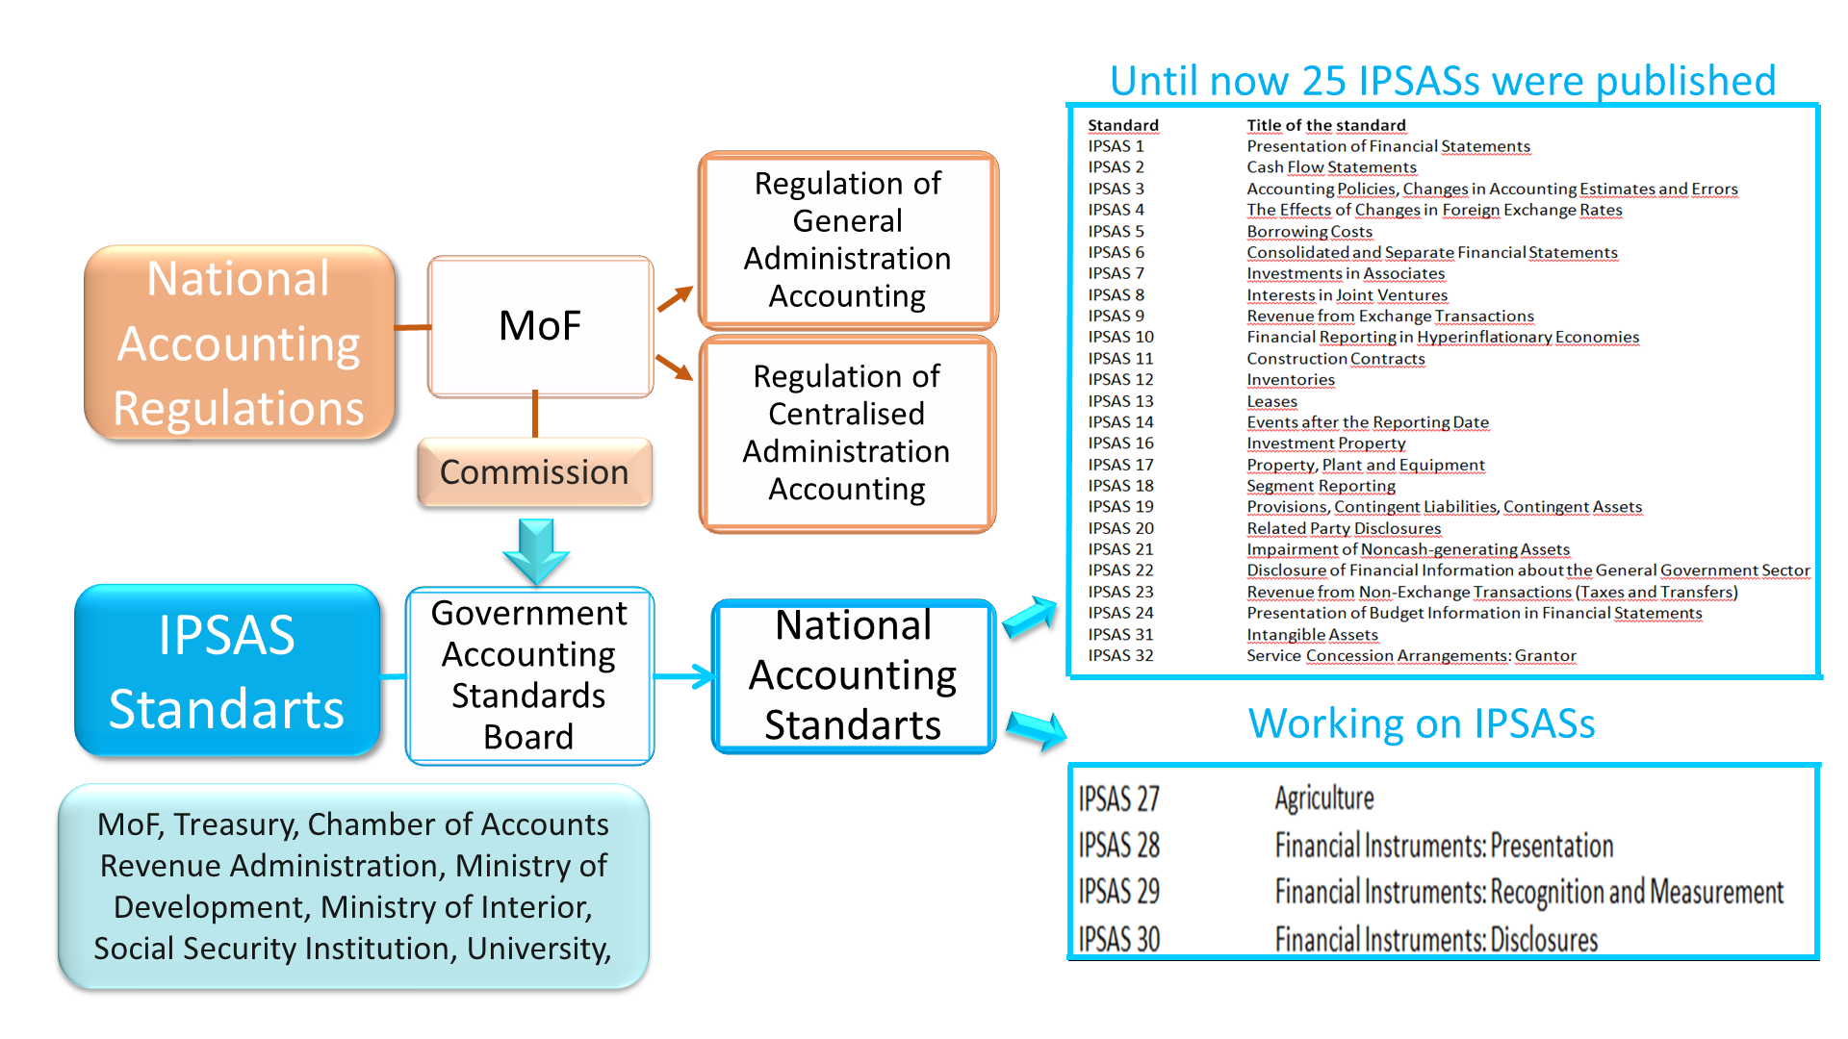
APPROACH
3
Turkish Ministry of Finance, General Directorate of Public Accounts - 2 October 2016

Slide 5
Remaining Main Challenges
Valuation & recognition of some immovables within the scope of PPSs
Valuation & recognition of underground resources
Preparation of Financial Statements regarding each unit in general budget.
4
Turkish Ministry of Finance, General Directorate of Public Accounts - 2 October 2016

Slide 6
Solutions
3-year Project about reconciliation of the national accounts to IPSASs
Expected gains of the Project:
Valuation and recognition of some immovables within the scope of PPSs
Preparation of Financial Statements regarding each unit in general budget.
5
Turkish Ministry of Finance, General Directorate of Public Accounts - 2 October 2016

Slide 7
Thank You for Your Attention

