Slide 1

Treasury Service Committee under the Ministry of Economy and Finance of the Republic of Uzbekistan
Liquidity management of the Treasury Single Account of the Ministry of Economy and Finance of the Republic of Uzbekistan
Bakhtiyor G'aniev and Tursunboy Madraimov
"PEMPAL" Treasury COP Annual Meeting
May 23, 2023

Slide 2
Legal basis for ensuring the liquidity of the Treasury Single Account and managing funds
2
• Article 125 of the Budget Code of the Republic of Uzbekistan stipulates the management of funds in the Treasury Single Account opened at the Central Bank of the Ministry of Economy and Finance.
• According to the decision No. 245 of the Cabinet of Ministers of the Republic of Uzbekistan dated August 29, 2014 "On approval of normative legal documents on the implementation of the Budget Code of the Republic of Uzbekistan", the procedure for cash planning and management of State budget funds is established.
According to the decision of the Cabinet of Ministers of the Republic of Uzbekistan dated May 22, 2018 No. 383 "On regulating the management of funds in the Treasury Single Account of the Ministry of Economy and Finance of the Republic of Uzbekistan", the procedure for placing temporarily free funds in the Treasury Single Account in bank deposits is established.

Slide 3
The number of budget organizations served by the Treasury Service Committee under the Ministry of Economy and Finance of the Republic of Uzbekistan
3
The total number of serviced budget organizations is 8,603
Republic of Karakalpakstan
Navoi
671
Tashkent city
Samarkand
411
Namangan
522
Sirdaryo
1 026
Khorezm
791
554
635
362
725
486
Andijan
  530
Tashkent
661
Fergana
Bukhara
Jizzakh
629
600
Surkhandarya
Kashkadarya

Slide 4
Treasury Single Account in national currency
4
• Treasury Single Account
(in national currency)
Local budget income and expenditure
•Income and expenditure of extra-budgetary funds
Revenue and expenditure of the republican budget
Income and expenses of state and other special purpose funds
Appropriate Funds of Commodity Exchange Clearinghouse
Customs funds of the State Customs Committee
Funds for contract payments of higher education institutions

Slide 5
Treasury Single Account in foreign currency
5
• Treasury Single Account
(in foreign currency)
Interest payments and principal for a Eurobond
• Off-budget funds of budget organizations in foreign currency
Proceeds from the sale of state shares abroad
Funds returned on budget loans and deposits
Remittances from foreign countries to the Government
Product Sharing Agreement Revenue (SRP)

Slide 6
Cash planning and management of state budget funds
6
Cash planning — is carried out by making monthly and annual forecasts of the republican budget and local budgets of the Republic of Uzbekistan, the sources and amount of revenues, as well as the amount of expenses, the direction of expenses and their purpose.
Cash planning of state budget revenues and expenses: for the republican budget of the Republic of Uzbekistan — by the Treasury Service Committee; for local budgets — carried out by regional treasury departments.
The forecast of the state budget income is made based on the information of the Tax and Customs authorities.
The forecast of cash payments for state budget expenditures is made on the basis of information from budget organizations and recipients of budget funds.

Slide 7
Preparation of the forecast of the republican budget of the Republic of Uzbekistan and cash planning
7
Tax and Customs Committees and other authorized bodies
Monthly forecast of earnings
Until the 28th of the current month for the next month
Annual revenue forecast
By December 30 of the current fiscal year for the next fiscal year
Budget organizations and recipients of budget funds
By December 30 of the current fiscal year for the next fiscal year
Forecast of monthly and annual expenses from the state budget
By December 30 of the current fiscal year for the next fiscal year
Ministry of Economy and Finance
Funds allocated to local budgets
Until the 28th of the current month for the next month
Treasury Service Committee
Financial planning and management
Constantly

Slide 8
8
Treasury Single Account liquidity management
State Tax Committee (Revenue Forecast)
Processing of revenue forecast data
Formation of the cash plan of the republican budget
Treasury Service Committee
State Customs Committee (revenue forecast)
Deficit
Surplus
Ministry of Finance (Revenue and Expenditure Forecast)
A source of deficit financing
Budget organizations (expenditure forecast)
Forming information on budget execution and expenditure forecasting
Placement of domestic bonds
Foreign debt

Slide 9
Management of funds in a Treasury Single Account
9
The Treasury Service Committee is the sole authorized body for placing temporarily free funds in the Treasurye Single Account of the Ministry of Economy and Finance in deposits of commercial banks.
Budget organizations and funds place their temporarily free funds in bank deposits by submitting orders to the Treasury Service Committee.
Temporary free funds and non-budgetary temporary free funds for bank deposits are placed on the basis of an electronic auction, which is carried out by placing an announcement in the special information system of the Ministry of Economy and Finance.
The e-auction takes place within one banking day.
Temporary free funds are placed in commercial bank deposits for a period of 12 to 24 months.

Slide 10
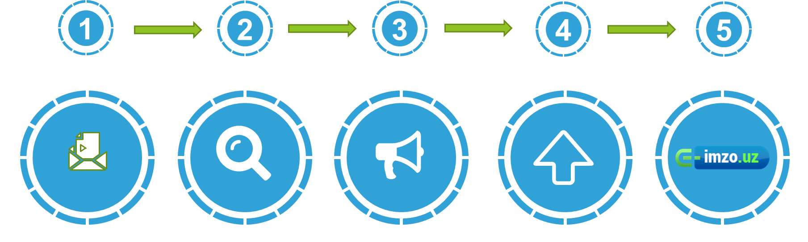
The process of placing temporarily idle funds of budget organizations in a bank deposit
10
UzASBO
Orders are created in the UzASBO program
DMBAT
Funding is verified in the DMBAT program
Announcement
If the fund is available, the announcement for the auction will be created automatically
Agreement
Quick conclusion of the contract based on the result of the auction
Electronic signature
Confirmation of the contract with an electronic digital signature

Slide 11
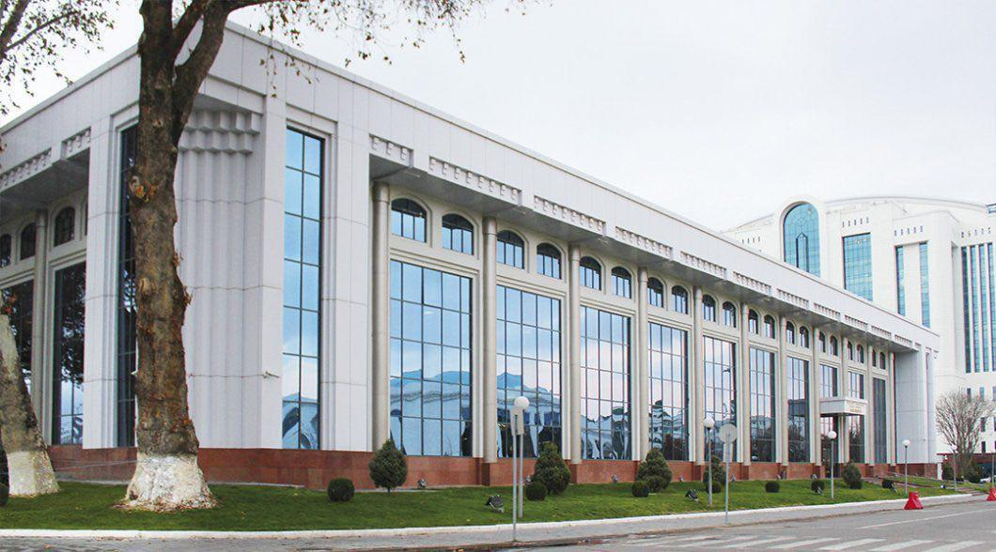

Treasury Service Committee under the Ministry of Economy and Finance of the Republic of Uzbekistan
Thank you for your attention!

