Slide 1



EUROPEAN UNION
Delegation of the Republic of Uzbekistan
UZBEKISTAN
2018 National PEFA Assessment
Budget Community of Practice of PEMPAL
March 18, 2019
Tashkent, Uzbekistan

Slide 2
Overview
2
The PEFA Program
Highlights of the PEFA Assessment
Review of Strengths and Weaknesses of Pillar II on Transparency of Public Finances
Comparison between 2012 and 2018 Assessments related to Pillar on Comprehensiveness and Transparency
Next Steps

Slide 3

The PEFA Program
4
PEFA: Public Expenditure and Financial Accountability
PEFA partnership founded in 2001
The PEFA program provides a framework for assessing Public Financial Management
Notes:
Founded as a partnership in 2001 by the EU, IMF, WB, and the governments of France, Norway, Switzerland, and the United Kingdom. PEFA was established as a means to reduce the duplication and costs of multiple assessments and to facilitate dialogue between government and donors. PEFA introduced a standard methodology and reference tool for PFM diagnostic assessments. The PEFA program provides a framework for assessing and reporting on the strengths and weaknesses of public financial management (PFM) using quantitative indicators to measure performance.
PEFA introduced a standard framework for PFM diagnostic assessments in 2005; minor upgrade in 2011; major upgrade in 2016.
PEFA approach to PFM:
A country-led PFM reform program, including a strategy and action plan reflecting country priorities; implemented through government structures
A coordinated program of support, covering analytical, technical and financial support
A common information pool, based on a framework for measuring performance and monitoring results over time i.e. the PFM Performance Measurement Framework

Slide 4
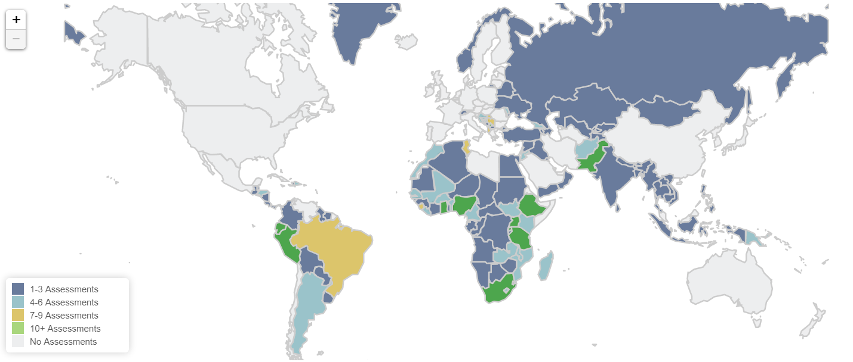
9
Assessment Overview - PEFA ASSESSMENTS BY REGION January 2019
- USED BY 150 COUNTRIES
- 602 ASSESSMENTS
- 21 ASSESSMENTS PLANIFIED
Source: https://pefa.org/countries-regions#/

Slide 5
8
Assessment Overview - The PEFA Framework
Purpose
Provide a thorough, consistent and evidence-based analysis of PFM performance at a specific point in time
Establish the foundation for analyzing and improving PFM
Assess how PFM impacts on key budget outcomes: fiscal discipline, efficient resource allocation, efficient service delivery
PEFA does not assess government policies
:

Slide 6
10
Assessment Overview - PEFA ASSESSMENTS TOOLS
3 OUTCOMES
94 DIMENSIONS
7 PILLARS
31 INDICATORS
The PEFA framework was upgraded in 2016. It is the most comprehensive upgrade since it was first published in 2005 and slightly revised in 2011.
Notes:
These are the key numbers of PEFA 2016:
3 budgetary outcomes (presented earlier)
7 pillars of good performance of an open and orderly PFM system that are essential to achieving the three desired budgetary and fiscal outcomes
31 performance indicators which are further disaggregated into
94 separate dimensions
The 7 pillars define key elements of a PFM system; it reflects what is desirable and feasible to measure. Within the 7 areas the Framework identifies 31 indicators that focus on key aspects of PFM which are regrouped around the 7 pillars.
Same pillars as in 2011 Framework plus one new.
Dimensions: from 76 to 94.
Increased relevance: includes independence of SAI, segregation of duties, debt management.

Slide 7







11
Assessment Overview - PEFA ASSESSMENTS TOOLS
7 PEFA Pillars of PFM Performance
Pillar One
Budget reliability
Pillar Two
Transparency of public finances
Pillar Three
Management of assets and liabilities
Pillar Four
Policy-based fiscal
strategy and budgeting
Pillar Five
Predictability and control in budget execution
Pillar Six
Accounting and reporting
Pillar Seven
External scrutiny and audit
Notes:
PEFA identifies 7 pillars of performance that are essential to achieving that government policies are implemented as intended and achieve their objectives. The 7 pillars define the key elements of a PFM system. They also reflect what is desirable and feasible to measure.
Budget reliability. Reflects the outputs of the system. Budget is realistic & implemented as intended. Measured by comparing actual revenues and expenditures (the immediate results of the PFM system) with the original approved budget.
Transparency of public finances. Information is comprehensive, consistent, & accessible to users; achieved through comprehensive budget classification, transparency of all Gvt revenue & expenditure including ITG transfers, access to public information on SDP, fiscal & budget doc.
Management of assets and liabilities. NEW Effective mgt of A & L ensures that public investments provide value for money, assets are recorded & managed, fiscal risks are identified, and debts and guarantees are prudently planned, approved, and monitored. This pillar focus on the importance of a prudent planning and management
Policy-based fiscal strategy and budgeting. Fiscal strategy and budget are prepared with due regard to government fiscal policies, strategic plans, and adequate macroeconomic and fiscal projections.
Predictability and control in budget execution. Budget is implemented within a system of effective standards, processes, and internal controls, ensuring that resources are obtained and used as intended.
Accounting and reporting. Accurate and reliable records are maintained; information is produced and disseminated at appropriate times to meet decision-making, management, and reporting needs.
External scrutiny and audit. Public finances are independently reviewed and there is external follow-up on the implementation of recommendations for improvement by the executive.
Within the 7 broad areas, PEFA defines 31 specific indicators that focus on key measurable aspects of the PFM system. PEFA uses the results of the individual indicator calculations, which are based on available evidence, to provide an integrated assessment of the PFM system against the 7 pillars of PFM performance. It then assesses the likely impact of PFM performance levels on the three desired budgetary outcomes: aggregate fiscal discipline, strategic allocation of resources, and efficient service delivery.

Slide 8
PEFA and the Budget Cycle
12
Policy-based Fiscal
Strategy and Budgeting
Transparency of public finances
External Scrutiny and Audit
Management of Assets and Liabilities
Predictability and Control in Budget Execution
Budget Reliability
Accounting and Reporting
Notes:
Another way to look at the 7 pillars of the indicator set is to look at the budget cycle. PEFA 2016 Framework is structured around the phases of the budget cycle.
The diagram illustrates how a budget cycle might work:
Starting with policy based fiscal strategy and budgeting – plans should reflect priorities/ policies of government.
Having got this the budget needs to be executed in a predictable fashion (predictability and control in budget execution) – the best budget in the world is of no use if it cannot be executed. Look at standards, processes and internal control.
Similarly accounting and reporting is essential so as to inform progress in execution of the budget.
External scrutiny and audit is not just for ensuring integrity but also to provide feedback to policy makers on the success or otherwise of policies – this requires more than just looking at the numbers
Across all of these are transparency of public finances/ management of assets and liabilities – has everything been captured?
Budget reliability indicators reflect outputs of the system as a result of the institutional and more qualitative assessment covered by the remainder of the indicator set. Understanding links between the institutional strengths/weaknesses and budget reliability is important for summarizing the assessment.

Slide 9
Highlights of PEFA Assessment
14
61% (19 out of 31) of the indicators have score of C+ and above.
Out of the 6 indicators related to Pillar on Transparency of Public Finances only 2 (33%) have a score of C+ and above.
A comparison of 2012 to 2018 PEFA scores shows that the Pillar on Comprehensiveness and Transparency improved in 1 indicator (17%), 3 indicators (50%) maintained their results and 2 indicators (33%) had a decline in performance.

Slide 10
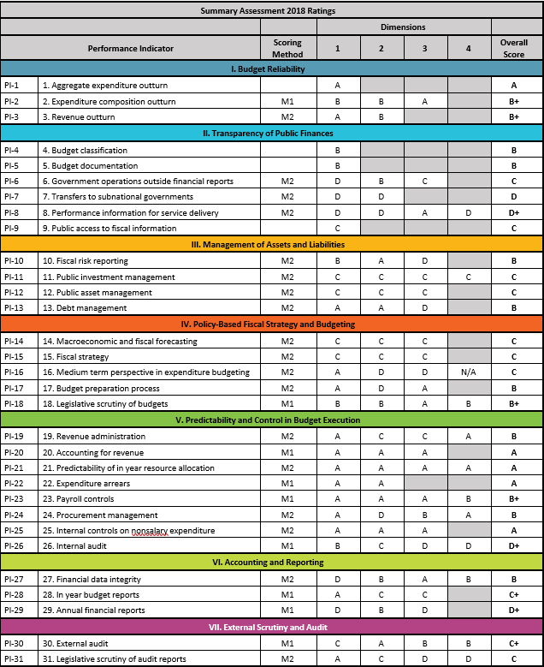
13

Slide 11
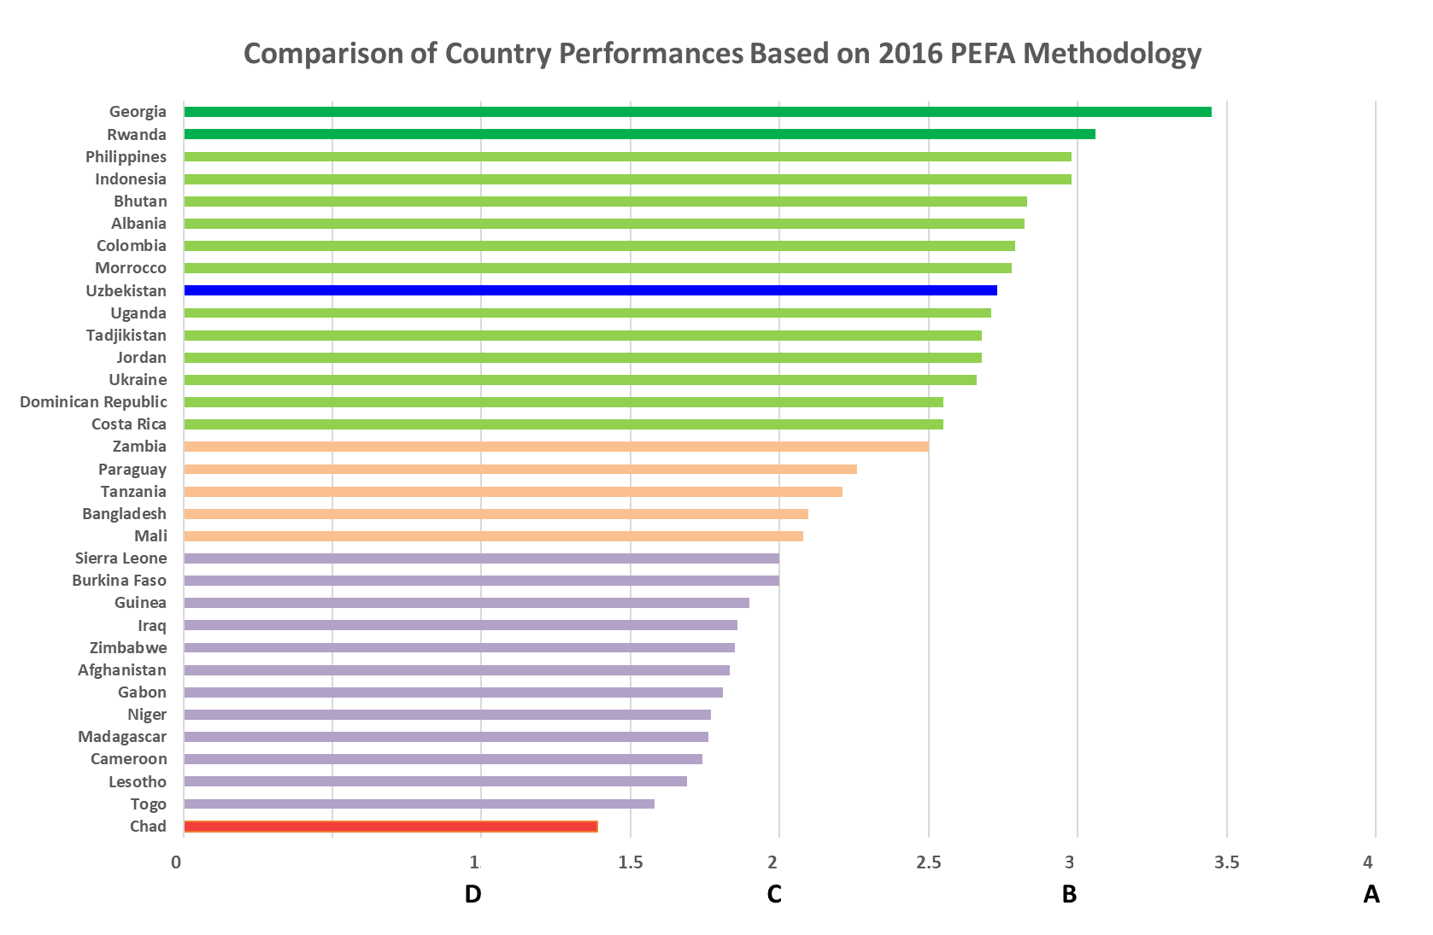

Slide 12
Uzbekistan National PEFA Assessment Scores for 2018

Slide 13
Comparison of PEFA Pillar Performances for Uzbekistan,
ECA Region and 32 Countries

Slide 14
Comparison of Uzbekistan's 2012 and 2018 PEFA
Pillar Performances based on 2011 Methodology

Slide 15
19
Results of PEFA Assessment by Pillars
Strengths and Weaknesses (Continued)
PILLAR II: TRANSPARENCY OF PUBLIC FINANCES
Strengths:
The budget classification is comprehensive and consistent with international standards, including functional classification (PI-4=B).
Parliament is properly informed about the budget it has to adopt, though the budget documentation could be further enriched by including information on details of debt stock, financial assets, fiscal risks, medium-term fiscal forecasts and quantification of tax expenditures (PI-5=B).

Slide 16
20
Results of PEFA Assessment by Pillars
Strengths and Weaknesses (Continued)
PILLAR II: TRANSPARENCY OF PUBLIC FINANCES
Weaknesses:
Reducing central government off-budget operations not included in fiscal reports (PI-6=C).
Establishing rule-based and transparent procedures for transferring resources to subnational government, and increasing predictability of the transfers (PI-7=D).
Performance information for service delivery is lacking, as annual performance plans and reports are not prepared (PI-8=D+).
The citizens were not sufficiently and not timely informed about the budgetary and financial activity of the government (PI-9=C).

Slide 17
28
Comparison between 2012 and 2018 (Pillar on Comprehensiveness and Transparency)
Improvements
Public has better access to key fiscal information (PI-10: D to B).
Decline
Extent of unreported government operations (PI-7: A to D).
Transparency of inter-governmental fiscal relations (PI-8: B+ to C+).

Slide 18
28
Comparison between 2012 and 2018 (Pillar on Comprehensiveness and Transparency)
Same Scores
Classification of the budget (PI-5: A retained).
Comprehensiveness of information included in budget (PI-6: A retained).
Oversight of aggregate fiscal risk from other public sector entities (PI-9: C+ retained).

Slide 19
31
NEXT STEPS
  This will mainly involve updating Uzbekistan’s 2018-2025 Public Financial Management Strategy to cover key weaknesses arising from the PEFA assessment such that they are addressed.
  The World Bank, European Union and other interested development partners will be keen on supporting the updated PFM strategy.

Slide 20
THANK YOU

Slide 21
Annexes
Annexes

Slide 22
Comparison of PEFA Indicator Scores for Uzbekistan and Average Scores for ECA Region and 32 Countries
A
B
C
D

Slide 23
Comparison of Uzbekistan's PEFA Scores for 2012 and 2018

