Slide 1
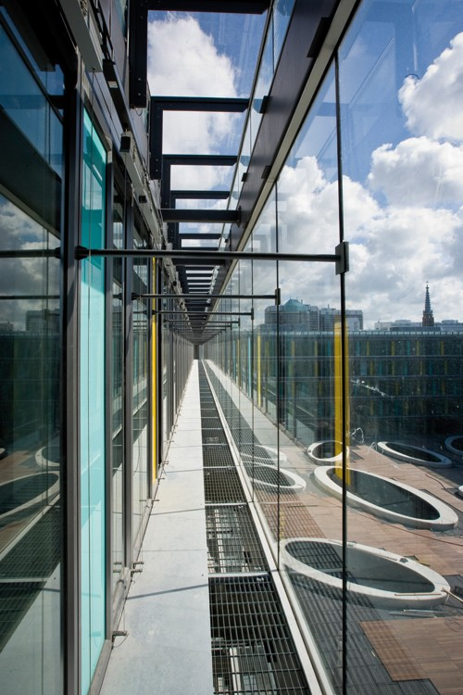
Audit Committees: practices in the EU
Manfred van Kesteren
Bucharest, December 4th 2014

Slide 2
Contents
Introduction (basis)
Types of Public Sector Audit Committees
Overview EU practice
Dutch situation

Slide 3
Introduction: the Audit Committee
In most cases (private and public sector):
The committee assists top management to fulfill its governance and overseeing responsibilities in relation to an entity’s financial reporting, internal control system, risk management system and internal and external audit functions. Its role is to provide advice and recommendations to top management within the scope of its terms of reference / charter.

Slide 4
Introduction: the Audit Committee
In general (public sector):
Key responsibilities / roles:
Supporting / advising role to management in their responsibility;
Oversight role regarding governance, risk management, internal control, audit, (financial) reporting and compliance;
Coordinating role, including strengthening of independence and effectiveness of (internal) audit function.

Slide 5
Types of Public Sector Audit Committees
Central Advisory Boards (CAB’s);
Internal Audit management committees (IAMC’s);
Governance Audit Committees (GAC’s).

Slide 6
Types of Public Sector Audit Committees
AD 1. Central Advisory Boards (CAB’s):
Also known as ‘PIFC-council’;
Good first step towards Audit Committee’s;
Usually advices cabinet of Ministers or minister of Finance on development and implementation of PIFC;
Strong cooperation with CHU
Members: usually government officials (political and civil service);

Slide 7
Types of Public Sector Audit Committees
AD 2. : Internal Audit management committees (IAMC’s):
Attached to a (line) ministry or other budget spending agency;
Focus on internal audit plan, audit recommendations and report to top management;
Members: usually line managers;

Slide 8
Types of Public Sector Audit Committees
AD 3. : Governance Audit Committees (GAC’s):
Broad focus on ‘Good Governance’ (on institutional- and/or cross-institutional level);
Supporting: financial management, internal control, risk management, financial reporting and the internal audit function;
Internal and (usually) external members;
Oversight-role, supporting role and coordination role.

Slide 9
Overview EU-practice
IN EU: 9 out of 27 member states have a CAB-like body in place;
GAC’s have been established in France, Ireland, the Netherlands and the United Kingdom;
New member states (EU-12): little experience;
Poland: IAMC (see presentation day 1);
Some countries: AC’s on voluntary basis: Estonia, Slovakia, Latvia etc.).

Slide 10
Overview EU-practice (GAC’s):
France: each ministry has a committee. Focus on: defining audit policy, ensuring quality internal control, risk management, approving internal audit plan and follow up of recommendations. Mostly external members;
Ireland: each ministry has a committee. Focus on: reviewing annual and strategic audit plan, assure quality of internal audit, risk management monitoring, internal control, facilitate in improvements (IA and IC). At least 2 external members. Chair: from outside the organization.
United Kingdom: each ministry (but also local government). Focus: risk, control and governance, accounting policies, planned activities of internal and external audit, follow up, management responses, anti-fraud policies. Strong reliance on external membership.

Slide 11
Dutch situation
Established in the 1980’s → 2012: updated regulation
Each ministry has a committee as well as government wide.
Tasks:
Review the quality of the organisational processes, including financial reporting, management statements and reports,
Coordination of the audit policy: review and approve annual and strategic audit plan and the audit function itself;
Reviewing risk management policy and its results;
Reviewing and commenting on the internal control system and the results of policy evaluation.

Slide 12
Dutch situation
A committee has at least 2 external members (minister appoints all members);
CFO and Director of IA support the committee;
Supreme Audit Institution receives a copy of the agenda (joins if necessary);
Frequency of meetings: at least 4 times a year (linked to the ministerial planning- and control cycle);
The committees perform once every two years a self assessment on its functioning.

Slide 13
Relevant sources:
Audit Committees in the Public Sector, A discussion paper (may 2012): Noel Hepworth and Robert de Koning;
Regulation of the Dutch ministry of Finance concerning Audit Committees within Central Government (2012).

Slide 14
Thank you for your attention!!!!!
M.kesteren@minfin.nl

