Slide 1

Leveraging COSO across the three lines of defense
Jean-Pierre Garitte
Tbilisi, 29 October 2018

Slide 2
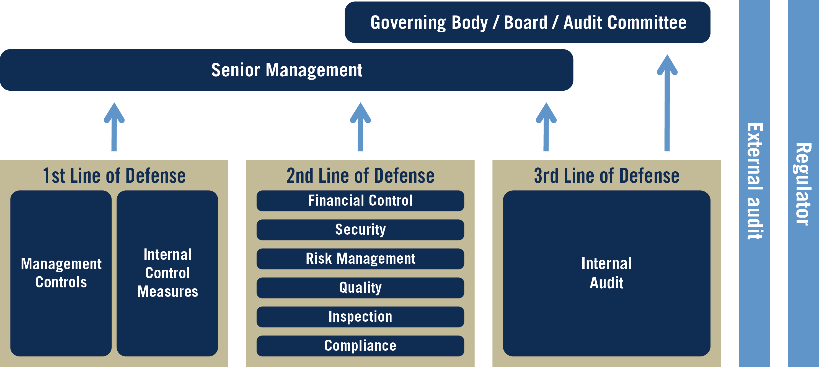
Remember the three lines of defense
The Three Lines of Defense in Effective Risk Management and Control, (Altamonte Springs, FL: The Institute of Internal Auditors Inc, January 2013.
Notes:
Models for assurance – Various models: 5 lines of defense, 3 lines of defense, movement to use the term lines of assurance. The foundation and principles behind these models are all the same. It is a matter of choosing the terms that resonate with your organization and leadership.
First important to understand who is doing what. Regulators in UK expect told implemented and demonstrated
How many have heard of 3LOD?
“The premise of the Three Lines of Defense model is that:
Each area within a company has a clearly defined and specific role to play.
And when each does its assigned task effectively, the likelihood that a risk will slip past all of the defense lines and penetrate the organization diminshes.”
The IIA’s model does not include the board of directors and equivalent governing bodies or senior management among the lines of defense. Instead, they are considered stakeholders served by the three lines. However, because they are responsible for setting organizational objectives and establishing structures to manage any risks arising from the pursuit of those objectives, they play an important role in risk and control.
Two other groups sit outside the model, while still having a major effect on its operation: regulators and external audit. These groups can be considered another type of defense, but their scope is generally too narrow to align with the overarching nature of the three lines.

Slide 3
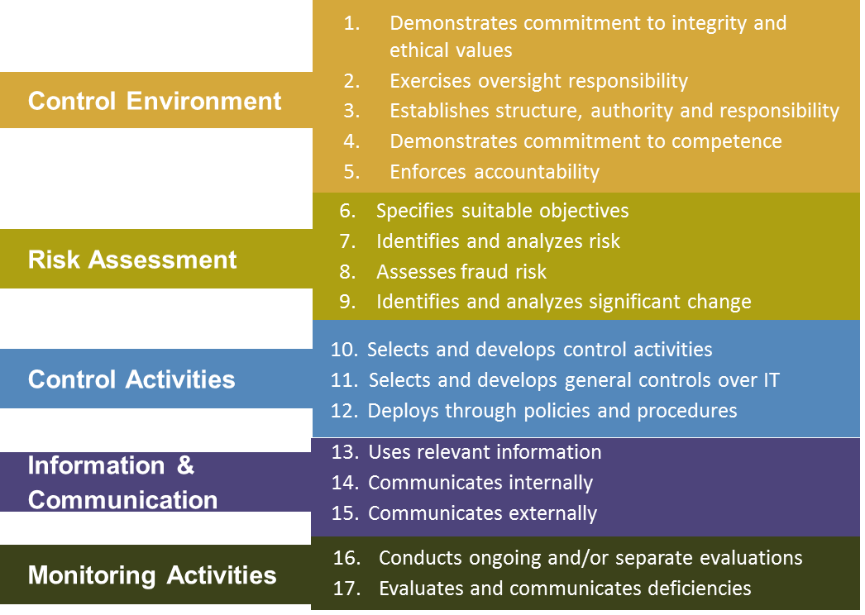
Remember the COSO principles
Internal Control – Integrated Framework, Committee of Sponsoring Organizations of the Treadway Commission (Jersey City, NJ: American Institute of Certified Public Accountants, May 2013.
Notes:
Control activities: Most people spend their time in their silo doing their tasks. Ideally control activities are preventive and timely. You many have informal control activities, but typically these are monitoring activities.
Monitoring happens based upon your experience and gut filling. You know it when you see it.
Information and Communication – No one likes to deliver bad news. Sometimes people are not good communication good news. Only when necessary, reactionary and sometimes too late. Ideally, you have control in periodic reporting complements reporting. Other is thresholds with timeliness associated to address the problems.
Risk Assessment - I did this 10 years ago when I started my business during the SWOT analysis.
Control Environment – Follow the leader. Ideally, leaders demonstrate and inspire desired behavior. Enforces accountability.

Slide 4
Who is mainly responsible for the control environment?
Control Environment
Notes:
Models for assurance – Various models: 5 lines of defense, 3 lines of defense, movement to use the term lines of assurance. The foundation and principles behind these models are all the same. It is a matter of choosing the terms that resonate with your organization and leadership.
First important to understand who is doing what. Regulators in UK expect told implemented and demonstrated
How many have heard of 3LOD?
“The premise of the Three Lines of Defense model is that:
Each area within a company has a clearly defined and specific role to play.
And when each does its assigned task effectively, the likelihood that a risk will slip past all of the defense lines and penetrate the organization diminshes.”
The IIA’s model does not include the board of directors and equivalent governing bodies or senior management among the lines of defense. Instead, they are considered stakeholders served by the three lines. However, because they are responsible for setting organizational objectives and establishing structures to manage any risks arising from the pursuit of those objectives, they play an important role in risk and control.
Two other groups sit outside the model, while still having a major effect on its operation: regulators and external audit. These groups can be considered another type of defense, but their scope is generally too narrow to align with the overarching nature of the three lines.

Slide 5
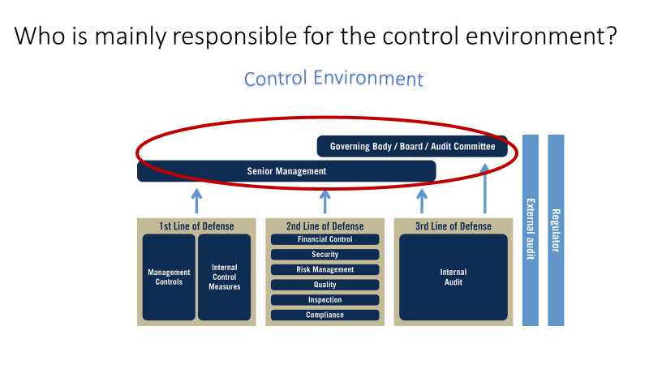
Control environment
Demonstrates commitment to integrity and ethical values
Exercises oversight responsibility
Establishes structure, authority and responsibility
Demonstrates commitment to competence
Enforces accountability

Slide 6
Who is mainly responsible for risk assessment?
Risk Assessment
Notes:
Models for assurance – Various models: 5 lines of defense, 3 lines of defense, movement to use the term lines of assurance. The foundation and principles behind these models are all the same. It is a matter of choosing the terms that resonate with your organization and leadership.
First important to understand who is doing what. Regulators in UK expect told implemented and demonstrated
How many have heard of 3LOD?
“The premise of the Three Lines of Defense model is that:
Each area within a company has a clearly defined and specific role to play.
And when each does its assigned task effectively, the likelihood that a risk will slip past all of the defense lines and penetrate the organization diminshes.”
The IIA’s model does not include the board of directors and equivalent governing bodies or senior management among the lines of defense. Instead, they are considered stakeholders served by the three lines. However, because they are responsible for setting organizational objectives and establishing structures to manage any risks arising from the pursuit of those objectives, they play an important role in risk and control.
Two other groups sit outside the model, while still having a major effect on its operation: regulators and external audit. These groups can be considered another type of defense, but their scope is generally too narrow to align with the overarching nature of the three lines.

Slide 7
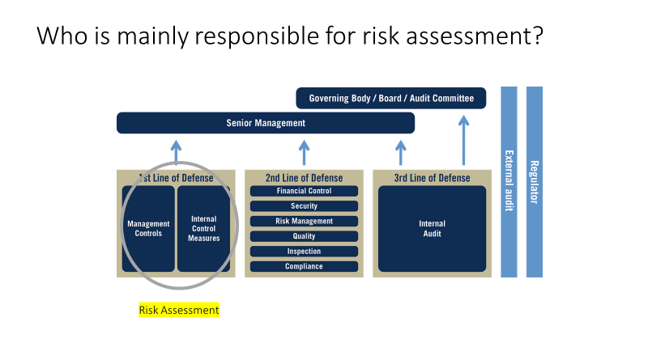
Risk assessment
Specifies suitable objectives
Identifies and analyzes risk
Assesses fraud risk
Identifies and analyzes significant change

Slide 8
Who is mainly responsible for control activities?
Risk Assessment
Control Activities
Notes:
Models for assurance – Various models: 5 lines of defense, 3 lines of defense, movement to use the term lines of assurance. The foundation and principles behind these models are all the same. It is a matter of choosing the terms that resonate with your organization and leadership.
First important to understand who is doing what. Regulators in UK expect told implemented and demonstrated
How many have heard of 3LOD?
“The premise of the Three Lines of Defense model is that:
Each area within a company has a clearly defined and specific role to play.
And when each does its assigned task effectively, the likelihood that a risk will slip past all of the defense lines and penetrate the organization diminshes.”
The IIA’s model does not include the board of directors and equivalent governing bodies or senior management among the lines of defense. Instead, they are considered stakeholders served by the three lines. However, because they are responsible for setting organizational objectives and establishing structures to manage any risks arising from the pursuit of those objectives, they play an important role in risk and control.
Two other groups sit outside the model, while still having a major effect on its operation: regulators and external audit. These groups can be considered another type of defense, but their scope is generally too narrow to align with the overarching nature of the three lines.

Slide 9
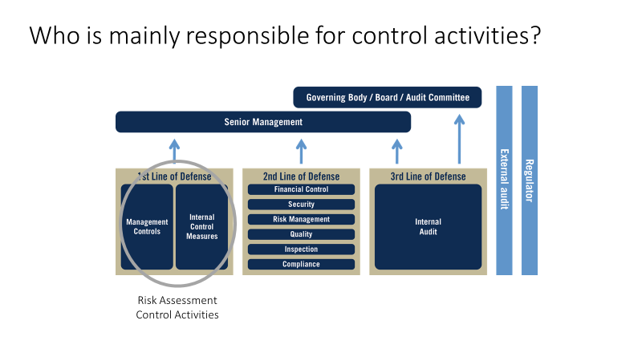
Control activities
Selects and develops control activities
Selects and develops general controls over IT
Deploys through policies and procedures

Slide 10
Who is mainly responsible for information and communication?
Risk Assessment
Control Activities
Information & Communication
Notes:
Models for assurance – Various models: 5 lines of defense, 3 lines of defense, movement to use the term lines of assurance. The foundation and principles behind these models are all the same. It is a matter of choosing the terms that resonate with your organization and leadership.
First important to understand who is doing what. Regulators in UK expect told implemented and demonstrated
How many have heard of 3LOD?
“The premise of the Three Lines of Defense model is that:
Each area within a company has a clearly defined and specific role to play.
And when each does its assigned task effectively, the likelihood that a risk will slip past all of the defense lines and penetrate the organization diminshes.”
The IIA’s model does not include the board of directors and equivalent governing bodies or senior management among the lines of defense. Instead, they are considered stakeholders served by the three lines. However, because they are responsible for setting organizational objectives and establishing structures to manage any risks arising from the pursuit of those objectives, they play an important role in risk and control.
Two other groups sit outside the model, while still having a major effect on its operation: regulators and external audit. These groups can be considered another type of defense, but their scope is generally too narrow to align with the overarching nature of the three lines.

Slide 11
Who is mainly responsible for information and communication?
Information & Communication
Risk Assessment
Control Activities
Information & Communication
Notes:
Models for assurance – Various models: 5 lines of defense, 3 lines of defense, movement to use the term lines of assurance. The foundation and principles behind these models are all the same. It is a matter of choosing the terms that resonate with your organization and leadership.
First important to understand who is doing what. Regulators in UK expect told implemented and demonstrated
How many have heard of 3LOD?
“The premise of the Three Lines of Defense model is that:
Each area within a company has a clearly defined and specific role to play.
And when each does its assigned task effectively, the likelihood that a risk will slip past all of the defense lines and penetrate the organization diminshes.”
The IIA’s model does not include the board of directors and equivalent governing bodies or senior management among the lines of defense. Instead, they are considered stakeholders served by the three lines. However, because they are responsible for setting organizational objectives and establishing structures to manage any risks arising from the pursuit of those objectives, they play an important role in risk and control.
Two other groups sit outside the model, while still having a major effect on its operation: regulators and external audit. These groups can be considered another type of defense, but their scope is generally too narrow to align with the overarching nature of the three lines.

Slide 12
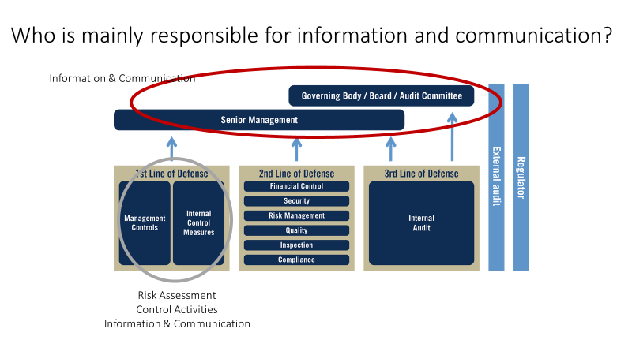
Information & Communication
Uses relevant information
Communicates internally
Communicates externally

Slide 13
Who is mainly responsible for monitoring?
Risk Assessment
Control Activities
Information & Communication
Monitoring
Notes:
Models for assurance – Various models: 5 lines of defense, 3 lines of defense, movement to use the term lines of assurance. The foundation and principles behind these models are all the same. It is a matter of choosing the terms that resonate with your organization and leadership.
First important to understand who is doing what. Regulators in UK expect told implemented and demonstrated
How many have heard of 3LOD?
“The premise of the Three Lines of Defense model is that:
Each area within a company has a clearly defined and specific role to play.
And when each does its assigned task effectively, the likelihood that a risk will slip past all of the defense lines and penetrate the organization diminshes.”
The IIA’s model does not include the board of directors and equivalent governing bodies or senior management among the lines of defense. Instead, they are considered stakeholders served by the three lines. However, because they are responsible for setting organizational objectives and establishing structures to manage any risks arising from the pursuit of those objectives, they play an important role in risk and control.
Two other groups sit outside the model, while still having a major effect on its operation: regulators and external audit. These groups can be considered another type of defense, but their scope is generally too narrow to align with the overarching nature of the three lines.

Slide 14
Who is mainly responsible for monitoring?
Risk Assessment
Control Activities
Information & Communication
Monitoring
Monitoring
Notes:
Models for assurance – Various models: 5 lines of defense, 3 lines of defense, movement to use the term lines of assurance. The foundation and principles behind these models are all the same. It is a matter of choosing the terms that resonate with your organization and leadership.
First important to understand who is doing what. Regulators in UK expect told implemented and demonstrated
How many have heard of 3LOD?
“The premise of the Three Lines of Defense model is that:
Each area within a company has a clearly defined and specific role to play.
And when each does its assigned task effectively, the likelihood that a risk will slip past all of the defense lines and penetrate the organization diminshes.”
The IIA’s model does not include the board of directors and equivalent governing bodies or senior management among the lines of defense. Instead, they are considered stakeholders served by the three lines. However, because they are responsible for setting organizational objectives and establishing structures to manage any risks arising from the pursuit of those objectives, they play an important role in risk and control.
Two other groups sit outside the model, while still having a major effect on its operation: regulators and external audit. These groups can be considered another type of defense, but their scope is generally too narrow to align with the overarching nature of the three lines.

Slide 15
Who is mainly responsible for monitoring?
Information & Communication
Monitoring
Risk Assessment
Control Activities
Information & Communication
Monitoring
Monitoring
Notes:
Models for assurance – Various models: 5 lines of defense, 3 lines of defense, movement to use the term lines of assurance. The foundation and principles behind these models are all the same. It is a matter of choosing the terms that resonate with your organization and leadership.
First important to understand who is doing what. Regulators in UK expect told implemented and demonstrated
How many have heard of 3LOD?
“The premise of the Three Lines of Defense model is that:
Each area within a company has a clearly defined and specific role to play.
And when each does its assigned task effectively, the likelihood that a risk will slip past all of the defense lines and penetrate the organization diminshes.”
The IIA’s model does not include the board of directors and equivalent governing bodies or senior management among the lines of defense. Instead, they are considered stakeholders served by the three lines. However, because they are responsible for setting organizational objectives and establishing structures to manage any risks arising from the pursuit of those objectives, they play an important role in risk and control.
Two other groups sit outside the model, while still having a major effect on its operation: regulators and external audit. These groups can be considered another type of defense, but their scope is generally too narrow to align with the overarching nature of the three lines.

Slide 16
Who is mainly responsible for monitoring?
Information & Communication
Monitoring
Risk Assessment
Control Activities
Information & Communication
Monitoring
Monitoring
Monitoring:
Assurance
Reassurance
Notes:
Models for assurance – Various models: 5 lines of defense, 3 lines of defense, movement to use the term lines of assurance. The foundation and principles behind these models are all the same. It is a matter of choosing the terms that resonate with your organization and leadership.
First important to understand who is doing what. Regulators in UK expect told implemented and demonstrated
How many have heard of 3LOD?
“The premise of the Three Lines of Defense model is that:
Each area within a company has a clearly defined and specific role to play.
And when each does its assigned task effectively, the likelihood that a risk will slip past all of the defense lines and penetrate the organization diminshes.”
The IIA’s model does not include the board of directors and equivalent governing bodies or senior management among the lines of defense. Instead, they are considered stakeholders served by the three lines. However, because they are responsible for setting organizational objectives and establishing structures to manage any risks arising from the pursuit of those objectives, they play an important role in risk and control.
Two other groups sit outside the model, while still having a major effect on its operation: regulators and external audit. These groups can be considered another type of defense, but their scope is generally too narrow to align with the overarching nature of the three lines.

Slide 17
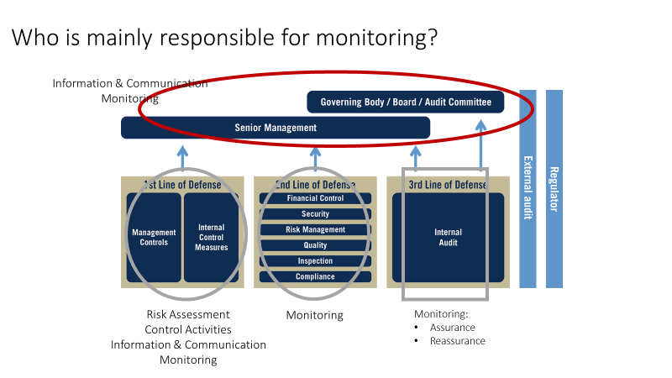
Monitoring
Conducts ongoing and/or separate evaluations
Evaluates and communicates deficiencies

Slide 18
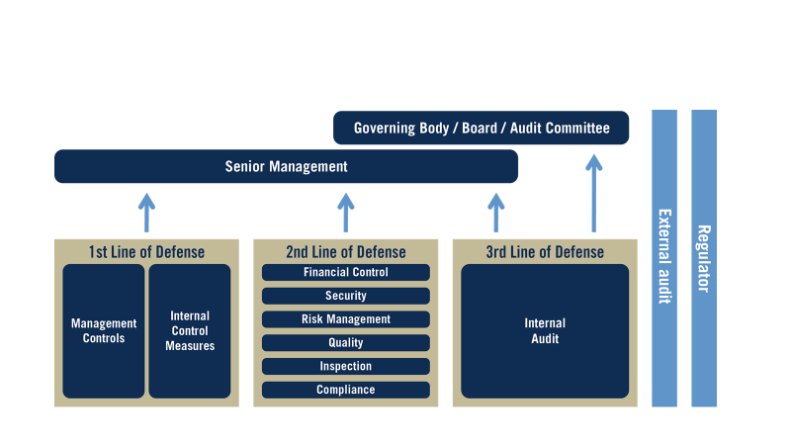
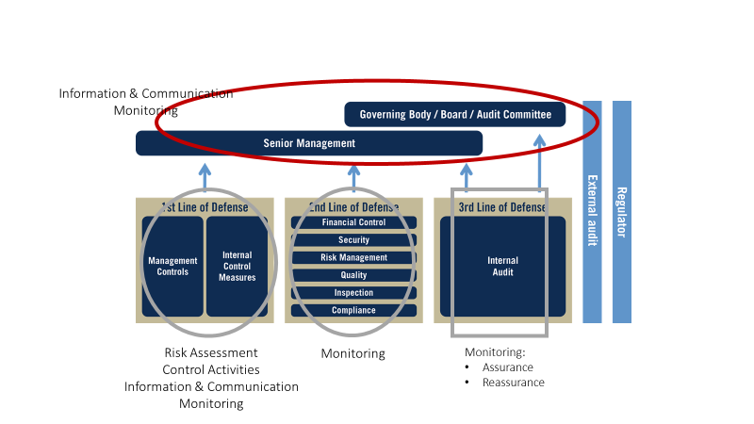
Leveraging COSO across the three lines of defense
Adapted from the Leveraging COSO Across the Three Lines of Defense, commissioned by The Committee of Sponsoring Organizations of the Treadway Committee (Lake Mary, FL: The Institute of Internal Auditors Inc and, July 2015).
Notes:
Control activities: Most people spend their time in their silo doing their tasks. Ideally control activities are preventive and timely. You many have informal control activities, but typically these are monitoring activities.
Monitoring happens based upon your experience and gut filling. You know it when you see it.
Information and Communication – No one likes to deliver bad news. Sometimes people are not good communication good news. Only when necessary, reactionary and sometimes too late. Ideally, you have control in periodic reporting complements reporting. Other is thresholds with timeliness associated to address the problems.
Risk Assessment - I did this 10 years ago when I started my business during the SWOT analysis.
Control Environment – Follow the leader. Ideally, leaders demonstrate and inspire desired behavior. Enforces accountability.

Slide 19
Questions?

