Slide 1
PEMPAL Cross-Cop Executive Meeting, 13-15 July 2016 Bern
Developing Accrual Accounting in Switzerland:
Overview and lessons learned
Building Competence. Crossing Borders.
Sandro Fuchs, MSc, Deputy Head Center for Public Financial Management
Sandro.fuchs@zhaw.ch

Slide 2
Agenda
The following issues are covered in this presentation…
1
Fiscal Federalism in Switzerland
2
Developing Accrual Accounting in Switzerland:
Overview
3
Accrual Accounting at Swiss National Level:
Implementation process and lessons learned
4
Conclusion
… of course we will have time for an in-depth discussion afterwards.

Slide 3
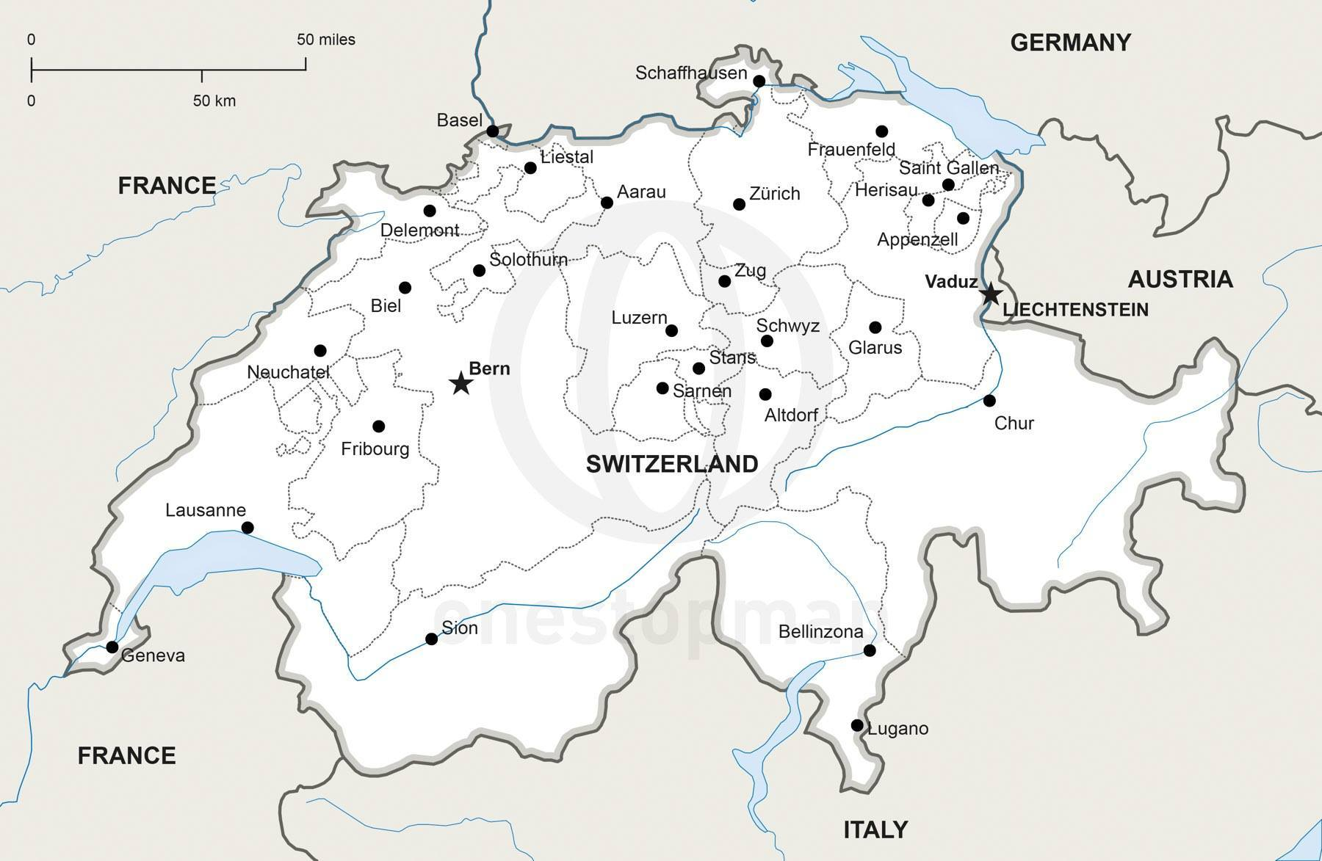
Fiscal Federalism in Switzerland
Switzerland…
Fiscal federalism in a nutshell
States and local governments enjoy high fiscal autonomy (responsibility) with respect to revenues and expenditures…
… and also with respect to their accounting and budget law.
Implications for Public Accounting and Reporting
Federal Level lacks the capacity to determine cantonal / sub-national accounting and budget law
The consequence is a huge heterogenity of public financial reporting practices on Swiss state and local government level.
… and its federal architecture.
Federal Level
26 states («cantons»)
2’300 local governments

Slide 4
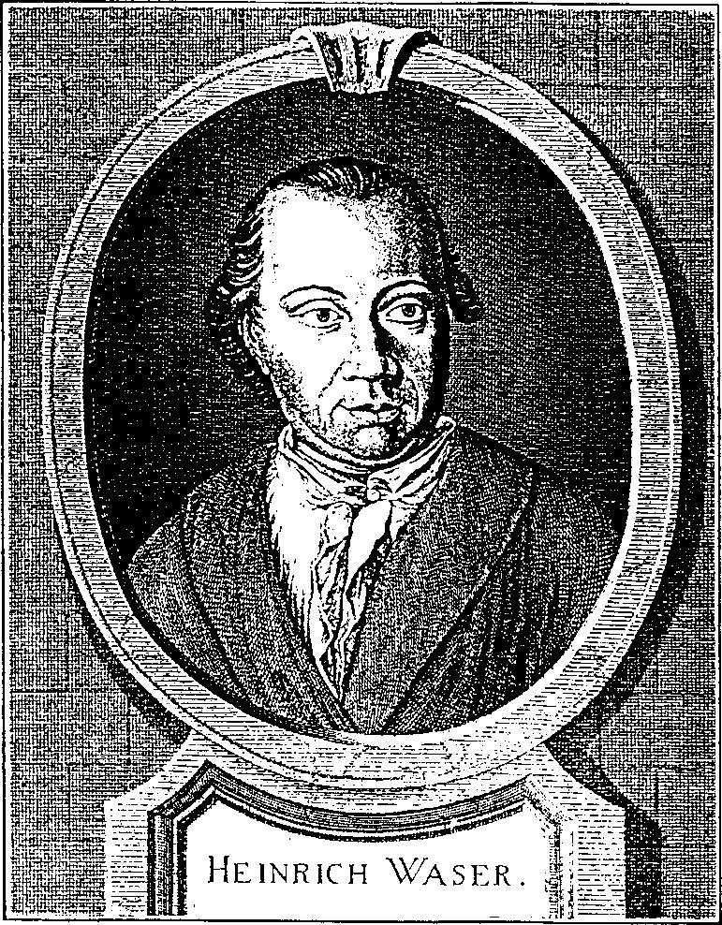
Developing Accrual Accounting in Switzerland:
Overview (1)
  Early history of Public Sector Accounting and Reporting not at all promising!
  Johann Heinrich Waser
  Beheaded 27 May 1780, 1 o’clock p.m.,
  in Zurich
  His „crime“:
  The publication of the State of Zurich Financial Report

Slide 5
Developing Accrual Accounting in Switzerland:
Overview (2)
HAM1
HAM2 Light
HAM2 Adv.
IPSAS
4 States
National Lev.
4 States
7 States
15 States
11 States
Comprehensive presentation, measurement and disclosure requirements; Fair presentation will be achieved through complete application of IPSASs
Revised and updated accrual accounting model; comprehensive presentation requirements; advanced measurement and disclosure requirements; Oriented towards fair presentation
Revised and updated accrual accounting model; comprehensive presentation requirements; limited measurement requirements; no fair presentation
Basic accrual accounting model; no fair presentation
Increasing recognition, measurement and disclosure requirements

Slide 6
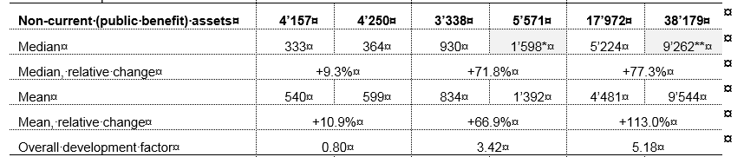
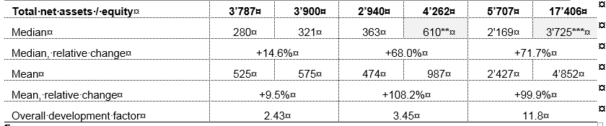
Developing Accrual Accounting in Switzerland:
Overview (3)
in m CHF
HAM2 L
HAM2 A
IPSAS
IPSAS as an unique opportunity for «housekeeping», i.e. a fresh start with «new» assets, liabilities and opening-balance
Increasing revaluation gains
in m CHF
HAM2 L
HAM2 A
IPSAS
Increasing revaluation gains

Slide 7
Accrual Accounting at Swiss Federal Level:
Implementation process (1)
Accrual Reform at Swiss Federal Level
    Conceptual work starts in 2001 / 2002
    Important driver of change: IT environment - very heterogenous (17 different SAP configurations within Federal Administration!)
    But also weaknesses of Cash Accounting and Budgeting
    Inconsistencies with NPM (called „Flag“ in Federal Administration)
  Cost accounting and intra-company invoicing requires accrual accounting
  New Accounting Model (NAM) to be developed, based on IPSAS
Broad NAM Implementation timeline
Project start February 2001
    New Financial Management Act approved by parliament October 2005
    First NAM budget approved by parliament December 2006
    First NAM accounts approved by parliament (IPSAS deviations) June 2008
    First NAM consolidated accounts published (IPSAS deviations) April 2010
    First NAM consolidated accounts published (minimal IPSAS deviations) exp. April 2018

Slide 8
Accrual Accounting at Swiss Federal Level:
Implementation process (2)
New Accounting Model: Reports produced

Slide 9
Accrual Accounting at Swiss Federal Level:
Implementation process (3)
Legal / institutional framework – Swiss Federal Level
Constitution
1 paragraph dedicated to budgeting / financial reporting; no link to IPSAS
Federal Financial Management Act
Approx. 66 paragraphs; no link to IPSAS
Implementing decree
Approx. 79 paragraphs; decree refers to IPSAS
Accounting Manual
Approx. 700 pages; mandatory regulation of all relevant accounting matters and issues
Transformation of principles included in act and decree into practice

Slide 10
Accrual Accounting at Swiss Federal Level:
Implementation process (4)
Year | Deviations from IPSAS
2007 | Miliatary Equipment (Expenses) Taxes (Cash) Employee Benefits Financial Instruments Consoliated Entities
2017 (exp) | Miliatary Equipment (Expenses) Taxes Employee Benefits Financial Instruments Consoliated Entities
Unperfect world…
Reducing deviations
from IPSAS
over time
There exist various approaches on how to sequence accrual accounting reforms
No unique solution – depending on country resources and capacities
A common strategy is the «basic-first approach» (elementary, advanced, full accrual accounting) (see also IMF, 2016)
Even in Switzerland, it took more then 10 years to reduce deviations from IPSAS to a minimal extent.

Slide 11
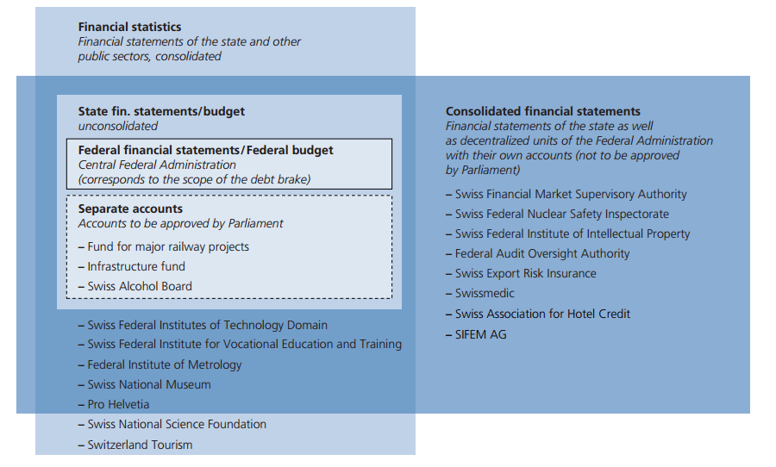
Accrual Accounting at Swiss Federal Level:
Implementation process (5)
Overview of publications on budget figures at Swiss federal level
Consolidated Agencies
GFS
Central government / seperate financial statements / budget

Slide 12
Accrual Accounting at Swiss Federal Level:
Lessons learned (1)
Reform projects of this magnitude can not be treated as mere accounting projects
  Support and buy-in of all relevant management and political authorities necessary
  Early involvement of all parties concerned, resistance has to be dealt with
  Proactive communication → overcommunicate
Benefit should be as tangible as possible
  Difficult task – costs are more obvious
  Most benefits are mid to long term

Slide 13
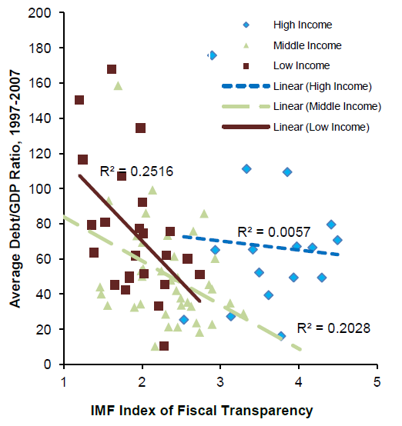
Accrual Accounting at Swiss Federal Level:
Lessons learned (2)
Key arguments for public sector accounting reforms
Improved accountability
Direct / indirect impact on credit ratings
Improved data basis for decision making
“Housekeeping” of assets and liabilities
Asset register as an instrument to ensure, plan and manage maintenance activities
IMF, 2012

Slide 14
Accrual Accounting at Swiss Federal Level:
Lessons learned (3)
Pragmatism is neccessary
  apply the 80/20 rule
  IPSAS is 95% common sense
It is change management
top level commitment for financial transparency as
a pre-condition
accounting standards affect internal procedures, structures and organizational culture
Quality of results strongly depends on the support of senior management
first-time recognition and measurement may be difficult and/or
costly → effort needed in every ministry, not only the MOF
unique opportunity for „housekeeping“ rethink or even re-design processes
fresh start with a new opening balance

Slide 15
Accrual Accounting at Swiss Federal Level:
Lessons learned (4)
Much resources needed for accounting manual and training
Involvement of experts and consultants is important
  specify experience required
  use consultants and experts for transfer of know how
  avoid dependency on consultants
Training and education is key for success
  early start of training
  daily work is more demanding and interesting (job enrichment)
  communicate and demonstrate opportunities for each individual

