Slide 1
PEMPAL Cross-Cop Executive Meeting, 13-15 July 2016 Bern
Institutional and Legal Framework of Subnational jurisdictions: Swiss cantonal debt brakes
Building Competence. Crossing Borders.
Nadia Yerly, Dr. rer. pol., Research Associate and Project Manager
Nadia.yerly@zhaw.ch

Slide 2
Agenda
1
Swiss context: federal and cantonal
3
Institutional architecture of fiscal rules
4
Cantonal index of fiscal rules
5
Conclusion
2
Introduction

Slide 3
Introduction
Fiscal responsibility  fiscal discipline
Fiscal discipline: ex ante requirements written down into the institutional framework (Constitution, law of finance, statutory documents, …)
Fiscal discipline cannot be resumed in one unique formula but is characterized by a set of institutional features
Institutional and legal framework make financial management more predictable and enhance the sustainability of public finance on the long term

Slide 4
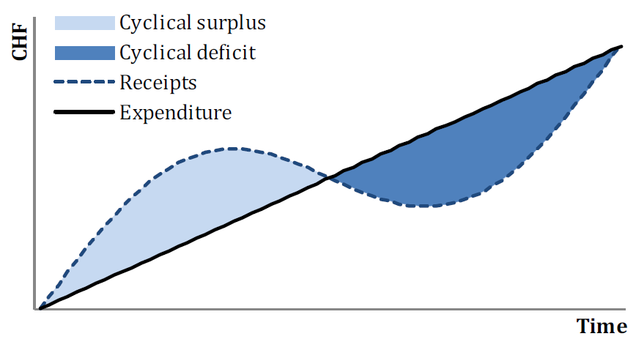
Swiss context: federal
Swiss federal debt brake
The debt brake limits the level of expenditure to the level of estimated structural (i.e. cyclically adjusted) receipts.
Exceptions are permitted in special situations. A sanction mechanism completes the regulations.
These core provisions are enshrined in the Federal Constitution. This ensures that the rule is binding to a high degree.

Slide 5
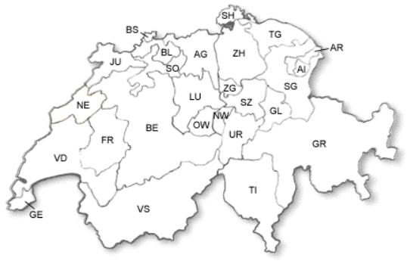
Swiss context: cantons
Cantonal fiscal rules
Total autonomy in the definition of their fiscal discipline regime.
Swiss cantonal laboratory (26 cantons):
25 various mechanisms of fiscal rules
Cantonal Conference of Financial Directors edits recommendations

Slide 6
Institutional architecture of fiscal rules
The six components
t
Budget / Account
Object of balance
Components of
fiscal rules
Constitution / Law
Time requirement
Sanction
Amortization policy
Notes:
These six components drawn the institutional architecture of fiscal rules.
Under these components, there are various degree of stringency and hardness that I’ll explain in the next slides…

Slide 7
Institutional architecture of fiscal rules Component 1
Constitution / Law
Constitution combined with Statutory legislation with Mandatory Referendum | 5
Constitution combined with Statutory legislation with Optional Referendum | 4
Statutory legislation with Mandatory Referendum | 3
Statutory legislation with Optional Referendum | 2
Statutory legislation without Referendum | 1
No requirement | 0
Constitution / Law
Notes:
Constitutional requirements are placed at the top of institutional hierarchy, it is the more difficult to change.
The financial law (statutory legislation) is derived from the Constitution and sets the application details of these fundamental principles. It is usually easier to change statutory fiscal restraints than constitutional fiscal restraints.
In Switzerland, the distinction has to be made between the Mandatory Referendum and the Optional Referendum.

Slide 8
Institutional architecture of fiscal rules Component 2 and Component 3
Budget / Account
Budget and Account | 3
Account only | 2
Budget only | 1
No requirement | 0
Budget / Account
Object of balance
Current and capital | 4
Current, incl. debt amortization | 3
Current, without debt amortization | 2
General balance of the « household finance » | 1
No requirement | 0
t
Object of balance

Slide 9
Institutional architecture of fiscal rules Component 4
Time requirement for the Budget / Account
 | im-mediately | as soon as possible | on the medium term or on the term, both delimited | on the medium term or on the term, both not explicitly delimited | no time requirement | Deficit compensation
Budget / Account | 10 or 9 | 9 or 8 | 8 or 7 | 7 or 6 | 5 | 1-2 year(s)
 |  |  | 7 or 6 | 6 or 5 | 4 | 3-4 years
 |  |  | 6 or 5 | 5 or 4 | 3 | 5-6 years
 |  |  | 5 or 4 | 4 or 3 | 2 | 7-10 years
 |  |  | 4 or 3 | 3 or 2 | 1 | mentioned but not explicitly delimited
 | 10 or 9 | 9 or 8 | 3 or 2 | 2 or 1 | 0 | no deficit compensation
Time requirement

Slide 10
Institutional architecture of fiscal rules Component 5
Amortization policy
Repayment of the debt | 1
Amortization rates specified in statutory legislation | 4
Amortization rates specified in the financial plan ( 4-5 years) | 3
Amortization rates specified in the budget process (1 year validity) | 2
General amortization limit (i.e. minimum rate) | 1
no limit, no amortisation rate | 0
Amortization policy

Slide 11
Institutional architecture of fiscal rules Component 6
Sanctions
Tax adjustment |  |  | Carry over deficit
Immediate tax adjustment, i.e. increase tax rate during the fiscal year t | Tax adjustment in the following fiscal year t+1 | no tax adjustment
8 | - | -
- | 7 | 3 | Carrying over deficit in the following budget in preparation (the deficit is entirely compensated over 1 year)
- | 6 | 2 | Carrying over deficit in the two following budgets (the deficit is compensated over 2 years)
- | 5 | 1 | Carrying over deficit in the following budgets (the deficit is compensated over more than 2 years)
- | 4 | 0 | no carry over deficit
Sanction

Slide 12
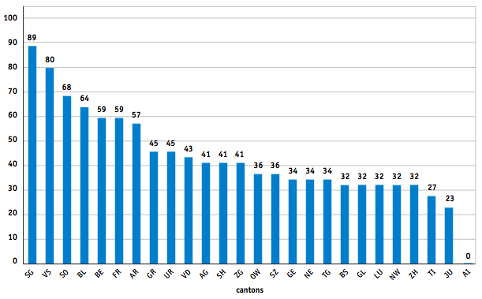
Cantonal index of fiscal rules
Cantonal index of fiscal rules in the year 2011

Slide 13
Conclusion
Fiscal rules are the very safeguard promoting fiscal discipline.
Cantonal fiscal rules positively work on the financial indebtedness of the cantons, i.e. higher the fiscal rule index lower the loan-financial need per capita (but very faintly).
The assessment of fiscal rules could be enlarged considering other important features designing a sustainable fiscal policy.

Slide 14
Thank you for your attendance
Nadia Yerly, Dr. rer. pol., Research Associate and Project Manager
Nadia.yerly@zhaw.ch

Slide 15
Appendix: integrating PFM institutional framework
Fiscal rules
Institutional Diagnostic
debt / deficit brake
Financial
key figures
Financial and task plan
Diagnostic
Tool
Fiscal Equalization
Accounting
Budgetary processes
Task sharing/ equalization
Sustainable
fiscal
policy
Fiscal rules
Tax policy
Credit law
Taxation
scenario
ex Post
-10
+10
Financial diagnostic
Trends and scenarios analyse

